Slide 1
Work-related MSDs Reported by Employers (SOII Data)

Slide 2
1. Rate of nonfatal injuries resulting in days away from work, selected industries, 1992-2017
Note: Due to the revised record keeping rules, the estimates since the 2002 survey are not comparable with previous years for nonfatal injuries.
Source: U.S. Bureau of Labor Statistics, 1992-2017 Survey of Occupational Injuries and Illnesses.

Slide 3
2. Number and rate of WMSDs resulting in days away from work in
construction, 1992-2017
OSHA revised recordkeeping rules
Source: U.S. Bureau of Labor Statistics, 1992-2017 Survey of Occupational Injuries and Illnesses.

Slide 4
3. Rate of WMSDs resulting in days away from work, by major industry, 2017
Source: U.S. Bureau of Labor Statistics, 2017 Survey of Occupational Injuries and Illnesses.

Slide 5
4. Median days away from work, WMSDs versus all nonfatal injuries in construction, 1992-2017
2017
Source: U.S. Bureau of Labor Statistics, 1992-2017 Survey of Occupational Injuries and Illnesses.
Notes:
Fewer injuries, but more days away from work…are only more serious injuries being reported now? Or are there fewer injuries, but they’re just more serious?

Slide 6
5. Causes of WMSDs resulting in days away from work in construction, 2017
Total = 19,960 injuries
Note: “Other” includes overexertion and bodily reaction, unspecified; and multiple types of overexertion and bodily reactions.
Source: U.S. Bureau of Labor Statistics, 2017 Survey of Occupational Injuries and Illnesses.

Slide 7
6. WMSDs resulting in days away from work in construction, by nature of injury, 2017
Total = 19,960 injuries
Note: “Other” includes Bruise, contusions, multiple traumatic injuries with sprains or fractures, etc.
Source: U.S. Bureau of Labor Statistics, 2017 Survey of Occupational Injuries and Illnesses.

Slide 8
7. WMSDs resulting in days away from work in construction, by body part, 2011 to 2017
Source: U.S. Bureau of Labor Statistics, 2011-2017 Survey of Occupational Injuries and Illnesses.

Slide 9
8. Distribution of WMSDs resulting in days away from work, by body part, construction versus all industries, 2017
Note: Upper extremities include shoulder, arm, wrist, and hand; lower extremities include knee, ankle, and foot (toe, toenail); other includes trunk (except back) and all other uncategorized body parts.
Source: U.S. Bureau of Labor Statistics, 2017 Survey of Occupational Injuries and Illnesses.
Notes:
So ugly to put together!

Slide 10
Work-related MSDs among Worker Subgroups

Slide 11
9. Rate of WMSDs resulting in days away from work in construction, by race/ethnicity, 2015-2017 average
Source: U.S. Bureau of Labor Statistics, 2015-2017 Survey of Occupational Injuries and Illnesses, and Current Population Survey. Calculations by the CPWR Data Center

Slide 12
10. Distribution of WMSDs resulting in days away from work by age group in construction, 2003-2017
Source: U.S. Bureau of Labor Statistics, 2003-2017 Survey of Occupational Injuries and Illnesses.
Notes:
12
Growing older

Slide 13
11. Rate of WMSDs resulting in days away from work by age group in construction, 2015-2017 average
Source: U.S. Bureau of Labor Statistics, 2015-2017 Survey of Occupational Injuries and Illnesses, and Current Population Survey.

Slide 14
12. Number and rate of WMSDs, selected construction subsectors, 2017
Source: U.S. Bureau of Labor Statistics, 2017 Survey of Occupational Injuries and Illnesses.

Slide 15
13. Number and rate of WMSDs resulting in days away from work, selected
construction occupations, sum of 2015 to 2017
Number of cases
Rate of WMSDs per 10,000 FTEs
Sources: U.S. Bureau of Labor Statistics, 2015-2017 Survey of Occupational Injuries and Illnesses, and Current Population Survey. Calculations by the CPWR Data Center.

Slide 16
Low Back Pain and Other MSD Symptoms Self-reported by Employees (NHIS Data)

Slide 17
14. Self-reported low back pain (in the past three months) among construction workers, 2002-2017
Source: National Center for Health Statistics, 2002-2017 National Health Interview Survey. Calculations by the CPWR Data Center.

Slide 18
15. Rate of self-reported low back pain (in the past three months) among construction workers by race/ethnicity, 2015-2017 average
% of workers
Source: National Center for Health Statistics, 2015-2017 National Health Interview Survey. Calculations by the CPWR Data Center.

Slide 19
16. Rate of self-reported MSD symptoms among construction workers, by age group, 2015-2017 average
Source: National Center for Health Statistics, 2015-2017 National Health Interview Survey. Calculations by the CPWR Data Center.
Notes:
19
Growing older

Slide 20
17. Rate of self-reported MSD symptoms among construction workers, by age group, 2015-2017 average
Source: National Center for Health Statistics, 2015-2017 National Health Interview Survey. Calculations by the CPWR Data Center.
Notes:
20
Growing older

Slide 21
18. Rate of work limitations due to arthritis or joint pain among construction workers, by age group, 2015-2017 average
Source: National Center for Health Statistics, 2015-2017 National Health Interview Survey. Calculations by the CPWR Data Center.
Notes:
21
Growing older

Slide 22
Resources to Address the Barriers to Preventing MSDs among Construction Workers

Slide 23
19. Evaluation results from the pilot workers’ ergonomics training program

Slide 24
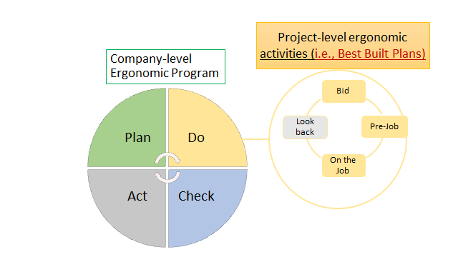
20. Company-level ergonomic program and project-level activities

