Slide 1
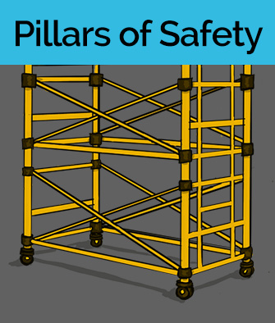



Slide 1 FSL 3 New Scenarios
Notes:
We’re going to work through [list the scenarios you’ve picked]. If we have time, we’ll do some others.
CLICK THE ICON OF THE SCENARIO YOU WISH TO USE
CLICK THE TAKEAWAY ICON IF YOU ARE AT THE END OF THE CLASS

Slide 2
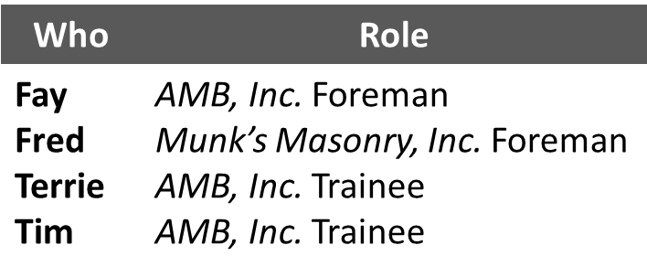



Slide 2 Pillars of Safety
Pillars
WATCH
READ
PLAY
Notes:
The key safety leadership moment illustrated in “Pillars of Safety” is how to help crew members correct an unsafe situation.
The safety hazard in this scenario is falls.
INSTRUCTOR INFORMATION - It is designed to illustrate the following safety leadership skills:
Leading by example
Actively listening and Practicing 3-way communication
Developing team members through teaching, coaching, and feedback
CLICK ON DESIRED TEACHING MODE…

Slide 3
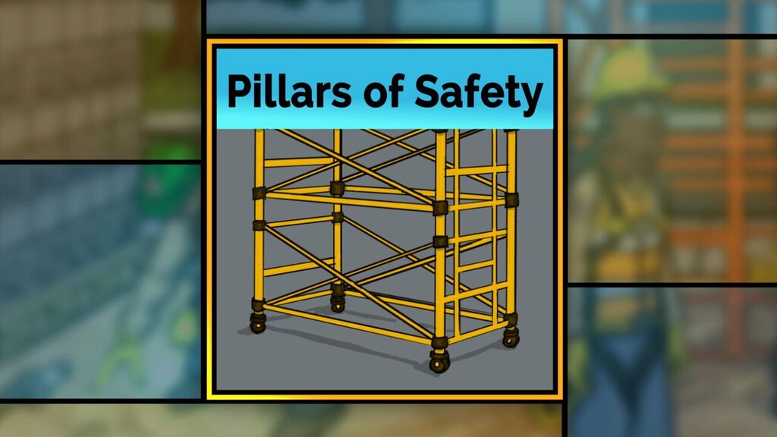
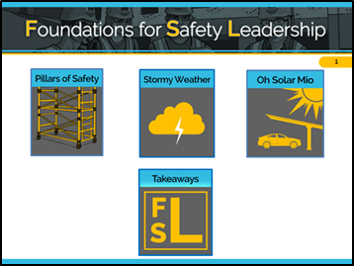
Slide 3 Pillars of Safety
Pillars
Situation
Notes:
VIDEO WILL START AUTOMATICALLY
ADVANCE SLIDE

Slide 4
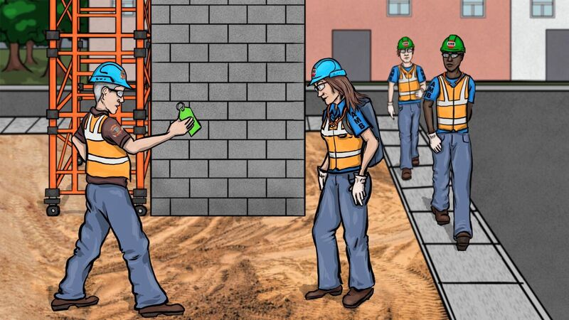
Slide 4 Pillars Outcome A
Pillars
Outcome A
Notes:
VIDEO WILL START AUTOMATICALLY
ADVANCE SLIDE

Slide 5

Slide 5 Pillars Discussion Questions: Outcome A
Pillars
Discussion Questions: Outcome A
What are your thoughts on how Fred handled this situation?
What about Fay?
Do you think Fay’s approach will help Terrie and Tim learn how to properly inspect a scaffold?
Notes:
Reveal the discussion questions and/or use the facilitation table to go through skills.
In outcome A, neither Fred nor Fay used any safety leadership skills. Fay did not lead by example when she yelled at them for making her look bad. She didn’t use any of the active listening skills to understand why they signed off on a non-compliant scaffold. She also did not teach, coach, or provide constructive feedback to help Terrie and Tim be more informed and engaged safety leaders.
ADVANCE SLIDE

Slide 6
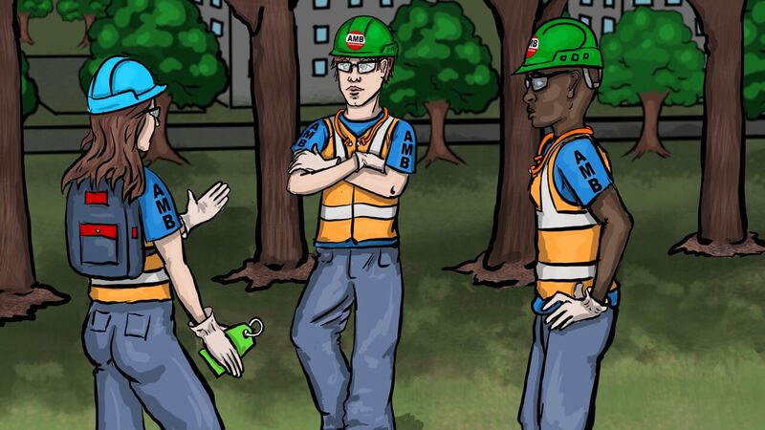
Slide 6 Pillars Outcome B Video
Pillars
Outcome B
Notes:
VIDEO WILL START AUTOMATICALLY
ADVANCE SLIDE

Slide 7
Slide 7 Pillars Discussion Questions: Outcome B
Pillars
Discussion Questions: Outcome B
Which of the leadership skills did Fay demonstrate this time?
What are some things Fay can do in the future to ensure that her crew has the necessary training and skills to always be safe on the jobsite?
Notes:
Reveal the discussion questions and/or use the facilitation table to go through skills.
In outcome B, Fay leads by example by taking the time to help Terrie and Tim understand the importance of the situation. She uses her active listening skills to help her realize that Terrie and Tim might be unsure of how to properly inspect a scaffold and she develops them by teaching and coaching them on how to do it.
CLICK SCENARIO MENU ICON TO RETURN TO MAIN MENU

Slide 8
Slide 8 Pillars Situation Key Points
Pillars
Situation – Key Points
AMB wants two brick pillars built on either side of the parking lot entrance of the Cain building before the grand opening in a month.
A scaffold guardrail is getting in the way of the masons working on the pillars, so they decide to remove it. They forget to put it back before leaving for the weekend.
On Monday morning, AMB laborers Terrie and Tim don’t notice the missing guardrail, so they sign the green tag indicating that the scaffold is 100% OSHA compliant.
Notes:
Refer students to page 5 in the student guide
Read/have students read the situation in the “Pillars of Safety” script (or instructor reads it aloud).
ADVANCE SLIDE

Slide 9
Slide 9 Pillars Outcome A Key Points
Pillars
Outcome A – Key Points
On Monday morning, Fred, the masonry foreman, sees Terrie, Tim, and their foreman, Fay. He yells at Fay, saying her crew signed off on a scaffold missing a guardrail and now he won’t be able to start work on time, putting them behind schedule.
Fay apologizes before turning to Terry and Tim to yell at them for signing off on a non-compliant scaffold and for making her look bad in front of Fred.
Notes:
Read/have students read outcome A in “Pillars of Safety” script (or instructor reads it aloud).
ADVANCE SLIDE

Slide 10
Slide 10 Pillars Discussion Questions: Outcome A
Pillars
Discussion Questions: Outcome A
What are your thoughts on how Fred handled this situation?
What about Fay?
Do you think Fay’s approach will help Terrie and Tim learn how to properly inspect a scaffold?
Notes:
Reveal the discussion questions and/or use the facilitation table to go through skills.
In outcome A, neither Fred nor Fay used any safety leadership skills. Fay did not lead by example when she yelled at them for making her look bad. She didn’t use any of the active listening skills to understand why they signed off on a non-compliant scaffold. She also did not teach, coach, or provide constructive feedback to help Terrie and Tim be more informed and engaged safety leaders.
ADVANCE SLIDE

Slide 11
Slide 11 Pillars Outcome B Key Points
Pillars
Outcome B – Key Points
On Monday morning, Fred sees Terrie, Tim, and their foreman, Fay. He yells at Fay, saying her crew signed off on a scaffold missing a guardrail and now he won’t be able to start work on time, putting them behind schedule.
Fay wants to yell at Terrie and Tim for making her look bad, but she knows it will make them defensive and tune out what she’s saying. Instead, she takes them aside to discuss the situation.
Once away from the pillar, Fay asks Terrie and Tim if they know why Fred was mad.
Notes:
Continue reading or have students continue reading outcome B in “Pillars of Safety” script (or instructor reads it aloud).
ADVANCE SLIDE TO READ THE REST OF OUTCOME B

Slide 12
Slide 12 Pillars Outcome B Key Point (continued)
Pillars
Outcome B – Key Points (cont.)
When they don’t respond, Fay explains that they must always do a thorough inspection before letting anyone use a scaffold that AMB builds.
Fay reads OSHA’s e-tool scaffold inspection instructions aloud from her tablet, asking Tim and Terrie to repeat the steps back to her so she can clarify any misunderstanding.
Afterwards, Fay watches as they replace the guardrail, re-inspect the scaffold, and fill out the tag indicating its 100% OSHA compliant.
Notes:
Read/have students continue to read outcome B in “Pillars of Safety” script (or instructor reads it aloud).
ADVANCE SLIDE

Slide 13
Slide 13 Pillars Discussion Questions Outcome B
Pillars
Discussion Questions: Outcome B
Which of the leadership skills did Fay demonstrate this time?
What are some things Fay can do in the future to ensure that her crew has the necessary training and skills to always be safe on the jobsite?
Notes:
Reveal the discussion questions and/or use the facilitation table to go through skills.
In outcome B, Fay leads by example by taking the time to help Terrie and Tim understand the importance of the situation. She uses her active listening skills to help her realize that Terrie and Tim might be unsure of how to properly inspect a scaffold and she develops them by teaching and coaching them on how to do it.
CLICK SCENARIO MENU ICON TO RETURN TO MAIN MENU

Slide 14
Slide 14 Pillars of Safety Video
Pillars
Situation
Notes:
For the role play activity, we’ll first watch the scenario situation together. Then, in groups of 2, each person will take the role of one character and for 2 minutes play out the conversation the characters might have by using or not using the skills. After, we’ll come back as a group to discuss how it went.
VIDEO WILL START AUTOMATICALLY
ADVANCE SLIDE

Slide 15
Slide 15 Pillars Outcome A & Discussion Questions for Outcome A
Pillars
Outcome A
Please role play how Fay might respond to Terrie and Tim after Fred, the masonry foreman, yells at her for her crew signing off on a scaffold missing a guardrail, and for making her look bad in front of him. DO NOT use any of the 5 leadership skills.
Discussion Questions for Outcome A
Fay, what did you say to Terrie and Tim?
What could go wrong in a situation like this?
From Terrie’s and Tim’s standpoint, in what way(s) might Fay’s reaction affect the crew?
Notes:
Divide students into groups of 2 and ask them to do a role-play as indicated on the slide using none of the leadership skills.
After 2 minutes, reveal the discussion questions or use the facilitation table to go through skills.
In outcome A, Fay did not lead by example when she yelled at Terrie and Tim for making her look bad. She didn’t attempt to actively listen to understand why they signed off on a non-compliant scaffold. She also didn’t teach, coach, or provide constructive feedback to develop Terrie and Tim into more informed and engaged safety leaders.
ADVANCE SLIDE

Slide 16
Slide 16 Pillars Outcome B & Discussion Questions for Outcome B
Pillars
Outcome B
This time, role play the interaction between Fay and her crew if she chooses to lead by example, actively listen, and develop her team members by teaching and coaching them.
Discussion Questions for Outcome B
What did Fay say to Terrie and Tim this time?
Terrie and Tim, how might Fay’s reaction affect your future behavior at work?
Notes:
Now have the students redo conversation between Fay and her crew using the following safety leadership skills:
1. Leading by example
2. Actively listening and practicing 3-way communication
3. Developing Team Members through teaching, coaching, and feedback
After 2 minutes, reveal the discussion questions or use the facilitation table to go through skills
In outcome B, Fay leads by example by explaining the importance of the situation to Terrie and Tim. She uses her active listening skills to help her realize that Terrie and Tim might be unsure of how to properly inspect a scaffold and she teaches and coaches them on how to do it.
CLICK SCENARIO MENU ICON TO RETURN TO MAIN MENU

Slide 17
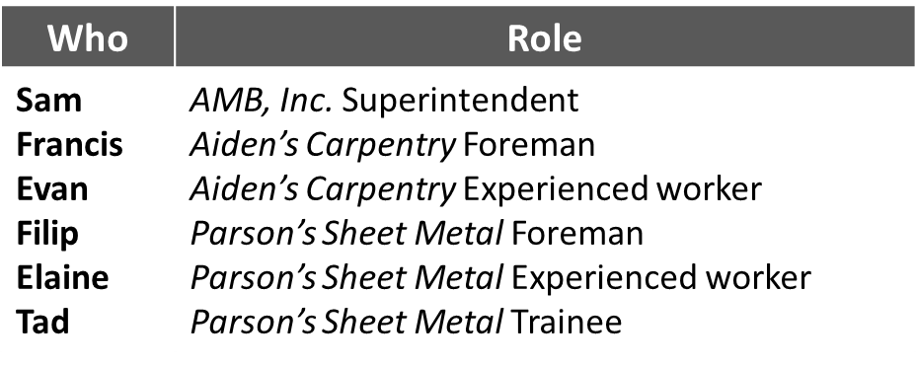
Slide 17 Stormy Weather
Stormy
WATCH
READ
PLAY
Notes:
The primary safety leadership moment illustrated in “Stormy weather” is how to encourage others to use safety leadership skills.
The safety hazard in this scenario is falls and bad weather.
INSTRUCTOR INFORMATION - It is designed to illustrate the following safety leadership skills:
Leading by example
Engaging and empowering workers
Developing team members through teaching, coaching, and feedback
Recognizing team members for a job well done
CLICK ON DESIRED TEACHING MODE…

Slide 18
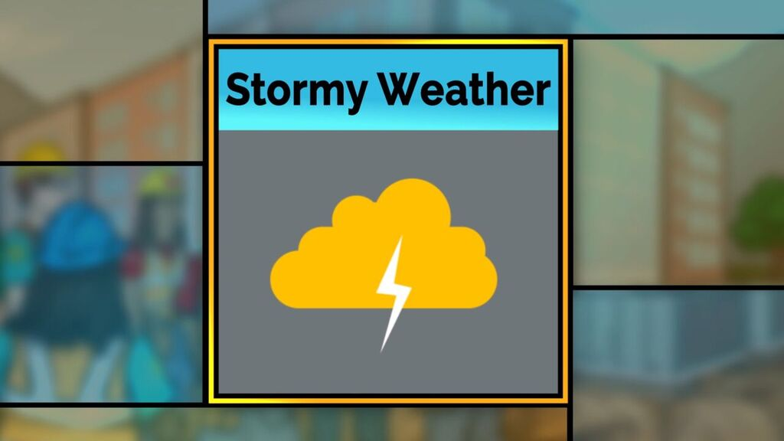
Slide 18 Stormy Weather Video
Stormy
Situation
Notes:
VIDEO WILL START AUTOMATICALLY
ADVANCE SLIDE

Slide 19
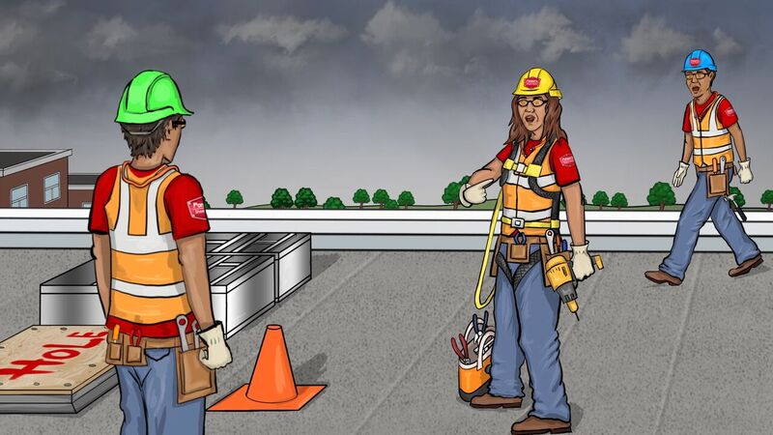
Slide 19 Stormy Outcome A Video
Stormy
Outcome A
Notes:
VIDEO WILL START AUTOMATICALLY
ADVANCE SLIDE

Slide 20
Slide 20 Stormy Discussion Questions Outcome A
Stormy
Discussion Questions: Outcome A
What are your thoughts on how Elaine and Filip handled this situation?
Which safety leadership skills did they or did they not demonstrate?
What message is Filip sending to Elaine and Tad about how much he values safety?
Notes:
Reveal the discussion questions and/or use the facilitation table to go through skills.
In outcome A, Elaine was leading by example and developing her team member, Tad, when she started teaching him that the hole in the roof presents a fall hazard and that they should all be wearing fall protection. Filip on the other hand was not leading by example when he interrupted her and gave reasons why they didn’t have to worry about the fall protection. He undercut Elaine’s authority as an experienced worker and sent a message to Tad that in the future he need not pay attention to what she asks him to do in terms of jobsite safety.
ADVANCE SLIDE

Slide 21
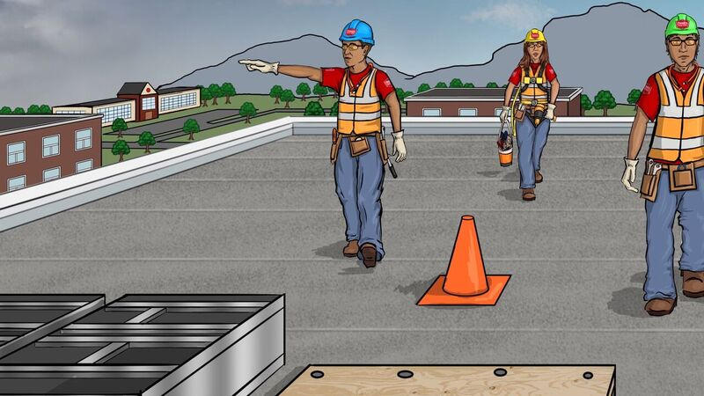
Slide 21 Stormy Outcome B Video
Stormy
Outcome B
Notes:
VIDEO WILL START AUTOMATICALLY
ADVANCE SLIDE

Slide 22
Slide 22 Stormy Discussion Questions Outcome B
Stormy
Discussion Questions: Outcome B
Which of the leadership skills did Filip and Elaine demonstrate this time?
Think of a situation where a worker spoke up about a safety hazard. What happened and what was the outcome?
How can you encourage others on your crews to use safety leadership skills?
Notes:
Reveal the discussion questions and/or use the facilitation table to go through skills.
In outcome B, Elaine was leading by example and developing her team member, Tad, when she started explaining that the hole in the roof presents a fall hazard and that they should all be wearing fall protection. This time, Filip leads by example and empowers Elaine by giving her the time to explain the fall hazard to Tad despite the impending storm. Filip also recognized Elaine by thanking her for being a good role model to Tad.
CLICK SCENARIO MENU ICON TO RETURN TO MAIN MENU

Slide 23
Slide 23 Stormy Situation
Stormy
Situation – Key Points
At a morning huddle, AMB superintendent Sam tells the sheet metal and carpentry crews that today they’ll prepare the roof for HVAC systems.
After discussing the steps and potential hazards, Sam adds that they’ll need to get started because the forecast is showing severe storms with lightning this afternoon.
Once on the roof, Francis and Evan from Aiden’s Carpentry cut 2 holes for the sheet metal workers to install duct work.
They won’t start duct work until after lunch, so they screw down plywood over the holes and put out safety cones.
Notes:
Refer students to page 7 in the student guide
Ask students to read the situation for “Stormy Weather” (or instructor reads it aloud).
ADVANCE SLIDE

Slide 24
Slide 24 Stormy Outcome A Key Points
Stormy
Outcome A – Key Points
After lunch, Filip, the foreman at Parson’s Sheet Metal, notices dark clouds coming in. At the same time, Elaine, an experienced sheet metal worker, notices she’s the only one wearing fall protection, which they’ll need when they remove the plywood covering the holes.
As Elaine starts telling Tad that everyone needs to be wearing fall protection, Filip interrupts saying there’s really no risk of falling since they’re not working at the edge and the hole won’t be open for that long.
Notes:
Ask students to read outcome A for “Stormy Weather” (or instructor reads it aloud).
ADVANCE SLIDE

Slide 25
Slide 25 Stormy Discussion Questions Outcome A
Stormy
Discussion Questions: Outcome A
What are your thoughts on how Elaine and Filip handled this situation?
Which safety leadership skills did they or did they not demonstrate?
What message is Filip sending to Elaine and Tad about how much he values safety?
Notes:
Reveal the discussion questions and/or use the facilitation table to go through skills.
In outcome A, Elaine was leading by example and developing her team member, Tad, when she started teaching him that the hole in the roof presents a fall hazard and that they should all be wearing fall protection. Filip, on the other hand, was not leading by example when he interrupted her and gave reasons why they didn’t have to worry about the fall protection. He undercut Elaine’s authority as an experienced worker and sent a message to Tad that in the future he need not pay attention to what she asks him to do for safety.
ADVANCE SLIDE

Slide 26
Slide 26 Stormy Outcome B Key Points
Stormy
Outcome B – Key Points
After lunch, Filip notices dark clouds coming in. At the same time, Elaine notices she’s the only one wearing fall protection, which is needed to remove the plywood covering the holes.
As Elaine tells Tad that everyone needs fall protection, Filip starts to interrupt but stops. He empowers Elaine by allowing her to explain the fall hazard to Tad.
Filip realizes the situation allows him to recognize Elaine for taking ownership of safety and for demonstrating good behavior to Tad. When she’s done, Filip thanks Elaine for being a good role model and asks Tad to get the fall protection.
Notes:
Ask students to read outcome B for “Stormy Weather” (or instructor reads it aloud).
ADVANCE SLIDE

Slide 27
Slide 27 Stormy Discussion Questions Outcome B
Stormy
Discussion Questions: Outcome B
What do you think of the way Filip and Elaine handled the situation this time?
Which of the leadership skills did they demonstrate?
Describe a situation where a worker recognized and spoke up about a safety hazard. What safety leadership skills did they use? What was the outcome?
How can you encourage others on your crews to use safety leadership skills?
Notes:
Reveal the discussion questions and/or use the facilitation table to go through skills.
In outcome B, Elaine was leading by example and developing her team member, Tad, when she started explaining that the hole in the roof presents a fall hazard and that they should all be wearing fall protection. This time Filip leads by example and empowers Elaine by giving her the time to explain the fall hazard to Tad despite the impending storm. Filip also recognized Elaine by thanking her for being a good role model to Tad.
CLICK SCENARIO MENU ICON TO RETURN TO MAIN MENU

Slide 28
Slide 28 Stormy Weather Video
Stormy
Situation
Notes:
For the role play activity, we’ll first watch the scenario situation together. Then, in groups of 2, each person will take the role of one of the scenario characters and for 2 minutes play out the conversation the characters might have either not using or using leadership skills. After 2 minutes is up, we’ll come back together as a group to discuss how it went.
VIDEO WILL START AUTOMATICALLY
ADVANCE SLIDE

Slide 29
Slide 29 Stormy Outcome A & Discussion Questions for Outcome A
Stormy
Outcome A
A sheet metal crew will be installing HVAC ductwork through holes cut into a roof. Elaine, an experienced worker, notices she’s the only one wearing fall protection. As she starts telling Tad that everyone needs to use fall protection, their foreman Filip interrupts her. Please role play the conversation between Filip and Elaine. DO NOT use any of the leadership skills.
Discussion Questions for Outcome A
Filip, what did you say to Elaine?
Elaine, what was your response and what could Filip have done better?
Notes:
Divide students into groups of 2 and ask them to do a role-play as indicated on the slide using none of the leadership skills.
After 2 minutes, reveal the discussion questions or use the facilitation table to go through skills.
In outcome A, Elaine was leading by example and developing her team member, Tad, when she started teaching him that the hole in the roof presents a fall hazard and that they should all be wearing fall protection. Filip on the other hand was not leading by example when he interrupted her and gave reasons why they didn’t have to worry about the fall protection. He undercut Elaine’s authority as an experienced worker and sent a message to Tad that in the future he need not pay attention to what she asks him to do in terms of jobsite safety
ADVANCE SLIDE

Slide 30
Slide 30 Stormy Outcome B & Discussion Questions for Outcome B
Stormy
Outcome B
This time, role play the same situation, but with Filip leading by example, empowering, and recognizing Elaine.
Discussion Questions for Outcome B
Filip, how did you use the leadership skills and in what ways was your conversation with Elaine different?
Elaine, how did it feel when Filip used the safety leadership skills?
Notes:
Now have the students redo conversation between Filip and Elaine using one or more of the leadership skills such as:
Leading by example
Engaging and empowering team members
Developing team members through teaching, coaching, and feedback
Recognizing team members for a job well done
After 2 minutes, reveal the discussion questions or use the facilitation table to go through skills.
In outcome B, Elaine was leading by example and developing her team member, Tad, when she started explaining that the hole in the roof presents a fall hazard and that they should all be wearing fall protection. This time, Filip leads by example and empowers Elaine by giving her the time to explain the fall hazard to Tad despite the impending storm. Filip also recognized Elaine by thanking her for being a good role model to Tad.
CLICK SCENARIO MENU ICON TO RETURN TO MAIN MENU

Slide 31
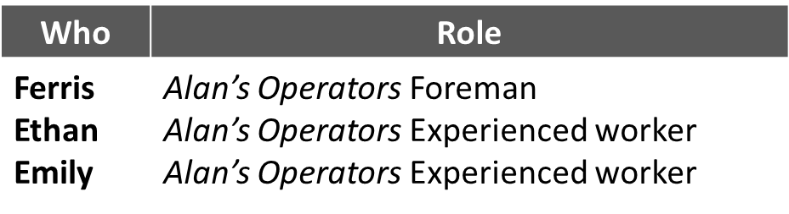
Slide 31 Oh Solar Mio
Oh Solar
WATCH
READ
PLAY
Notes:
The primary safety leadership moment illustrated in “Oh Solar Mio” is what can happen when production and scheduling are prioritized over safety.
The safety hazard in this scenario is use of proper equipment.
INSTRUCTOR INFORMATION - It is designed to illustrate the following safety leadership skills:
Leading by example
Engaging and empowering workers
Actively listening and practicing three-way communication
Recognizing team members for a job well done.
CLICK ON DESIRED TEACHING MODE…

Slide 32
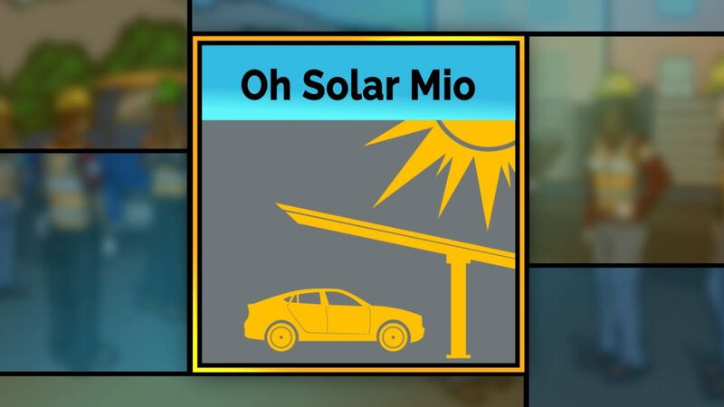
Slide 32 Oh Solar Mio Video
Oh Solar
Situation
Notes:
VIDEO WILL START AUTOMATICALLY
ADVANCE SLIDE

Slide 33
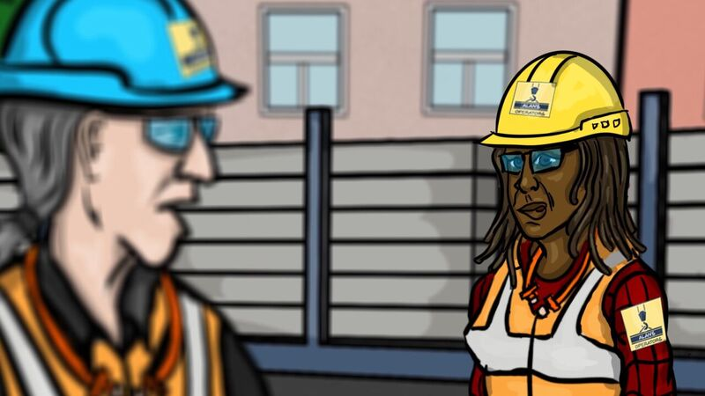
Slide 33 Oh Solar Video
Oh Solar
Outcome A
Notes:
VIDEO WILL START AUTOMATICALLY
ADVANCE SLIDE

Slide 34
Slide 34 Oh Solar Discussion Questions Outcome A
Oh Solar
Discussion Questions: Outcome A
What do you think about how Ferris handled this situation?
How might his decision to go ahead with the lift affect the likelihood that Emily and Ethan will feel comfortable raising safety issues in the future?
Notes:
Reveal the discussion questions and/or use the facilitation table to go through skills.
In outcome A, Ferris did not use any safety leadership skills. He didn’t lead by example when he decided to go ahead with the lift even though he knew he didn’t have the right equipment. He didn’t engage his crew in the safety decision-making process and he also didn’t listen to Emily when she voiced her concern.
ADVANCE SLIDE

Slide 35
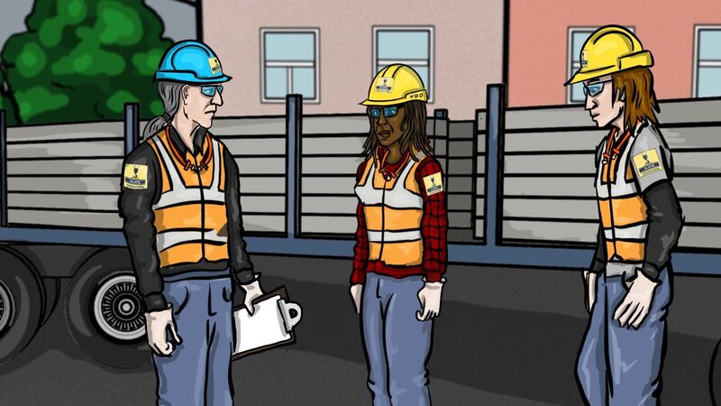
Slide 35 Oh Solar Outcome B Video
Oh Solar
Outcome B
Notes:
VIDEO WILL START AUTOMATICALLY
ADVANCE SLIDE

Slide 36
Slide 36 Oh Solar Discussion Questions Outcome B
Oh Solar
Discussion Questions: Outcome B
Which of the leadership skills did Ferris demonstrate this time?
Describe how this ending differed from the first one and what the impact might be on the crew.
Notes:
Reveal the discussion questions and/or use the facilitation table to go through skills.
In outcome B, Ferris leads by example, actively listens to Emily’s concerns, and empowers her when he decides to stop the job until the proper equipment is available. He also recognizes Emily for having the courage to speak up and for being a valuable team member.
CLICK SCENARIO MENU ICON TO RETURN TO MAIN MENU

Slide 37
Slide37 Oh Solar Situation Key Points
Oh Solar
Situation – Key Points
Operating engineers Ethan and Emily, their foreman Ferris, and some ironworkers are at the Cain Building parking lot checking out a trailer loaded with mounting structures needed to build solar carports.
Ferris’s lift plan involves using a crane with a load and capacity big enough to lift the materials, but the GC needed that crane on another jobsite and the only one available to rent is smaller with less capacity.
When an ironworker reminds him they’re behind schedule, Ferris feels pressured and decides to use the smaller crane.
Notes:
Refer students to page 9 in the student guide
Ask students to read the situation for “Oh Solar Mio” (or instructor reads it aloud).
ADVANCE SLIDE

Slide 38
Slide 38 Oh Solar Outcome A Key Points
Oh Solar
Outcome A – Key Points
Ferris asks Ethan and Emily to get the slings and attach them to the mounting structure.
Emily says she’s worried the crane may be too small to do the lift safely. Ferris responds defensively, saying he’s sure it will be fine.
As Ferris starts the lift and extends the boom, he feels the bed of the crane begin to shift and the outrigger starts lifting off the ground. Luckily, he’s able to retract the boom just in time to prevent a possible disaster.
Notes:
Ask students to read outcome A for “Oh Solar Mio” (or instructor reads it aloud).
ADVANCE SLIDE

Slide 39
Slide 39 Oh Solar Discussion Questions Outcome A
Oh Solar
Discussion Questions: Outcome A
What do you think about how Ferris handled this situation?
How might his decision to go ahead with the lift affect the likelihood that Emily and Ethan will feel comfortable raising safety issues in the future?
Notes:
Reveal the discussion questions and/or use the facilitation table to go through skills.
In outcome A, Ferris did not use any safety leadership skills. He didn’t lead by example when he decided to go ahead with the lift even though he knew he didn’t have the right equipment. He didn’t engage his crew in the safety decision-making process and he also didn’t listen to Emily when she voiced her concern.
ADVANCE SLIDE

Slide 40
Slide 40 Oh Solar Outcome B Key Points
Oh Solar
Outcome B – Key Points
When Ferris asks his crew to get the slings and attach them to the mounting structure, he hears Emily say she’s worried the crane may be too small to do the lift safety.
He realizes that if he ignores her comment, his role as a safety leader will be greatly weaken and his expectation that his crew voice safety concerns will be meaningless.
Ferris decides not to use the smaller crane and tells the crew that although the GC may not be happy, he is going to postpone the lift. He thanks Emily for having the courage to speak up about her concern.
Notes:
Ask students to read outcome B for “Oh Solar Mio” (or instructor reads it aloud).
ADVANCE SLIDE

Slide 41
Slide 41 Oh Solar Discussion Questions Outcome B
Oh Solar
Discussion Questions: Outcome B
Which of the leadership skills did Ferris demonstrate this time?
Describe how this ending differed from the first one and what the impact might be on the crew.
Notes:
Reveal the discussion questions and/or use the facilitation table to go through skills.
In outcome B, Ferris leads by example, actively listens to Emily’s concerns, and empowers her when he decides to stop the job until the proper equipment is available. He also recognizes Emily for having the courage to speak up and for being a valuable team member.
CLICK SCENARIO MENU ICON TO RETURN TO MAIN MENU

Slide 42
Slide 42 Oh Solar Mio Situation Video
Oh Solar
Situation
Notes:
For the role play activity, we’ll first watch the scenario situation together. Then, in groups of 2, each person will take the role of one of the scenario characters and for 2 minutes play out the conversation the characters might have either not using or using leadership skills. After 2 minutes is up, we’ll come back together as a group to discuss how it went.
VIDEO WILL START AUTOMATICALLY
ADVANCE SLIDE

Slide 43
Slide 43 Oh Solar Outcome A & Discussion Questions for Outcome A
Oh Solar
Outcome A
Please role play the conversation between Emily and Ferris when she tries to tell him she’s concerned about the lift. DO NOT use any of the 5 leadership skills.
Discussion Questions for Outcome A
Emily, what did you say to Ferris?
Ferris, how did you respond?
Notes:
Divide students into groups of 2 and ask them to do a role-play as indicated on the slide using none of the leadership skills.
After 2 minutes, reveal the discussion questions or use the facilitation table to go through skills.
In outcome A, Ferris did not use any safety leadership skills. He didn’t lead by example when he decided to go ahead with the lift even though he knew he didn’t have the right equipment. He didn’t engage his crew in the safety decision-making process and he also didn’t listen to Emily when she voiced her concern.
ADVANCE SLIDE

Slide 44
Slide 45 Takeaways
Takeaways
It takes COURAGE to be a leader.
It takes COURAGE to speak up.
These skills can easily be inserted into the daily workflow and productivity will not be effected.
Leaders…
  Lead by example
  Engage and empower team member
  Actively listen and Practice 3-way communication
  Develop team members by teaching, coaching, and knowing how to give constructive feedback
  Recognize team members
Leaders improve SAFETY CLIMATE AND SAFETY OUTCOMES
Notes:
We’ve come to the end of the FSL course and we’ve covered a lot.
Before we uncover the take away messages, tell me one or two things you learned today, or even better, something you’re going to start doing right away (or stop doing) when you get back to the jobsite.
So, here’s are the key points I hope you will take away with you and put into practice on the jobsite:
It takes COURAGE to be a leader.
It takes COURAGE to speak up.
These skills can easily be inserted into the daily workflow and productivity will not be affected.
Leaders…
Lead by Example
Engage and Empower team members
Actively listen and Practice 3-way communication
Develop team members by teaching, coaching, and knowing how to give constructive feedback
Recognize team members for going above and beyond for safety
And finally, if you use these skills on the jobsite and become a true safety leader, you can improve both jobsite SAFETY CLIMATE and SAFETY OUTCOMES.
ADVANCE SLIDE

Slide 45





Slide 46
(c) 2018, CPWR - The Center for Construction Research and Training. All rights reserved. These materials are made available free of charge by CPWR. No content can be modified without CPWR's approval. CPWR is the research and training arm of North America's Building Trades Unions and serves the construction industry and its workers. (http://www.cpwr.com/).
Production of this training program was supported by NIOSH cooperative agreement OH009762. The contents are solely the responsibility of the authors and do not necessarily represent the official views of NIOSH.
Notes:
The FSL course was developed collaboratively by these organizations.

