Slide 1
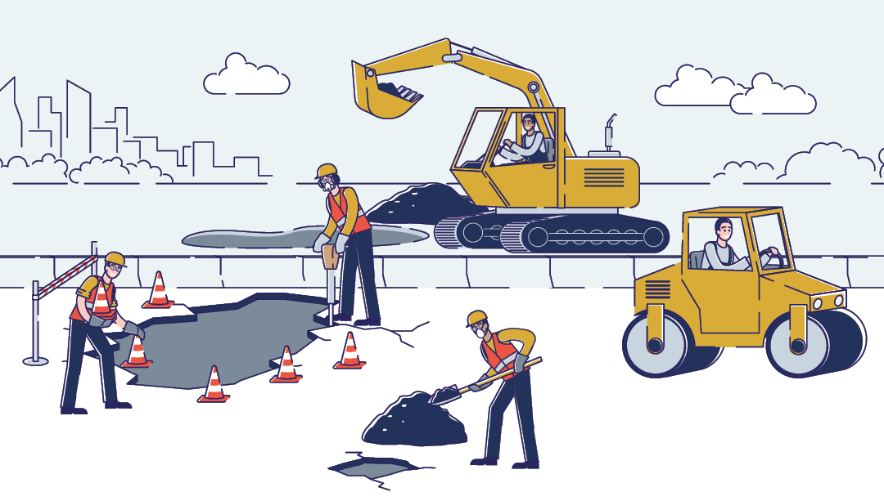

Preventing Struck-by Incidents in Construction
Presenter
April 18, 2023

Slide 2
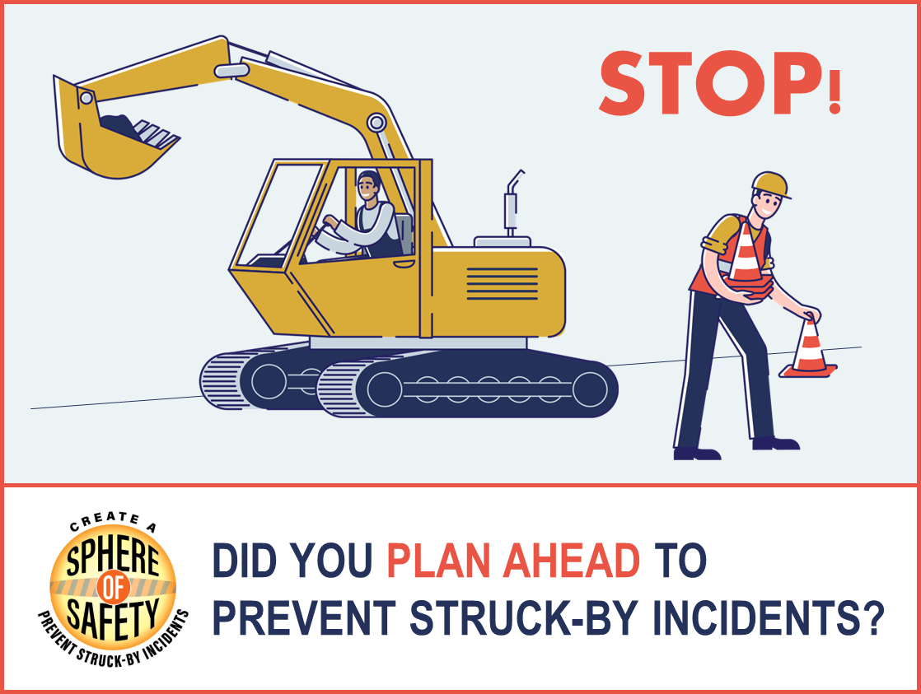
What is a Struck-By Hazard?
Notes:
Struck-by hazards on a construction site can include any hazard where a person comes in forceful contact with a moving object – a flying or falling tool or debris, a vehicle or piece of heavy equipment, crane hazards, etc.

Slide 3
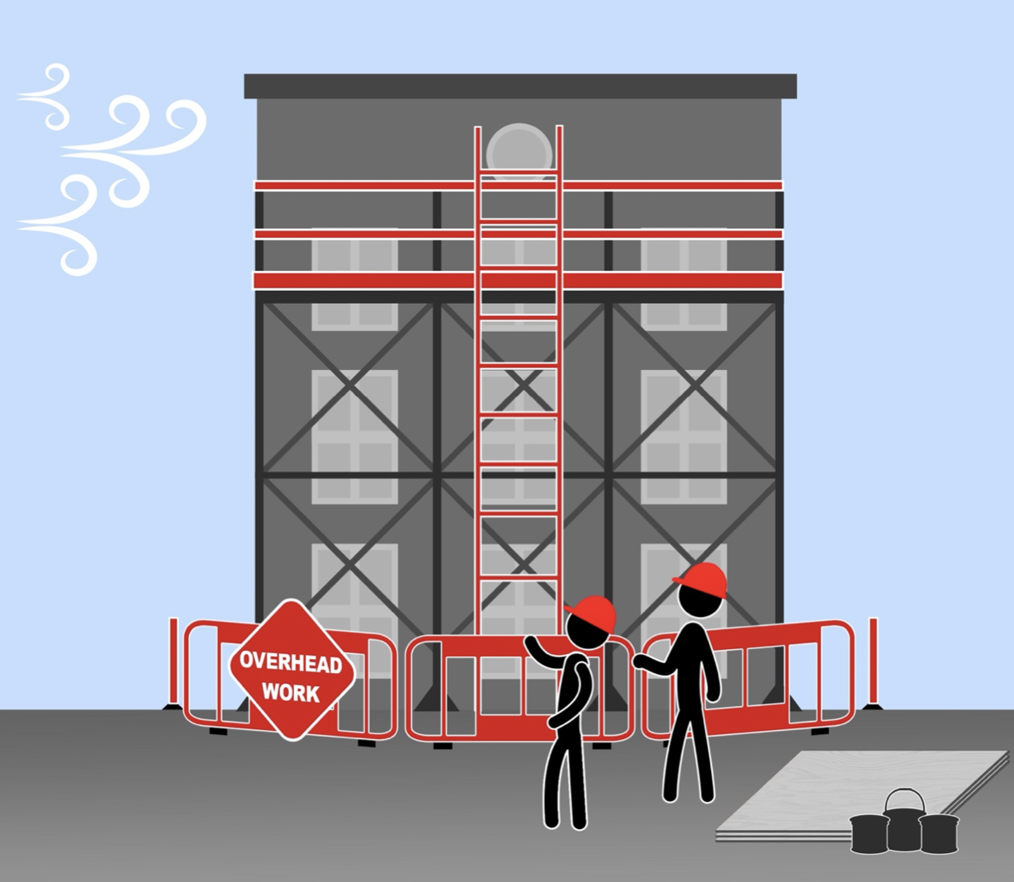
What is a Struck-By Hazard?
Construction workers face many safety and health hazards, including being struck by an object or a piece of equipment such as:
Accidents involving vehicles and transportation equipment
Falling tools or objects, flying and discharged objects
Non-transportation vehicles or equipment, such as swing hazards from cranes
Notes:
Struck-by hazards on a construction site can include any hazard where a person comes in forceful contact with a moving object – a flying or falling tool or debris, a vehicle or piece of heavy equipment, crane hazards, etc.

Slide 4
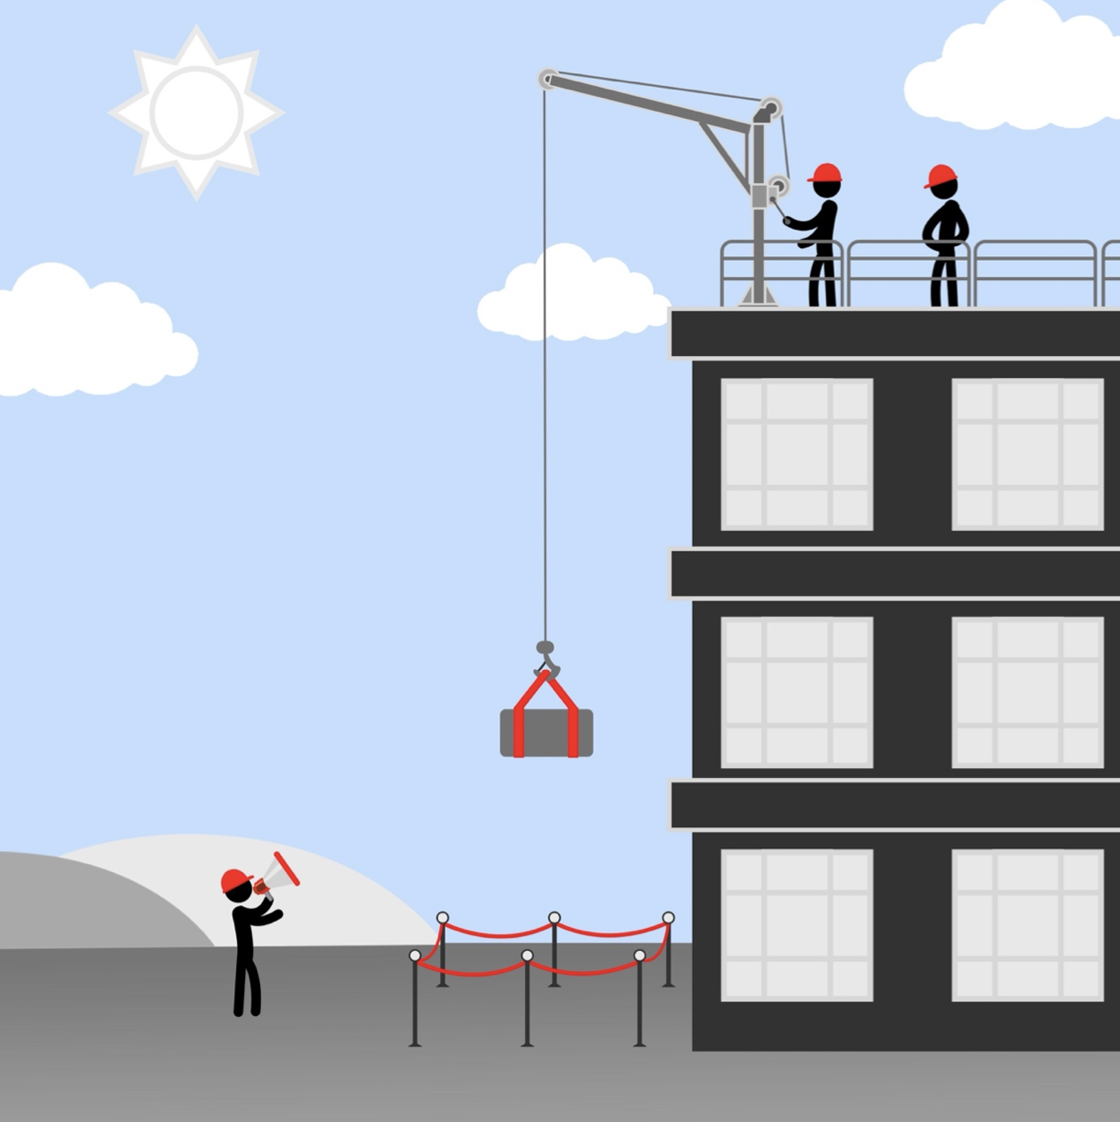
What is a Struck-By Hazard?
Many of these incidents are preventable and could be avoided through:
Better understanding of the hazards
Improved planning and scheduling
Implementation of interventions
Increased training
Continuing efforts are needed to address hazards in construction workplaces!
Notes:
Struck-by hazards on a construction site can include any hazard where a person comes in forceful contact with a moving object – a flying or falling tool or debris, a vehicle or piece of heavy equipment, crane hazards, etc.

Slide 5
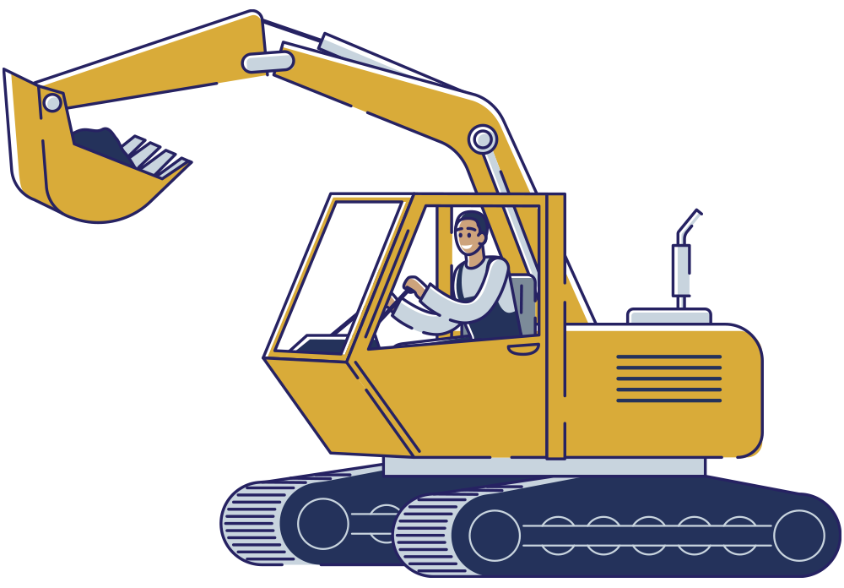
Join or Host a Safety Stand-Down Event
A safety stand-down event is an opportunity to educate workers on hazard prevention topics including:
Creating internal traffic control plans
Keeping positive separation between workers and moving vehicles
Using temporary traffic control devices
Tethering tools and equipment
Avoiding blind-spots around large equipment
Using high-visibility clothing
• Good housekeeping practices
• Installing toe boards
• And many more…
Notes:
How do you address these struck-by hazards in the workplace? Hold a safety stand-down event.

Slide 6
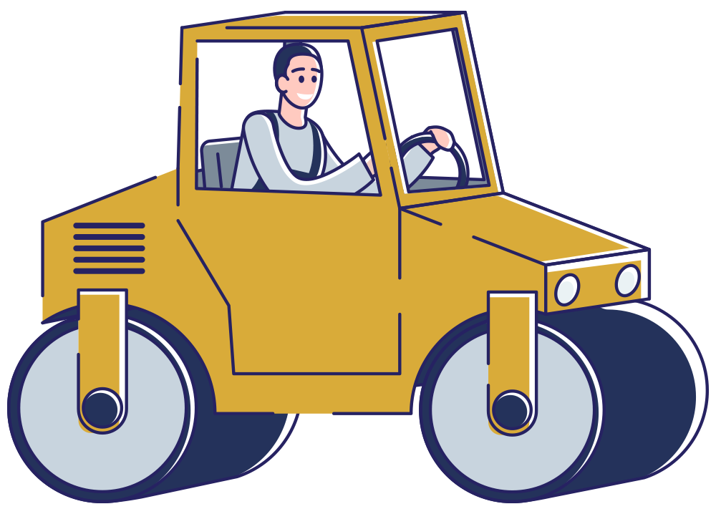
STOP. TALK. ACT. as a Stand-Down theme
STOP work.
TALK about hazards.
ACT on what you learn.
Notes:
The STOP. TALK. ACT. slogan is a primary theme for the Stand-Down.

Slide 7
On average there have been 165 fatal struck-by injuries annually
On average struck-by injuries have accounted for 17% of all fatal injuries annually
Notes:
Struck-by incidents are a major problem – and are the #1 cause injuries and the #2 cause of death among construction workers.

Slide 8
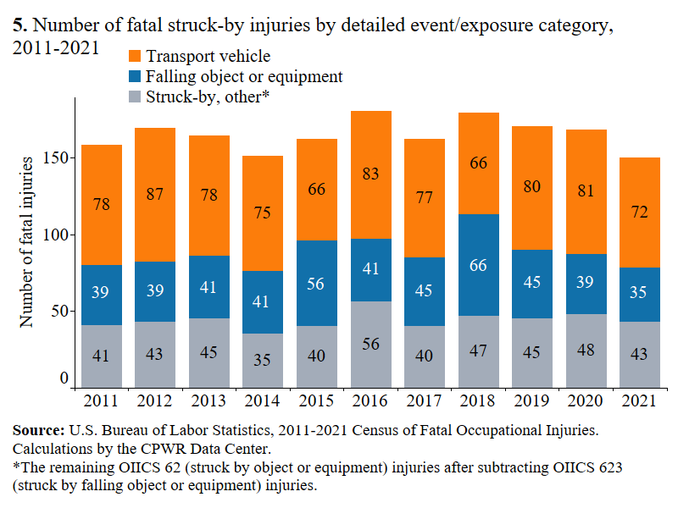
Notes:
Struck-by incidents are a major problem – and are the #1 cause injuries and the #2 cause of death among construction workers.
An average of 165 construction workers die each year from a struck-by incident. These numbers need to be decreasing.

Slide 9
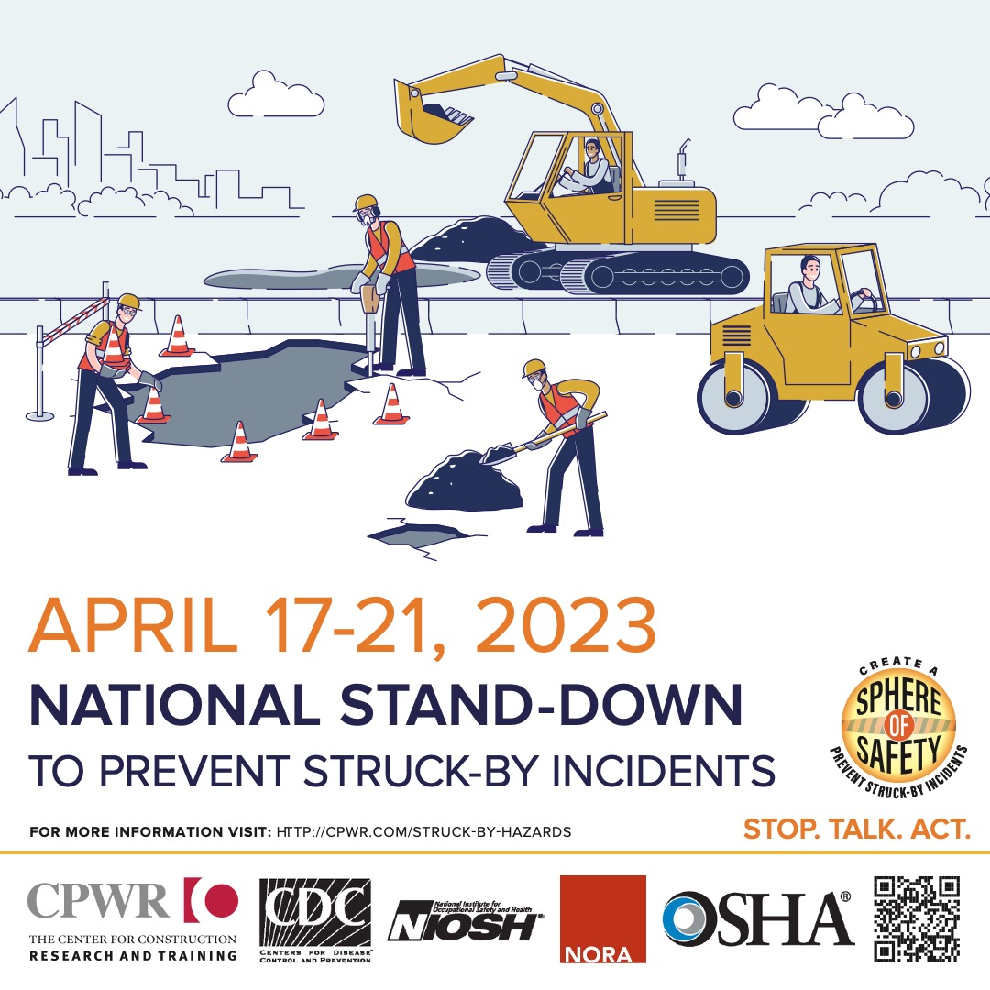
Save the Date!
Notes:
A stand-down in the construction industry is an activity where all normal work on a site is paused so that the entire site can focus on a specific safety issue.
During National Work Zone Awareness Week this year, we are holding a voluntary National Stand-Down to Prevent Struck-By Incidents to focus on struck-by hazards.
These struck-by hazards on a construction site can include any hazard where a person comes in forceful contact with a moving object – a flying or falling tool or debris, a vehicle or piece of heavy equipment, crane hazards, etc.

Slide 10
Incidents May Arise From . . .
Moving vehicles and equipment, particularly when backing
Rotating or oscillating equipment, such as cranes
Falling objects and materials, such as dropped tools
Tipping or tilting materials, such as stacked signs and lumber

Slide 11
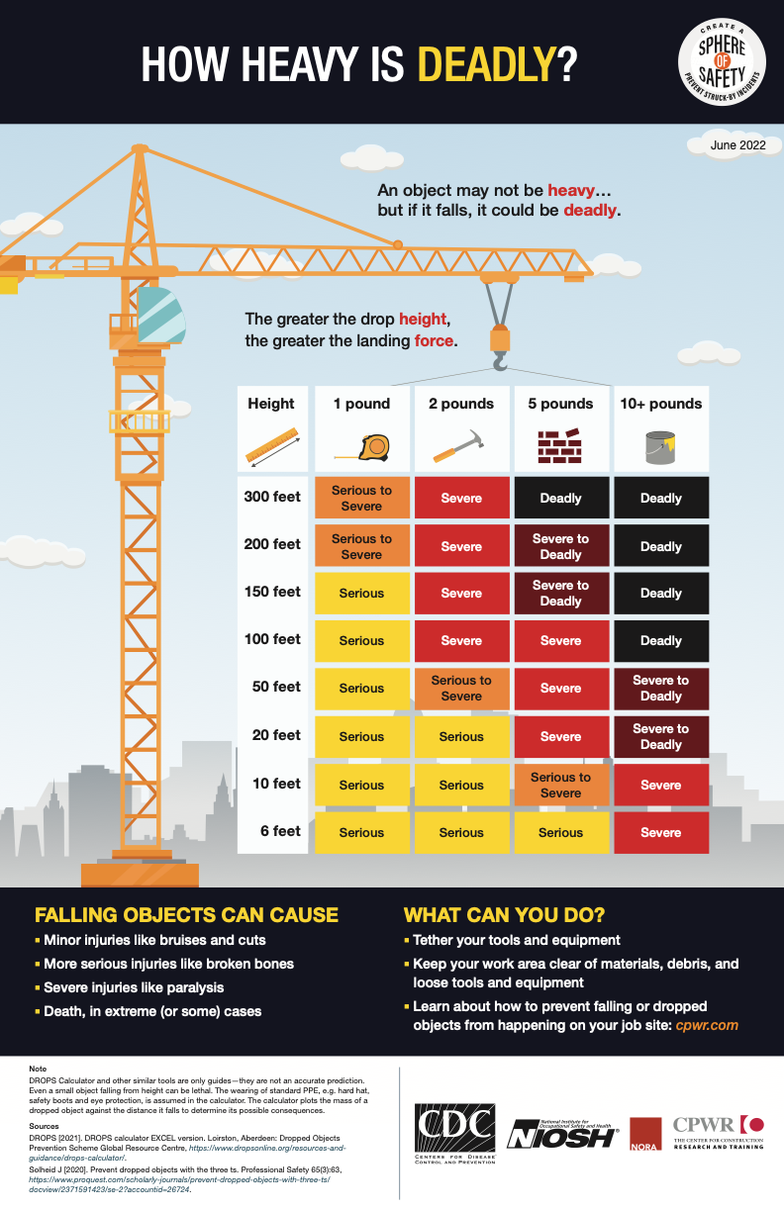
How Heavy is Deadly?
Notes:
Highlight a few important ones.

Slide 12
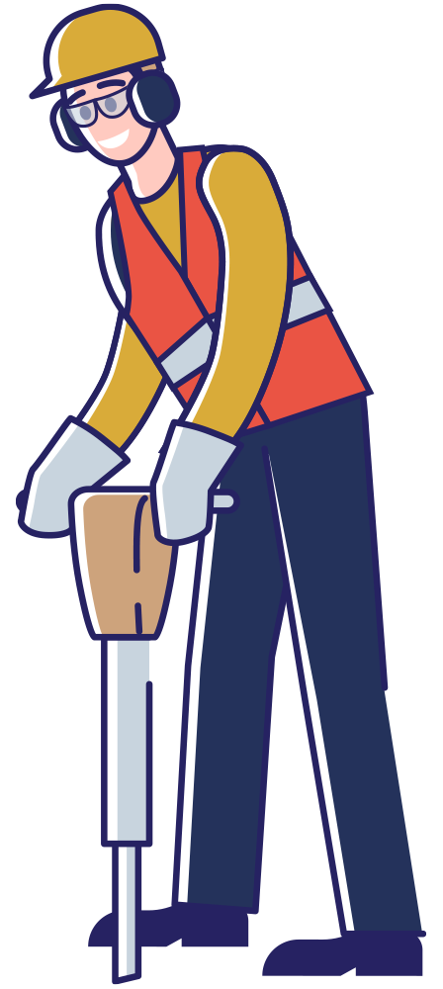
Struck-by Summary for Dropped Objects
Do not hoist loads or allow them to pass over people
Secure all tools in elevated work areas if they are close to leading edges
Use toe boards on all scaffolding and open elevations
Secure loads before lifting them by forklifts
Always wear a hard hat
Notes:
Short summary of hazard prevention involving dropped objects

Slide 13
Struck-by Resources for Dropped Objects
Toolbox Talks:
Preventing Falling Objects
Challenges Preventing Falling Objects
Solutions for Falling Objects and Dropped Tools
Infographics:
Stop the Drop (English PDF & JPEG)
How Heavy is Deadly? (English PDF & JPEG)
Webinars:
Preventing Struck-by Incidents from Dropped Tools & Other Objects: Recording & PDF of Slides
Prevención de Incidentes por Atropellos: Zonas de Trabajo, Equipos Pesados e Impacto de Objetos: ver video & descargar presentación
Notes:
Resources for Dropped Objects

Slide 14
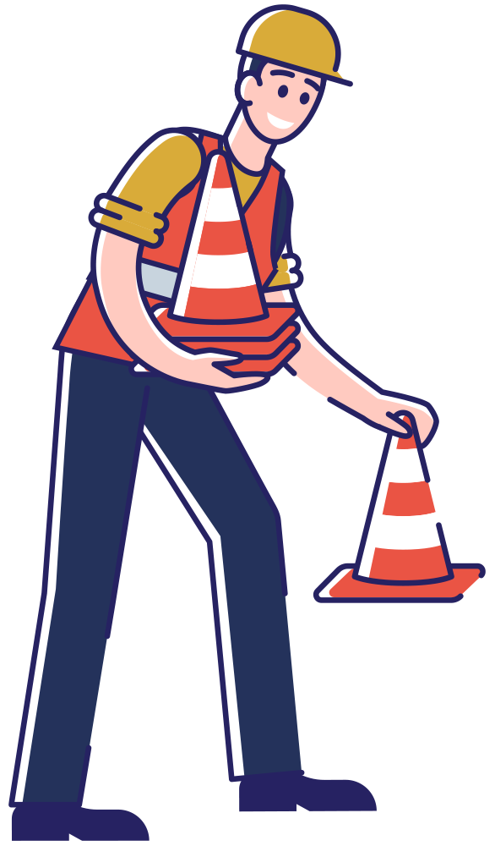
Struck-by Summary for Work Zones
On average, 135 construction workers die each year in work zones
  Struck-by incidents are the leading cause of death in the work zone
  Most commonly motor vehicle struck-by incidents
Ensure high visibility clothing is worn
Use adequate lighting during night operations
Install barriers, attenuators and/or rumble strips
Notes:
Short summary of workzone incidents. By far, the most common struck-by incident is involving passenger cars and commercial vehicles entering the workzone and striking construction workers.

Slide 15
Struck-by Resources for Work Zones
Toolbox Talks:
Work Zone Safety: Vehicle Operators (English, Spanish)
Work Zone Safety: Working Around Vehicles (English, Spanish)
Equipment: Falling Objects (English, Spanish)
Traffic Safety (English, Spanish)
Infographics:
STAY ALERT IN WORK ZONES! (English PDF & JPEG, Spanish JPEG)
OPERATORS! 4 Steps for Work Zone Safety (English PDF & JPEG, Spanish JPEG)
CONTRACTORS! Work Zone Safety Starts with Your Internal Traffic Control Plan (English PDF & JPEG, Spanish JPEG)
Head Protection (English PDF & JPEG)
In 1 Strike You Could Be Out (English PDF & JPEG)
Webinars:
Preventing Struck-by Incidents in Roadway Work Zones: Recording & PDF of Slides
Preventing Struck-By Incidents: Learning by Experience: Recording & PDF of Slides
Prevención de Incidentes por Atropellos: Zonas de Trabajo, Equipos Pesados e Impacto de Objetos: ver video & descargar presentación
Notes:
Safety resources for work zones

Slide 16
Struck-by Summary for Lift Zones
Load movement planning should be performed for EVERY lift
Safe rigging strategies are imperative
  Proper inspection protocols
  Knowledge of principles of safe rigging
  Using tag lines and push sticks
Proper training for all workers in the area
Barricaded safe zones
Never stand beneath the load!
Notes:
Short summary of hazard prevention involving cranes
60% of fatalities involving cranes were from a worker stuck by a load
For Point #1: Analysis indicated that crane lifts that did not have a pre-lift meeting have a 335 times higher risk of having an accident than one that has a meeting.

Slide 17
Struck-by Resources for Lift Zones
NIOSH Science Blog: Preventing Struck-by Injuries in Construction: Lift Zone Safety
Toolbox Talks:
Cranes: Stability & Tipping (English, Spanish)
Lift Zone Safety: Planning a Lift (English, Spanish)
Tower Crane Safety (English), (Spanish)
Infographics:
Crane and Lift Zone Safety: Planning for a Safe Lift (English PDF & PNG; Spanish PDF & PNG)
In 1 Strike You Could Be Out (English PDF & JPEG)
Struck-by Incidents Are a Leading Cause of Injury in Construction (English PDF & PNG; Spanish PDF & PNG)
Best Practices for Safe Crane Lifts (English PDF & PNG; Spanish PDF & PNG)
Struck-by Incidents are the 2nd Leading Cause of Work-Related Death in Construction (English PDF & PNG; Spanish PDF & PNG)
Notes:
Safety resources for lift zones

Slide 18
Struck-by Resources for Lift Zones (continued)
Webinars:
What’s the risk? Best Practices to reduce the likelihood of struck-by injuries from heavy equipment and crane activities: Recording & PDF of Slides
Cranes & Lifting – Avoiding Struck-By Incidents Under the Hook: Recording & PDF of Slides
Prevención de Incidentes por Atropellos: Zonas de Trabajo, Equipos Pesados e Impacto de Objetos: ver video & descargar presentación
NIOSH Alert: Crane Tip Overs
Notes:
Safety resources for lift zones

Slide 19
Struck-by Summary for Heavy Equipment
Never allow workers beneath the bucket of an excavator
Always have a spotter/backer in place when dump trucks are backing
Internal traffic control plans are necessary to separate heavy equipment from workers on foot
Notes:
Short summary of hazard prevention involving heavy equipment

Slide 20
Struck-by Resources for Heavy Equipment
NIOSH Science Blog – Preventing Stuck-by Fatalities Related to Excavator Quick Couplers, Buckets, and Attachments
Toolbox Talks:
Equipment: Falling Objects (English, Spanish)
Equipment: Getting On & Off (English, Spanish)
Equipment Maintenance (English, Spanish)
Boom Truck Safety (English, Spanish)
NIOSH Workplace Solutions: Preventing Worker Injuries and Deaths from Backing Construction Vehicles and Equipment
NIOSH Webpage: Construction Equipment Visibility (aka, blind area diagrams)
Webinars:
What’s the risk? Best Practices to reduce the likelihood of struck-by injuries from heavy equipment and crane activities: Play Recording & PDF of Slides
Preventing Struck-By Incidents: Learning by Experience: Play Recording & PDF of Slides
Prevención de Incidentes por Atropellos: Zonas de Trabajo, Equipos Pesados e Impacto de Objetos: ver video & descargar presentación
Notes:
Short summary of hazard prevention involving heavy equipment

Slide 21
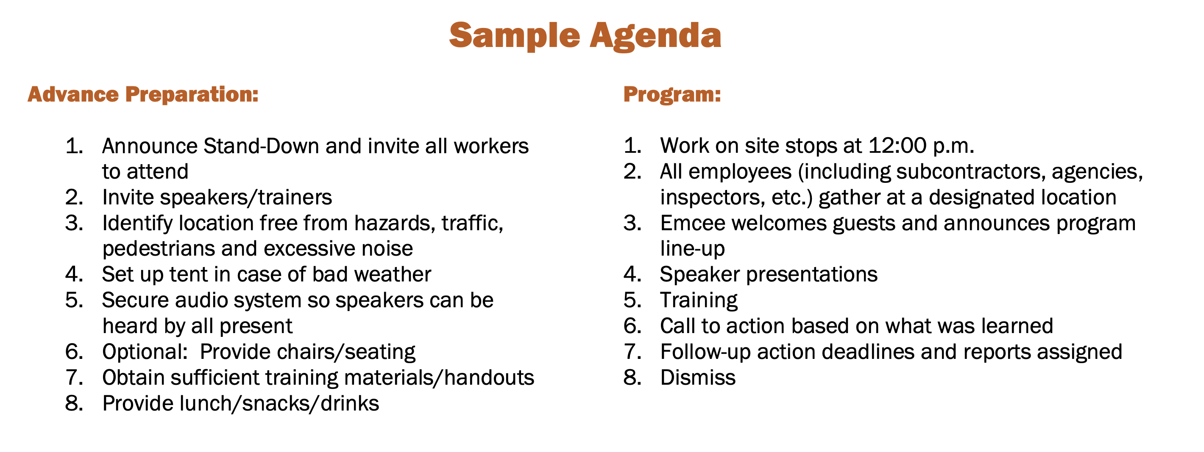
Conduct a Stand Down to Discuss Likely Hazards
Notes:
Explain how to conduct your own Stand Down

Slide 22
Tools Are Available
National Stand-Down to Prevent Stuck-by Incidents:
      https://www.cpwr.com/wp-content/uploads/What-is-the-Struck-by-Stand-Down-2023.pdf
CPWR Struck-by Handouts, Tools and Training:
      https://www.cpwr.com/struck-by-hazards
Avoiding Struck-by Hazards YouTube playlist:
      https://youtube.com/playlist?list=PLuzTg2wYpXWWGx-lT-2LwqJCby8gvHc3M

Slide 23
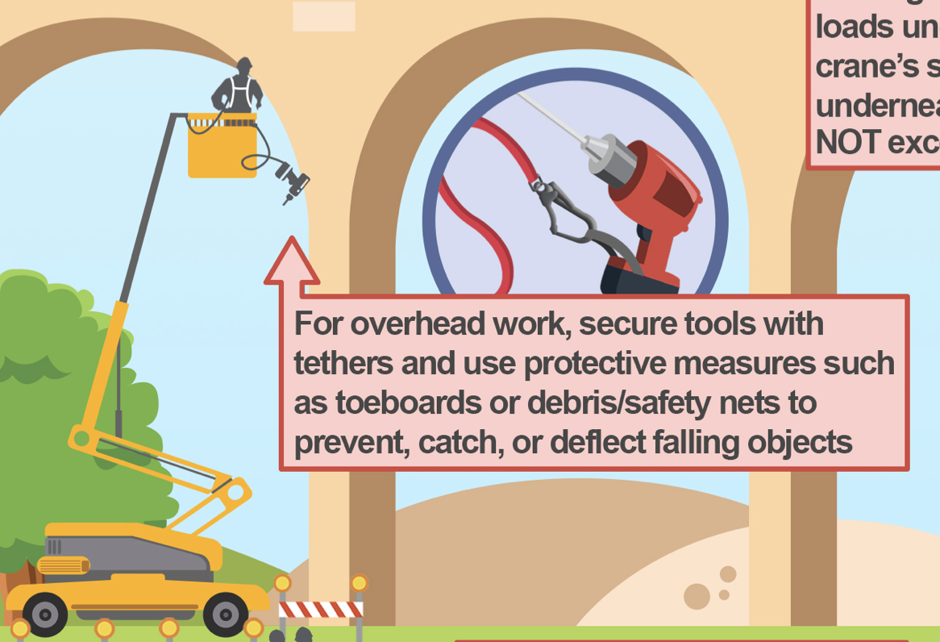
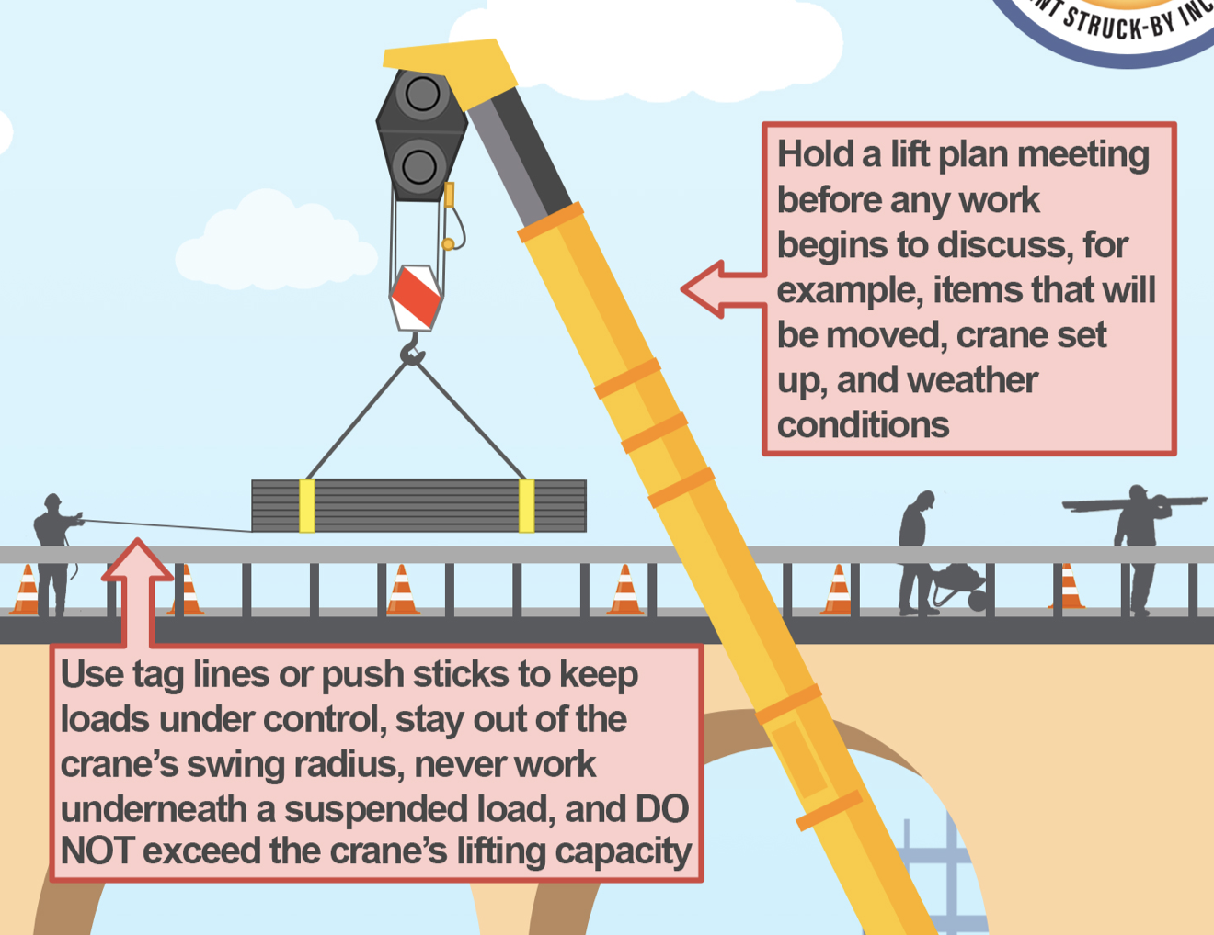
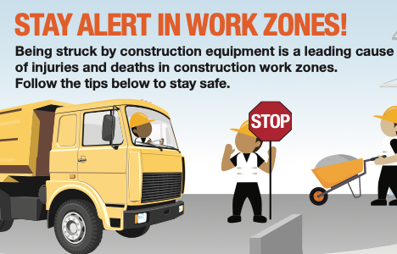
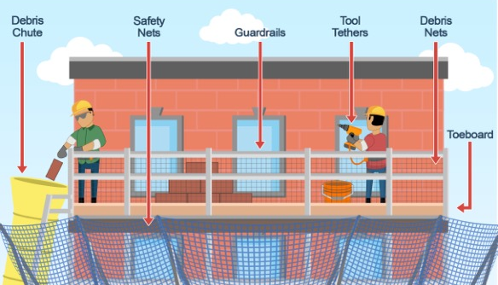
Notes:
Options for supervisors to share with their crews for each day of the Stand-Down

Slide 24
Find Us Under These Hashtags:
#standdown4struckby
#workzonesafety
#liftzonesafety
#StopTalkAct

Slide 25
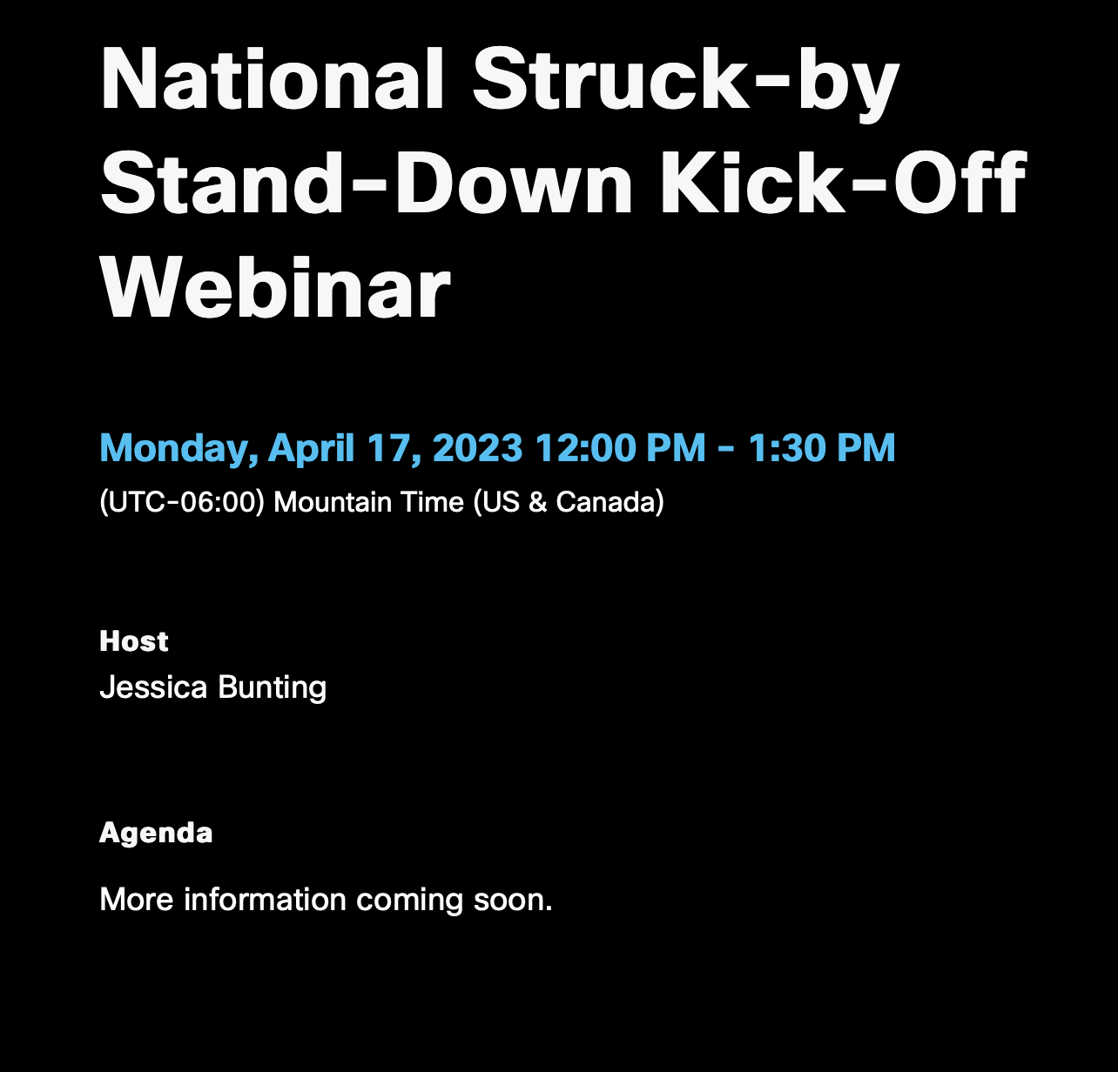
Register here: https://tinyurl.com/452dke6p
Notes:
Be sure to join the kick-off webinar on April 17th at 12:00 pm Mountain Time. Register at the above link.
The actual registration link is: https://cpwr.webex.com/weblink/register/r011eaf71bee2b48f4eb63fb24e1df40c -- I added a URL shortener here for ease. Feel free to change if necessary.

Slide 26
See You There!
Notes:
A stand-down in the construction industry is an activity where all normal work on a site is paused so that the entire site can focus on a specific safety issue.
During National Work Zone Awareness Week this year, we are holding a voluntary National Stand-Down to Prevent Struck-By Incidents to focus on struck-by hazards.
These struck-by hazards on a construction site can include any hazard where a person comes in forceful contact with a moving object – a flying or falling tool or debris, a vehicle or piece of heavy equipment, crane hazards, etc.

