Slide 1
Coronavirus Update
CPWR-NIOSH COVID-19 Webinar
January 13, 2022

Slide 2
Outline
CDC / NIOSH Guidance
Coordination with information from OSHA
Protect Yourself and Others
Updates
Vaccine/booster
Testing
Isolation/quarantine
Construction Workplaces
Workplace Plan

Slide 3
Endemic
“Endemic” refers to the constant presence and/or usual prevalence of a disease or infectious agent in a population within a geographic area.
https://www.cdc.gov/csels/dsepd/ss1978/lesson1/section11.html
‘Virus will have a constant presence’
‘Endemic diseases often settle into more predictable and stable patterns’

Slide 4
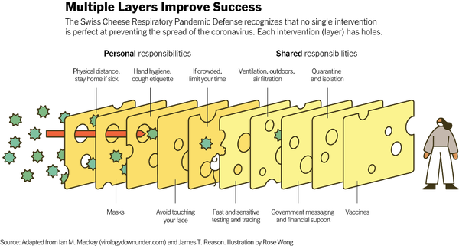

Slide 5
How to Protect Yourself & Others
https://www.cdc.gov/coronavirus/2019-ncov/prevent-getting-sick/prevention.html

Slide 6
How to Protect Yourself & Others
Get Vaccinated
Wear a mask*
Distance
Avoid crowds and poorly ventilated spaces
Testing as a tool for diagnosis and to help prevent spread to others
Wash hands/Respiratory hygiene/Cough etiquette
Monitor your health daily – if sick stay home except to get medical care
Clean and disinfect as needed

Slide 7
Types of Masks and Respirators | CDC
Respiratory Protection Information Trusted Source | NPPTL | NIOSH | CDC

Slide 8
How to Protect Yourself & Others
Get Vaccinated
Wear a mask
Distance
Avoid crowds and poorly ventilated spaces
Testing as a tool for diagnosis and to help prevent spread to others*
Wash hands/Respiratory hygiene/Cough etiquette
Monitor your health daily – if sick stay home except to get medical care
Clean and disinfect

Slide 9
How to Protect Yourself & Others
Layers of prevention are important
‘The Ds’ for prevention and risk assessment
Distance
Density
Dilution
Duration

Slide 10
Vaccines – Stay “Up to Date” with your vaccination
Stay Up to Date with Your Vaccines | CDC
Primary series
CDC recommends that people remain up to date with their vaccines, which includes additional doses for individuals who are immunocompromised or booster doses
COVID-19 Vaccine Booster Shots | CDC
Discussion of breakthrough infections at:
Vaccine Breakthrough Infections: The Possibility of Getting COVID-19 after Getting Vaccinated (cdc.gov)

Slide 11
Testing – one of the layers of prevention strategies
Test for Current Infection | CDC
Self-Testing | CDC
Selected Key Points
Provides criteria for
Who should get tested
Who does not need to be tested
Positive self-test result - the test detected the virus, and you are very likely to have an infection and should follow isolation guidelines
Negative self-test result - the test did not detect the virus

Slide 12
Interim Guidance for SARS-CoV-2 Testing in Non-Healthcare Workplaces
SARS-CoV-2 Testing Strategy: Considerations for Non-Healthcare Workplaces | COVID-19 | CDC
In-depth discussion of
Diagnostic testing – performed in individuals who have:
signs or symptoms; or
recent known or suspected exposure to SARS-CoV-2.
Screening testing – performed in individuals who are asymptomatic and do not have known, suspected, or reported exposure to SARS-CoV-2

Slide 13
https://www.cdc.gov/coronavirus/2019-ncov/your-health/quarantine-isolation.html
Isolation (after test + for COVID-19 OR symptoms of COVID-19)
Same for all, regardless of vaccination status
5 days, consider symptoms
Wear mask when around others for an additional 5 days
If considering testing, best approach is to use an antigen test towards the end of the 5-day isolation period

Slide 14
https://www.cdc.gov/coronavirus/2019-ncov/your-health/quarantine-isolation.html
Quarantine (after exposure to someone with COVID-19) – depends on:
Age ≥ 18 ‘up to date’ on vaccine OR who had COVID-19 in last 90 days
Wear mask around others for 10 days
Test at least 5 days after exposure
Test for Current Infection | CDC
All others
Stay home for 5 days
Wear mask around others for 10 days
Test at least 5 days after exposure

Slide 16
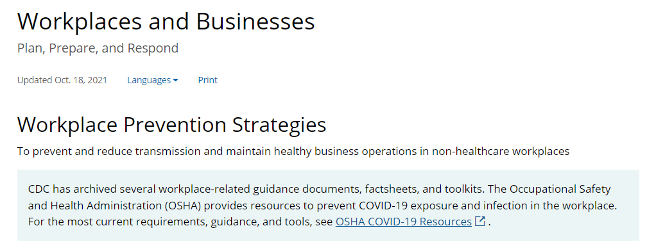
https://www.cdc.gov/coronavirus/2019-ncov/community/workplaces-businesses/index.html

Slide 17
OSHA Coronavirus Disease (COVID-19) https://www.osha.gov/coronavirus

Slide 18
Protecting Workers: Guidance on Mitigating and Preventing the Spread of COVID-19 in the Workplaces
https://www.osha.gov/coronavirus/safework#executive-summary

Slide 19
Protecting Workers: implementing multi-layered interventions – major points of the Guidance (1)
Facilitate employees getting vaccinated
Employers should grant paid time for employees to get vaccinated
Workplace Vaccination Program | CDC
https://www.cdc.gov/coronavirus/2019-ncov/community/workplaces-businesses/field-stories.html
Instruct workers to follow isolation/quarantine guidance
Implement physical distancing in all communal work areas for unvaccinated and otherwise at-risk workers.
Provide workers with face coverings or surgical masks, as appropriate, unless their work task requires a respirator or other PPE

Slide 20
Protecting Workers: implementing multi-layered interventions – major points of the Guidance (2)
Educate and train workers on your COVID-19 policies and procedures using accessible formats and in languages they understand
Suggest or require that unvaccinated customers, visitors, or guests wear face coverings in public-facing workplaces
Maintain Ventilation Systems*
Perform routine cleaning and disinfection

Slide 21
Protecting Workers: implementing multi-layered interventions – major points of the Guidance (3)
Record and report COVID-19 infections and deaths
Implement protections from retaliation and set up an anonymous process for workers to voice concerns about COVID-19-related hazards
Follow other applicable mandatory OSHA standards

Slide 22
Ventilation
NIOSH
Ventilation in Buildings | CDC
Includes in-depth FAQs
CPWR
CPWR-COVID-19-ventilation-guidance.pdf
“Quick Tips to Increase Ventilation at Indoor Construction Sites Without Operating HVAC Systems”
RR2020-COVID-19-Ventilation-Survey.pdf (cpwr.com)
“Ventilation to Reduce COVID-19 Spread in Enclosed Work Areas
During Cold Weather: A Survey of Construction Contractors”

Slide 23
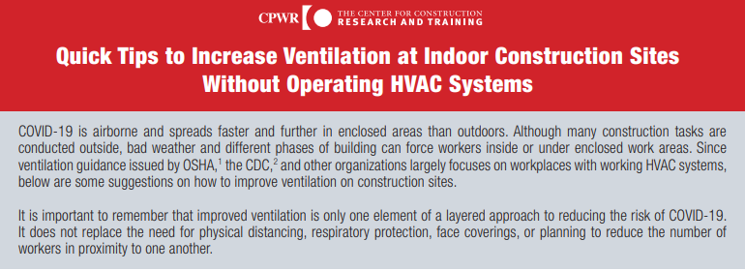

Slide 24
Resources
Coronavirus Disease (COVID-19) | Occupational Safety and Health Administration (osha.gov)
Coronavirus Disease 2019 (COVID-19) | CDC
Workplaces and Businesses | COVID-19 | CDC
CPWR | COVID-19 Resources
CPWR COVID-19 Construction Clearinghouse : (elcosh.org)

