Slide 1


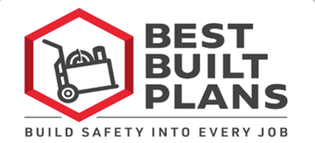
Creating a Contractor Ergonomics Program
to Reduce Soft Tissue Injuries
Among Construction Workers
Contractor Program
Notes:
Welcome to today’s presentation.
The goal of this presentation is to provide you with information that you can use to create your own ergonomics program to reduce soft tissue injuries among the construction workers that you employ.

Slide 2
Questions address:
Why do contractors need an ergonomics program?
What do workers and management need to know about ergonomics?
How can ergonomics be integrated into a company’s safety program?
Notes:
So let’s begin.
This presentation is intended to answer three questions:
1) Why do contractors need an ergonomics program?
2) What do workers and management need to know about ergonomics?
3) And how can ergonomics be integrated into a company’s safety program?
During this presentation, we will also introduce a new program called Best Built Plans that has resources to help you plan for and train your employees on how to prevent strain and sprain injuries.

Slide 3
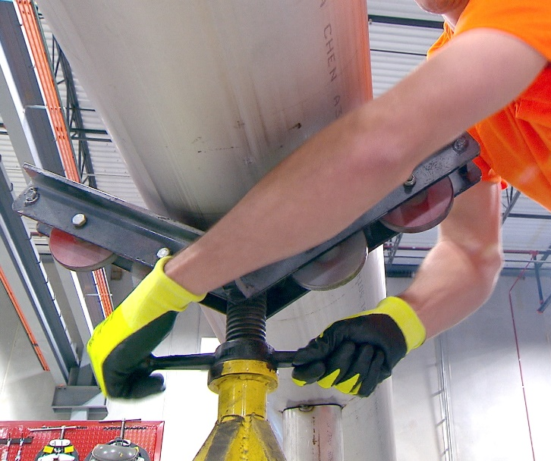
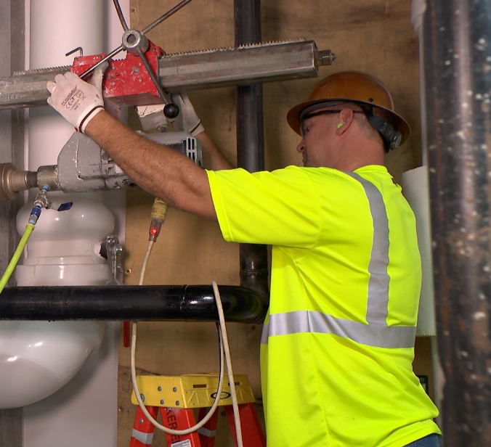
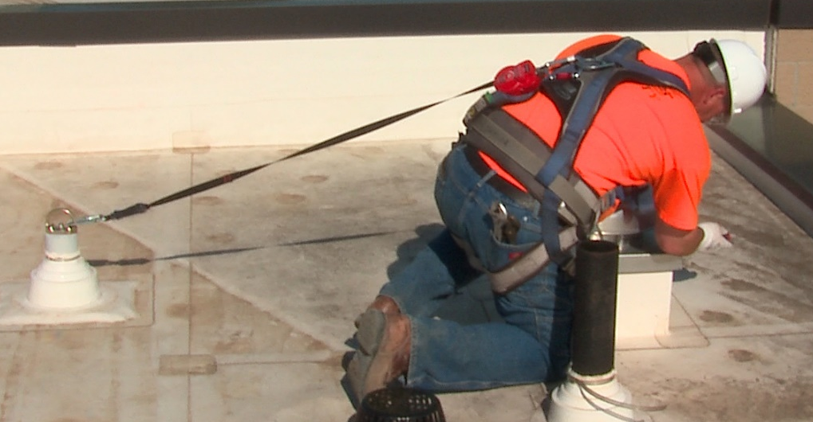
Soft tissue (i.e., ergonomic) injuries are common
Ergonomic injuries include sprains, strains, and overexertions:
  Sprains and strains account for 27.3% of all nonfatal injuries in construction each year.¹
  Lifetime risk of overexertion injuries is 21% for all construction trades, although many more suffer chronic pain.²
Photos courtesy of the MCAA
1) Bureau of Labor Statistics. (2016). Table R1. Number of nonfatal occupational injuries and illnesses involving days away from work by industry and selected natures of injury or illness, private industry, 2014. http://www.bls.gov/iif/oshwc/osh/case/ostb4367.pdf.
2) Dong X, Ringen K, Welch L, Dement J. (2014). Risks of a lifetime in construction, Part I: traumatic injuries. Am J of Ind Med, 57(9): 973-83. https://doi.org/10.1002/ajim.22363.
Notes:
So why do contractors need an ergonomics program?
Ergonomics is intended to address soft tissue injuries, which are commonly called sprains, strains, or overexertion injuries. These types of injuries are common in the construction industry.
Sprains and strains account for 27% of all nonfatal injuries in the industry each year.
And construction workers have a 21% lifetime risk of experiencing an overexertion injury although MANY more workers will suffer chronic pain from overexertion without having a recordable injury.

Slide 4
Soft tissue injuries are costly
Overexertion injuries cost U.S. businesses more than $13 billion in 2016*
Strain causes pain, which affects productivity and decreases worker morale
Ongoing pain is often treated with opioid medication:
  Even short-term opioid use can affect safety and may lead to addiction.
  Opioid addiction has become an epidemic, and it is profoundly affecting the construction industry.
  Reducing ergonomic injuries can reduce the number of workers prescribed opioids, and the possible development of opioid dependency.
* Liberty Mutual Workplace Safety Index 2019, https://www.libertymutualgroup.com/about-lm/news/documents/2019-workplace-safety-index.pdf
Notes:
Since these injuries are relatively common, it’s not surprising that they are also costly.
Overexertion injuries have been reported to cost U.S. businesses more than $13 billion dollars in one year.
Soft tissue injuries lead to chronic pain, and this pain can affect productivity and lower worker morale.
Another more recent concern is the growing problem caused by the treatment of musculoskeletal injuries with prescription opioid medication.
There is new evidence that even short-term opioid use can lead to opioid dependency or addiction.
Opioid addiction is profoundly affecting the construction industry, with workers overdosing on construction sites.
Reducing the risk for ergonomic injuries can reduce the need for pain treatments including opioids, thus reducing addiction.

Slide 5
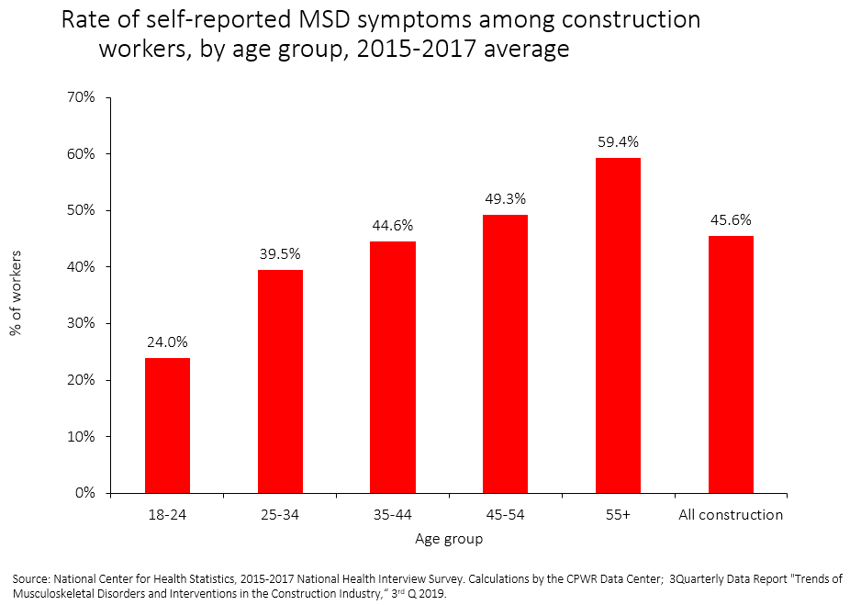
The workforce is aging
Rising workforce aged 45 to 64 years: 25% (1985) to 40% (2015)*
40% of construction workers 50 years or older suffer from low back pain, and it is even higher among those with longer tenure.*
Musculoskeletal disorders are more common among older workers, particularly those with more than 5 years working in construction.
Older workers suffer from more comorbidities compared to younger workers, including heart disease, hypertension, and diabetes, but fewer suffer from obesity.
Source: Dong XS, Wang X, Fujimoto A, et al. (2012). Chronic back pain among older construction workers in the United States: a longitudinal study. Int J Occup Environ Health, 18(2): 99–109; Construction Chart Book, 6th edition
Notes:
In addition, the construction workforce is aging.
In 1985, 25% of the workforce was between 45 and 64 years of age. In 2015, the older group accounted for 40% of workers.
In 2012, a study by CPWR’s Data Center showed that 40% of construction workers over the age of 50 suffered from low back pain, and it was higher among those who had worked in the industry for more than 5 years.
A more recent CPWR study found that musculoskeletal disorders – or MSDs – are more common among older workers, as shown on the top chart. They are also more common among those with more than 5 years working in construction.
Compared to younger workers, older workers also suffer from more comorbidities – in other words, diseases or conditions that a person may have at the same time. As the second chart shows, more older workers suffer from heart disease, hypertension, and diabetes than younger workers but fewer suffer from obesity.

Slide 6
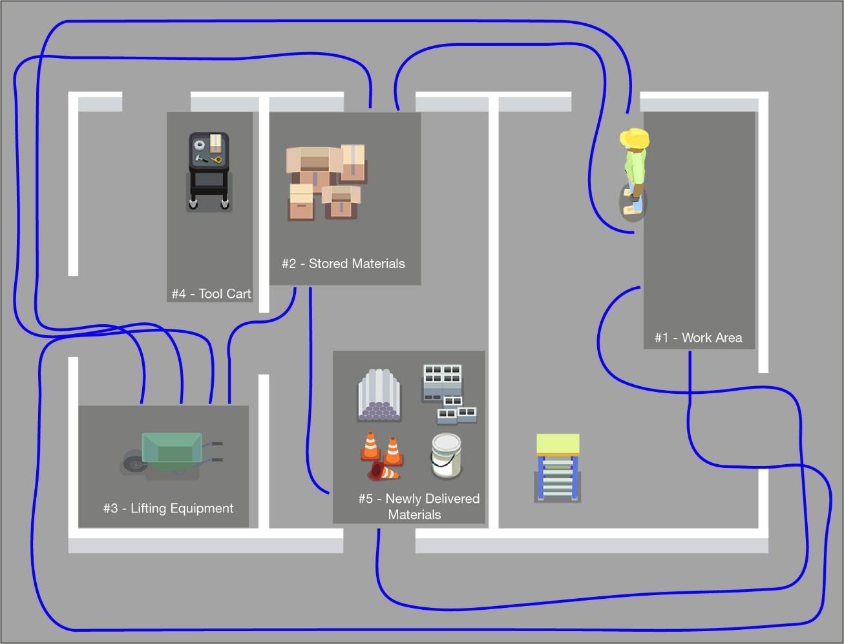
Poor work layouts are also costly
Cause physical stress and fatigue…and waste time
Spaghetti chart: visual method of showing wasted movement of your workers
Notes:
Construction workers also suffer from physical stress and fatigue, which impacts their productivity.
This slide shows an example of a poor work layout. The blue lines indicate the path a worker would have to travel to retrieve their materials and equipment in order to move it to the location where it will be installed. This “spaghetti chart” is a visual way to see wasted motions that likely increase fatigue and decrease productivity.
Ergonomics is focused on reducing hazards and excess physical demands on workers. One common description is to make the demands of the job fit within the workers’ abilities, because excessive demands will tear their bodies down over time.
Limiting extra motions will help reduce physical demands.
To improve your project layout, consider drawing a spaghetti chart with your project layout and asking your employees if there is a better way to locate materials.

Slide 7
Most safety programs do not address ergonomics
Many companies have excellent safety programs ‒ but their programs do not address ergonomic hazards.
Contractors/project managers plan for and provide ergonomic equipment on some projects but not all ‒ it is not company wide.
Workers rely on their employer to provide appropriate equipment and training to allow the BEST ergonomic work processes.
Contractors face challenges to addressing ergonomic hazards and providing the best equipment.
Notes:
While many companies have excellent safety programs that they have spent a long time building and modifying over time, most do not cover ergonomics, even though ergonomics is intended to address the large number of costly soft tissue injuries that occur in the workforce.
With regard to ergonomic hazards, generally contractors or project managers determine what equipment will be available for workers to use on projects and then expect the foremen to “make it work.”
Some contractors do a great job of assessing ergonomic hazards, such as manual materials handling, and providing the necessary equipment for workers on one project, but they don’t do it consistently for all of their projects.
From the worker perspective, they rely on their employer to provide the best equipment and training to prevent soft tissue injuries, but contractors can face challenges to make that happen.
So getting back to the question about why contractors need an ergonomics program, the answer is that it can help them reduce costly injuries and improve productivity.

Slide 8
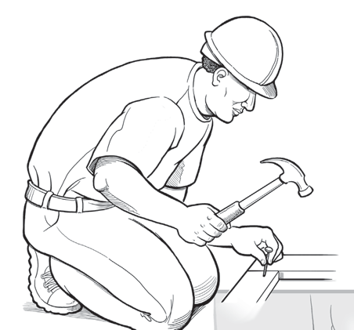
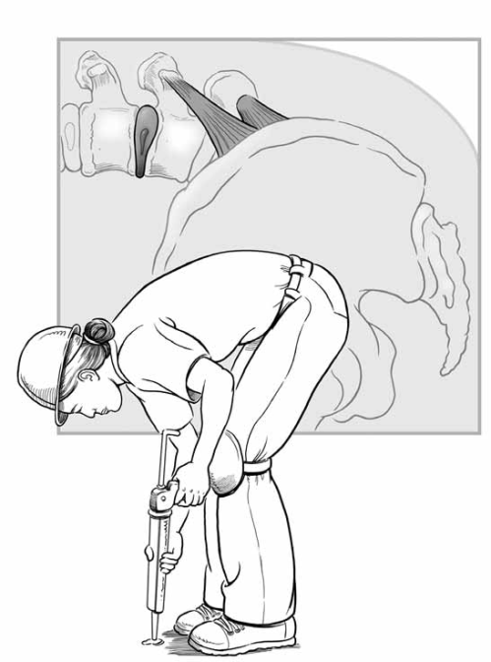
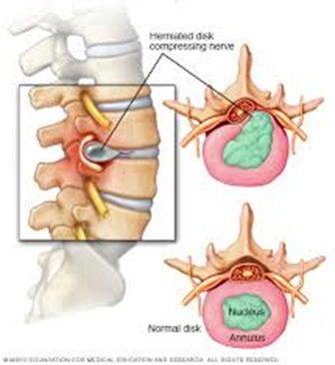
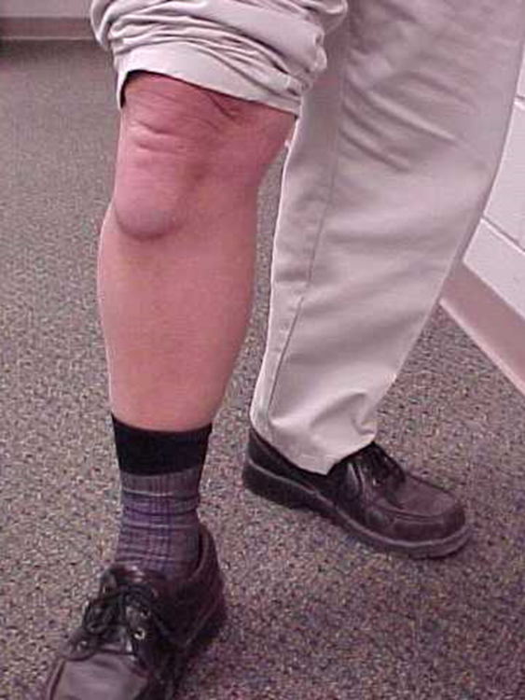

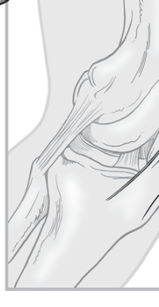
Sprains, strains, and other soft tissue injuries or musculoskeletal disorders (MSDs)
1) Damage to the musculoskeletal system – muscles, nerves, tendons, ligaments, joints, cartilage, and spinal discs.
2) They are cumulative – they happen gradually, as opposed to accidents.
3) They are chronic – the effects last a long time.
Photo courtesy of NIOSH
Photo courtesy of Dr. Ann Marie Dale
Photo courtesy of NIOSH
Used with permission of Mayo Foundation for Medical Education and Research, all rights reserved
Notes:
So how do soft tissue injuries develop? Sprains, strains, and other soft tissue injuries, which in the medical world are called musculoskeletal (“musk-u-low-skel-e-tall”) disorders or MSDs, are damage to the different soft tissues of your body – your muscles, nerves, bones, and connecting tissues like tendons and ligaments.
Soft tissue injuries develop gradually over time because the tissues are traumatized daily by heavy workloads. The damage accumulates in the tissues. Eventually, the damaged tissues fail, which may appear as a sudden event, such as an incident of back pain. The task or activity that caused the failure may be the same activity that caused tissue trauma in the past, but not always. This is important to consider if you use past injury records to figure out how to change the way the work is done.
The damage may also become chronic or persistent, which means it lasts for a long time, possibly the rest of your life.
The photos at the bottom on the left show the structure of your low back – the most common body part injured. The soft disc is a cushion between each bone but the center “jelly,” the part in green on the slide, may push on the spinal nerves, which are the orange tubes on the slide, when the body bends forward. The back is complex. Once the tissues “wear and tear,” it is very hard to get them to heal.
The bottom right photo shows a worker with knee bursitis who spent a lot of time kneeling on a hard floor without the benefit of padding against the floor. This worker‘s doctor recommended a knee joint replacement. Once you have this procedure, it is difficult to kneel. So this worker cannot go back to doing the same type of work, at least the way he used to work, by kneeling.

Slide 9
Ergonomics reduces risk of MSDs
Definition: Fitting the tasks, tools, and environment to the physical abilities of the worker
Identify Ergonomic Hazards
High Force
Awkward Postures
Fast/Prolonged Repetition
Stress from Contact
Hand/Body Vibration
Environment (cold)
Notes:
Ergonomics is the science to reduce the risk of musculoskeletal disorders or soft tissue injuries.
Since heavy physical demands will cause excess wear and tear on a worker’s body, the goal of ergonomics is to fit the job tasks, tools, and environment to meet the physical abilities of the worker.
There are several ergonomic hazards that should be considered in each work task, because they can make the work too demanding for a worker’s body.
These hazards are high force, awkward postures, repetitive movements, stress from contact against the body, hand or body vibration, and working in a cold environment.

Slide 10
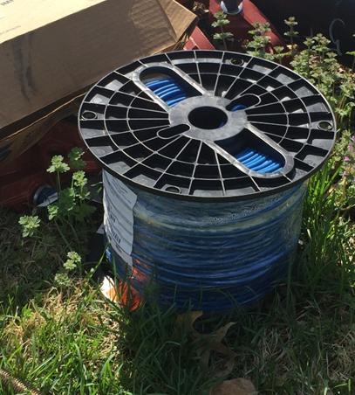
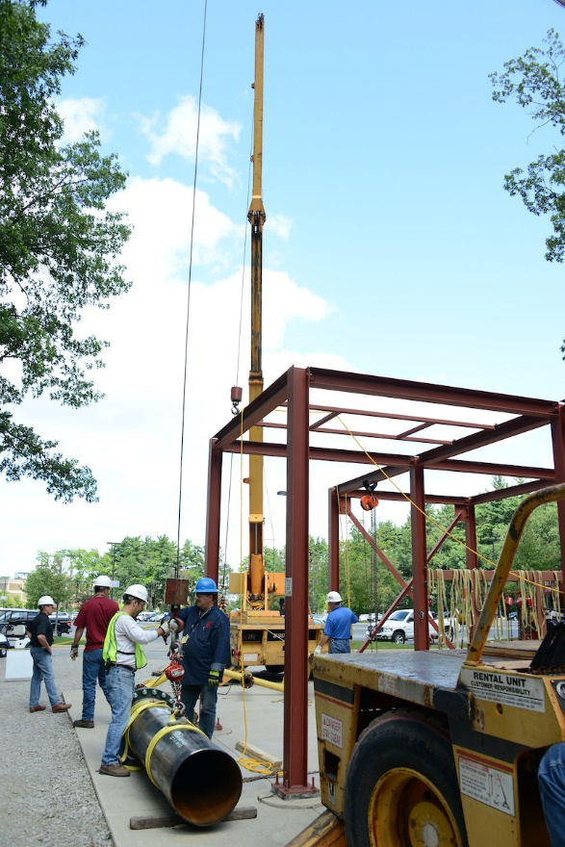
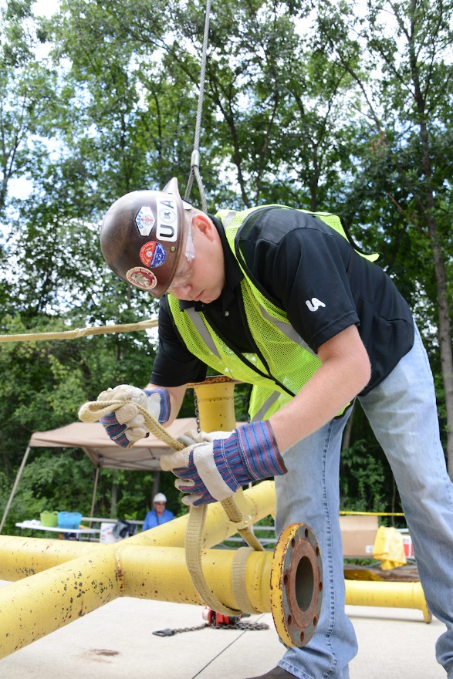
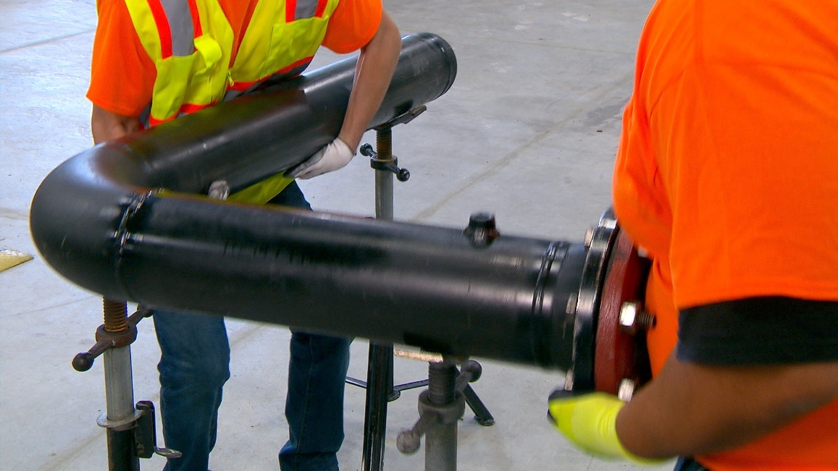
High Force: how much is too much?
Force is the physical power needed to move an object
Photo courtesy of the Healthy Work Center,
Washington University School of Medicine in St. Louis
Photo courtesy of the UA
Photo courtesy of the UA
Photo courtesy of the MCAA
Notes:
Force is the amount of physical power needed to move an object.
It’s the most important hazard that causes physical stress or wear and tear. In construction, this often occurs with material handling.
But how much is too much force?
It’s easy to decide whether something is too heavy for one person to lift if it weighs a lot, such as 200 pounds or more.
It’s more challenging to decide if one person should lift an object that weighs 100 pounds, or if they should lift an object that weighs 80 pounds and must be carried a long distance, such as to the other side of a building or job site.
NIOSH recommends lifting no more than 50 pounds by one person, which is why baggage on airlines is charged more if it weighs more than 50 pounds.
Defining how much is too much for your employees to lift will be helpful for controlling hazards from lifting.

Slide 11
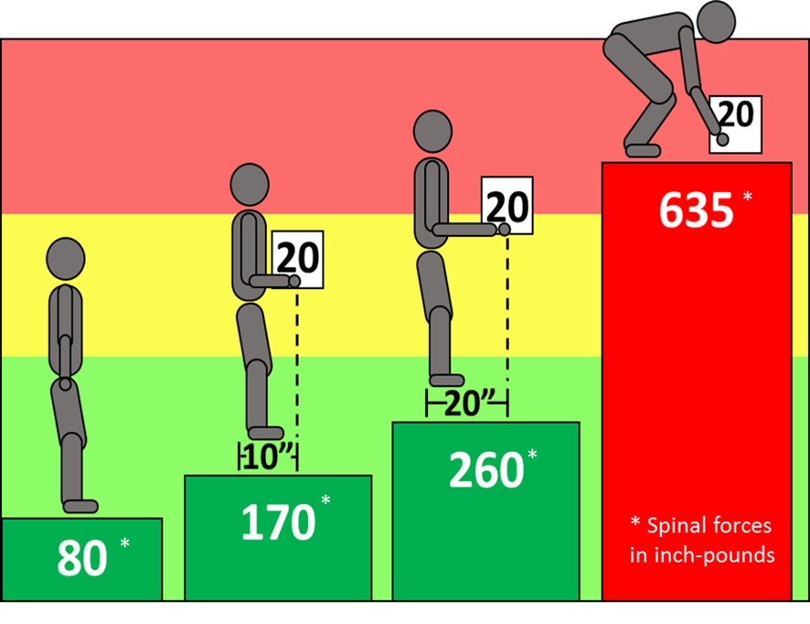
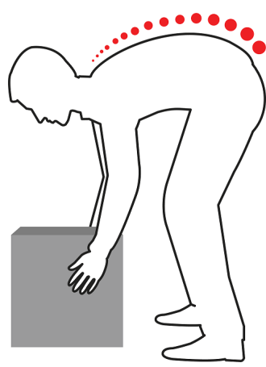
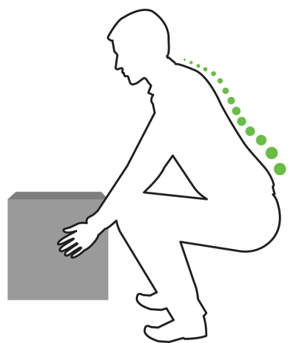
Risk of injury: Low back (spinal) forces and lifting
Effect of load and positioning on spinal forces
Rounded back, high disc pressure
*
Image courtesy of Washington University in St. Louis
Locked back,
low disc pressure
*
*
* Spinal forces in inch-pounds
*
Spinal Forces
Maanas/Shutterstock.com
Notes:
How does the weight of the load affect your low back?
The weight can be measured through spinal forces in the joints of your low back.
In this colorful diagram, the figure to the left is standing upright with no load. The spinal forces from gravity on his low back is 80 inch-pounds.
The second figure is holding a 20-pound load close to their body ‒ 10 inches from the hands to the low back ‒ this is an IDEAL posture to carry a load. The spinal force goes up to 170 inch-pounds.
If the load is moved away from the body to a distance of 20 inches, the spinal forces increase significantly to 260 inch-pounds. This shows that how close you hold an object to your body makes a BIG difference to your low back forces.
The last figure shows the large increase in spinal forces from lifting an object from the floor. The distance to the box is larger and the body is not upright. The spinal forces have more than tripled from the IDEAL figure ‒ 170 inch-pounds to 635 inch-pounds.
The two figures on the right side of the slide show a curved back posture on the top which causes high spinal disc pressure – a POOR posture. The bottom figure shows a “locked” back straight posture – a GOOD posture. By keeping your back locked in a straight position while lifting, your spinal forces stay low.

Slide 12
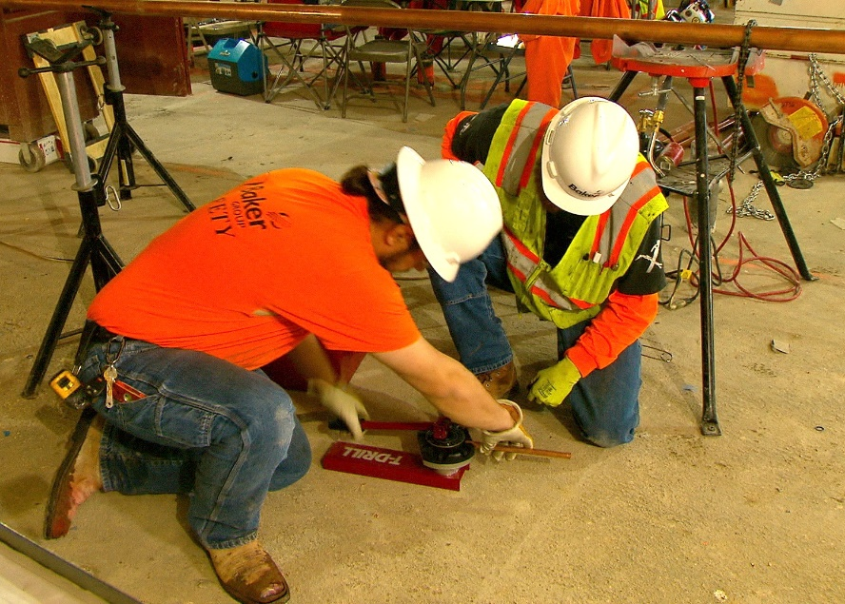
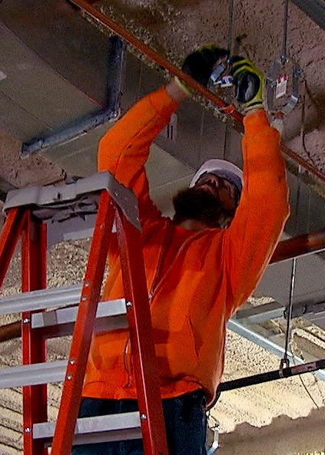
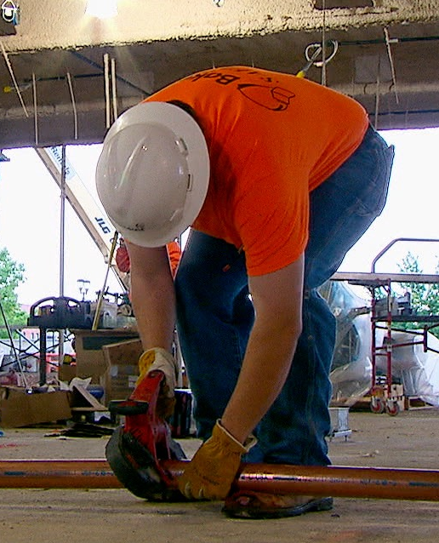
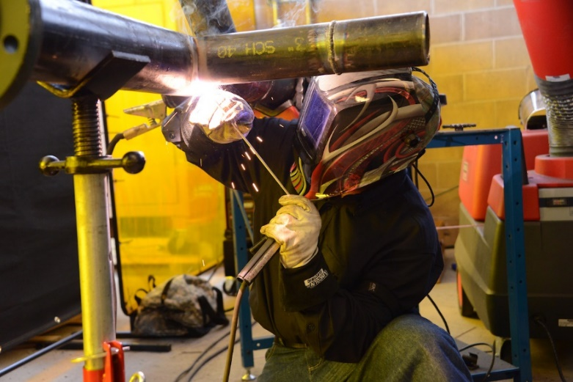
Awkward Postures: near floor or overhead
Photo courtesy of the MCAA
Photo courtesy of the MCAA
Photo courtesy of the UA
Photo courtesy of the MCAA
Notes:
Awkward postures is another common hazard in construction work.
Working at the floor level using a forward bent posture is an awkward posture that causes increased spinal force.
Kneeling causes a contact stress between the hard ground surface and your knee.
Working at the ceiling level doing overhead work places the body in another poor or awkward posture.
Working in this posture decreases a worker’s available strength to perform the task and will cause fatigue more quickly.
Any time a worker’s hand is positioned above their head height, there is high stress on their shoulders.

Slide 13
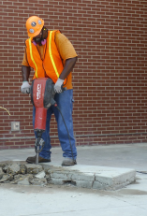
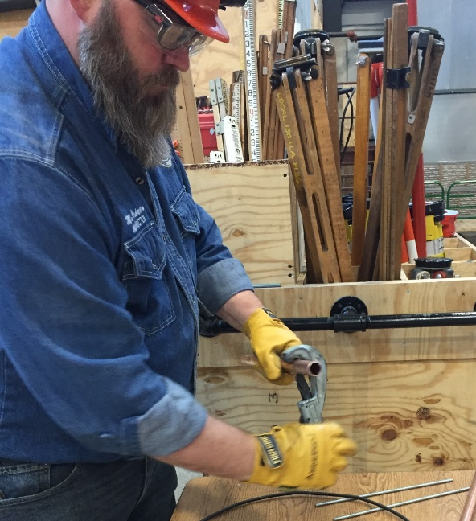
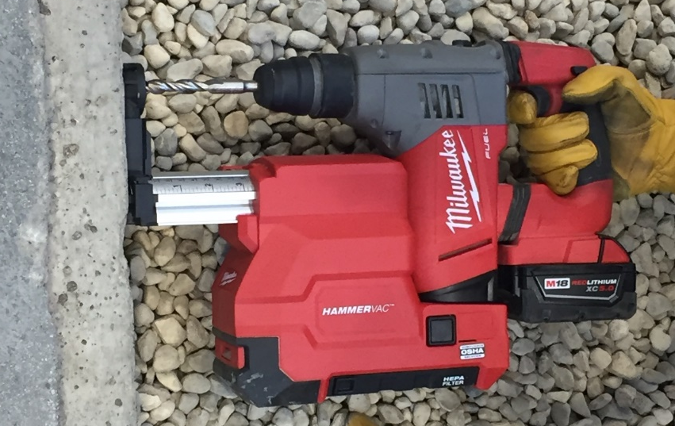
Other Hazards
Repetition
Contact stress
Vibration
Environment (cold)
High Touch Surfaces (spread of disease)
Photo courtesy of the UA
Photo courtesy of the International Masonry Institute & OSHA
Photo courtesy of Milwaukee Tool
Disclaimer: CPWR does not endorse any specific equipment or product.
Notes:
Less common hazards but still important to consider are highly repetitive tasks, contact stress, hand and body vibration, working in a cold environment, and exposure to diseases when multiple individuals touch a material, tool or piece of equipment.

Slide 14
Build an ergonomics program to create an ergonomics culture
Must include:
  Management ‒ commitment to address ergonomic risks and willingness to participate in developing the program.
  Workers ‒ engage workers to create the program and to attend ongoing meetings to support the program over time.
  A Plan ‒ decide on the company goal for ergonomics and define the steps for achieving the goal.
  Communication and ongoing activities to work on to develop and implement the ergonomics program.
Development of an ergonomics program and change in culture will take time.
Notes:
To address the ergonomic hazards and reduce the risk of soft tissue injuries, you need to build an ergonomics program. Your program will help you create a culture focused on ergonomics and, by implementing work practices that reduce the need for multiple people touch a material, tool or piece of equipment, an added benefit will be a reduction in the risk for exposing workers to and spreading diseases, such as COVID-19.
The most important ingredients to your program are listed on this slide.
First, you must have management support. This is not just a commitment to having the company address ergonomics, but a commitment to having management actively participate in developing and implementing the program over time. I want to emphasize, a culture cannot change without showing true commitment, and the effort must be consistent over time. A one-time toolbox talk or telling workers informally to lift properly is not enough to cause a change.
Second, workers must be included in the program. You need their involvement to get buy-in and to help them understand what you want them to do. Workers should be engaged in creating the program. They should also help review the progress of the program over time.
Third, you must have a plan for creating your program. This should include a company goal for ergonomics, and some clear steps you plan to take to achieve your goal.
Finally, you should communicate your plan and program to everyone in your company. You should also include several activities from your ergonomics plan that are delivered over time.
Growing a program and changing a culture takes time. You can start by assembling a small team and have a meeting to layout an approach, establish your goal, and develop a schedule and next steps.

Slide 15
What should an ergonomics program include?
Identify the common ergonomic hazards in your company.
Develop key elements of a good ergonomics program:
  A plan to mitigate hazards
  Defined work processes to reduce ergonomic hazards
  Obtain proper equipment and make it available
  Train employees for ergonomic knowledge and awareness
  Ongoing review of ergonomic hazards and injuries
Every company should create an ergonomics program that systematically addresses ergonomic hazards on all projects.
Notes:
What should an ergonomics program include?
When you set your ergonomic goal, you need to consider the common ergonomic hazards in your company.
Then you need to develop 5 key elements to your program:
The first element is planning to mitigate the hazards.
The next 3 elements are methods to mitigate the hazards. They include:
Defining the work processes or steps for how the work can be done to control the hazards.
Making sure the proper ergonomic equipment is available.
Training employees to ensure they have knowledge and awareness of ergonomic work processes and proper use of the equipment.
And the last element is engaging in an ongoing review to check to see if the ergonomics program is working as planned.
These elements should be systematically applied to every construction project.

Slide 16
A. Hazard identification processes
Review types of injuries on your OSHA log to identify cause of sprains/strains
  ‒ more useful for large companies
Ergonomic hazard assessment of common work task
  ‒ use simple checklist of ergonomic hazards
Start by addressing manual materials handling risks
  ‒ the most common ergonomic hazard in the construction industry
Notes:
Let’s look at what should be included in your ergonomics program in more detail.
The hazard identification process should highlight what is of greatest concern or risk in your company.
You may identify the problem by one of three ways:
Review your OSHA log or injury records to see which tasks or events caused soft tissue injuries. This may not be the best approach for all companies, however, since most companies don’t have enough injuries to actually see a pattern of cause unless they are very large.
The second method is to use an ergonomic hazard checklist. These simple checklists ask you to list the common work tasks, identify ergonomic hazards in each task, and then prioritize the list of hazards to address the highest risk tasks first. This method is feasible for many companies but not all.
Finally, you may want to consider starting by addressing the task of manual materials handling since this is the most common ergonomic hazard in the construction industry, often associated with 40% of nonfatal injuries.

Slide 17
What should an ergonomics program include?
BASIC
ADVANCED
COMPREHENSIVE
Project & Task Planning
Work Practices
Project-level activities
Company-level program
Equipment
Key Elements
Knowledge & Awareness
Review
Notes:
Next, is to develop the five key elements of the ergonomics program touched on earlier and shown on this slide.
Most companies will start to build a basic program and include a simple activity or process for each of the elements.
The basic program is applied through project-level activities. These may be done on one or more projects in a company. Over time, a company should apply the same activities or processes to all projects.
As the ergonomics program begins to grow within the company, the program will become more “advanced” and then “comprehensive.” These levels are achieved when a company has created a company-level program, and systematically applies the same activities and processes throughout the company and in all projects.

Slide 18
BASIC
ADVANCED
COMPREHENSIVE
Key Elements
Project and Task Planning
Planning for each task when bidding a job/ daily plan includes ergonomic information
Work Practices
Proper lifting and team work
Equipment
Basic ergo PPE (knee pads)
Knowledge & Awareness
Toolbox Talks
Review
OSHA log/EMR – review of records
Notes:
This chart shows an example of activities across all elements of a basic ergonomics program.
Project planning tools may include worksheets to consider ergonomic needs during project bids, or for daily planning of best ergonomic methods in work tasks.
Workers are trained in simple ergonomic techniques such as proper lifting and team work.
Workers are provided with ergonomic equipment, such as knee pads or floor movers.
And Toolbox Talks on ergonomic topics are used to increase worker awareness and knowledge.
The review at this stage primarily relies on the OSHA log, which is a crude measure of the progress of a program at best.

Slide 19
BASIC
ADVANCED
COMPREHENSIVE
Key Elements
Project and Task Planning
Planning for each task when bidding a job/ daily plan includes ergonomic information
Best ergonomic processes in tasks for bid, pre-job, and on the job in all projects
Work Practices
Proper lifting and team work
Policy on lift limits
Equipment
Basic ergo PPE (knee pads)
Process for good supply of ergonomic equipment
Knowledge & Awareness
Toolbox Talks
New employee orientation
OSHA 30 Ergo Module
Review
OSHA log/EMR – review of records
Integrate ergonomics into audits
Formal review of leading ergonomic indicators
Notes:
As a company’s ergonomics program develops and advances, a contractor will monitor planning from what was bid on the job for ergonomic equipment to what was actually used during the project.
The program may expand to include:
- Policies such as lifting limits, and requirements for how to lift loads of different weights manually or by mechanical means;
- Steps to ensure there is an adequate supply of ergonomic equipment, a way to monitor whether or not workers had what they needed, and may consider an annual budget to purchase a supply of ergonomic equipment;
- Ergonomics training in the new employee orientation;
- And the program will review ergonomic methods in project written audits that record the use of equipment and work processes.

Slide 20
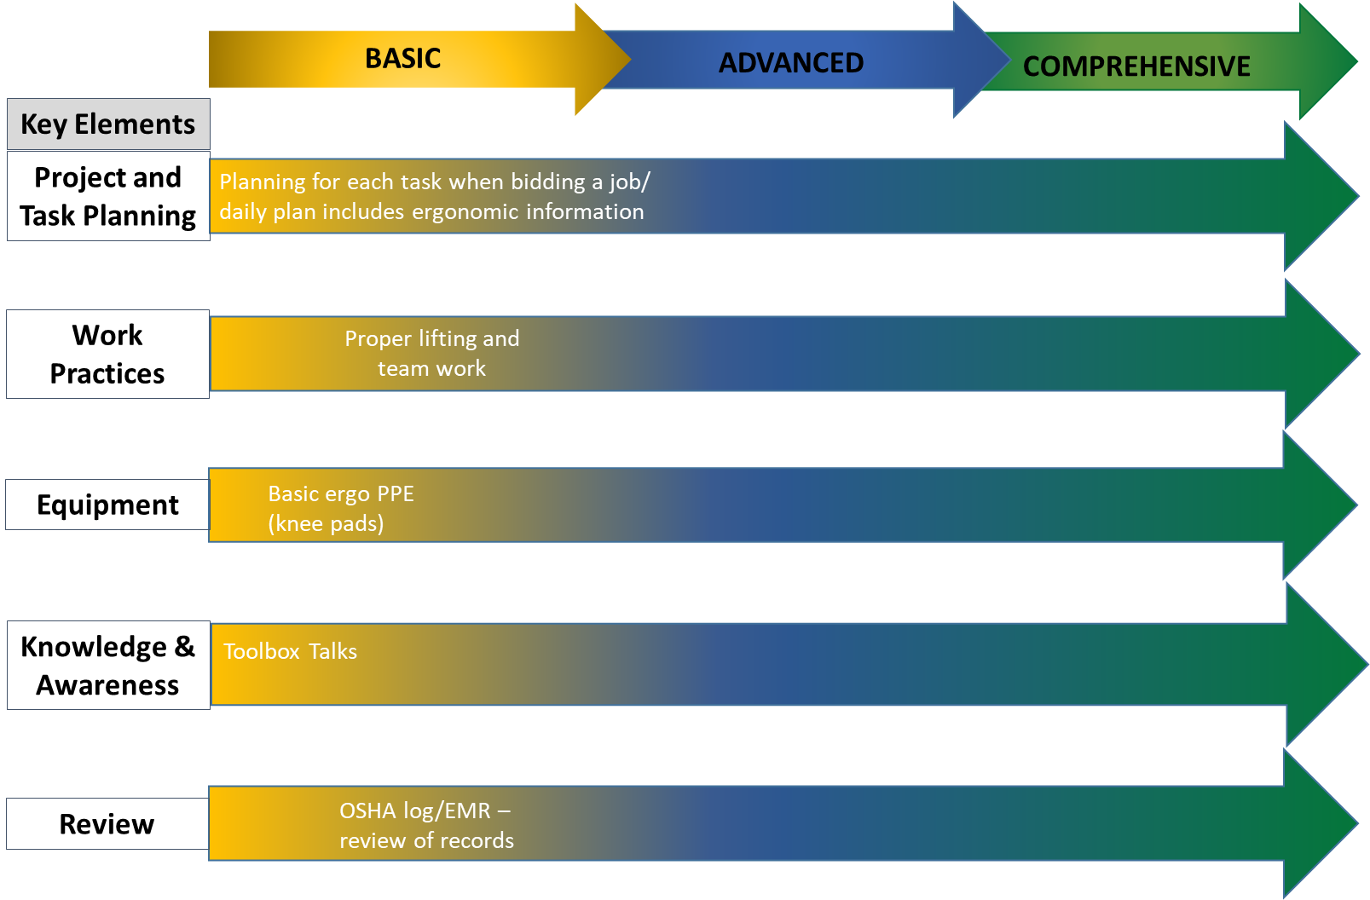
Planning, Practices, and Equipment
(elements #1-3)
Prevent injuries through effective controls:
  Create a plan or steps to consider ergonomics in addition to safety during project planning
  Define ergonomic work practices that reduce the hazards
  Find ergonomic tools/equipment to rent or purchase
Notes:
Now let’s focus on the specific elements, starting with elements 1-3, which include project planning, work practices, and proper equipment to address ergonomic hazards.
At this point, you should have already identified the safety and ergonomic hazards that you need to mitigate.
For the ergonomic hazards, your plans should define the best ergonomic work practices that will be followed and include finding the best ergonomic tools and equipment. It is important to remember that renting instead of purchasing the tools and equipment may be an option, as well as coming up with solutions of your own.
Contractors and workers have developed some brilliant work practices for one project that the workers in the same crew continued to use on future projects. Sadly, these ideas are not always picked up by other crews in the same company or adopted by the management of the company.
Having an ergonomics program can help you capture these work practices so the company as a whole benefits.

Slide 21
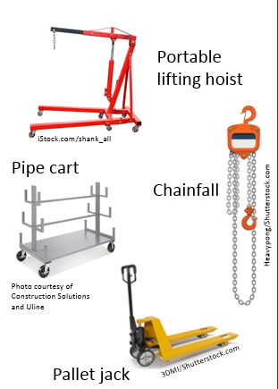
Reduce Force: Move Materials With Lifting Equipment
PLAN YOUR WORK
USE ENGINEERING CONTROLS
  Lift assist to lift large-sized, long, or heavy materials.
  Lifting equipment to transport loads, make fewer trips, and avoid carrying materials on your shoulder.
KEEP FLOORS CLEAR
Notes:
To reduce force and prevent injuries, the first step in planning your work is to think through how you are going to do the work and what equipment will be needed for a safe lift – the engineering controls.
Planning for lifting and moving materials is an essential part of any construction ergonomics program.
The plan should consider different aspects of the work, including:
The weight of the load;
The size of the load, such as long pipe versus large boxed material or loose fittings;
The distance to move the load; and
The surface to move the load.
Although this information may seem like basic knowledge, many workers don’t have the proper equipment needed to move the material when the material needs to be moved. That’s why involving your construction workers in planning the work is critical.
You should provide your employees with the lifting equipment for the heavier loads and train them on how to use the equipment. This slide shows several examples of lifting equipment.
Since many of these tools are on wheels, it is important to keep the work area clear of obstacles and debris – in other words, engage in good housekeeping practices.

Slide 22
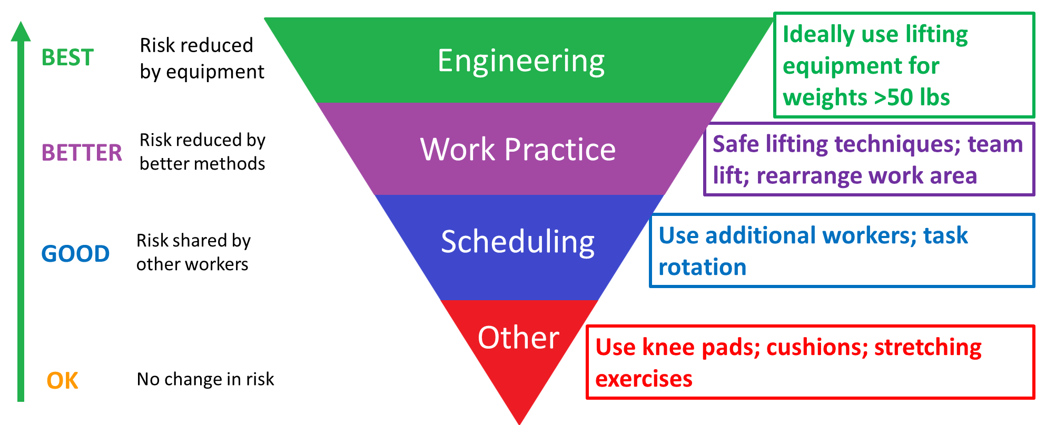
Hierarchy of Ergonomic Controls to Reduce the Risk
Notes:
There are a number of solutions or controls that reduce the risk of ergonomic hazards.
Some controls reduce the risk better than others.
This figure shows the hierarchy of ergonomic controls. The types of controls at the top of the triangle are “BEST” while the controls at the bottom are just “OK.”
Engineering controls generally use equipment to reduce the risk. The previous slide, for example, showed examples of types of equipment used to lift and move heavy objects.
Work practice controls use the best methods to perform the task. Examples include using safe lifting techniques or team lifts.
Scheduling, or what is more commonly called administrative controls, shares the work between workers. Usually your foreman or superintendent must authorize using this solution.
“Other” is the lowest control that offers the smallest benefit. Examples include knee pads or stretching exercises. If you have no other option, stretching exercises may be helpful.

Slide 23
Hierarchy of Ergonomic Controls
HOC level | Ergonomic Hazards
 | Manual material handling | Work below knee | Arms overhead
Engineering | Use mechanical assist | Preassemble at shop/in field | Mechanical assist: scissor lift, hoist
Work Practices | Position material close | Raise height of work | Assemble at waist level
Scheduling | Assign more workers | Rotate workers | Rotate workers
Other | Stretch after task | Knee pads, stretch after task
BEST
BETTER
GOOD
OK
Reduction of risk
Notes:
Once you identify your ergonomic hazards, lay out a plan based on the hierarchy of controls.
Identify controls at each level since sometimes workers are unable to use the best control and must resort to one that is only “good enough.”
Here is a simple matrix of solutions that could be used for three different hazards: Manual material handling, work below knee, and arms overhead.
Remember to implement engineering controls over other methods if possible.

Slide 24
Ergonomic topics on safety forms and checklists
Example of a site-specific safety plan
Find worksheets to help you create your site-specific safety plan at www.bestbuiltplans.org
Notes:
Next, create a simple form/checklist to list how tasks will be done. This information may be listed in your safety program or on site-specific safety plans for general contractors, and will need to be communicated to your workforce.
This is one example. The Best Built Plans program includes a workbook and individual worksheets that you can use and tailor to create your site-specific safety plan.

Slide 25
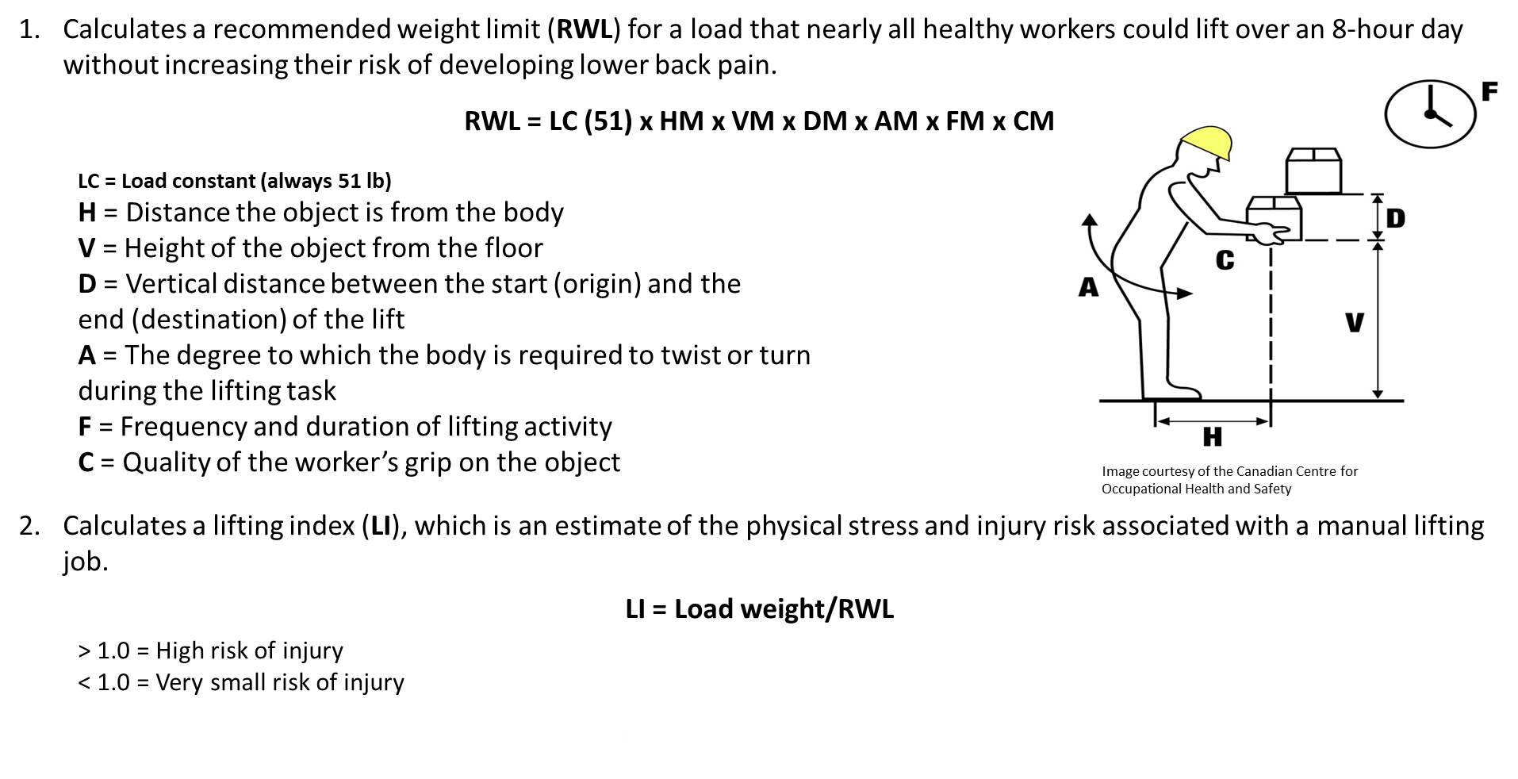
NIOSH Lifting Equation
Notes:
As you progress with your program, you may decide to assess your hazards more formally. You can hire someone to help you assess risks from handling materials using the NIOSH lifting equation or you can use the equation on your own.
The NIOSH Lifting Equation provides guidelines for evaluating the risk of injury associated with two-handed manual lifting tasks. It calculates a recommended weight limit or RWL for a load that nearly all healthy workers could lift over an 8-hour day without increasing their risk of developing lower back pain.
The equation, which is listed on this slide, always uses a load constant ‒ the LC ‒ of 51 pounds, because it represents the maximum recommended load weight to be lifted under ideal conditions. It also includes six task variables ‒ H, V, D, A, F, and C ‒ that are expressed as multipliers in the equation (M is the multiplier). As these variables deviate from the ideal, the amount of weight that can safely be lifted by an employee decreases.
To use the equation to determine the recommended weight limit, you will need to measure the following six task variables in order to calculate the multipliers used in the equation:
H is the horizontal distance the object is from the body
V is the vertical location of the object relative to the floor, in other words, the height of the object from the floor
D is the vertical distance between the origin and the destination of the lift
A is the degree to which the body is required to twist or turn during the lifting task
F is the frequency and duration of the lifting activity
C is the quality of the worker’s grip on the object, which is rated as good, fair, or poor
The NIOSH Lifting Equation also calculates the lifting index, or LI, which provides an estimate of the physical stress and injury risk associated with a manual lifting job. To calculate it, take the load weight of what you are lifting and divide it by the recommended weight limit you calculated. The equation is shown on the bottom of this slide.
If the value is greater than 1.0, then there is a high risk of low back injury. If the value is less than 1.0, there is only a small risk of injury. The goal is to design all lifting tasks to have an LI of less than 1.0!

Slide 26
Knowledge & Awareness
(element #4)
What do workers and management need to know about ergonomics?
  The physical risks (aspects of tasks that cause undue stress on body)
  Job-specific hazards (recognize risks of tasks)
  Prevention – controls (potential solutions)
Worker ergonomic training program that includes in-class lecture and hands-on & computer/app-based training components (www.cpwr.com/research/research-practice-library/construction-ergonomic-research-solutions)
Notes:
The fourth element of a good ergonomics program is making sure that workers and management have the knowledge and awareness to understand the physical abilities and limitations of the body, recognize job-specific ergonomic hazards in work tasks, and identify appropriate controls and work practices to prevent injuries.
In addition, we have developed a free worker training program for apprentices and other workers that is available for use with your employees. This training program covers basic ergonomic information and lift training techniques, computer and app-based training components that I’ll speak more about later, and a refresher module for workers who have received the basic training.
It is important that all employees be able to recognize ergonomic hazards so they can help plan for solutions. The worker program should be provided not only to workers and foremen, but also to project managers, estimators, and other staff so all are aware of the hazards and solutions.

Slide 27
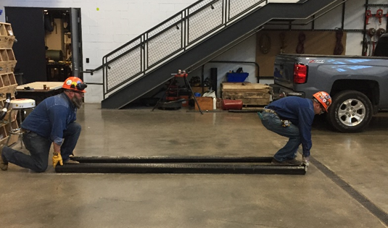
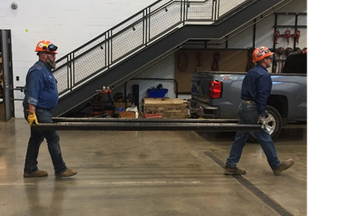
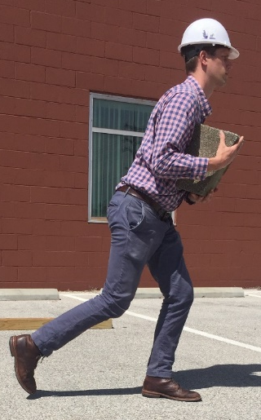
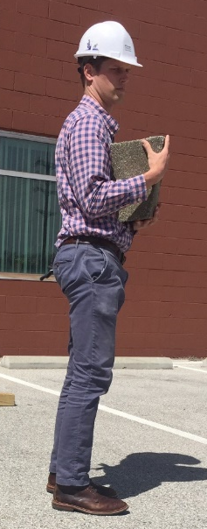
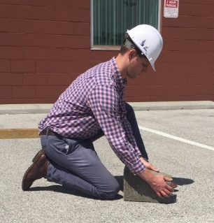
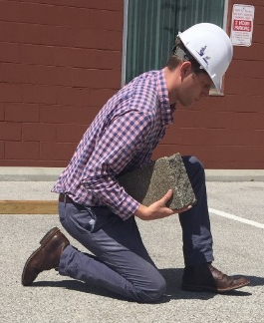
High Force: Make sure workers are properly trained
1 person ideally lifting no more than 50 pounds
Carrying heavy objects no more than 100 feet
Keep work involving objects weighing more than 25 pounds at waist height
One-person lift: small heavy object
Photo courtesy of the UA
Two-person lift: 2-10’ long poles
Photo courtesy of the UA
Photos courtesy of the Healthy Work Center, Washington University School of Medicine in St. Louis
Notes:
For material handling, it is critical to train workers in proper body mechanics. These are photos from the worker training program I just mentioned. The lifting practices are included in both the presentation and the hands-on portions.
Each worker is expected to perform each lift. The left photo is a two-person lift of two 10-foot pipes. Workers learn to plan the lift, proper body mechanics, and communication.
The right photo series is a lift of a small heavy object, rolled up to the waist.
Through proper lift training you can reduce injuries, as long as the weight of the object is reasonable for a worker to lift.
The human body has limits and it will break down over time. If too much is expected from the individual’s body, the damage and cost of the injury will be worse.

Slide 28


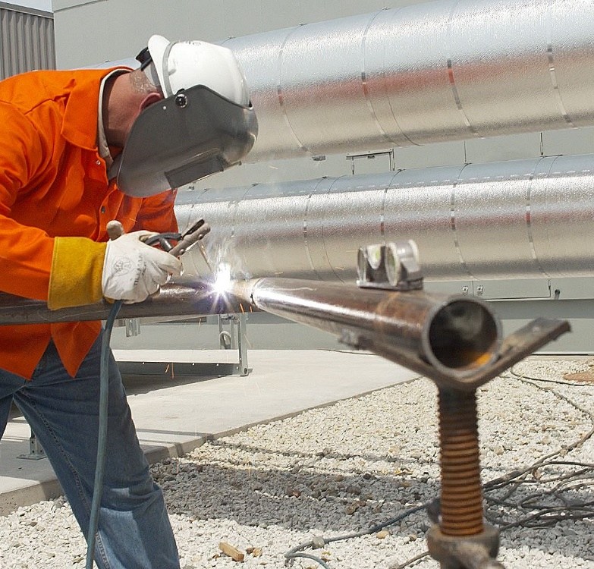
Awkward Posture:
Ground-Level WORK – “RAISE IT UP”
When possible, bring material to waist height using a stand or a cart.
Adjust its position to get close to the task.
Photo courtesy of the MCAA
Photo courtesy of the MCAA
Notes:
Awkward postures are another hazard.
It’s important to teach your employees and provide them with equipment, such as a cart or stand to assemble materials, to set up their work area so they can avoid working from the floor or ground, by raising the work up.
On this slide, a jig or pipe stand on a tripod is being used so the worker can work at waist level.

Slide 29
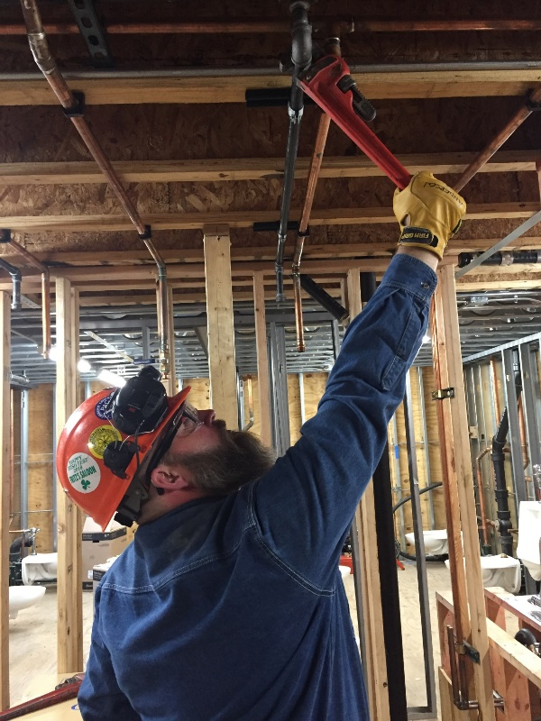
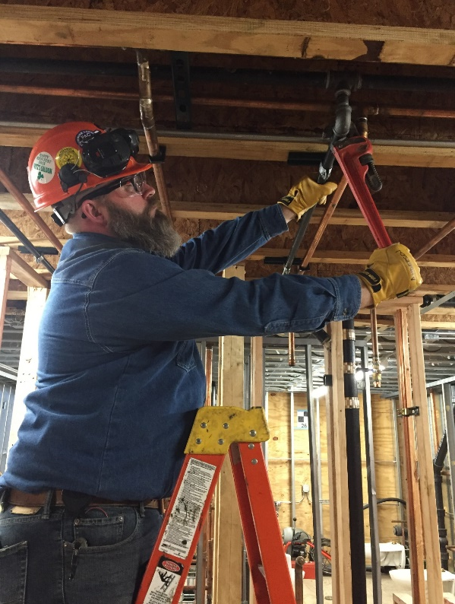
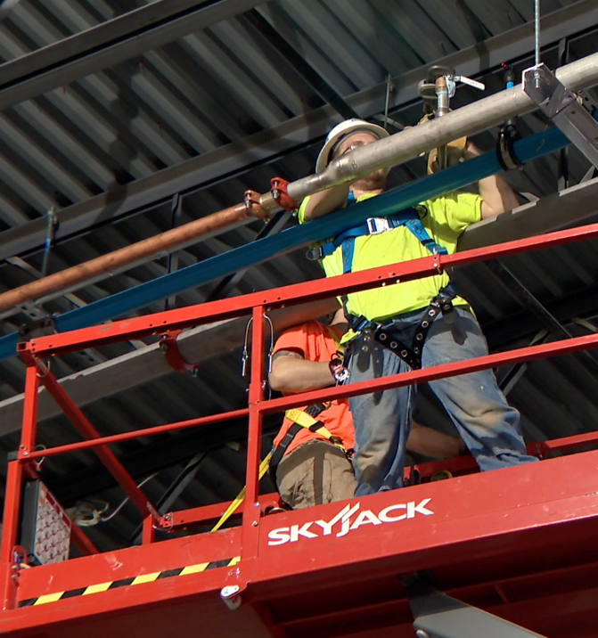
Awkward Posture:
Overhead Work
To avoid straining shoulders and low back, workers should:
Get as close to the task as possible.
Move the lift closer or move up on the ladder.
Use extended handled tools or tool extensions.
Photos courtesy
of the UA
Photo courtesy of the MCAA
Notes:
Another awkward posture is reaching up overhead to perform a task. This posture puts extra strain on a worker’s shoulders and low back.
If your employees are required to perform work overhead, they should be provided with a device such as a lift or ladder to raise them up, and the equipment should be positioned so the work is at or near the worker’s head height.
The top photo shows a worker reaching overhead. The shoulder angle is greater than 90 degrees. This worker could use a taller ladder or a scissor lift to get closer to the work.
Tools with longer handles or extensions can also reduce overhead reaching.

Slide 30
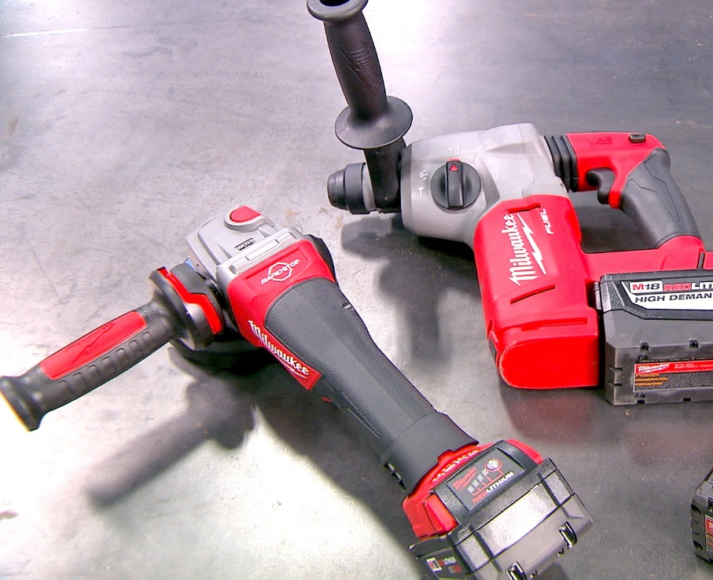
Other ergonomic risks
Contact Stress
Cushioned handles help relieve this pressure
Vibration
• Use tools with internal dampers
• Alternate tasks
• Wear anti-vibration gloves
Budgeting for these tools and equipment can improve your ergonomics program
Other risk: Disease spread
Minimize manual materials handling - use work practices and lifting tools and equipment
Photo courtesy of Milwaukee Tool
Disclaimer: CPWR does not endorse any specific equipment or product.
Notes:
Other ergonomic risks include contact stress and vibration.
There are new ergonomically designed tools with light weight batteries, cushioned handles, or additional handles for better leverage, and internal damping for vibration that can reduce exposures.
Budgeting for these tools will improve your ergonomic program.
COVID-19 has introduced another risk – namely the potential spread of disease when multiple workers lift and move the same material. Implementing equipment or work practices to minimize manual materials handling can help reduce the number of high-touch surfaces and the risk.

Slide 31
Review (element #5)
Review OSHA log, EMR, injury records (lagging indicators)
Collect one or more leading indicators to monitor the program delivery to review program
  Review training & planning documentation for compliance
  Conduct discrete observations and audits
Get worker feedback
Notes:
The final element in a good ergonomics program is Review. The Review step allows you to gauge how well your program is working, and help you understand whether modifications are needed.
Most contractors rely solely on their OSHA log, injury records, or Experience Modification Rates – their EMR – to assess their program’s effectiveness. Although these are commonly collected for business requirements, these lagging indicators are not sensitive to early program improvements or failures.
It is best to collect one or more “leading indicators.” Examples may include tracking of training records, reviewing planning documentation for compliance, or collecting and reviewing discrete worker observations or job site audits.
It is also useful to “ask the workers” if the program is working. Engaging your employees will be a sign of management commitment to making improvements and encourage honest and constructive input.

Slide 32
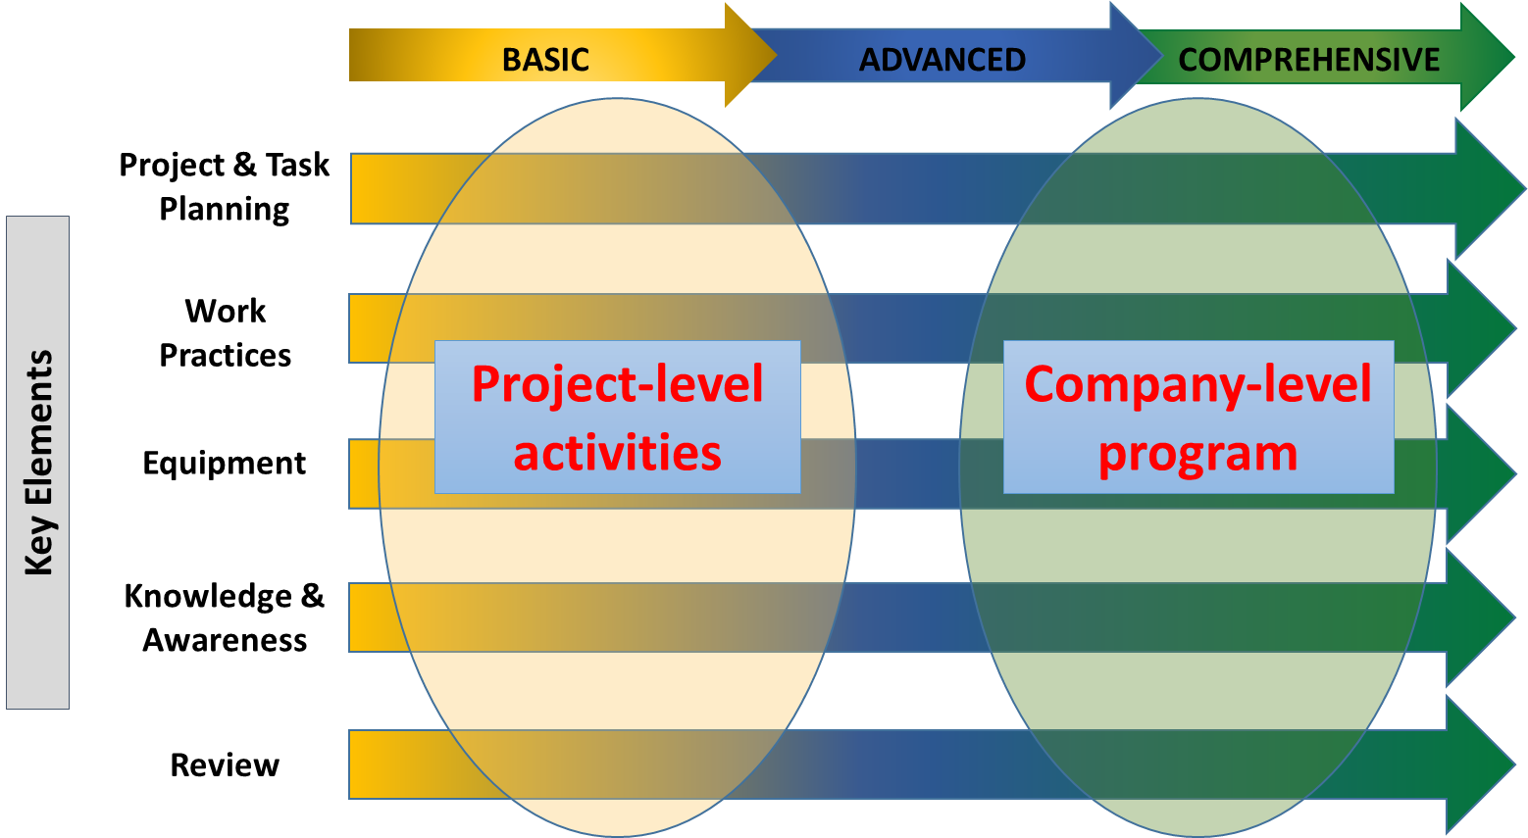
Transitioning from “Activities” to “Program”
Use a process improvement plan to transition from project-level planning to a company-level ergonomics program
Plan-Do-Check-Act (PDCA) is a common model to create a systematic company-level program
Notes:
Once you have your basic ergonomics activities that you are delivering through your project-level plans, you will want to formalize your program throughout your company, if you haven’t already done so at the outset.
Whether you start working at the project level or across your entire company, your program must follow a process improvement plan so it can achieve the results you desire – namely, to reduce soft tissue injuries and increase worker productivity.
Many companies use the plan-do-check-act process to create their company-level program.

Slide 33
Company-level Ergonomic Program
STARTING POINT:
Review injuries
Conduct hazard assessment
Select an ergonomic hazard
Plan
Do
  Include ergonomics in planning
  Develop best work practices and write them down (JHA)
  Provide equipment
  Train workers
  Company safety program & policies
  Set goals and objectives
Act
Check
  Discuss
  Modify plans
  Re-train
  Review OSHA log, EMR, injuries
  Conduct audits
  Worker feedback
Notes:
The plan-do-check-act process improvement model is shown here This is a continuous improvement model.
As discussed throughout this presentation, your program should start with a plan. Identify your plan to address ergonomic hazards or injuries as part of your company safety program, and plan out your ergonomics program, policies, goals, and objectives.
Then “do” your plan. Train workers to identify ergonomic hazards, provide ergonomic equipment, and develop best ergonomic processes.
Then periodically review your program to assess its effectiveness by reviewing injuries and other indicators, conducting worksite audits, and asking for worker feedback.
Based on the results from “check,” “act” by taking steps to modify the program, re-train workers, and create new activities.
The process improvement plan will repeat itself in order to achieve your advanced or comprehensive company-level ergonomics program to reduce the risk of injuries.

Slide 34
How does a smaller company get started?
PLAN
  Pick a specific hazard in your work
  Define one or more controls for the hazard & create a plan
DO
  Communicate plan, provide equipment, train workers
  Document compliance (checklist for equipment and training on each project)
CHECK: Review to verify that controls are consistently used
ACT: Revise plan or expand controls to make robust over time
Bid Phase
Pre-job Phase
On-the-Job Phase
Review/ Look Back
Audits:
Check worker compliance with use of duct hoist and team lift
ID Risk – lifting heavy load (low back pain)
Include Solution: Use duct hoist and team lift
Duct hoist delivered to all projects
Workers trained in team lifting
Checklist for equipment/ training returned to office
Quarterly monitoring – review checklist for compliance
Notes:
So how can a smaller company get started? The process works the same but will likely start at the project level before working into a more advanced plan. The Best Built Plans program that I mentioned earlier, and will touch on more later, has resources contractors of all sizes can use to develop their plan for each of the project phases noted on this slide.
Here is an example for the task of installing duct:
At the bid phase, lifting the heavy load to install was identified so the bid included funds for the solution to use a duct hoist and team lift for a pre-assembled duct.
During the pre-job phase, plans are made to ensure the duct hoist is delivered to the project and all workers will be trained in team lifting. This could be the focus of a toolbox talk or a hands-on demonstration exercise from the worker training module mentioned earlier.
During the on-the-job phase, a checklist is used to ensure equipment is onsite, accessible and being used, and all workers are trained. During this phase, audits are performed on a regularly scheduled basis to check that the equipment is available and workers are using the duct hoist and proper team lifting. The checklist and any documentation on training should be returned to your office.
The last step is the review or look back. The plan, checklists, and other documentation are reviewed to assess how well the plan was implemented. The results are discussed with employees and input is solicited to help find solutions for areas where there was low compliance.

Slide 35
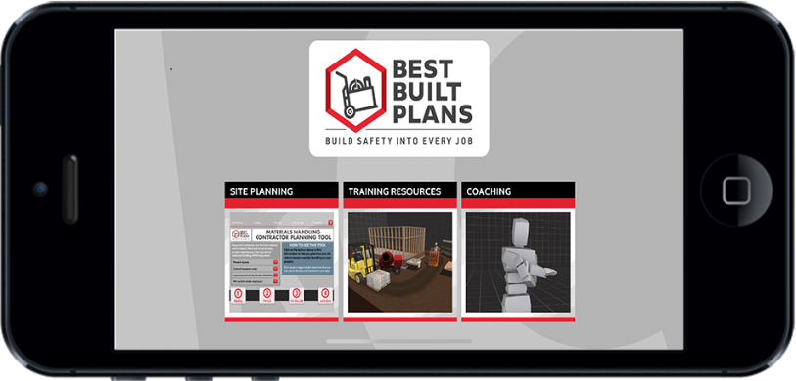
  BestBuiltPlans.org
Addresses barriers:
Planning questions, spreadsheets, & checklists
Training & Coaching Resources
Full Program available to download to your PC or as an App
All planning resources, infographics, video, games, toolbox talks, & hazard alerts available directly online and in Spanish
Notes:
As mentioned earlier, the Best Built Plans program includes resources to help you plan for safe materials handling at each phase of your project to reduce the risk for sprain and strain injuries.
The full program, which includes interactive training and coaching resources, is available for download to your PC or as an app for Apple and Android devices.
All of the planning resources are also available online in English and Spanish.

Slide 36
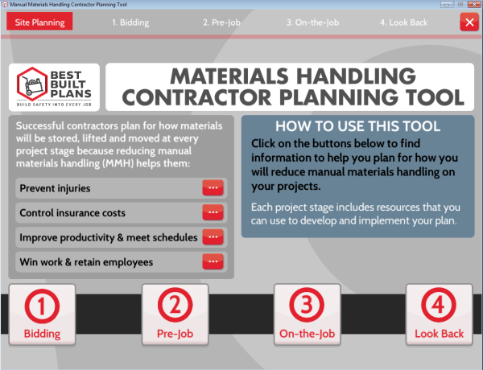
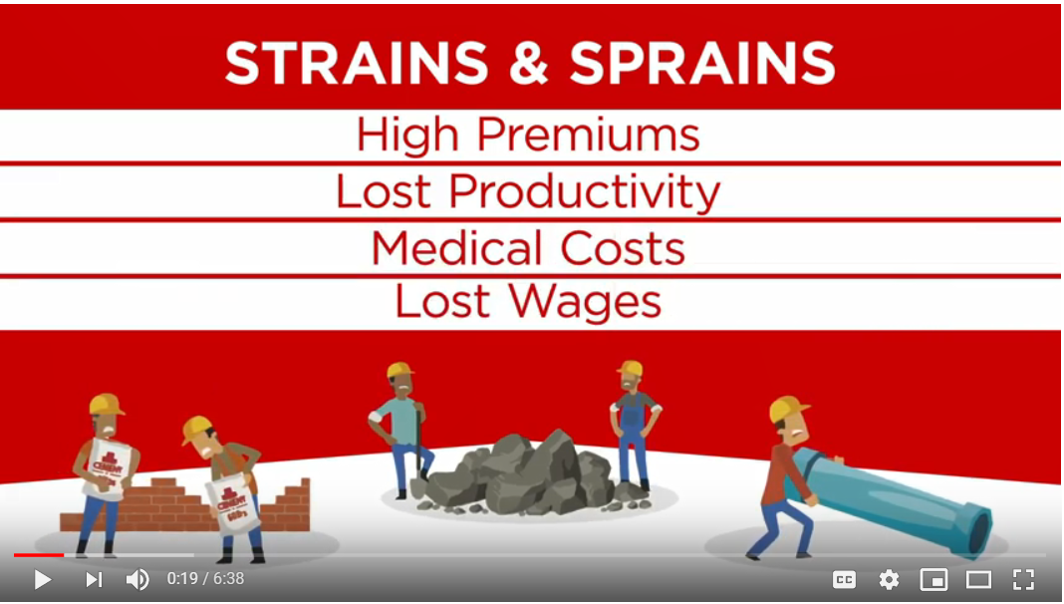
Help Contractors…
A Planning Tool
Planning questions, spreadsheets, & checklists
Weights of materials
Storage options
Lifting options
Training resources
Video demos why, how, and when to use this resource
https://www.youtube.com/watch?v=kigonAjj2gU&t=1s
Notes:
The program includes resources to involve everyone in reducing strain and sprain injuries, including you, your employees, and trainers.
This ergonomics training program is one of the newest resources in the program.
Some of the tools and resources in Best Built Plans were specifically designed to help you develop your project-level plan and others were designed to help you implement it.
In addition to information on the benefits of reducing manual materials handling, the program includes questions to consider at each project stage, starting with what you should be considering when you prepare a bid, spreadsheets to calculate costs and related information, the weights of common building materials, storage options to reduce lifting risks, equipment options for lifting and moving materials, spreadsheets and checklists to track what will be needed once you’re awarded the work, and training materials.
There is also a video in English and Spanish that walks you through how to create and implement a project-level plan.

Slide 37
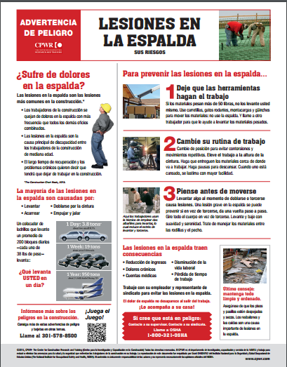
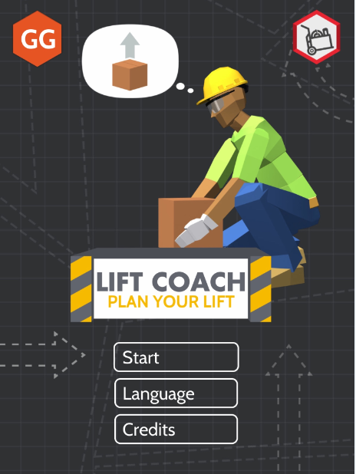
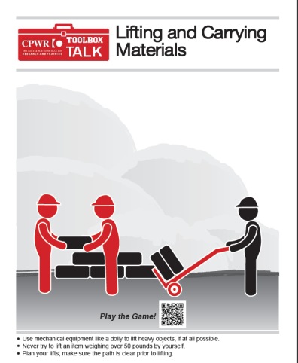
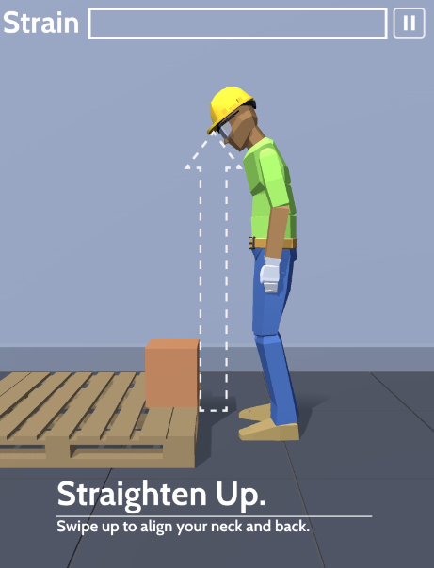
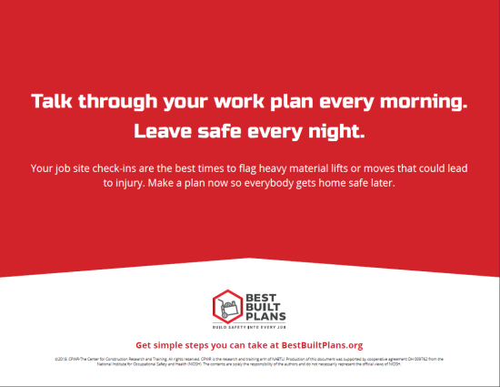
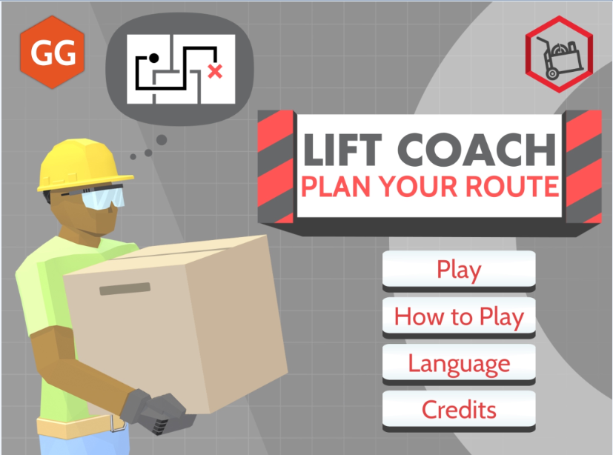


Notes:
The program has resources to use with construction workers, including a hazard alert card, infographics that can be used as reminders or posters on the job, and a toolbox talk that includes a link to two smartphone games, Lift Coach Plan Your Route and Lift Coach Plan Your Lift. Both are designed to reinforce safe practices.
All of these resources are available in English and Spanish.

Slide 38

Risk of opioid dependence from opioid prescriptions and illicit drugs
1 out of 4 people prescribed opioids for long-term pain become addicted.*
Construction work can result in painful injuries; many are treated with prescription opioids (e.g., codeine, morphine, hydrocodone, hydromorphone, oxycodone)
Actions:
If you are injured, talk to your doctor about non-addictive medications or physical therapy to treat the pain.
Opioids are addictive and should be the last option to treat your pain. Talk to your doctor about non-addictive medications.
DO NOT take opioids for more than 30 days without consulting with your doctor.
iStock.com/Darwin Brandis
*Centers for Disease Control and Prevention. Promoting Safer and More Effective Pain Management. https://tinyurl.com/overdosefacts
Notes:
As mentioned earlier, the goal of this program is to provide you with information on how to prevent the injuries and pain up front, and a benefit of doing so is that your employees will not need pain medication.
Opioid dependence has become a serious issue for construction employers and their employees, because construction workers are at risk for painful injuries and opioids are commonly prescribed for pain relief. According to the Centers for Disease Control and Prevention, 1 out of 4 people prescribed opioids for long-term pain become addicted.
If your employees do get injured, there are resources that you can share with them to ensure they understand that:
Opioids are strong, addictive medications that should only be used if they are prescribed by a doctor and determined to be the best option to manage the pain.
Misuse of opioids prescriptions, including taking more than the dose prescribed, taking someone else’s prescription, taking multiple opioid medications, or taking high doses for long periods of time can all lead to opioid dependency and addiction.
Before taking prescription opioids, they should FIRST ask their doctor for information on ALL available treatments for pain. There may be non-addictive medications or treatments available.

Slide 39




https://cpwr.com/research/opioid-resources
Notes:
Here are a few of the publications available through the CPWR website listed under “Opioid Resources.”
The upper two documents are a toolbox talk and hazard alert about opioids deaths in construction.
The bottom left is an infographic on the staggering statistics on the effects of the opioid crisis, and the last document is a physicians’ alert to provide clinicians advice when treating construction workers for pain.
https://www.cpwr.com/sites/default/files/publications_handouts-and-toolbox-talks_physicians-alerts_opioids.pdf

Slide 40
Recommendations for building a successful ergonomics program
Find a starting point:
  a) Review injuries
  b) Ergonomic hazard assessment of common work task
  c) Addressing manual materials handling risks (overexertion; disease exposure)
Select one or more key elements to address the change:
  Create a plan or steps to consider ergonomics in addition to safety during project planning
  Define ergonomic work practices that reduce the hazards
  Find ergonomic tools/equipment to rent or purchase
  Educate/train to increase awareness
  Collect one or more leading indicators to monitor the program delivery to review progress
Follow a safety management improvement process (Plan-Do-Check-Act)
  Take advantage of Best Built Plans resources
Know the change will happen gradually but won’t happen without sustainable effort!
Notes:
To recap,
If you want to build an ergonomics program, find a starting point using one of three methods.
Then use the 5 key elements to define your program.
Follow a safety management improvement process and take advantage of resources available from the Best Built Plans program.
Be patient, developing a program and building a culture for your ergonomics program will take time.

Slide 41

Resources
CPWR Construction Ergonomics Research and Solutions www.cpwr.com/research/research-practice-library/construction-ergonomic-research-solutions
Best Built Plans – resources to help you reduce injuries and other risks associated with materials handling www.bestbuiltplans.org
Notes:
Finally, here are more resources for construction ergonomics research and solutions that may be found at CPWR.com, including the resources in the “Best Built Plans” program, which can be accessed at either of the links on this slide.

Slide 42

Other information
Many ergonomic solutions are available through the CPWR central resource, including Best Built Plans: www.cpwr.com/research/research-practice-library/construction-ergonomic-research-solutions
New ergonomic equipment is being developed and made available for construction use.
Solutions to reduce high-touch surfaces to prevent the spread of COVID-19 and other diseases: www.covid.elcosh.org
Photo courtesy of the International Union of Bricklayers and Allied Craftworkers
  MULE: https://www.youtube.com/watch?v=l0c314NLY0M
Disclaimer: CPWR does not endorse any specific equipment or product.
Notes:
Once you have your basic program developed, you may consider more sophisticated but often more costly solutions. Here is an example of the “MULE” used to set block.
Other solutions may be found through the web and CPWR’s central ergonomics resource.
And solutions reduce high touch surfaces and prevent the spread of disease can be found in the COVID-19 Construction Clearinghouse.

Slide 43
Thank you!
CPWR and the Washington University Research Team
©2020, CPWR-The Center for Construction Research and Training. All rights reserved. CPWR is the research and training arm of NABTU. Production of this document was supported by cooperative agreement OH 009762 from the National Institute for Occupational Safety and Health (NIOSH). The contents are solely the responsibility of the authors and do not necessarily represent the official views of NIOSH.
Notes:
Thank you.

