Slide 1

Capacitación en comunicación de riesgos
Curso de 4 horas en cumplimiento de la norma 29 CFR1910.1200
M-1
Notes:
Trainer Notes:
Throughout these notes you will see some copy in brackets. These are suggestions for you, the instructor. Notes outside brackets are, in order:
The direct information on the slide.
Background information that you may find helpful.
[Emphasize that this course covers the information from OSHA under the Global Harmonization of the Hazard Communication Standard, 29 CFR1910.1200.]

Slide 2

Vamos a romper el hielo
Dentro de su grupo hable sobre sustancias químicas a las que está expuesto en su trabajo y sobre el daño que ocasionan. ¿Conoce algún incidente provocado por alguna sustancia química?
Foto cortesía de Wikimedia y U.S. NOAA
Notes:
Trainer Notes:
Icebreaker
[Assign 3-4 students to a group. Allow each group to discuss the chemicals they are exposed to on their jobs and the harm these chemicals can cause. Students should write their responses in their student manuals. Write responses on a flip chart or chalk board.]
In your group discuss chemicals that you are exposed to on your job and discuss the harm they can cause. Do you know of any specific incidents involving chemicals?

Slide 3
Este curso consta de 8 secciones:
Introducción del curso
Aspectos generales de la norma de comunicación de riesgos (HCS)
Análisis de los efectos comunes sobre la salud
Aspectos químicos
Medición y límites de exposición
Otras maneras de comunicar riesgos
Control de riesgos
Emergencias y primeros auxilios
M-1
Notes:
Trainer Notes:
This course is delivered in 8 sections
Course introduction
Hazard Communication Standard (HCS) overview
Review of common health effects
Chemical overview
Measurement and exposure limits
Other ways of communicating hazards
Controlling hazards
Emergencies and first aid

Slide 4
Al terminar este curso, usted podrá:
Hablar de los cinco elementos principales de la norma de comunicación de riesgos de OSHA Hazcom.
Describir los derechos que le otorga la norma de comunicación de riesgos, Hazcom, de OSHA.
Identificar los nuevos símbolos de etiquetado de OSHA y explicar lo que significa cada uno.
Describir las cuatro vías de penetración de las sustancias químicas en el cuerpo. Por cada una de las vías, dar un ejemplo de una sustancia conocida por penetrar a través de ella.
M-2
Notes:
Trainer Notes:
After completing this course you will be able to:
Discuss the 5 key elements of OSHA’s Hazard Communication Standard (Hazcom).
Describe your rights under OSHA’s Hazcom standard.
Identify the new OSHA label symbols and explain what each means.
Describe the 4 routes of entry for chemicals and give an example of a chemical known to enter the body through each.

Slide 5
Al terminar este curso, usted podrá:
Especificar tres maneras de buscar información sobre las sustancias químicas que puede encontrar en su lugar de trabajo.
Describir distintos métodos para controlar la exposición a sustancias químicas y ordenarlos según el nivel de protección que ofrecen a los trabajadores.
Usar una hoja de datos de seguridad de un producto, determinar si es inflamable, si es más pesado que el aire y si tiene un Límite de exposición permisible (PEL) de OSHA.
M-2
Notes:
Trainer Notes:
State three ways to find information about chemicals found on your jobsite.
Describe several methods to control chemical exposures and rank them for greater worker protection.
Using a product’s safety data sheet, assess whether it is flammable, heavier than air and has an OSHA PEL.

Slide 6
Introducción del curso
Sección 1
M-2
Notes:
Trainer Notes:
Section 1
Course Introduction

Slide 7
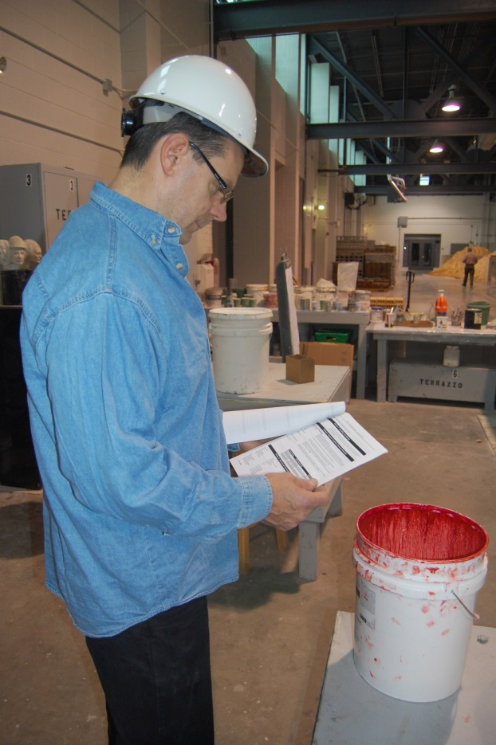
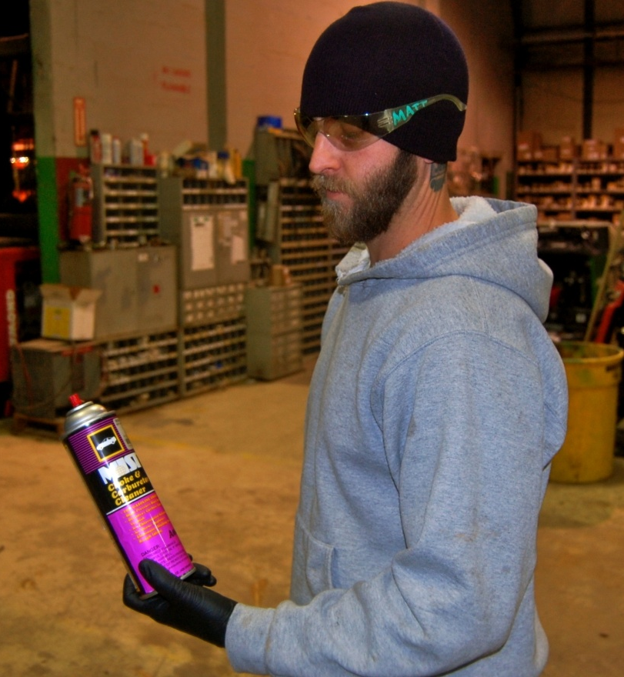
La norma de comunicación de riesgos (Hazcom) de OSHA le otorga el derecho de entender los riesgos químicos que puede encontrar en el trabajo, además de las maneras de protegerse
M-2
Notes:
Trainer Notes:
The OSHA Hazard Communication standard gives you the right to understand the chemical hazards on your job and ways to protect yourself.

Slide 8

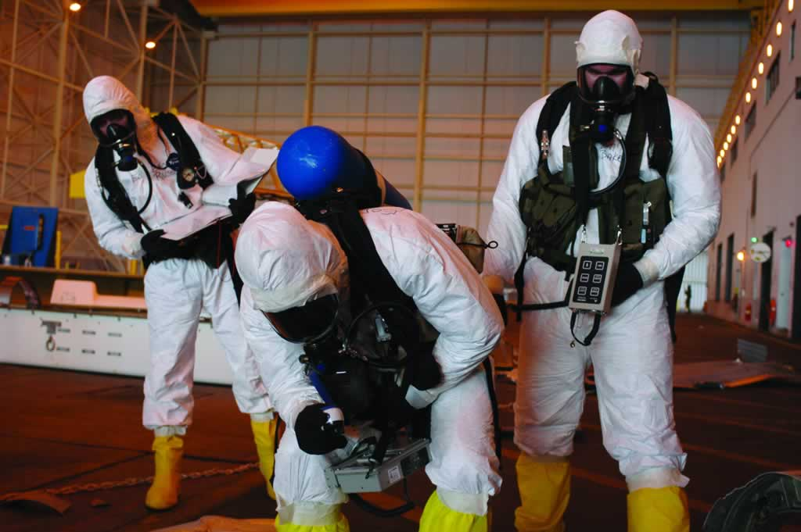
Este curso no lo capacitará para limpiar derrames ni emanaciones
M-2
Notes:
Trainer Notes:
This course will not train you to clean up spills and releases.

Slide 9
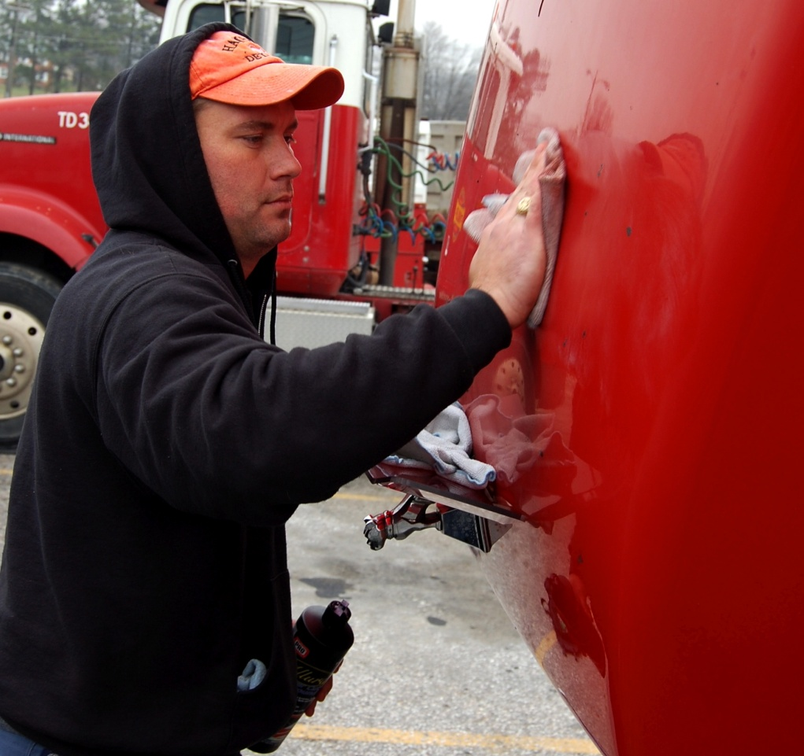
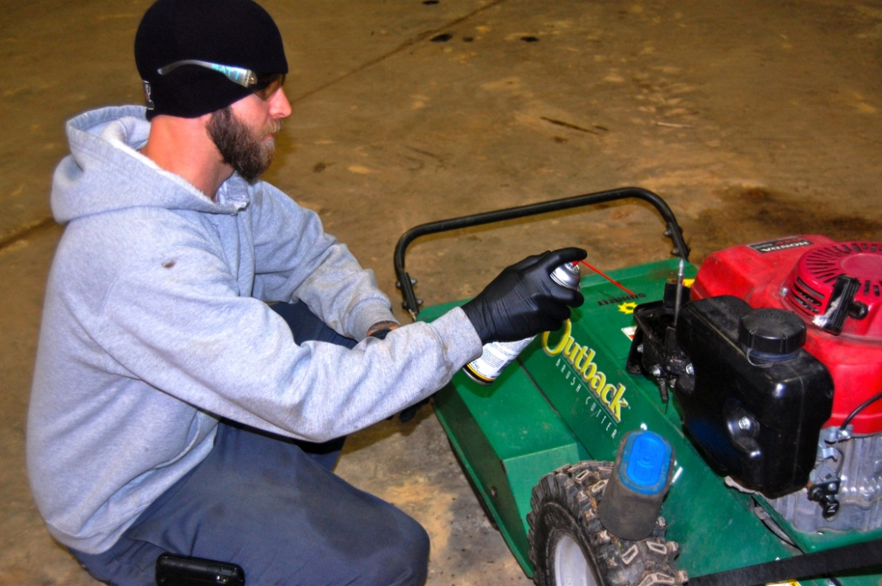
Este curso tampoco le dará instrucción sobre los riesgos químicos específicos de su lugar de trabajo. Eso le corresponde a su empleador
M-2
Fotografía de Neil Lippy
Notes:
Trainer Notes:
This course will not teach you about the specific chemical hazards on your job site. Your employer must do that.

Slide 10
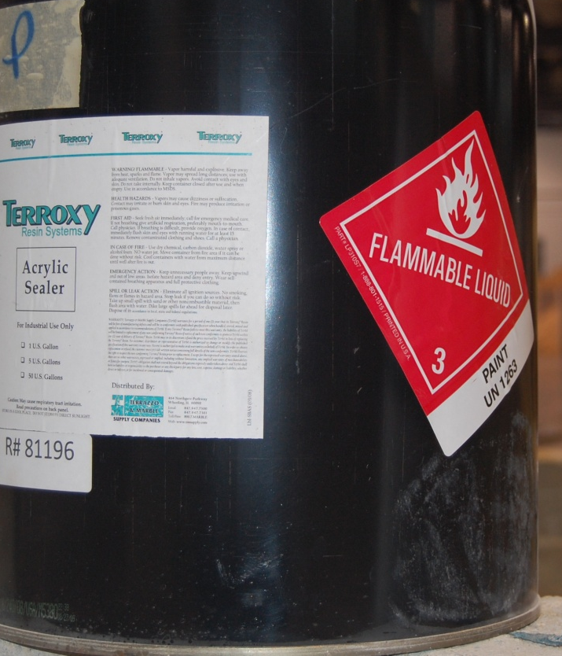
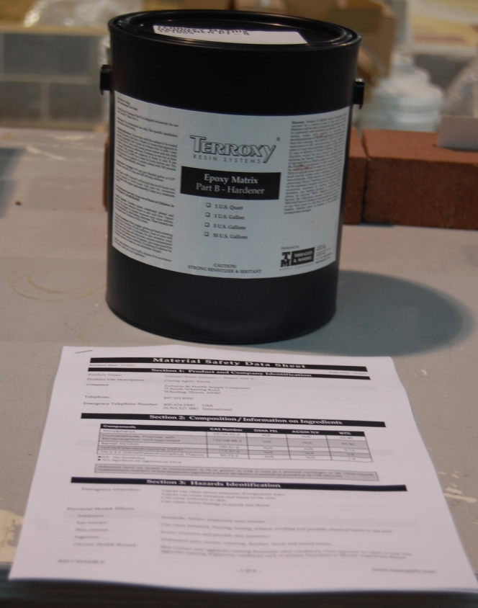
La capacitación sobre la norma Hazcom lo preparará para buscar y usar información sobre las sustancias químicas que puede encontrar en su trabajo
Foto cortesía de International Masonry Institute
M-2
Notes:
Trainer Notes:
Hazcom training will prepare you to find and use information about chemicals on your job.

Slide 11
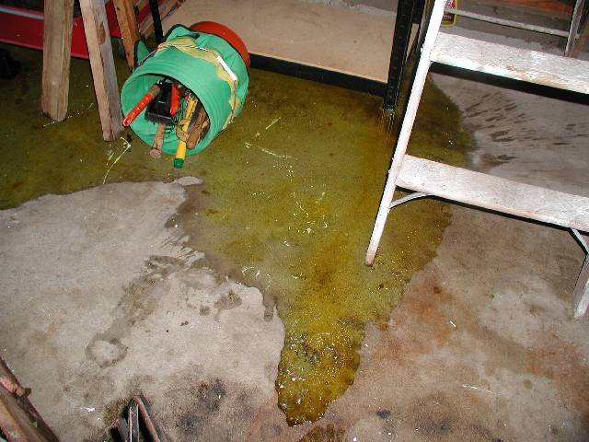
Esta capacitación le enseñará a avisar sobre la emanación de sustancias químicas al personal cualificado para casos de emergencia a fin evitar la exposición
Fuga desconocida
M-2
Notes:
Trainer Notes:
This training will teach you to report releases of hazardous chemicals to qualified response personnel and to avoid exposure.

Slide 12
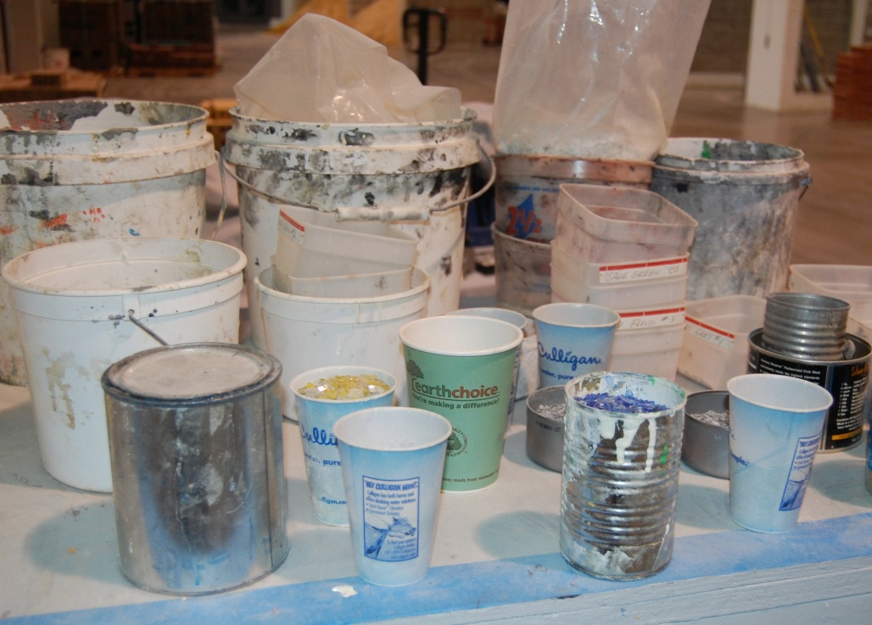
Vamos a hacer la actividad 1, pero primero…
¿Cuántas personas ya han recibido capacitación de Hazcom?
¿Qué elementos de la norma recuerdan?
M-2
Notes:
Trainer Notes:
[Ask students to raise their hands if they have had Hazcom training. Have students volunteer some of the key elements of the standard that they learned. This will orient the trainers as to how much the participants already know about hazard communication basics. ]

Slide 13

Actividad uno: Compruebe el conocimiento de Hazcom que tiene su grupo
Verdadero
Falso
a. La norma obliga a todos los empleadores a dar a los trabajadores información sobre las sustancias químicas peligrosas a las que están expuestos.
b. Los empleadores están obligados a ofrecer a los traba-jadores una hoja de datos de seguridad (SDS) en el turno laboral que corresponda.
c. Los importadores, fabricantes y distribuidores de sustancias químicas fueron los que dieron origen a la norma de comuni-cación de riesgos de OSHA porque les preocupaba la responsa-bilidad que pudiera recaer sobre ellos.
d. Los empleadores están obligados a ofrecer anualmente capacitación en comunicación de riesgos.
✔
✔
✔
✔
M-3
Actividad
Notes:
Trainer Notes:
[Have students work from their workbooks.]
a. true
b. true
c. false. Unions and occupational and public health advocates fought vigorously for workers' "right-to-know" about chemical hazards, passing over 20 state right-to-know laws, prior to chemical manufacturers and employers conceding to a national OSHA standard.
d. false. The HCS requires only an initial training at the time of hire or assignment that involves exposure to hazardous chemicals and additional training when new chemicals are introduced. Some state's still enforce a "right-to-know" law that requires annual training. Check with your state labor department for more information.

Slide 14
Actividad uno: Compruebe el conocimiento de sustancias químicas que tiene su grupo. ¿Cuántos…
b.
...trabajadores mueren cada año por causa de lesiones ocupacionales?
...trabajadores mueren cada año por causa de enfermedades ocupacionales causadas por exposición química?
...reglamentos exclusivamente químicos hace cumplir OSHA?
...productos químicos se usan en el lugar de trabajo?
Respuestas posibles
a. 500
b. 5,000
c. 10,000
d. 50,000
e. >50,000
e.
a.
e.
Actividad
M-3
Notes:
Trainer Notes:
[Work this exercise in groups if you can. Otherwise, have everyone mark the answers they think are correct in their manual. Solicit answers from them before clicking the right answers. You can see if any group got them all correct and acknowledge them.]
Activity One: Test your group’s knowledge of chemicals. How many…
b. workers die each year from occupational injuries? (5,000)
e. workers die each year from occupational diseases caused by chemical exposures? (>50,000)
a. chemical-specific standards does OSHA enforce? (500)
chemical products used in the workplace? (>50,000)
According to the US Bureau of Labor Statistics 4,609 workers (private and public sectors) died from occupational injuries in 2011. Of 4,114 worker fatalities in private 721 or 17.5% were in construction. The leading causes of worker deaths on construction sites were falls (251), followed by electrocution (67), struck by object (73), and caught-in/between (19). These "Fatal Four" were responsible for nearly three out of five (57%) fatalities.
According to a study by Paul Leigh, the estimated number of deaths due to occupational diseases in 2007 was 53,000 at a cost of $46 billion. More on the job deaths are due to occupational diseases than injuries. About a third of the disease deaths are due to occupational cancers.
OSHA enforces chemical standards for about 450 substances. When OSHA was formed in 1970, they adopted national consensus standards including the 1968 ACGIH TLVs (American Conference of Governmental Industrial Hygienist Threshold Limit Values). In its 52 year existence, OSHA has created less than 30 new chemical standards. In 1989 OSHA tried to update its chemical standards to the 1988 ACGIH PELs, but it was overturned by the Supreme Court. Some states have adopted the 1988 ACGIH TLVs such as California. Check with your state labor department to see which standard they are using.
According to OSHA, there are more than 650,000 thousand chemical products in the workplace with thousands of new ones being introduced annually.
J Paul Leigh, The Economic Burden of Occupational Injury & Illness in the US, The Milbank Quarterly, Vol. 89, No. 4, 2011 (pp. 728–772)

Slide 15
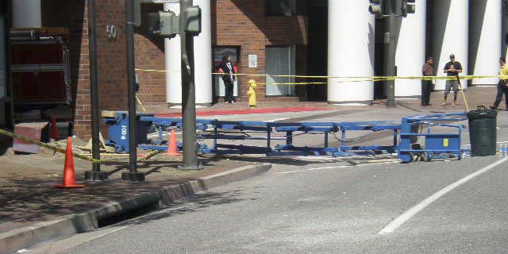
Cada día alrededor de cuatro trabajadores de la construcción mueren en el trabajo
Imagen cortesía de California FACE Report #10CA008
Notes:
Trainer Notes:
Every day approximately four construction workers die on the job.
[This is a June 2010 NIOSH Fatality report from California (#10CA008) construction worker died when the fully extended scissor lift from which he was working fell over. The victim and two co-workers were in a scissor lift that was fully extended 20 feet above the ground. They were attempting to remove a planter box from the exterior wall of a parking structure. The work crew was shoveling dirt out of the planter box into a plastic trash container on the platform of the scissor lift. While the work crew was removing the planter box from the wall, it suddenly shifted and struck the scissor lift, knocking it over. The scissor lift was rated for 500 pounds.
The CA/FACE investigator determined that, in order to prevent future incidents, construction companies that use scissor lifts should:
Ensure that employees use scissor lifts that are the appropriate size and capacity for the job.
Ensure that employees are specifically trained on the appropriate load capacity and materials handling of scissor lifts.

Slide 16
El siguiente mapa ilustra las muertes en obras de construcción en el año 2017 según los datos recabados por CPWR
http://stopconstructionfalls.com/fatality-map/
M-4
Notes:
Trainer Notes:
This map is a part of the Stop Construction Falls campaign and is maintained by CPWR. It is the result of a comprehensive effort to document every death on construction sites in the United States for the calendar year 2017. If you go to the website you can click on any of these pushpins and read about the specific fatality. For trainers this is a powerful tool when in a new location.
These fatalities are only the ones CPWR could confirm in our data research. BLS data shows even more fatalities during this time period.

Slide 17
Aspectos generales de la norma de comunicación de riesgos (HCS)
Sección 2
M-4
Notes:
Trainer Notes:
Section 2
Hazard Communication Standard Overview

Slide 18
¿Qué motivó a OSHA a establecer la norma Hazcom en 1983?
Breve historia
M-4
Notes:
Trainer Notes:
[Ask this question of the class to begin Section 2.]
What led up to OSHA developing the Hazcom Standard in 1983?

Slide 19
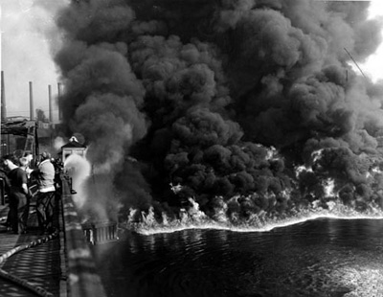
En 1952 y 1969, el río Cuyahoga ardió en fuego
Ese hecho originó la creación de EPA y dirigió el enfoque hacia la contaminación química
M-4
Notes:
Trainer Notes:
In 1952, the Cuyahoga River caught fire. This led to the creation of the EPA and a focus on chemical pollution.
From Wikipedia: At least 13 fires have been reported on the Cuyahoga River, the first occurring in 1868. The largest river fire in 1952 caused over $1 million in damage to boats and a riverfront office building. Fires erupted on the river several more times before June 22, 1969, when a river fire captured the attention of Time magazine, which described the Cuyahoga as the river that "oozes rather than flows" and in which a person "does not drown but decays". The 1969 Cuyahoga River fire helped spur an avalanche of water pollution control activities, resulting in the Clean Water Act and the creation of the federal Environmental Protection Agency.

Slide 20

Los sindicatos y grupos ambientalistas dieron origen a la lucha por la protección contra las sustancias químicas peligrosas
En 1977, 60 trabajadores de una planta química en California que fabricaba el pesticida DBCP manifestaron síntomas de esterilidad
http://www.youtube.com/watch?feature=player_detailpage&v=75__L8hX-1o
M-5
Notes:
Trainer Notes:
Unions and environmental groups led the fight for protections from hazardous chemicals.
One example comes from a chemical plant in Lathrop California (near Stockton). Workers in one area of the plant worked on the DBCP production line. 1,2-Dibromo-3-chloropropane, DBCP is a pesticide which was used in the United States to control nematodes. During lunch time and breaks, employees started talking about the problems they had trying to start a family. They started to notice no employees in their particular area of the plant were successful. These employees went to their doctors, and found out they were all sterile. Several years earlier literature had been published by a UCSF researcher who found that DBCP was a reproductive hazard. This was published information but workers were never informed about this particular hazard. Fortunately for these workers, the effects of the exposure was not long term. Once they were removed from the DBCP production line, the reproductive effects from the DBCP exposure were reversed. The DBCP case triggered legislative hearings which resulted in California passing a new statute in the California Labor Code in 1981. This statute is commonly known as the Hazard Communication Regulation. The new regulation required the California Department of Industrial Relations to create a list of hazardous substances. It required manufacturers to develop material safety data sheets (MSDS) for hazardous substances which they manufactured and to provide a copy of the MSDS to employers who purchased the hazardous substances from them.
State chemical “right-to-know” laws led to the original OSHA Hazcom standard in 1983.
Further information on Proposition 65 can be found at: http://oehha.ca.gov/prop65.html

Slide 21
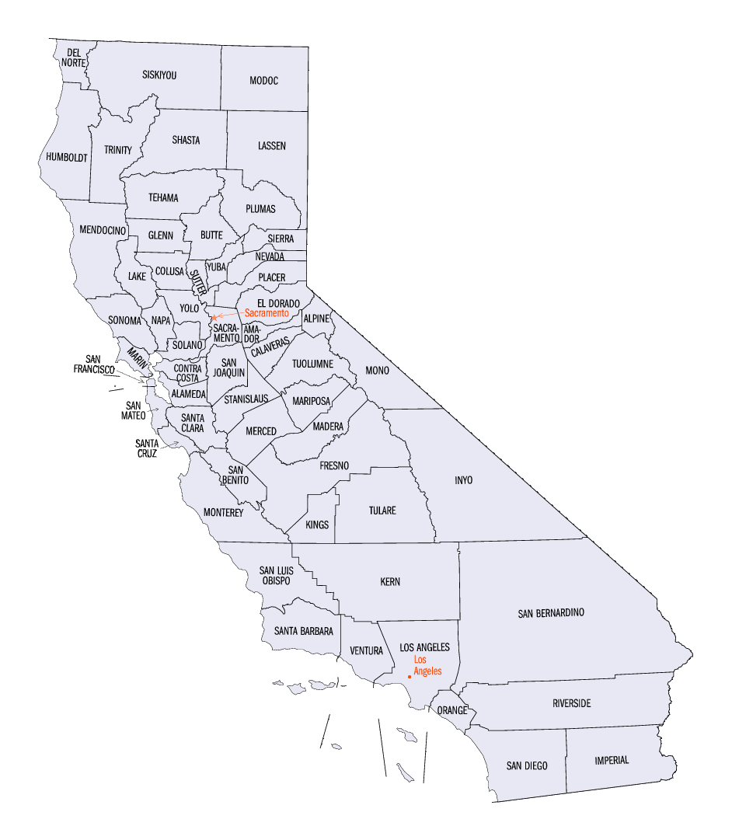

Las leyes estatales relativas al “derecho de saber” dieron origen a la primera norma Hazcom de OSHA en 1983
La norma Hazcom de California fue impulsada por el caso del pesticida DBCP
M-5
Notes:
Trainer Notes:
[Make the point that the states’ having Hazcom standards put pressure on OSHA to act, but also that businesses wanted OSHA to set a national standard because they were having a terrible time trying to comply with dozens of individual state requirements.]
State chemical “right-to-know” laws led to the original OSHA Hazcom standard in 1983. California’s Hazcom standard was triggered by the DBCP pesticide case.

Slide 22
¿Por qué es importante la norma de comunicación de riesgos?
Hable del tema con su grupo y anote las respuestas en el manual del estudiante
Actividad
M-5
Notes:
Trainer Notes:
[In their groups allow students time to discuss why the standard is important and write their answers in their manuals. Write responses on a flip chart or chalk board.]
Why is the hazard communication standard important?
Possible good answers:
Hazcom standards help workers:
Reduce their risks to chemicals
Avoid dangerous chemicals
Obtain proper education about chemicals
Select proper PPE

Slide 23

32 millones de trabajadores están potencialmente expuestos a sustancias químicas
OSHA
Alrededor de un cuarto de enfermedades que ocurren en el lugar de trabajo son causadas por sustancias químicas
Organización Internacional del Trabajo
M-5
Notes:
Trainer Notes:
[Point out these are also reasons that the standard is important.]
32 million workers are potentially exposed to chemicals according to OSHA.
Roughly one-quarter of workplace diseases and injuries are caused by chemicals, according to the International Labor Organization.
The ILO is an agency of the United Nations responsible for drawing up and overseeing international labor standards. The ILO brings together representatives of governments, employers and workers to jointly shape policies and programs promoting Decent Work for all. This unique arrangement gives the ILO an edge in incorporating 'real world' knowledge about employment and work.

Slide 24

HazCom fue el segundo estándar más citado en el año fiscal 2017
4,176 citaciones
Fuente: Safety + Health Diciembre 2017
M-5
Notes:
Trainer Notes:
Hazcom was the second most cited standard in FY 2017. There were 4,176 citations.
Reference: Jeffery Dalto, Health and Safety December 6, 2017. https://www.convergencetraining.com/blog/oshas-top-ten-citations-2017-extended-citation-violation-data-released

Slide 25
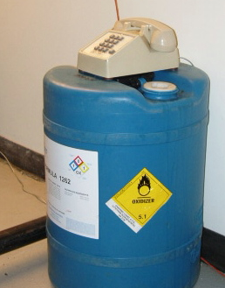
La Hazard Communication Standard, en español la Norma de Comunicación de Riesgos, también se conoce como:
Hazcom o HCS
Right to Know o Derecho de saber
Right to Understand o Derecho de entender
OSHA 29 CFR 1910.1200 (para la industria en general)
OSHA 29 CFR 1926.59 (para la construcción)
?
¿Este teléfono forma parte de una buena comunicación de riesgos?
M-6
Notes:
Trainer Notes:
The Hazard Communication Standard is also known as:
Hazcom or HCS
Right to Know
Right to Understand
OSHA 29 CFR 1910.1200
OSHA 29 CFR 1926.59 (construction)
The Hazard Communication Standard (HCS) is based on a simple concept: workers have both a need and a right to know the identities of the chemicals they are exposed to when working and the hazards associated with these chemicals. They also need to know what protective measures are available to prevent adverse effects from occurring.
The HCS will help employers provide safer workplaces for their workers. When employers have information about the chemicals being used, they can take steps to reduce exposures, substitute less hazardous materials, and establish proper work practices. These efforts will help prevent the occurrence of work-related illnesses and injuries caused by chemicals.
The HCS addresses the issues of evaluating and communicating hazards to workers. The HCS is designed so that employers who simply use chemicals, rather than produce or import them, are not required to evaluate the hazards of those chemicals. Hazard determination is the responsibility of the producers and importers of the materials. Producers and importers of chemicals are then required to provide the hazard information to employers that purchase their products. Employers that don't produce or import chemicals need only focus on those parts of the rule that deal with establishing a workplace program and communicating information to their workers.

Slide 26
¿Es la norma Hazcom de OSHA para la construcción, 1926.59, diferente a la 1910.1200?
NO. La norma completa dice así:
“Los requisitos aplicables al trabajo de la construcción conforme a esta sección son idénticos a los estipulados en la 1910.1200.”
M-6
Notes:
Trainer Notes:
[Ask the question and solicit an answer before advancing the answer.]
Is the OSHA Hazcom standard for construction, 1926.59, different?
NO.
This is the whole standard: “The requirements applicable to construction work under this section are identical to those set forth at 1910.1200.”

Slide 27

OSHA revisó su norma para alinearse con el Sistema de Armonización Global (GHS), efectivo a partir de 2012
Comunicación de riesgos mundialmente armonizada
Clasificación de riesgos pareja para todo el mundo
Hojas de datos de seguridad de 16 secciones (SDS)
Etiquetado estándar
“Purple Book” GHS
M-7
Notes:
Trainer’s Notes:
OSHA has revised its standard to be part of the Global Harmonization System (GHS), effective 5-25-12.
The GHS, first adopted by the Sub-Committee on the Globally Harmonized System of Classification and Labeling of Chemicals (SCEGHS) in December 2002, is an initiative to establish international consensus on criteria for classifying chemical hazards for international distribution, and to create consistent requirements for MSDSs. The GHS has been revised seven times: 2005, 2007, 2009, 2011, 2013, 2015, and 2017. According to the GHS Sub-Committee of Experts, the GHS is now ready for worldwide implementation.
It is a common and coherent approach to defining and classifying hazards, and communicating information on labels and safety data sheets. There are 16 sections in the safety data sheets. The GHS provides the underlying infrastructure for the establishment of national, comprehensive chemical safety programs. Its target audience includes workers, consumers, transport workers, and emergency responders.

Slide 28
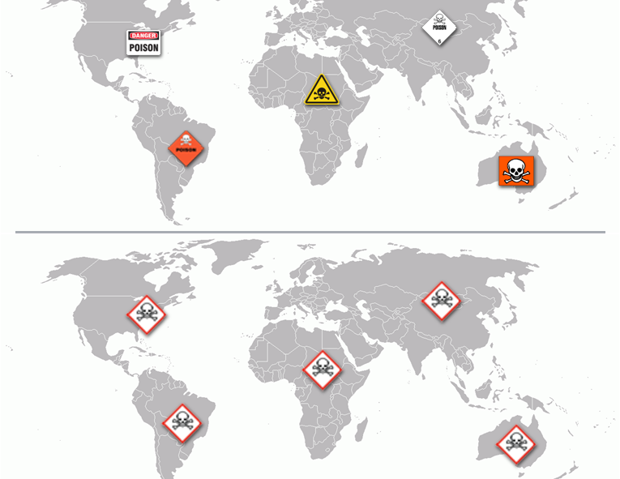
¿Por qué se creó el GHS?
Para sustituir la desigualdad existente…
…por un sistema parejo para todos.
Actividad
M-8
Notes:
Trainer Notes:
[Ask the class to give reasons for creating the GHS. Then click the answer.]
Why was GHS created?
To go from a real mix of approaches and symbols to a consistent world-wide system.

Slide 29
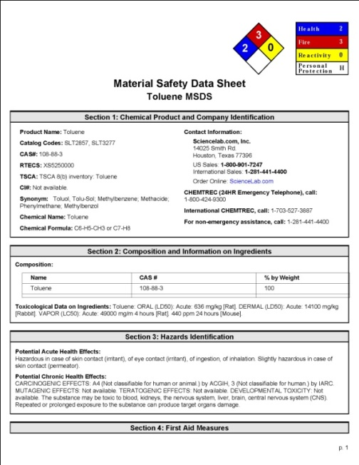
¿Cuáles son los cinco elementos clave de la norma Hazcom de OSHA?
Los empleadores deben contar con un programa Hazcom escrito
Los recipientes deben estar etiquetados y las etiquetas deben seguir un formato uniforme
Las sustancias peligrosas deben tener sus SDS correspondientes en el lugar de trabajo
Los trabajadores deben ser capacitados
Los empleadores deben mantener un inventario actualizado de las sustancias químicas
M-8
Notes:
Trainer Notes:
What are the key elements in the OSHA Hazcom standard?
Employers must have a written Hazcom Program
Containers must be labeled and labels must follow a consistent format
SDSs must be available for hazardous substances in the workplace
Workers must be trained
Employers must have an updated chemical inventory
There are exclusions under the OSHA standard that you should be aware of. Here is a slightly edited version of the standard under 1910.1200(b)(6): This section does not apply to:
Any hazardous waste as such term is defined by the Solid Waste Disposal Act, as amended by the Resource Conservation and Recovery Act of 1976, when subject to regulations issued under that Act by the Environmental Protection Agency;
Any hazardous substance as such term is defined by the Superfund Act (CERCLA) when the hazardous substance is the focus of remedial or removal action being conducted under CERCLA;
Tobacco or tobacco products;
Wood or wood products, including lumber which will not be processed, where the chemical manufacturer or importer can establish that the only hazard they pose to employees is the potential for flammability or combustibility
Articles
Food or alcoholic beverages which are sold, used, or prepared in a retail establishment.
Any drug, as that term is defined in the Federal Food, Drug, and Cosmetic Act.
Cosmetics which are packaged for sale to consumers in a retail establishment, and cosmetics intended for personal consumption by employees while in the workplace.
Any consumer product
Nuisance particulates
Ionizing and nonionizing radiation
Biological hazard

Slide 30
Los programas Hazcom deben estar constituidos de las siguientes partes
Hazcom
Programa escrito
Etiquetas
Capacitación
Inventario de sustancias químicas
SDS
M-8
Notes:
Trainer Notes:
[Point out we will be working our way around this circle starting with the highlighted element.]
Hazcom programs must have all of these parts.

Slide 31
Programa escrito de comunicación de riesgos
Primer requisito indispensable de la norma Hazcom de OSHA
1910.1200 (e)
Photo courtesy eLCOSH
M-9
Notes:
Trainer Notes:
Written Hazard Communication Program
First major requirement of OSHA’s Hazcom Standard
1910.1200 (e)
Employers must develop, implement, and maintain a written Hazcom program at the workplace.
A written hazard communication program ensures that all employers receive the information they need to inform and train their employees properly and to design and put in place employee protection programs. It also provides necessary hazard information to employees, so they can participate in, and support, the protective measures in place at their workplaces. You have the right to review the program on work time!

Slide 32
El programa escrito Hazcom debe estar disponible en la obra y debe incluir lo siguiente:
Una lista de todas las sustancias químicas peligrosas existentes en el lugar
Los métodos que el empleador utilizará para informar a los trabajadores sobre las etiquetas y las SDS
Los métodos que el empleador utilizará para informar a los empleados sobre los riesgos de las tareas no rutinarias
Los métodos que el empleador utilizará para dar a otros empleadores acceso a las SDS dentro de la obra, cuando se trate de obras con muchos empleadores
M-9
Notes:
Trainer Notes:
The written Hazcom program must be available at the job site and must include:
A list of the hazardous chemicals known to be present
The methods the employer will use to inform workers about labels and SDSs
The methods the employer will use to inform employees of the hazards of non-routine tasks
Methods the employer will use to provide the other employers on-site access to SDSs on multi-employer sites

Slide 33
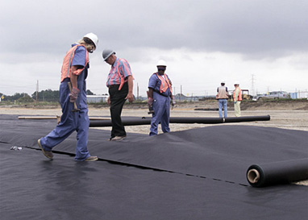
Según lo conferido por la norma Hazcom de OSHA, usted tiene derecho de:
Analizar el programa escrito
Recibir información referente a sustancias peligrosas
Hacer que su médico o representante sindical reciba información en su nombre
Ejercer sus derechos sin miedo a sufrir represalias ni despido
M-10
Notes:
Trainer Notes:
[It is important to emphasis that workers have the RIGHT to learn about the hazards of chemicals they work with or that are used in their area of work. This is a good place to discuss some issues that may arise when employees try to act upon or insist upon their rights.]
You have the right under OSHA’s Hazcom standard to:
Review the written program
Receive information regarding hazardous substances
Have your physician or union rep receive information on your behalf
Exercise your rights without getting fired or other punishment

Slide 34
Etiquetas: segundo requisito indispensable
Hazcom
Programa escrito
Etiquetas
Capacitación
Inventario de sustancias químicas
SDS
1910.1200 (f)
M-10
Notes:
Trainer Notes:
Labels, the second major requirement under the OSHA Hazcom standard. They can look it up at 1910.1200(f).

Slide 35
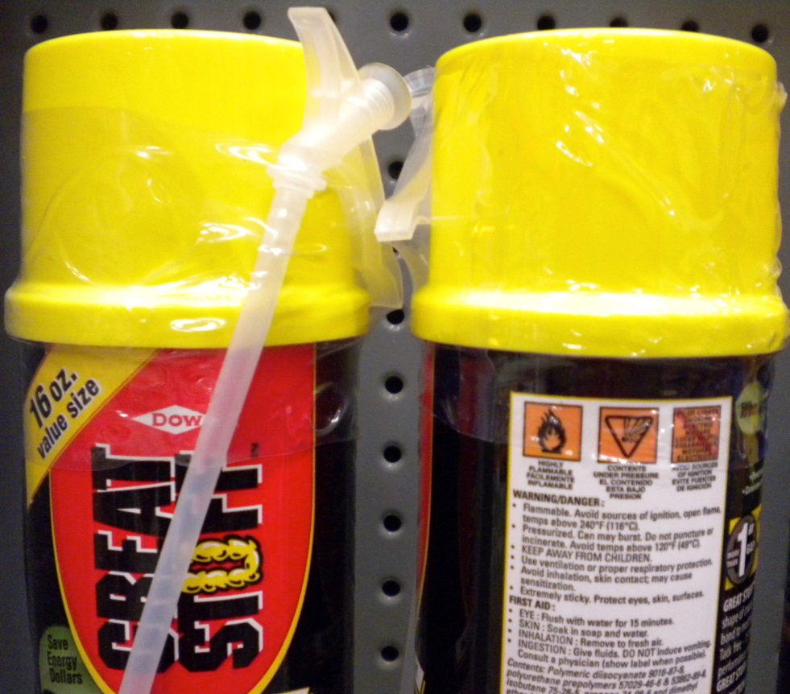
OSHA exige ahora que las etiquetas tengan estos cuatro elementos:
Palabras de advertencia
Declaración del riesgo
Pictogramas del riesgo
Consejos de prudencia
M-10
Notes:
Trainer Notes:
OSHA now requires that labels contain these elements:
Signal word means a word used to indicate the relative level of severity of hazard and alert the reader to a potential hazard on the label. The signal words used are "danger" and "warning." "Danger" is used for the more severe hazards, while "warning" is used for the less severe.
Hazard statement means a statement assigned to a hazard class and category that describes the nature of the hazard(s) of a chemical, including, where appropriate, the degree of hazard.
Hazard pictograms means a composition that may include a symbol plus other graphic elements, such as a border, background pattern, or color, that is intended to convey specific information about the hazards of a chemical. Eight pictograms are designated under this standard for application to a hazard category.
Precautionary statement means a phrase that describes recommended measures that should be taken to minimize or prevent adverse effects resulting from exposure to a hazardous chemical, or improper storage or handling.

Slide 36
La información adicional debe estar incluida en todas las etiquetas
Identificación del producto
Identificación del proveedor
Información suplementaria
M-11
Notes:
Trainer Notes:
Additional information must be included on labels, such as:
Product Identifier - the name or number used for a hazardous chemical on a label or in the SDS
Supplier Identifier - name, address, and telephone number of the chemical manufacturer, importer, or other responsible party
Supplemental Information -

Slide 37
Una o dos palabras de advertencia son exigidas en las etiquetas para recalcar el riesgo. ¿Cuál comunica la mayor gravedad...
✔
peligro? o
advertencia?
Actividad
M-11
Notes:
Trainer Notes:
[Ask for a volunteer to answer the question and explain their answer.]
One of two signal words is required on labels to emphasize hazard. Which communicates greater hazard?
DANGER means severe hazard
WARNING means the product is less hazardous

Slide 38
Las etiquetas también deben contar con consejos de prudencia para describir cómo evitar un daño
Los siguientes son algunos ejemplos:
“Only use non-sparking tools” (Usar solo herramientas que no generen chispas)
“Store in a cool, well ventilated and locked place” (Guardar en un lugar fresco, bien ventilado y cerrado bajo llave)
“Do not breathe vapors” (No inhalar los vapores)
“Wear protective gloves” (Usar guantes protectores)
M-11
Notes:
Trainer Notes:
Labels must also contain standard Precautionary Statements to describe how to prevent harm.
Here are some examples:
“Only use non-sparking tools”
“Store in a cool, well ventilated and locked place”
“Do not breathe vapors”
“Wear protective gloves”

Slide 39
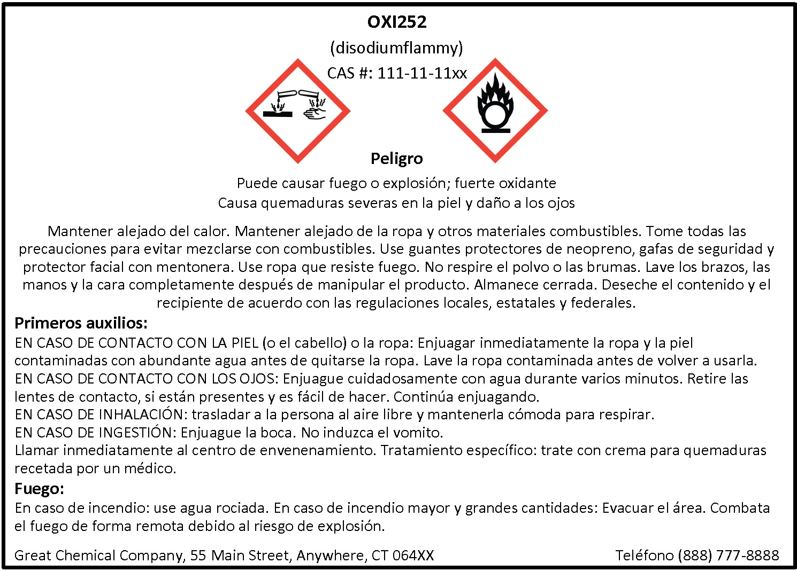
Vamos a analizar una etiqueta de muestra de OSHA
M-11
Notes:
Trainer Notes:
[Go over this example label from OSHA with the class so they can see all of the key elements]

Slide 40
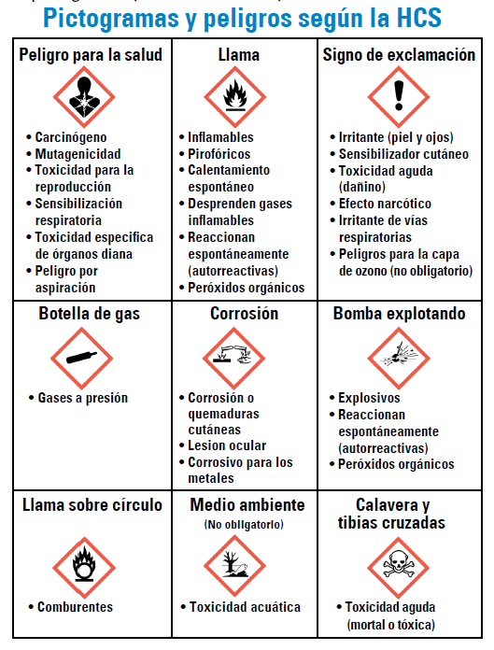
Existen 9 símbolos llamados pictogramas que vamos a estudiar
M-12
Notes:
Trainer Notes:
[Emphasize to the class that although these aren’t required by OSHA until June 1, 2015, they are showing up now because of U.S. companies doing business overseas meeting the GHS requirements in place throughout the world. Don’t try to read each one at this point. There will be considerable explanation and review following.]
There are 9 symbols called pictograms that we will discuss.

Slide 41
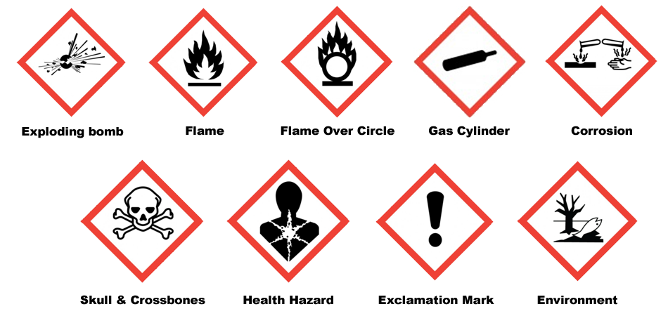
Existen riesgos físicos...*
...y riesgos para la salud
M-12
*Estos son los pictogramas con descripción en inglés
Notes:
Trainer Notes:
[This slide emphasizes the difference between physical and health hazards. There are only 8 pictograms shown here. The environmental one isn’t included because OSHA does not regulate that area, which is not a direct hazard for workers.]

Slide 42
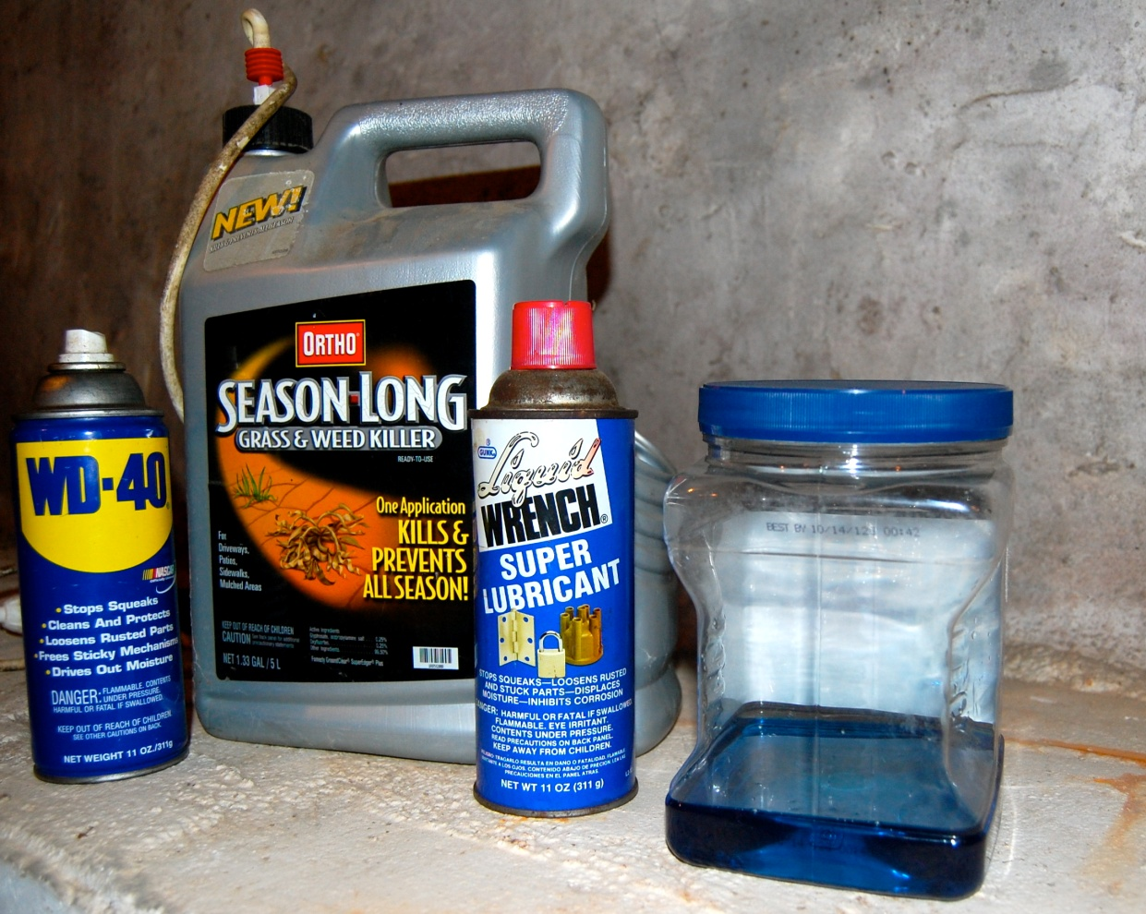
Si echa cualquier cosa en un recipiente, deberá etiquetarlo a menos que lo vaya a usar dentro de su turno y lo mantenga bajo control
M-12
Notes:
Trainer Notes:
If you pour anything into a container it must be labeled unless you are going to use it within the work shift and control it.
Employers can go beyond the minimum standard and require labeling for all containers.

Slide 43

Pictograma de llama
¿Qué tipo de sustancias químicas describe este?
Inflamables
Reaccionan espontáneamente
Pirofóricos
Se calientan espontáneamente
Emiten gas inflamable
Peróxidos orgánicos
M-13
Notes:
Trainer Notes:
[This is a series of 9 pictograms that follow the same format. You should ask for their opinion about the kinds of chemicals that are depicted and then click the answer after sufficient discussion.]
Flammables - a gas having a flammable range with air at 20°C (68°F) and a standard pressure of 101.3 kPa (14.7 psi), a liquid having a flash point of not more than 93°C (199.4°F) or a solid which is a readily combustible solid, or which may cause or contribute to fire through friction.
Self-Reactives are thermally unstable liquid or solid chemicals liable to undergo a strongly exothermic decomposition even without participation of oxygen (air). This definition excludes chemicals classified under this section as explosives, organic peroxides, oxidizing liquids or oxidizing solids. A self-reactive chemical is regarded as possessing explosive properties when in laboratory testing the formulation is liable to detonate, to deflagrate rapidly or to show a violent effect when heated under confinement.
Pyrophorics means a liquid or solid which, even in small quantities, is liable to ignite within five minutes after coming into contact with air.
Self-heating is a solid or liquid chemical, which, by reaction with air and without energy supply, is liable to self-heat; this chemical differs from a pyrophoric liquid or solid in that it will ignite only when in large amounts (kilograms) and after long periods of time (hours or days).
Emits Flammable Gas - solid or liquid chemicals which, by interaction with water, are liable to become spontaneously flammable or to give off flammable gases in dangerous quantities.
Organic Peroxide means a liquid or solid organic chemical which is considered a derivative of hydrogen peroxide. Organic peroxides are thermally unstable chemicals, which may undergo exothermic self-accelerating decomposition.

Slide 44

Llama sobre círculo
¿Qué tipo de sustancias químicas describe este?
Oxidantes*
M-13
*Aumentan la combustión de un incendio
Notes:
Trainer Notes:
[This is not an obvious symbol. You should tell them that the letter O in the symbol should be a memory clue for oxidizer.]
Flame over Circle Pictogram. What kind of chemical does this describe?
Oxidizing liquid means a liquid which, while in itself not necessarily combustible, may, generally by yielding oxygen, cause, or contribute to, the combustion of other material.
Oxidizing solid means a solid which, while in itself is not necessarily combustible, may, generally by yielding oxygen, cause, or contribute to, the combustion of other material.

Slide 45

Signo de exclamación
¿Qué tipo de sustancias químicas describe este?
Irritantes
Sensibilizadores cutáneos
Toxicidad aguda (dañina)
Efectos narcóticos
Irritación de las vías respiratorias
M-13
Notes:
Trainer Notes:
[This is also not an obvious symbol. When noting that this means acute toxicity, it is referring to “harmful” not “severe” toxicity which is represented by the skull and crossbones. These two symbols can never be used together, just one or the other.]
Exclamation Mark Pictogram. What kinds of chemicals does this describe?
Irritant - A chemical, which is not corrosive, but which causes a reversible inflammatory effect on living tissue by chemical action at the site of contact. A chemical is a skin irritant if, when tested on the intact skin of albino rabbits by the methods of 16 CFR 1500.41 for four hours exposure or by other appropriate techniques, it results in an empirical score of five or more.
Dermal Sensitizer - a chemical that will lead to an allergic response following skin contact.
Acute Toxicity (harmful) - refers to those adverse effects occurring following oral or dermal administration of a single dose of a substance, or multiple doses given within 24 hours, or an inhalation exposure of 4 hours.
Narcotic Effects - Central nervous system depression including narcotic effects in humans such as drowsiness, narcosis, reduced alertness, loss of reflexes, lack of coordination, and vertigo are included. These effects can also be manifested as severe headache or nausea, and can lead to reduced judgment, dizziness, irritability, fatigue, impaired memory function, deficits in perception and coordination, reaction time, or sleepiness;
Respiratory Tract Irritation - (characterized by localized redness, edema, pruritis and/or pain) that impair function with symptoms such as cough, pain, choking, and breathing difficulties are included.

Slide 46

Bomba explotando
¿Qué tipo de sustancias químicas describe este?
Explosivos
Reaccionan espontáneamente
Peróxidos orgánicos
M-13
Notes:
Trainer Notes:
Exploding Bomb Pictogram. What kinds of chemicals does this describe?
Explosives - a solid or liquid chemical which is in itself capable by chemical reaction of producing gas at such a temperature and pressure and at such a speed as to cause damage to the surroundings. Pyrotechnic chemicals are included even when they do not evolve gases.
Self-Reactives - are thermally unstable liquid or solid chemicals liable to undergo a strongly exothermic decomposition even without participation of oxygen (air). This definition excludes chemicals classified under this section as explosives, organic peroxides, oxidizing liquids or oxidizing solids. A self-reactive chemical is regarded as possessing explosive properties when in laboratory testing the formulation is liable to detonate, to deflagrate rapidly or to show a violent effect when heated under confinement.
Organic Peroxides - means a liquid or solid organic chemical which is considered a derivative of hydrogen peroxide.. Organic peroxides are thermally unstable chemicals, which may undergo exothermic self-accelerating decomposition.

Slide 47

Corrosión
¿Qué tipo de sustancias químicas describe este?
Corrosivos
M-13
Notes:
Trainer Notes:
Corrosion Pictogram. What kinds of chemicals does this describe?
Skin corrosion is the production of irreversible damage to the skin; namely, visible necrosis through the epidermis and into the dermis, following the application of a test substance for up to 4 hours. Corrosive reactions are typified by ulcers, bleeding, bloody scabs, and, by the end of observation at 14 days, by discoloration due to blanching of the skin, complete areas of alopecia, and scars. Histopathology should be considered to evaluate questionable lesions.

Slide 48

Botella de gas
¿Qué tipo de sustancias químicas describe este?
Gases bajo presión
M-13
Notes:
Trainer Notes:
Gas cylinder pictogram. What kinds of chemicals does this describe?
Gases under pressure

Slide 49

Peligro para la salud
¿Qué tipo de sustancias químicas describe este?
Carcinógeno
Sensibilizadores respiratorios
Toxicidad para la reproducción
Toxicidad en órganos específicos
Mutagenicidad
Toxicidad por aspiración
M-13
Notes:
Trainer Notes:
[Point out that this symbol covers a lot of health effects.]
Health Hazard Pictogram. What kinds of chemicals does this describe?
Carcinogen means a substance or a mixture of substances which induce cancer or increase its incidence. Classification of a substance or mixture as posing a carcinogenic hazard is based on its inherent properties and does not provide information on the level of the human cancer risk which the use of the substance or mixture may represent.
Respiratory Sensitizer means a chemical that will lead to hypersensitivity of the airways following inhalation of the chemical.
Reproductive Toxicity - includes adverse effects on sexual function and fertility in adult males and females, as well as adverse effects on development of the offspring.
Target Organ Toxicity - causes harm in specific organs
Mutagenicity - A mutation is defined as a permanent change in the amount or structure of the genetic material in a cell. The term mutation applies both to heritable genetic changes and to the underlying DNA modifications. The term mutagenic and mutagen will be used for agents giving rise to an increased occurrence of mutations in populations of cells and/or organisms.
Aspiration Toxicity Aspiration is a medical term referring to sucking in fluid. When you drink soda through a straw you are aspirating it into your mouth. In first aid and medical care it means getting fluids (or small solid particles) into the airways (trachea or lungs). It includes severe acute effects such as chemical pneumonia, varying degrees of pulmonary injury or death following aspiration.

Slide 50

Calavera y tibias cruzadas
¿Qué tipo de sustancias químicas describe este?
Toxicidad aguda (grave)
M-13
Notes:
Trainer Notes:
[Again, point out that this symbol is the severe version of the exclamation mark and if the skull and crossbones is used, the exclamation point can’t be used.]
Skull and Crossbones. What kinds of chemicals does this describe?
Acute Toxicity (severe)

Slide 51

Contaminantes ambientales
OSHA no se ocupa de hacer cumplir los reglamentos medioambientales.
Forma parte del GHS, pero no de la norma 1910.1200
M-13
Notes:
Trainer Notes:
Environmental pollutant
OSHA doesn’t enforce environmental regulations!
This is part of GHS, but not 1910.1200

Slide 52








Una los pictogramas con su significado correspondiente
A
B
C
D
E
F
G
H
Inflamables
Efectos narcóticos
Oxidantes
Se calientan espontáneamente
Irritantes
Peróxidos orgánicos
Explosivos
Gases bajo presión
Carcinógenos
Sensibilizadores cutáneos
Toxicidad aguda (dañina)
Irritación de las vías respiratorias
Reaccionan espontáneamente
Corrosivos
Sensibilizadores respiratorios
Toxicidad para la reproducción
Toxicidad en órganos específicos
Mutagenicidad
Ejercicio en grupo
Actividad
M-14
Notes:
Trainer Notes:
[This exercise is in their student manual. You can have them do it individually or in a group.]
Match pictograms with their meanings
Flammables
Narcotic Effects
Oxidizers
Self-heating
Irritant
Organic Peroxides
Explosives
Gases Under Pressure
Carcinogen
Dermal Sensitizer
Acute Toxicity (harmful)
Respiratory Tract Irritation
Self-Reactives
Corrosives
Respiratory Sensitizer
Reproductive Toxicity
Target Organ Toxicity
Mutagenicity

Slide 53
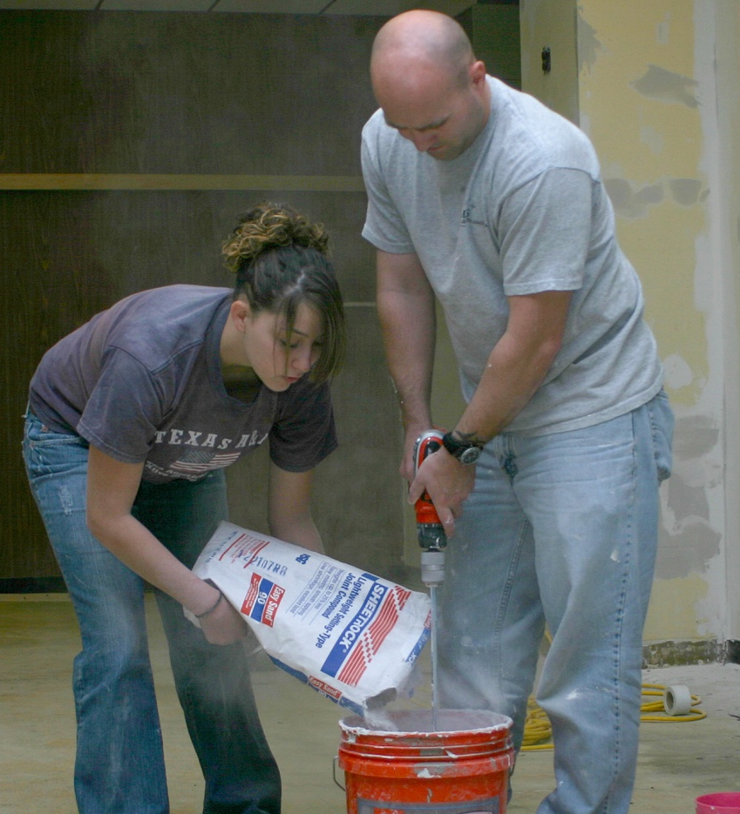


Este es un ejemplo de una palabra de advertencia, un consejo de prudencia y pictogramas en una etiqueta
ADVERTENCIA
Provoca irritación en la piel y los ojos
La piel y los ojos están desprotegidos
¿La etiqueta transmite el mensaje?
M-13
Notes:
Trainer Notes:
[Ask if the label is working. What you are really asking is whether the users of this product are protecting their skin and eyes. This is an important lesson you can draw about the effectiveness of administrative controls which are towards the bottom of the hierarchy of controls, as we will see in Section 7.]
This is an example of a signal word, precautionary statement and pictograms on a label.

Slide 54
Hojas de datos de seguridad (SDS):
Tercer requisito indispensable
Hazcom
Programa escrito
Etiquetas
Capacitac-ión
Inventario de sustancias químicas
SDS
1910.1200 (g)
M-15
Notes:
Trainer Notes:
Safety Data sheets are the third major requirement under the OSHA Hazcom standard. They can look it up at 1910.1200(g).

Slide 55
Las hojas de datos de seguridad deben seguir un formato de 16 secciones, conforme a la norma ANSI Z400.1
Identificación
Identificación del riesgo o riesgos
Composición; información sobre los ingredientes
Medidas de primeros auxilios
Medidas para combatir incendios
Medidas para enfrentar una emanación accidental
Manipulación y almacenamiento
Controles de exposición, protección personal
M-15
Notes:
Trainer Notes:
[Take time to explain the ANSI (American National Standards Institute) Z440.1 standard before going through the explanation of the sections. This standard was developed by the Chemical Manufacturers Association, but adopted by ANSI in 1993. It has become adopted internationally under the GHS.]
Safety Data Sheets must use a format with 16 sections, based on ANSI Z400.1.
They are:
Section 1: Identification includes the product identifier, the name of the manufacturer or distributor along with the phone number and an emergency number. It also lists the recommended use of the of the product as well as restrictions.
Section 2: Hazard(s) identification includes all the dangers about the chemical.
Section 3: Composition/information on ingredients lists the different chemicals in the product and any trade secret claims.
Section 4: First-aid measures describes the important symptoms, immediate or delayed health effects, and required treatment.
Section 5: Fire-fighting measures list the proper ways to extinguish fires, the equipment, and chemical hazards from fire.
Section 6: Accidental release measures explain the emergency procedures, protective equipments and proper methods of containment and cleanup.
Section 7: Handling and storage describe precautions for safe handling and storage, including other chemicals that are not compatible with the product.
Section 8: Exposure controls/personal protection lists OSHA’s Permissible Exposure Limits, Threshold Limit Values along with appropriate engineering controls and personal protective equipment

Slide 56
Las secciones figuran en orden de importancia y de la 12 a la 15 son opcionales
Propiedades físicas y químicas
Estabilidad y reactividad
Información toxicológica
Información ecológica
Consideraciones de eliminación
Información de transporte
Información regulatoria
Otra información
M-15
Notes:
Trainer Notes:
The sections are in order of importance and 12 -15 aren’t mandatory.
Section 9: Physical and chemical properties list the product’s characteristics such as vapor density, flash point or explosive limits.
Section 10: Stability and reactivity refer to the chemical’s stability and the possibility of hazardous reactions.
Section 11: Toxicological information includes the ways the chemical can enter the body the various health effects it can cause.
(Nonmandatory)
Section 12: Ecological information refers to damage the chemical can cause to the environment but is not enforced by OSHA.
Section 13: Disposal considerations cover possible dangers when disposing the chemical but is not enforced by OSHA.
Section 14: Transport information concerns potential hazards when transporting the chemical but is not enforced by OSHA.
Section 15: Regulatory information is not enforced by OSHA.
Section 16: Other information includes the date the SDS was prepared or the last revision.

Slide 57

Siempre que el empleador reciba una SDS nueva o revisada que podría tener un efecto sobre la salud, deberá notificarle en un plazo máximo de 30 días
M-16
Notes:
Trainer Notes:
Whenever the employer receives a new or revised SDS that could impact your health, you must be informed within 30 days after receipt.
From the OSHA standard:
“…such information shall be provided to employees on a timely basis not to exceed 30 days after receipt, if the new information indicates significantly increased risks to, or measures necessary to protect, employee health as compared to those stated on a material safety data sheet previously provided.”

Slide 58

¿Dónde se encuentran las SDS en la obra donde trabaja?
Notes:
Trainer Notes:
[Ask for a volunteer to answer and explain their answer.]
Where are SDSs located at your site?
[Recommend that if a worker doesn’t know where to start they should go to the general contractor’s trailer. If that isn’t possible, they can go to the subcontractor trailers to find the appropriate SDS.]

Slide 59

Analizar una hoja de datos de seguridad
Foto cortesía de Whiting Turner Construction Co. y George Washington U., Neil Lippy, Fotógrafo
M-17
Notes:
Trainer Notes:
Activity: Reviewing a Safety Data Sheet
[In this activity, there are SDSs for all of the chemicals in Appendix B that the class can use. There are also exposure data that can be referenced.]

Slide 60
Cuadro de productos y exposiciones
Oficio | Tarea | Producto | Sustancia química en cuestión | Datos de exposición disponibles
Carpintero | Recubrir madera Untar pega | MINWAX Fast Drying Polyurethane PL300 | Hidrocarburo Alifático Ligero Caliza | 61 ppm (muestra de 15 minutos) <0.025 mg/m3
Pintor | Dar una mano de pintura | Sherwin Williams PRO INDUSTRIAL™ Multi-Surface Acrylic Eg-Shel | 2-Butoxietanol | 0.04 a 367 ppm
Albañil (sheet metal) | Instalar ductos | 3M Fastbond 900 Sealer | Etilbencina | 5.0 ppm
Albañil | Reparar juntas o sellar grietas | Sikaflex Crack Flex Sealant | Isocianato | <0.001 a <0.002 ppm
Techador | Aplicar alquitrán de hulla | Tremfix Coal Tar Roofing Pitch | Sustancias volátiles del alquitrán de hulla | 0.14 a 1.93 mg/m3
M-17
Notes:
Trainer Notes:
[The students have these SDSs in Appendix B. Feel free to use them however you see fit. You can have them use just one SDS for the specific trade you are teaching or several to allow the class to see the chemicals other trades are exposed to.]

Slide 61
Analice la SDS de un producto utilizado en una tarea específica y estudie la sustancia química en cuestión y los datos de exposición proporcionados
¿Qué efectos podría tener este producto en la salud?
¿Hay probabilidad de que las exposiciones sobrepasen el Nivel de exposición ocupacional (OEL)? ¿O el Límite de exposición permisible (PEL)?
¿Es su producto combustible? ¿inflamable?
¿Hay alguna otra sustancia química que le preocupe?
Actividad
M-18
Notes:
Trainer Notes:
[Explain to the class that OELs stands for Occupational Exposure Limits and includes Threshold Limit Values by the American Conference of Governmental Industrial Hygienists and the Recommended Exposure Limits of NIOSH. PELs are the OSHA Permissible Exposure Limits and are the only occupational exposure limits that are regulation the employers must follow.]
Review a SDS for product used for a specific task and consider the chemical of concern and exposure data provided
What health effects may be experienced when using this product?
Are exposures likely to be over the OELs? The PELs?
Is your product combustible? Flammable?
Are there additional chemicals that you are concerned about?

Slide 62
Información y capacitación de empleados: cuarto requisito indispensable
Hazcom
Programa escrito
Etiquetas
Capacitación
Inventario de sustancias químicas
SDS
M-19
1910.1200 (h)
Notes:
Trainer Notes:
Employee Information and Training, This is the fourth major requirement of OSHA Hazcom Standard. 1910.1200 (h)

Slide 63
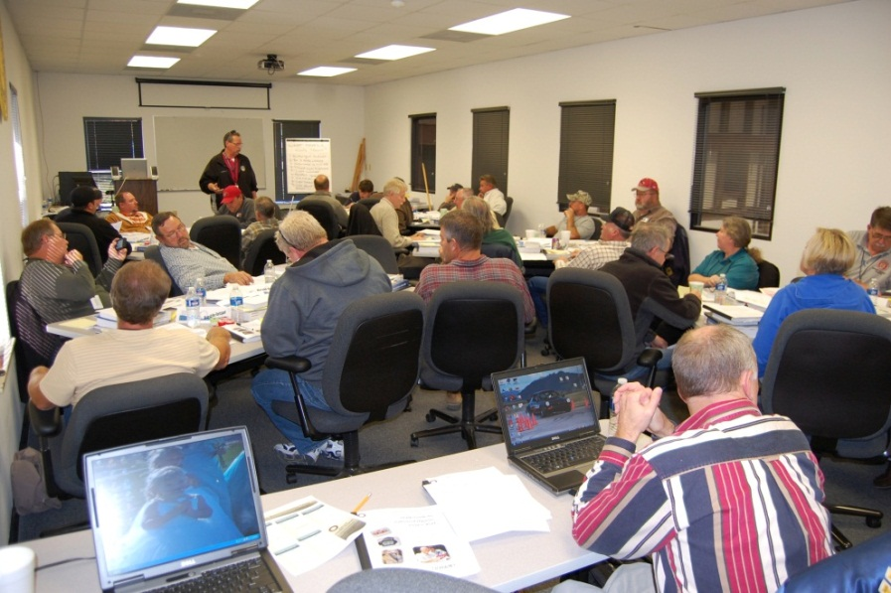
Los trabajadores deben recibir capacitación en:
Los requisitos de la norma Hazcom
Las operaciones dentro de las áreas de trabajo donde existan sustancias peligrosas
La naturaleza física y química de esos riesgos
M-19
Notes:
Trainer Notes:
Workers must be trained on:
Requirements of the Hazcom standard
Operations in their work area where hazardous substances are present
The physical and chemical nature of those hazards

Slide 64
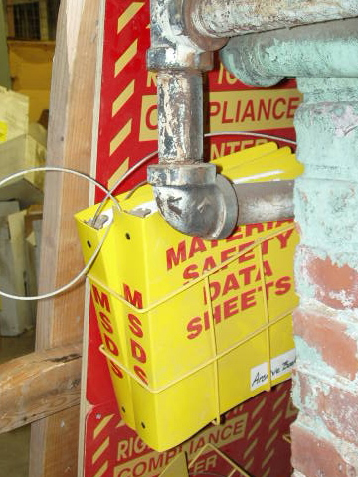
Los trabajadores también deben recibir capacitación en:
Los métodos para detectar la presencia o la emanación de una sustancia peligrosa en el área de trabajo
Medidas de protección
Los detalles y la ubicación del programa Hazcom escrito de su empleador
Ubicación y disponibilidad de las SDS
Los derechos especiales que Hazcom otorga a los empleados
Sistemas de etiquetado
M-19
Notes:
Trainer Notes:
Workers must also be trained on:
Methods to detect the presence or release of a hazardous substance
Protective measures to take
Location and details of their employer’s written Hazcom program
Location and availability of SDSs
Special employee rights under Hazcom
Labeling systems
Special employee rights may include additional training if a new chemical (with new hazards) is introduced into the work area, that employer has ensured each worker has an efficient level of knowledge with regard to the hazards in the workplace, their familiarity with the requirements of the standard, and the employer's hazard communication program, etc. This special rights may also be work site, or chemical specific.

Slide 65
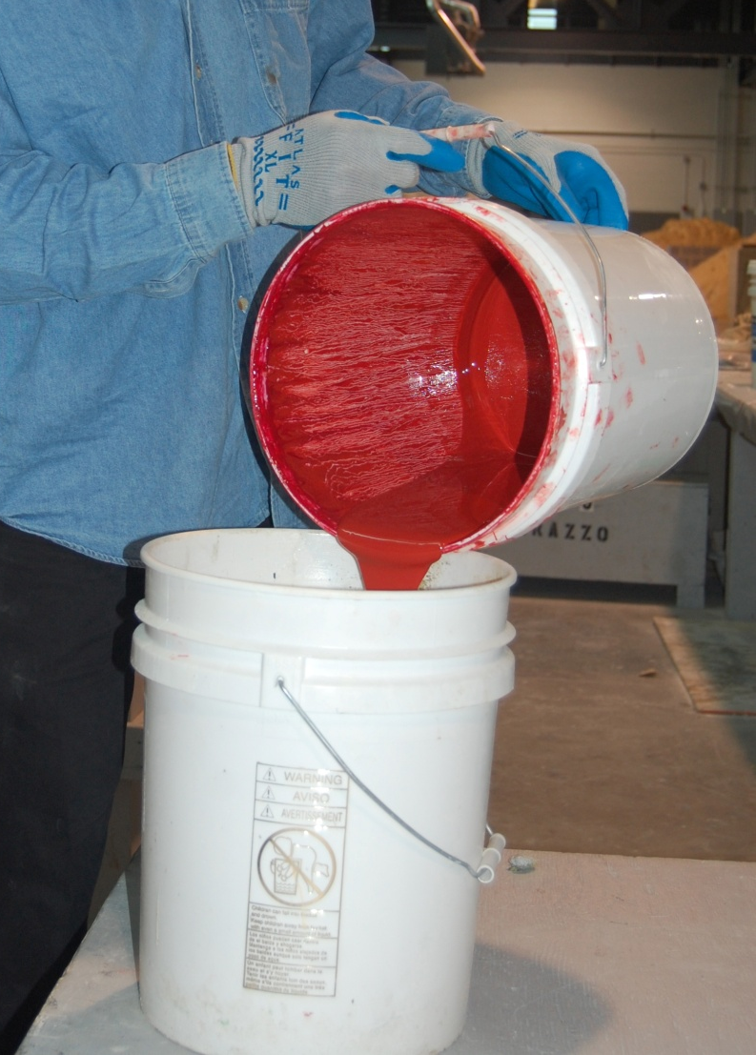
¿Existe un requisito de capacitación anual en Hazcom?
NO.
OSHA exige capacitación cuando se asigna la tarea inicial y siempre que un nuevo riesgo químico sea introducido en el área de trabajo
Actividad
Imagen cortesía de International Masonry Institute
M-19
Notes:
Trainer Notes:
[This is one of the major misunderstandings about the standard. Ask this question before clicking to the answer.]
Is there an annual Hazcom training requirement? NO.
OSHA requires training at time of initial assignment and whenever a new chemical hazard is introduced into the work area
From the standard:
Employers shall provide workers with effective information and training on hazardous substances in their work area at the time of their initial assignment and whenever a new hazard is introduced into their work area.
Photo shows a mason pouring a red colorant for grout.

Slide 66
Debe tener acceso permanente a una lista de todas las sustancias químicas peligrosas existentes en el lugar
Hazcom
Programa escrito
Etiquetas
Capaci-tación
Inventario de sustancias químicas
SDS
1910.1200 (e)(1)(i)
M-19
Notes:
Trainer Notes:
A list of the hazardous chemicals known to be present must be available for your review.
The list must use a product identifier that is referenced on the appropriate safety data sheet (the list may be compiled for the workplace as a whole or for individual work areas).

Slide 67
Análisis de los efectos comunes sobre la salud
Sección 3
M-20
Notes:
Trainer Notes:
Review of common health effects

Slide 68
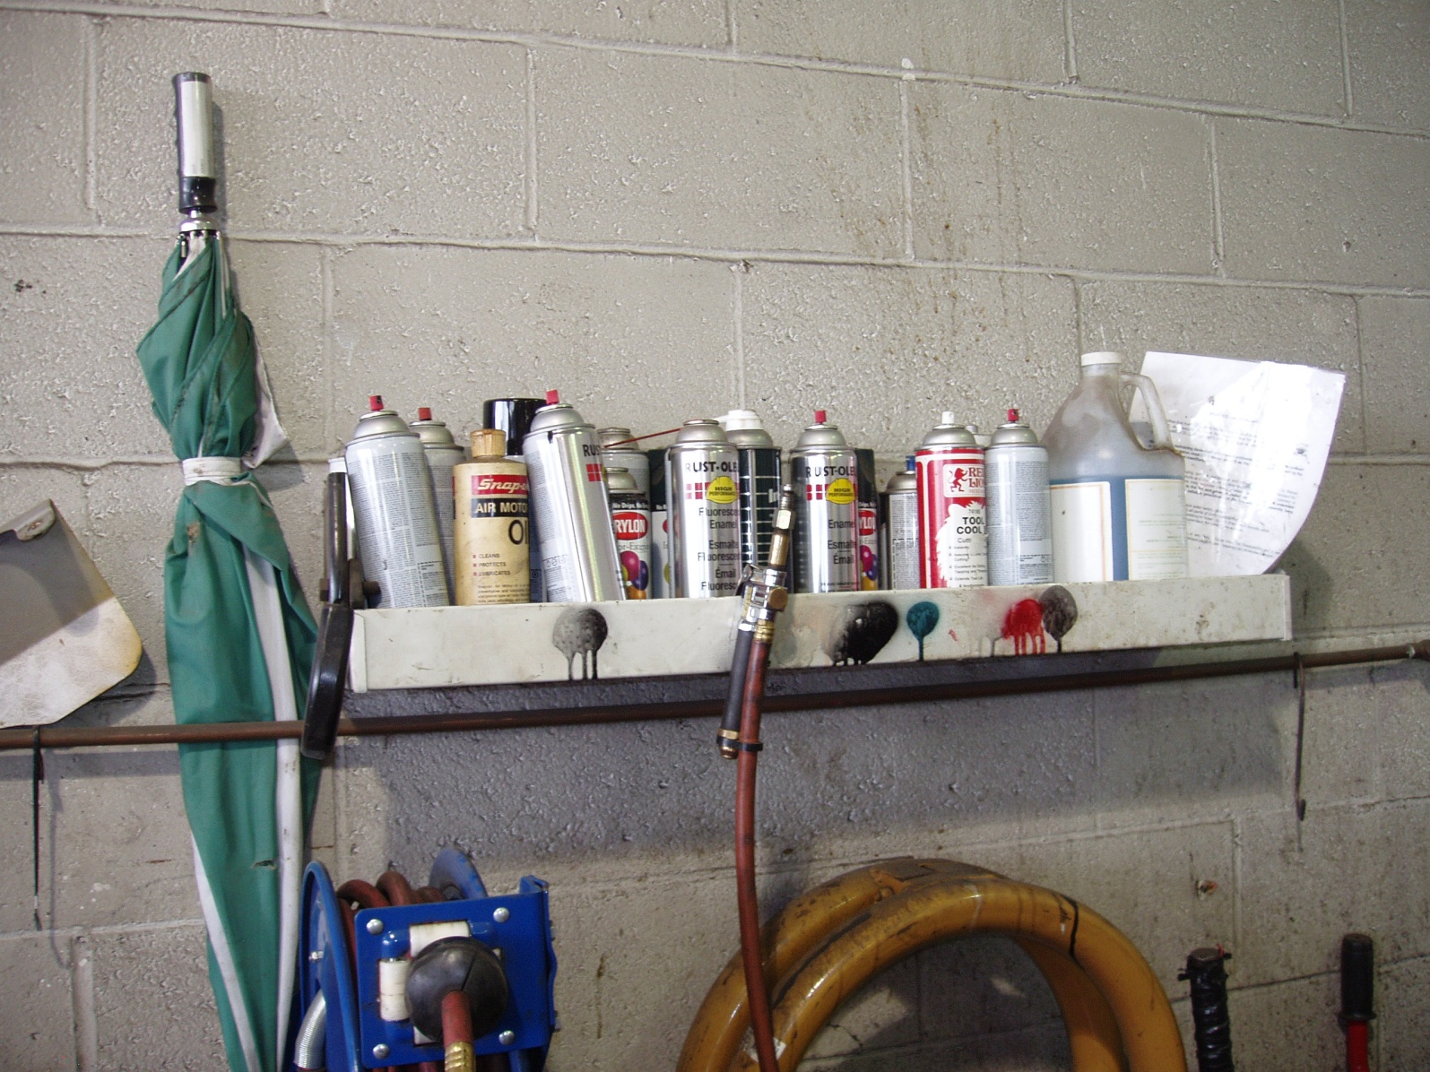
Existe una gran variedad de efectos sobre la salud que son causados por las sustancias químicas
M-20
Notes:
Trainer Notes:
There is a range of health effects caused by chemicals.

Slide 69
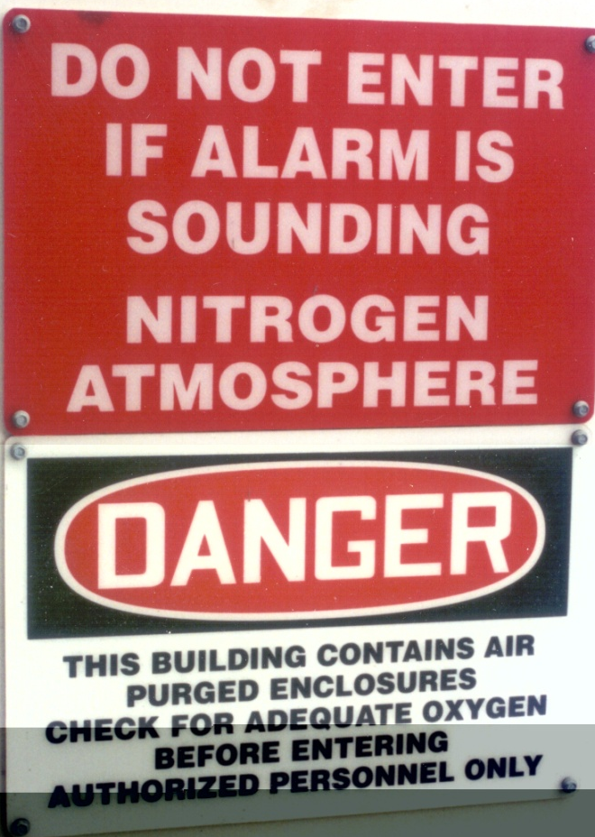
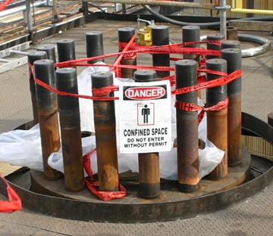
Si una sustancia química desplaza tal cantidad de aire que no deja suficiente oxígeno para respirar, puede ocasionar asfixia simple
M-20
Notes:
Trainer Notes:
[Point out that 2 workers died in this particular confined space in 2006. The case study by the Chemical Safety Board summarized below. There is a video of the incident at the CSB site.]
If a chemical replaces too much air there isn’t enough oxygen to breathe causing simple asphyxiation.
This Case Study describes the Valero Delaware City refinery asphyxiation death of two contractor employees who were preparing to reassemble a pipe on a pressure vessel while it was being purged with nitrogen. The first worker, in an attempt to retrieve a roll of duct tape from inside the vessel, was overcome by nitrogen, collapsed in the vessel,
and died. His co-worker, the crew foreman, was asphyxiated while attempting to rescue him.
Link to the case study: http://www.csb.gov/assets/document/Valero_Case_Study.pdf
Link to the video and more: http://www.csb.gov/investigations/detail.aspx?SID=25&Type=2&pg=1&F_All=y

Slide 70
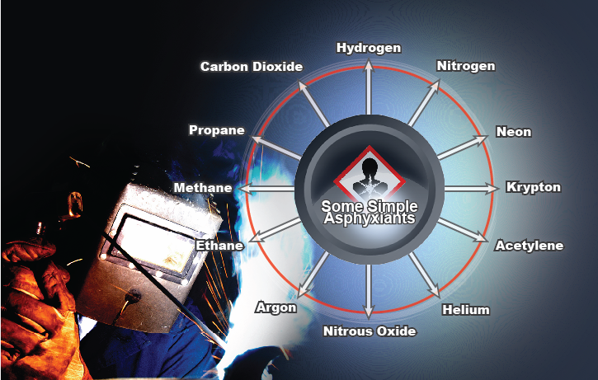
Existen muchos asfixiantes simples
Notes:
Trainer Notes:
[Ask the class, which of these gases could be found on a construction job.]
There are many simple asphyxiants.

Slide 71
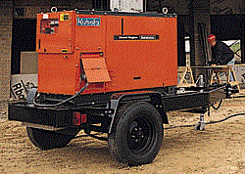
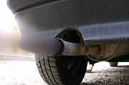
Los asfixiantes químicos reducen la capacidad de la sangre para transportar oxígeno, lo que puede producir asfixia
  ¿Ejemplos?
Ácido sulfhídrico
Monóxido de carbono
Cianuro de hidrógeno
M-21
Notes:
Trainer Notes:
Chemical asphyxiants reduce the blood's ability to carry oxygen which can lead to suffocation.
Examples:
Hydrogen sulfide
Carbon monoxide
Hydrogen cyanide

Slide 72
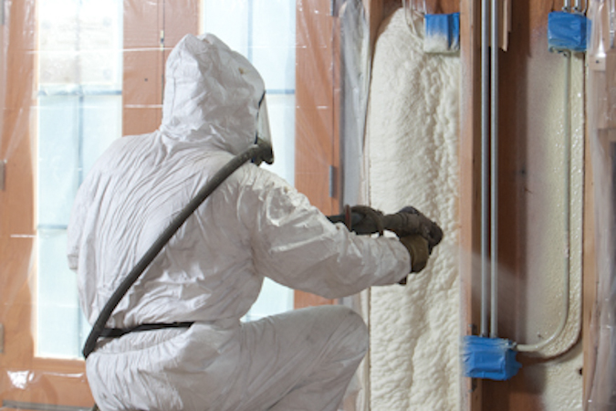
Los sensibilizadores y alérgenos desencadenan tal reacción en el cuerpo que hasta la más mínima exposición puede provocar un efecto
  ¿Ejemplos?
Actividad
Foto cortesía de Chicago Spray Foam y Steve Becker
M-21
Notes:
Trainer notes:
[Ask for an example and guide them towards poison ivy and oak as something everyone is familiar. Ask about the photo, which is a photo of sprayed foam insulation which contains isocyanates, very potent sensitizers.]
Sensitizers and allergens set up a reaction in the body so that even minor exposures can cause a reaction so that once sensitized or allergic, smaller and smaller exposures can cause a reaction, and the reaction can become more severe.
Examples:
Sprayed foam insulation with isocyanates, oil-based paints, wood dust, poison oak and ivy (Rhus family plants)

Slide 73
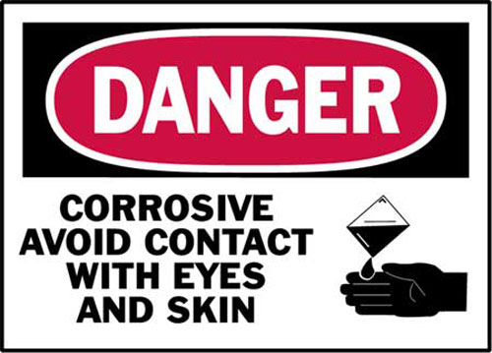
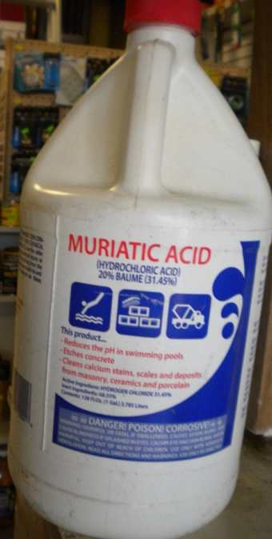
Los corrosivos pueden causar graves daños en el cuerpo
  Los ácidos y las bases son sustancias químicas corrosivas
  Pueden lesionar la piel, los ojos y los pulmones
  La magnitud del daño en la piel depende de la cantidad de tiempo que permanezca el corrosivo en ella y de su concentración
PELIGRO. Corrosivo. Evitar contacto con los ojos y la piel.
M-22
Notes:
Trainer Notes:
Corrosives can severely damage the body
Acids and bases are corrosive chemicals
Damaging to the skin, eyes and lungs
Extent of damage depends on how long the corrosive is on the skin and the strength of the corrosive

Slide 74

Los mutágenos pueden provocar alteraciones genéticas y pueden producir defectos de nacimiento u otros problemas en generaciones futuras
  Examples?
Ilustración del ADN, cortesía de Spiffistan
  ¿Ejemplos?
Radiación ionizante, agua oxigenada, bromo
M-22
Notes:
Trainer notes:
Mutagens cause genetic changes and can lead to birth defects or other problems in following generations.
Examples?
Ionizing radiation, hydrogen peroxide, bromine

Slide 75

¿Qué son los teratógenos?
  Los teratógenos son compuestos que pueden ocasionar daño al feto en desarrollo provocando defectos congénitos o la muerte
  ¿Ejemplos en obras de construcción?
  Metales pesados, particularmente el plomo y el mercurio
M-23
Notes:
Trainer Notes:
What are teratogens? Answer: Compounds that can harm the developing fetus, causing birth defects or death
Examples on construction jobs? Answer: Heavy metals, particularly lead and mercury
[Ask the questions before clicking the answers.]
Background:
The worst case of a teratogen exposure to a population was the Minamata Bay, Japan incident which was discovered in 1956. In this case, Methyl Mercury was used as a catalyst in a chemical process at Chisso Corporation’s chemical factory, which continued to dump the product from 1932 to 1968 into Minamata Bay.
Lead has been shown to a powerful teratogen, causing learning disabilities and other problems in children whose mothers are exposed to lead dust while pregnant. Even children who suffer no damage from lead in the womb, can have lots of problems caused by lead from living in houses with lead-based paint. Dr. Herbert Needleman conducted an innovative study using the baby teeth of children to identify high lead levels and followed them for years showing higher rates of dropping out of school, behavioral problems and trouble with the law. Here is a link to a Wikipedia account of his work:
http://en.wikipedia.org/wiki/Herbert_Needleman

Slide 76
Las sustancias químicas que producen cáncer deben nombrarse en la SDS incluso si la cantidad es de apenas 0.1 por ciento del producto
M-23
Notes:
Trainer’s Notes:
Cancer-causing chemicals must be listed on an SDS even if the amount is only 0.1 percent of the product. Other chemicals must be listed on an SDS if the amount is 1.0 percent of the product.

Slide 77
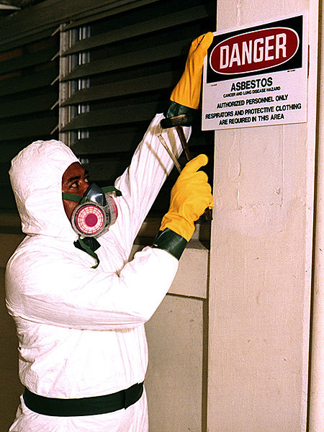
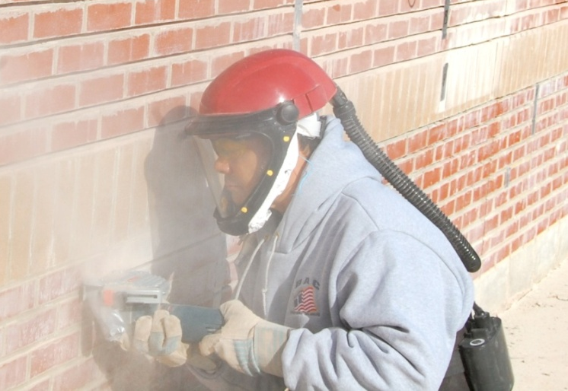

Los siguientes son algunos carcinógenos conocidos y supuestos
Asbesto
Benceno
Berilio
Cadmio
Emanaciones de asfalto
Sílice
Fotografía de Neil Lippy para eLCOSH
Foto cortesía del gobierno de Estados Unidos
Foto cortesía de Wikimedia
M-23
Notes:
Trainer Notes:
[NIOSH states that there is no know safe exposure level for carcinogens. Ask what that means for working with carcinogens.]
Here are a few known and suspected human carcinogens.
Asbestos
Benzene
Beryllium
Cadmium
Asphalt fume
Silica
[NIOSH states that there is no know safe exposure level for carcinogens. Ask what that means for working with carcinogens.]

Slide 78
Los efectos de las sustancias químicas sobre el cuerpo dependen de muchos factores:
La forma física de la sustancia química
Cómo las sustancias químicas penetran en el cuerpo (vía de penetración)
La dosis
La toxicidad
La reacción personal a la sustancia química
M-24
Notes:
Trainer Notes:
[This slide is a summary slide for the overview of chemicals and their effects on the body.]
Chemical effects on the body depend on the:
Physical form of the chemical
How chemicals get into the body (route of entry)
Dose
Toxicity
Individual’s reaction to the chemical

Slide 79

“El verdadero veneno es la dosis”
“Todas las sustancias son venenosas. No hay una que no lo sea. La dosis correcta es lo que diferencia el remedio del veneno”
Paracelso (1493-1541)
M-24
Notes:
Trainer Notes:
A sixteenth-century Swiss chemist named Paracelsus gave us the most basic rule of toxicology: "The dose makes the poison." Practically every substance on earth (including water and Vitamin C) can kill you if it's concentrated enough in your stomach or your bloodstream.
For instance, let’s take a very common substance, caffeine. If a person consumes 10 grams of caffeine at one time, that amount would be fatal. However, caffeine is a common substance which is found in our food and beverages.

Slide 80
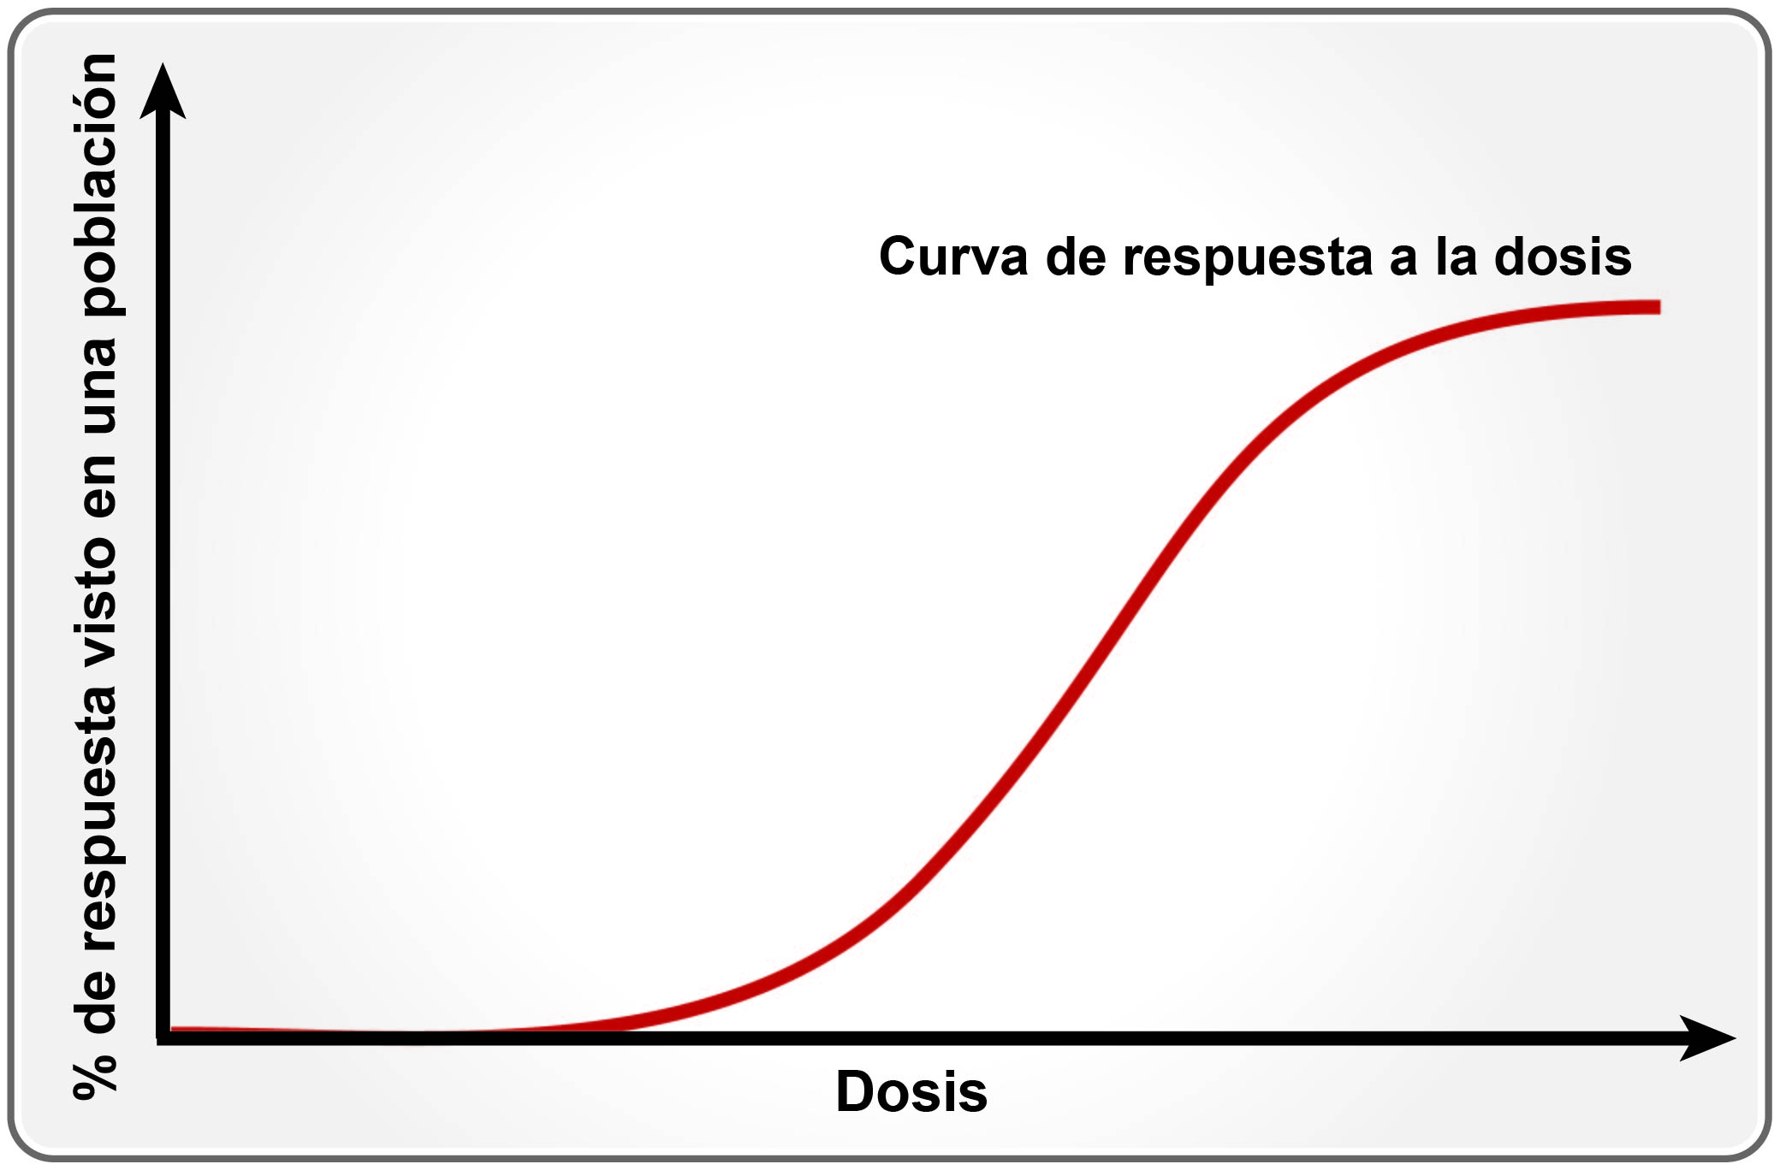
La curva de respuesta a una dosis determinada ilustra cómo la gente responde a las sustancias químicas tóxicas
M-24
Notes:
Trainer Notes:
[You should point out that as the dose increases along the horizontal axis, there is no response at first. But as the dose increases, the most sensitive people in the population start to respond and then a higher and higher percentage is affected until all of the population is affected and the curve levels off. No more people left who aren’t affected by the chemical.
The dose response curve shows us how people respond to toxic chemicals.

Slide 81
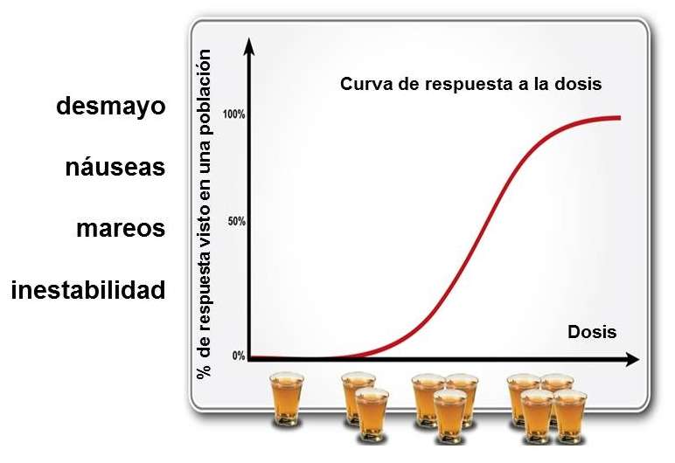
Veamos la curva de respuesta al consumo de alcohol según la dosis
M-24
Notes:
Trainer Notes:
Let’s look at the dose response curve for alcohol consumption
[The amount of a chemical, just like drinks, can have a cumulative effect. We don’t show any effect with just one drink, but as we continue showing effects until the amount is so great everyone would have an effect. You can ask, “Why do some people react differently to chemical exposures?” Continuing with the alcohol example, this is really asking what factors may impact different levels of impairment beside number of drinks. Your class may answer: weight, metabolism, pre-existing medical conditions. This is also true for exposure to chemicals." ]

Slide 82
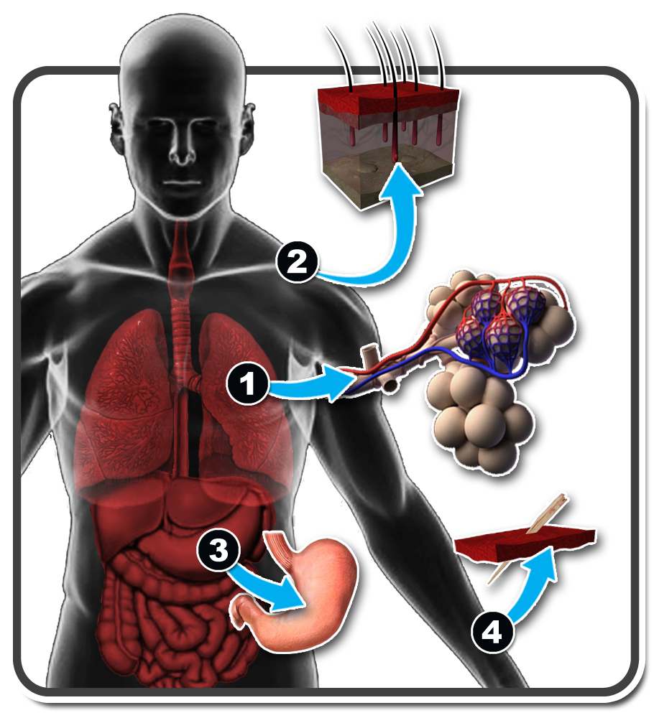
¿Cómo se introducen las sustancias químicas en el cuerpo?
Respiración (inhalación)
Absorción a través de la piel
Tragado (ingestión)
Inyección
¿Cuál es la vía más común?
M-25
Notes:
Trainer’s Notes:
Chemicals are only a hazard when you have been exposed to them. There are four major routes in which chemicals can enter your body. The most common type of exposure is through inhalation. You inhale the chemical, which would then enter your lungs, where it would be absorbed into your bloodstream. The majority of our exposure to chemicals is through inhalation. We breathe approximately 20-to-25 thousand breaths in one day, which averages a total volume of 10,000 –14,000 liters of air in a day.
The second most common type of workplace chemical exposure is absorption through the skin. For certain chemicals, once it is absorbed through the skin, it goes into the bloodstream.
The third most common type of chemical exposure is through ingestion, where the chemical enters the body through your mouth and is absorbed through the digestive tract. To minimize the ingestion route, good hygiene practices need to be observed–wash your face and hands prior to eating and drinking.
The last type of chemical exposure is through injection in which the chemical enters the body through a sharp object like a needle.

Slide 83
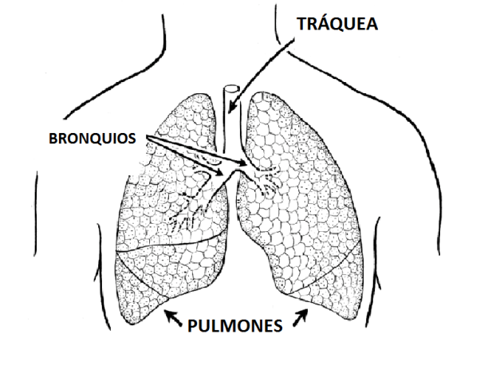
1. Inhalación
Las sustancias químicas transportadas por el aire son respiradas a través de la boca o la nariz
Los gases y vapores pueden llegar a lo más profundo de los pulmones
El tamaño de las partículas y gotas incide en donde se asienta la sustancia química en el aparato respiratorio, lo cual repercute en los síntomas y enfermedades
Ilustración cortesía de Pearson Scott Foresman y Wikimedia. Traducción interna
M-26
Notes:
Trainer Notes:
1. Inhalation
Airborne chemicals are breathed in through the mouth or nose
Gases and vapors can reach the deep lungs
Particle and droplet size affects where the chemical settles in the respiratory tract, which influences symptoms and disease

Slide 84
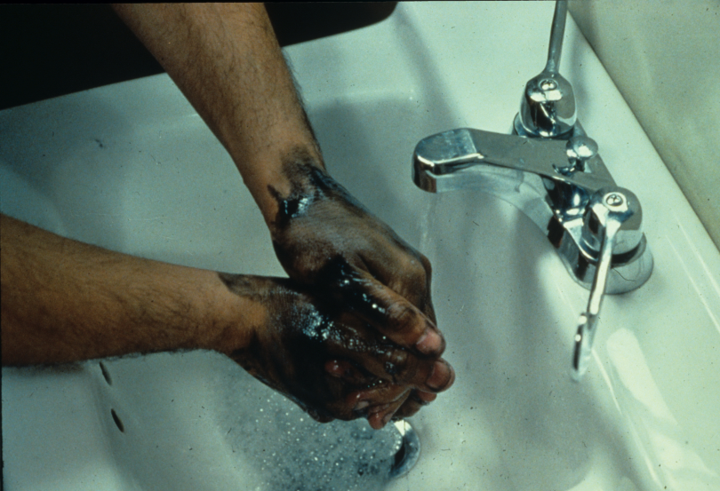
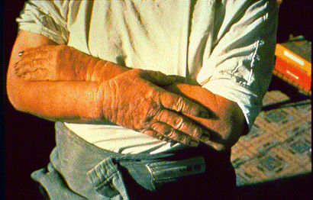
2. Absorción
Si las sustancias químicas entran en contacto con su cuerpo, existe la posibilidad de que penetren hasta la corriente sanguínea
Las heridas abiertas pueden aumentar la absorción
Las propiedades químicas afectan la absorción
Foto cortesía de John Rekus y NIOSH
Dermatitis por queroseno/eLCOSH
M-27
Notes:
Trainer Notes:
2. Absorption
If chemicals get onto your body they may be able to pass through to your bloodstream
Some areas are more at risk than others (eye, reproductive area, forehead)
Open wounds can increase absorption
Chemical properties affect absorption
[The photos are from eLCOSH]

Slide 85
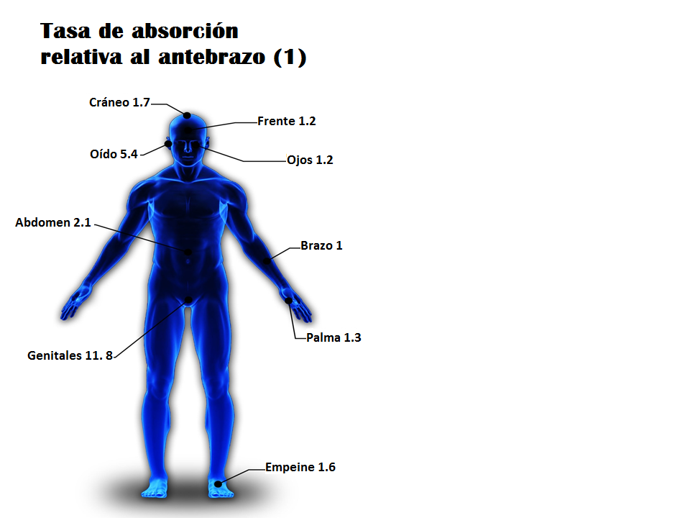
¿Tienen todas las áreas de la piel la misma protección?
No
Gráfico original en inglés cortesía del Programa Hazmat de IUOE
Traducción interna
Actividad
M-28
Notes:
Trainer Notes:
[Ask the question and then bring up the answer and explain the diagram a bit.]
Are all areas of the skin equally protective?
[The answer is no. The important point to bring up in the diagram is that chemicals can penetrate almost 12 times faster through the crotch area than the forearm and 1.6 times faster through the upper foot and 5 times faster through the ear. The point is that the students need to understand that these areas warrant additional protection. They shouldn’t walk through chemicals on the floor, for instance and must be careful not to transfer chemicals from their hands to disposable hearing protection that is inserted into the ear.]

Slide 86
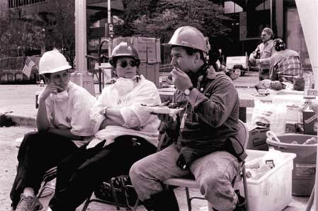
3. Ingestión
¿Cómo se ingieren las sustancias químicas?
Las sustancias químicas pueden ser transferidas sin querer a los alimentos y bebidas que después son consumidos por la persona. El polvo que se desplaza por el aire puede introducirse por la cara.
M-29
Notes:
Trainer Notes:
[Ask the students how would it be possible for workers to ingest chemicals? The following are some possibilities for how chemicals can enter the digestive tract.]
3. Ingestion
How are chemicals ingested?
Chemicals can rub off dirty hands and contaminate food, drinks or tobacco products
Chemicals in the air can settle on food or drink and be swallowed
Chemicals can be caught in mucus and be swallowed

Slide 87
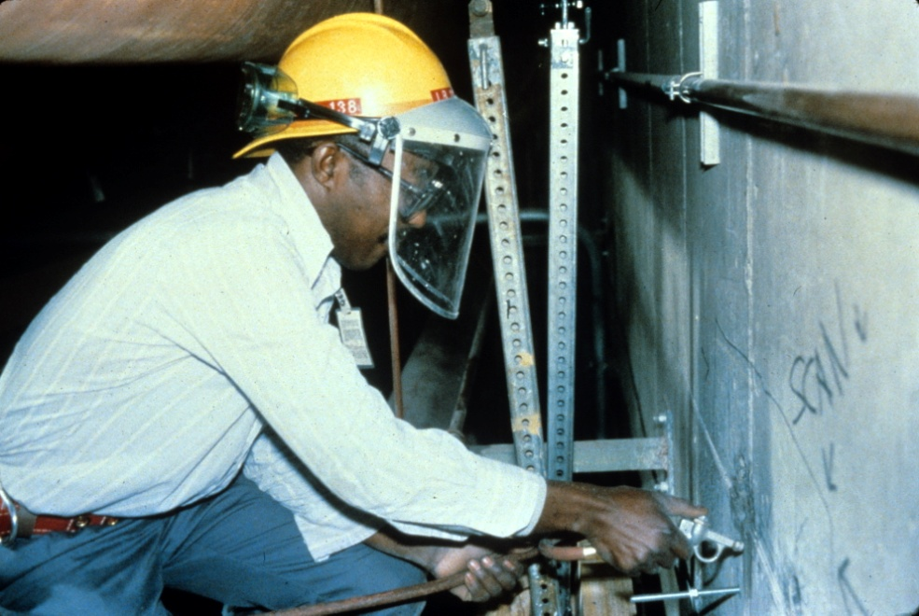

4. Inyección
Cualquier cosa que le perfore la piel permitirá que las sustancias químicas se introduzcan en la corriente sanguínea de inmediato
Perforando agujeros con una pistola neumática de alta presión. Foto cortesía de eLCOSH
Actividad
M-29
Notes:
Trainer’s Notes:
[Point out that high pressure washers or paint sprayers can inject water or product under the skin and can cause infections that can be serious.]
Anything that pierces your skin allows chemicals to enter your bloodstream immediately!

Slide 88
¿Cuál es la diferencia entre exposición aguda y exposición crónica?
Aguda
Exposición alta durante un tiempo corto (desde minutos hasta unos días)
Una vez que cesa la exposición, el daño puede ser o no ser reversible
Crónica
Exposición baja durante un tiempo prolongado (años)
Puede provocar una enfermedad u otros efectos irreversibles
M-30
Notes:
Trainer Notes:
Acute exposure is a short term or immediate high dose. Acute exposures can lead to disease or injury which develops immediately or within days. Generally, the effects wear off soon after the exposure ends. Sometimes, however, a permanent illness, such as asthma from chemicals, or cell death from ionizing radiation, can be caused by such an exposure. Eye and throat irritation from Portland cement dust is an example of an acute effect.
Chronic exposure is a repeated, low-to-mid dose of chemical which may lead to disease that develops slowly, over a period of months or years or manifests itself years after exposure. Asbestosis and cancer are examples of chronic illnesses.

Slide 89
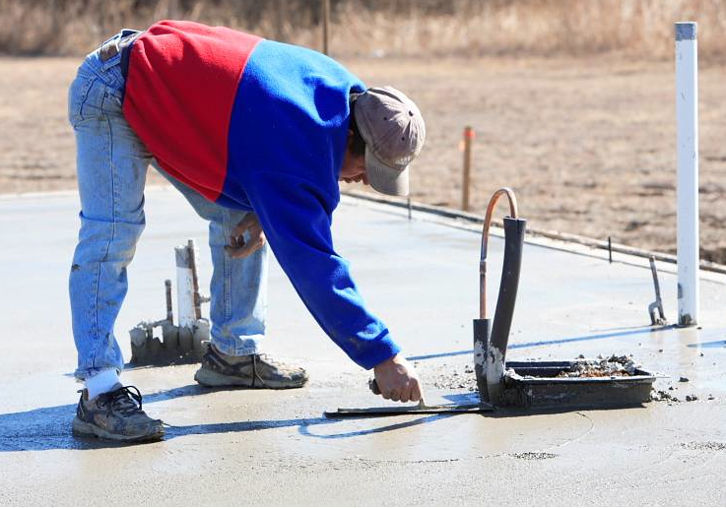
¿Qué padecimientos crónicos pueden ser provocados por el acabado de cemento?
Foto cortesía de eLCOSH
M-30
Notes:
Trainer Notes:
[Ask for ideas. Cement is a caustic material and will dry out the skin, causing the hands to get coarse and red. Someone in the class may mention the chronic condition of stooping posture leading to back problems. Not chemically induced, but definitely a chronic condition!]
What chronic conditions can result from cement finishing?

Slide 90
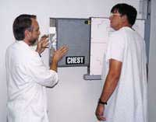
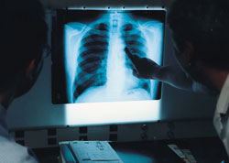
¿Qué significa periodo de latencia?
¿Qué es un ejemplo?
Ejemplo: La asbestosis y el mesotelioma pueden tardar hasta 25 años en aparecer, después de la exposición inicial
Un radiólogo prepara a una potencial víctima de asbesto para una radiografía
Actividad
M-30
Notes:
Trainer Notes:
[Ask the questions and ask them to write the answers in their student manual. After they have written their answers, advance the slide.]
What is a latency period?
A latency period is the time between an exposure and the emergence of a health problem, usually a period of years.
What is a classic example?
Asbestosis and mesothelioma can take up to 25 years from initial exposure to appear

Slide 91
¿Cuál es la diferencia entre daño local y daño sistémico?
Algunas sustancias químicas ocasionan daño en el punto donde el cuerpo entra en contacto con ellas, como en el caso de una quemadura de ácido
Otras sustancias químicas pueden tener un efecto sistémico sobre el cuerpo, como el plomo y el alcohol
Otras pueden tener ambos efectos, como el alcohol y los disolventes orgánicos que se usan en el trabajo
M-30
Notes:
Trainer Notes:
What is the difference between local and systemic harm?
Some chemicals harm the body at the site of their exposure, such as an acid burn
Other chemicals can affect entire body systems, such as lead and alcohol
Some can do both, such as alcohol and organic solvents you may use at work

Slide 92
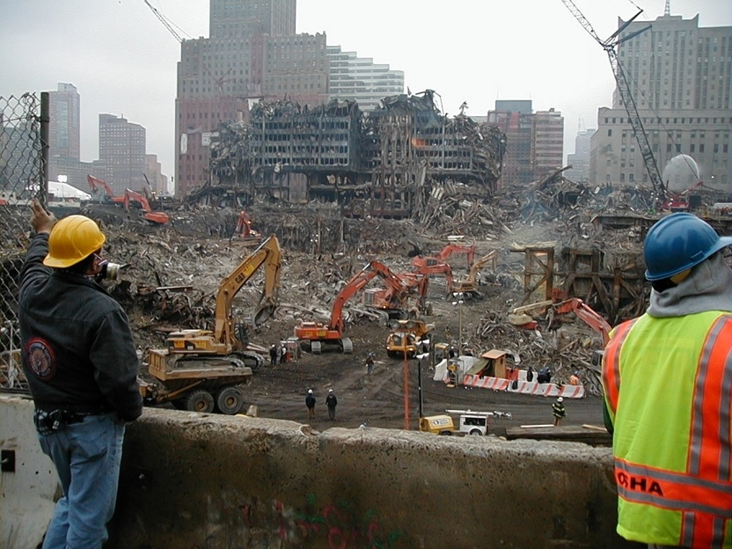
Muchas sustancias químicas pueden tener efectos más intensos cuando se combinan en el cuerpo
Alcohol y disolventes
Asbesto y humo de cigarrillos
Exposición en la limpieza del World Trade Center
M-31
Notes:
Trainer Notes:
Multiple chemicals may have unique effects when combined in your body
Alcohol and solvents
Asbestos and cigarette smoke
Exposures at the WTC cleanup
[Point out that we have almost no information on how more than one chemical acts simultaneously on the body. We know that for some the result is much more harmful than just adding the effects of the two chemicals. Asbestos and cigarette smoke is a classic example. Exposures at the WTC are another example. In that case, thousands of air samples were collected and most were below the OSHA standards, but still upwards of 40% of the responders have health problems. This action is called synergism.]

Slide 93
Generalidades de los riesgos químicos
Sección 4
M-32
Notes:
Trainer Notes:
Overview of Chemical Hazards

Slide 94
Todas las sustancias químicas se encuentran en uno de tres estados: sólido, líquido o gaseoso. Algunos ejemplos de las categorías son los siguientes:
Estado | Ejemplos
Sólido | polvo, fibra, humo
Líquido | aerosol, rocío, geles y adhesivos
Gaseoso | acetileno, oxígeno, monóxido de carbono, nitrógeno
Actividad
M-32
Notes:
Trainer Notes
All chemicals are found in one of three forms: solid, liquid or gas.
[Ask the class to think of some examples and fill in the table in their student manual before your show them the answers.]

Slide 95


Los sólidos liberados en el aire pueden penetrar en su cuerpo y hacerle daño
Humos
de la soldadura
Polvo del lijado
Fotografía de Neil Lippy para eLCOSH
Foto cortesía de eLCOSH
M-33
Notes:
Trainer Notes:
Solids released into the air can get into your body and harm you!
Dust in the air can settle out on work surfaces, cups, plates, utensils, food, etc. The settled dust can be swallowed with food or drinks or stirred back into the air.

Slide 96
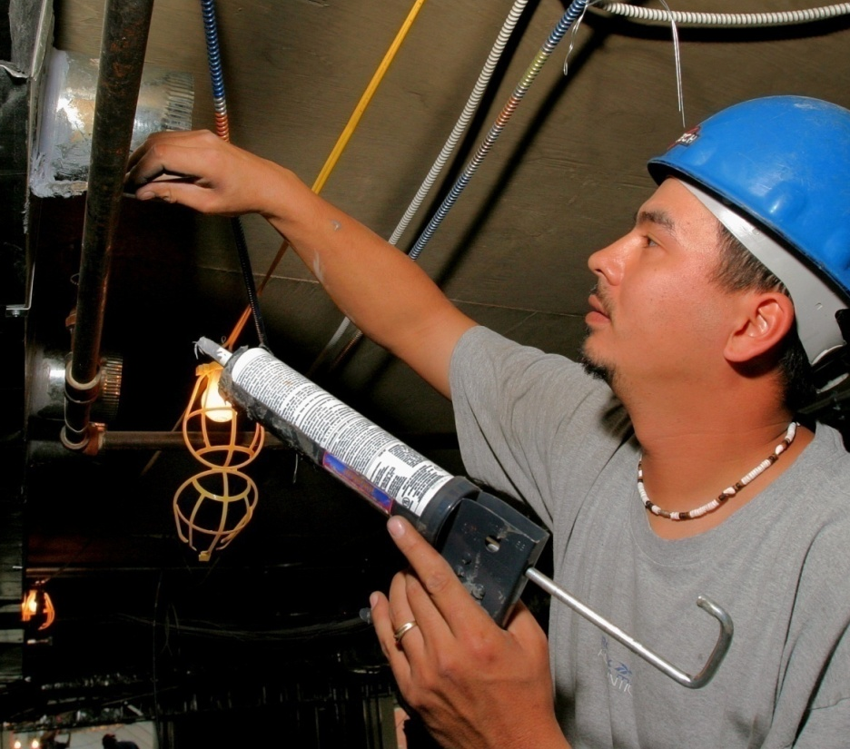

Los líquidos pueden entrar en contacto con la piel o los ojos y dañar esa área o ser absorbidos por el cuerpo
M-33
Notes:
Trainer Notes:
Liquids can be sprayed and form mists or evaporate and form vapors which can be inhaled.
Mists can settle on the skin and be absorbed or settle and contaminate food or drink.

Slide 97


Los gases y vapores que un trabajador respira pueden llegar a los pulmones y dañarlos
Foto cortesía de eLCOSH
M-33
Notes:
Trainer Notes:
Gases and vapors that a worker breathes can reach the lungs and cause harm.
The asphalt job shows a slight “haze” near the paver. Hot asphalt, along with its additives, will giver off a number of gases and vapors.

Slide 98
Es importante entender estas propiedades físicas de las sustancias químicas
pH
Presión de vapor
Punto de inflamabilidad
Ingredientes de un incendio
Límites explosivos
Densidad de vapor
M-34
Notes:
Trainer Notes:
[Briefly review this list of physical properties of chemicals with the class; use a white board or easel and paper to cover the properties in greater depth. These are not all physical properties but they are ones that most affect workers’ health and safety.]
It is important to understand these physical properties of chemicals
pH: corrosive power
Vapor pressure (VP): chemical’s volatility
Flash Point (Fl.P.): temperature at which it can burn
Ingredients for a fire: Fire tetrahedron
Explosive limits: fuel in the air required for fire
Vapor Density (VD): where it will be in the air

Slide 99

Con los corrosivos, la concentración es crítica
Ácido acético:
90% de la solución destruye la piel (pH<2),
6% es el vinagre que usamos para las ensaladas (pH~4.5)
M-34
Notes:
Trainer Notes:
With corrosives, concentration is critical
Acetic Acid:
90% solution destroys skin,
6% is vinegar we put it on salads

Slide 100

¿Qué dice la presión de vapor del ácido sulfúrico sobre el peligro de inhalación por causa de un derrame?
Ácido sulfúrico: Presión de vapor
(VP) = 0.001 mm Hg
M-34
Notes:
Trainer’s Notes:
What does vapor pressure of sulfuric acid say about the inhalation hazard from a spill?
Since sulfuric acid’s VP is almost zero, it should not be a serious respiratory hazard unless workers approach it closely.

Slide 101

¿Qué significa el punto de inflamabilidad de una sustancia química?
Es la temperatura a la cual un líquido emana suficiente vapor para arder con una fuente de ignición
Foto cortesía de Streicholz y Wikimedia
Actividad
M-35
Notes:
Trainer Notes:
[Ask this question and see if they know the unit that the answer is in.]
What is a chemical’s flash point?
The temperature at which a liquid gives off enough vapors to burn if there is a source of ignition.

Slide 102


Ejercicio en clase sobre el punto de inflamabilidad
Busque y registre el punto de inflamabilidad para las sustancias químicas que aparecen a continuación y ordénelas desde la más inflamable hasta la menos inflamable
Sustancia química | Punto de inflamabilidad | Orden de inflamabilidad
Combustible diesel | 136°F | 4
Gasolina | -45°F | 1
Benceno | 12°F | 2
Trementina | 95°F | 3
http://wiser.nlm.nih.gov/
http://www.cdc.gov/niosh/npg/
M-35
Notes:
Trainer Notes:
Flash point group exercise.
Look these up in any source and put in the order of most to least flammable.
[Only attempt this exercise if you have some resources to look these up. If the classroom has wireless internet, you can have students go out on the web to the NIOSH Pocket Guide site. WISER is a web-based app from the National Library of Medicine that gives a great deal more information than the NIOSH Pocket Guide. Encourage those in your class with a smart phone to download the free app and put it to work. If class is unfamiliar with resources, you can bring up a volunteer for each chemical and work with them to look up the flash point and write it on the board. Everyone should then be able to determine the order of flammability when the flash points are all on the board.]
Diesel fuel = 136 degrees F
Gasoline = - 45 degrees F
Benzene = 12 degrees F
Turpentine = 95 degrees F
[The order is gasoline: benzene, turpentine, diesel fuel]

Slide 103

¿Cuáles son los ingredientes de un incendio?
Comburente = Oxidante
Imagen tomada de Wikimedia Commons, www.commons.wikimedia.org
¿Qué es una reacción en cadena?
M-36
Notes:
Trainer Notes:
[You can help the class understand this by pointing out that flash point is the lowest temperature where a vapor will flash, but that is not the same thing as sustaining a fire. The chain reaction must ]
What are the ingredients for a fire? What is a chain reaction?
Flammability is the ability of a solid, liquid or gas to ignite and produce a flame. Four elements are required in specific ratios for combustion to occur: fuel, oxygen, heat, and a chain reaction. This relationship is described by the fire tetrahedron. The fire can be extinguished by taking away any one element of the fire tetrahedron. This used to be a fire triangle, but chain reaction was added because the reaction must continue if a fire is to be sustained. Think about lighting a cigarette lighter beneath a 2 by 4 for a second . There is heat, oxygen and fuel, but no chain reaction. If the 2 by 4 was ground into sawdust, the reaction would go forward because the ratios were right.

Slide 104
El límite explosivo es la gama de vapores que se encenderán en el aire
Busque y registre el límite explosivo bajo y alto para las sustancias químicas nombradas
Sustancia química | Límite explosivo bajo (%) | Límite explosivo alto (%)
Queroseno | 0.7% | 5%
Gasolina | 1.4% | 7.6%
Cloruro de metileno (quitapintura de muebles) | 13% | 23%
http://wiser.nlm.nih.gov/
http://www.cdc.gov/niosh/npg/
M-36
Notes:
Trainer Notes:
[If the class has access to the internet or the resources shown, have them look it up. If they don’t or time doesn’t allow, just write the answers on the board.]
Explosive limit is the range that vapors will burn in air
Kerosene = LEL: 0.75, UEL: 5
Gasoline = LEL: 1.4, UEL: 7.6
Methylene Chloride: = LEL: 13. UEL: 23
[Ask what this means. They should say that it takes a lot more methylene chloride in the air for ignition based on the LEL. You can also tell them that 1 percent equals 10,000 parts per million, so most chemicals become toxic before they become flammable. For instance, methylene chloride has an OSHA Permissible Exposure Limit of 25 ppm, but doesn’t become flammable until the concentration reaches 130,000 ppm (13%).]

Slide 105

¿Cuál es la regla que se aplica a la densidad de vapor para la mayoría de las sustancias químicas que se pueden encontrar en una obra de construcción?
✔
Más pesada que el aire
Más liviana que el aire
Actividad
M-37
Notes:
Trainer Notes:
[Ask the question and let them respond. You should ask for a show of hands. The answer is heavier than air. This Red Lion pre-paint surface preparation spray indicates on the SDS that the vapor density is greater than 1, which means it is heavier than air. You can ask them what the implications are for this information. The answer is that vapors often accumulate at the lowest point, which is particularly important in trenches and confined spaces. ]
What is the rule about vapor density for most chemicals encountered in construction work?

Slide 106
Medición y límites de exposición
Sección 5
M-37
Notes:
Trainer Notes:
Measurement and Exposure Limits

Slide 107


¿Por qué monitorear?
Fotografía de Neil Lippy para eLCOSH
M-37
Notes:
Trainer Notes:
Why do we monitor?
[This is a photo from a 2012 CPWR research project to see the effectiveness of ventilation controls for tuck pointing. Ask this question and possibly write down the answers on a flip chart, if you have time.]
Some possible answers:
To ensure respirators are sufficiently protective
To demonstrate the effectiveness of control technologies
To ensure compliance with OSHA standards

Slide 108



Existen dos tipos de monitoreo: el que se hace en tiempo real y las muestras que se envían a un laboratorio
Medidor de múltiples gases
Detector de fotoionización (PID)
Instrumentos en tiempo real
Foto cortesía de Lawrence Berkeley National Laboratory
M-38
Notes:
Trainer Notes:
There are two types of monitoring: real-time and samples that are sent to a lab.

Slide 109

El equipo de prueba en tiempo real puede dar una medida de exposición inmediata
Gases combustibles
Vapores y gases tóxicos
Oxígeno
Foto cortesía de NIOSH
M-38
Notes:
Trainer Notes:
Real-time equipment can give immediate chemical exposure measurements
Combustible gases
Toxic vapors and gases
Oxygen
[This slide is not meant to be an in-depth review of air monitoring equipment. Give the class enough background (along with the units on the next slide) so that they know there are methods that their employer can take to monitor their exposures. Let the class know it is also a worker’s right to know the results of their monitoring data.]
Use information from the CPWR HAZWOPER courses for background information on various air monitoring meters.

Slide 110


El monitoreo personal en la zona de respiración determina la exposición específica de un empleado en particular
Bomba de muestreo de aire
Muestreador
Foto cortesía de CPWR
Notes:
Trainer notes:
[Point out the sampling pump and cyclone with 37 millimeter filter cassette. You may also want to point out the powered air purifying respirator (PAPR) that the worker is wearing. This was part of a CPWR research project looking at ventilation or vacuum controls.]
Personal monitoring in the breathing zone determines a specific employee’s exposure.

Slide 111
El reconocimiento de estas unidades podrá ayudarle a comprender los resultados de la exposición y los límites de OSHA
Partes por millón (ppm)
Partes por mil millones (ppb)
Miligramos por metro cúbico (mg/m³)
Microgramos por metro cúbico (µg/m³)
Por ciento (%)
Fibras por centímetro cúbico (fibras/cc)
M-38
Notes:
Trainer Notes:
[There are several slides to help you explain these terms]
Recognizing these units will help you understand exposure results
Parts per million (ppm)
Parts per billion (ppb)
Milligrams per cubic meter (mg/m³)
Percent (%)
Fibers per cubic centimeter (fibers/cc)

Slide 112


Partes por millón (ppm) es una cantidad muy pequeña
4 gotas de tinta en un bidón de 55 galones = 1 ppm
M-38
Notes:
Trainer Notes:
Parts per million (ppm) is a very small amount. 4 drops of ink in a 55-gallon drum is 1 ppm.

Slide 113



Partes por mil millones (ppb) es un mil veces menos que las ppm
Una hojita de un rollo de papel higiénico extendido desde Nueva York hasta Londres
M-38
Notes:
Trainer Notes:
Parts per billion (ppb) is one thousand times less than ppm.
ppb would equal one separate tissue in a roll of toilet tissue stretched from NYC to London.

Slide 114

Gramo es una medida de peso
1 clip = 1 gramo
Miligramo (mg) = la milésima parte de un gramo (1,000a.)
Microgramo (μg) = la millonésima parte de un gramo (1,000,000a.)
M-38
Notes:
Trainer Notes:
Gram is a measure of weight
1 paperclip = 1 gram
Milligram (mg) = one-thousandth of a gram (1,000th)
Microgram (μg) = one millionth of a gram (1,000,000th)

Slide 115

Miligramo por metro cúbico es una medida de masa en el aire
Miligramos por metro cúbico (mg/m³)
Microgramos por metro cúbico (μg/m³)
1 metro = 100 centímetros = aprox. 3 pies
M-38
Notes:
Trainer Notes:
[Point out that this cube is 3 feet x 3 feet x 3 feet. There is a yard stick at the bottom. In this box of air would be 1,000th of a paperclip in weight of dust particles for a mg/m3. It is important to emphasize for toxic materials like lead that it doesn’t take much mass of airborne materials to cause health problems. With lead, OSHA has a Permissible Exposure Limit of 50 micrograms per cubic meter of air.]
Milligram per cubic meter is a measure of mass in air
Milligrams per cubic meter (mg/m³)
Micrograms per cubic meter (μg/m³)
1 meter = 100 centimeters = approx. 3’

Slide 116

Centímetro cúbico es una medida de volumen
Un dedal contiene alrededor de 3 centímetros cúbicos de aire
M-38
Notes:
Trainer Notes:
[Make sure you have a transition explaining that there are 1,000,000 cubic centimeters in 1 cubic meter. We are talking about a limited numbers of fibers in this space. ]
Cubic centimeter is a measure of volume. A thimble holds around 3 cubic centimeters of air.

Slide 117
OSHA ha establecido PEL o Límites de exposición permisible, pero lo que es sumamente importante recordar es que...
La mayoría de los límites se derivan de los Valores umbrales límite (TLV) establecidos por la American Conference of Governmental Industrial Hygienist (ACGIH) celebrada en 1968
Los Valores umbrales límite (TLV) que rigen hoy en día son generalmente más bajos
Los Límites de exposición recomendados por NIOSH (REL) son generalmente más bajos
La mayoría de las sustancias químicas no tienen asignados límites de exposición
M-39
Notes:
Trainer Notes:
[Explain that ACGIH is the American Conference of Governmental Industrial Hygienists. This voluntary organization had been setting non-mandatory recommendations for worker exposures called Threshold Limit Values for decades prior to OSHA. The ACGIH continues to update its standards, while OSHA has not been able to do so.]
Exposure limits are a way to compare a worker's exposure on the job with an assumed “safe” limit, which was derived from scientific study. It can be argued that many exposure limits are too low and most chemicals do not have an exposure limit. However, they are all we have to assist us in protecting workers. Some exposure limits are guidelines (usually more protective) and some are the Law (though usually not as protective as guidelines). Below are the three main exposure limits used to protect workers.
OSHA Permissible Exposure Limits (PELs). PELs are the Law!
ACGIH Threshold Limit Values (TLVs)
NIOSH Recommended Exposure Limits (RELs)
Exposure limits are based on 8-hour time weighted averages (TWA) for OSHA and ACGIH or 10-hour TWAs for NIOSH RELs, ceilings (cannot exceed), or 15-minute peak exposures. Exposures must be kept below OSHA PELs. Most exposure limits are for airborne exposures. Exposure limits do not take into account exposure from multiple chemicals.

Slide 118
La mayoría de los límites de exposición se basan en un promedio de ocho horas de trabajo
límite
de exposición
Exposiciones
en aumento
6:30 9:30 11:30 1:30 3:30
tiempo
M-39
Notes:
Trainer Notes:
Most exposure limits are based on an average over 8 hours.

Slide 119
Algunas sustancias químicas tienen topes que no se pueden exceder
tope
límite
de exposición
Exposiciones en aumento
6:30 9:30 11:30 1:30 3:30
tiempo
M-39
Notes:
Trainer Notes:
Some chemicals have ceilings that can’t be exceeded
[Point out the line that goes above the exposure limit can be a ceiling value. Show the dip for work stopping at lunch. It is questionable whether this would exceed the 8-hour time weighted average.]

Slide 120
Otras formas de comunicar los peligros
Sección 6
M-40
Notes:
Trainer Notes:
Other ways to communicate hazards

Slide 121

Otros tipos de sistemas de etiquetado
Sistema de identificación de materiales peligrosos (HMIS)
National Fire Protection Association (NFPA) 704 M
Placas del Departmento de Transporte (DOT) de EE UU
M-40
Notes:
Trainer Notes:
Hazardous Material Information System (HMIS)
National Fire Protection Association (NFPA) 704M placard system
Department of Transportation (DOT)

Slide 122


La codificación de colores del HMIS clasifica los riesgos y recomienda el equipo de protección personal (PPE) adecuado
M-40
Notes:
Trainer Notes:
Color-coded HMIS ranks hazards and recommends PPE.
[Point out that this approach is commonly used on products, but it is a proprietary system.]

Slide 123

La figura de diamante 704 M de la NFPA se usa ampliamente
Tomando la sustancia química de este ejemplo, conteste:
¿Cuál es el mayor peligro?
¿Cuál es el peligro específico?
Actividad
M-41
Notes:
Trainer Notes:
[Just ask the questions for the class together.]
NFPA’s 704M Diamond is widely used. For this example chemical,
What is the greatest hazard?
What is the specific hazard?
[The answers are:
Reactivity is the greatest risk with a score of 3, “Shock and heat may detonate.”
The specific hazard is that it is radioactive. This is a really hazardous chemical!]
According to the International Association of Fire Fighters (IAFF) master trainers, all “special hazard” symbols may be listed in the white diamond and it is taught in the fire and emergency services this way. NFPA committee states that only the water reactive and oxidizer should be allowed in the box. IAFF members make up the NFPA committees; mention any symbol may be seen, that covers all possibilities.

Slide 124

El Departamento de Transporte exige que los vehículos que transportan sustancias químicas peligrosas lleven las placas requeridas
Nueve clases de materiales peligrosos
Clase 1: Explosivos
Clase 2: Gases
Clase 3: Líquido inflamable y líquido combustible
Clase 4: Sólido inflamable, combustión espontánea y peligroso al mojarse
Clase 5: Oxidante y peróxido orgánico
Clase 6: Veneno (tóxico) y peligro de inhalación de veneno
Clase 7: Radiactivo
Clase 8: Corrosivo
Clase 9: Varios
Dangerous: Peligroso
M-42
Notes:
Trainer Notes:
The U.S. Department of Transportation divides regulated hazardous materials into the following nine classes, most of which are further divided into divisions. Here are some examples:
Class 1: Explosives
1.1 - Explosives with a mass explosion hazard (dynamite, TNT, black powder)
1.2 - Explosives with a projection hazard (aerial flares, power device cartridges, detonating cord)
1.3 - Explosives with predominantly a fire hazard (propellant explosives, liquid-fueled rocket motors)
1.4 - Explosives with no significant blast hazard (signal cartridges, practice ammunition, line-throwing rockets)
Class 2: Gases
2.1 - Flammable gases (propane, methyl chloride, butadiens)
2.2 - Non-flammable, non-toxic gases (compressed nitrogen, cryogenic argon)
2.3 - Toxic Poisonous; can injure or kill people or other organisms gases (chlorine, hydrogen fluoride, arsine, methyl bromide)
Class 3: Flammable liquids and combustible liquids
Class 4: Flammable Solid, Spontaneously Combustible, and Dangerous When Wet
Class 5: Oxidizing substances and organic peroxides
Class 6: Poison (Toxic), Poison Inhalation Hazard, Infectious Substance
6.1 - Poisonous liquids or solids (aniline, arsenic compounds, hydrocyanic acid, chemical warfare agents)
6.2 - Infectious/bio-hazardous substances (anthrax, botulism, tetanus)
Class 7: Radioactive
(uranium hexafluoride, yellowcake, radiological waste)
Class 8: Corrosive
(nitric acid, sulfuric acid, sodium hydroxide)

Slide 125
Control de riesgos
Sección 7
M-43
Notes:
Trainer Notes:
Controlling hazards

Slide 126
La jerarquía de controles puede protegerle contra las sustancias químicas peligrosas
Del más eficaz
Eliminación
Sustitución
Controles de ingeniería
Controles administrativos
PPE
Al menos eficaz
M-43
Notes:
Trainer Notes:
The hierarchy of controls can protect you from hazardous chemicals
[The hierarchy of controls is a very effective and OSHA-mandated method for reducing workers’ risks to hazards. Take a few moments to introduce (or refresh) workers on the hierarchy of controls.]
The hierarchy of controls is a list of methods, in order from most desirable to least desirable, which emphasizes controlling a hazard at its source. This is done by giving preference to eliminating the hazard altogether; then to the use of the engineering controls. These types of strategies should be used first, where possible, because they are subjected less to human error and because they are less disruptive and uncomfortable for people to use and for people working in the area. Whichever methods you use, remember that in each case, their effectiveness should be monitored regularly.
The overall idea is to design or redesign the workplace to fit the needs of workers. Training workers and providing personal protective equipment is necessary but, creating as safe and healthy a workplace as possible is the ultimate goal. To achieve this goal, we must substitute dangerous chemicals and processes with less dangerous ones, design workstations to cause less harm to workers, and ensure that health and safety concerns are integrated into the design stages of workplaces.

Slide 127

Eliminar o sustituir sustancias químicas por otras menos dañinas
¿Hay alguna sustancia química que podría eliminar o sustituir en su trabajo?
JobCorps usa un aislamiento de espuma basado en soya que es más seguro
Practicante de JobCorps aplica un aislamiento de espuma basado en soya
M-43
Notes:
Trainer Notes:
Eliminate or substitute chemicals you currently use with less harmful ones
Any chemicals you could eliminate or replace in your work?
JobCorps uses a soy-based foam insulation that is safer than the products with isocyanates in them.

Slide 128

El solo hecho de que sea “ecológico” no quiere decir que es seguro
Hardieplank: de 10 a 50% de sílice
Weatherboard (tabla de chilla): de 45 a 55% de sílice
“Hardieplank”: material para revestir paredes
M-44
Notes:
Trainer Notes:
Fiber-cement board is a concrete-like material used in roof shingles, panel units, floor underlayment, and siding. It is strong, durable, mold and weather resistant, and non-combustible. It is however potentially dangerous to workers due to its crystalline silica composition. Workers who cut it or work with it in such a way as to produce dust are at risk of silica exposure. Other workers in proximity to this work may also be affected by the silica hazard.
WISHA is the Washington Industrial Safety and Health Act enforcement group.
WISHA inspection data: 5 of 7 workers using circular saws outdoors on fiber-cement siding were exposed above ACGIH-TLV for silica

Slide 129

Existen controles de ingeniería que emplean métodos de humidificación para reducir la exposición al polvo en las obras de construcción
Controles de ingeniería
Foto cortesía de Bricklayers Local 1, Philadelphia
M-44
Notes:
Trainer Notes:
There are wet methods engineering controls to reduce dust exposures on construction jobs.

Slide 130



Los controles de aspiración son eficaces para protegerse de la exposición al polvo en la construcción
sin aspiración
con aspiración
M-45
Notes:
Trainer Notes:
Ventilation controls are effective for construction dust exposures
[This was from a CPWR test of ventilation systems for tuck pointers, which is a very dusty process as the upper photo on the right demonstrates. Point out that tuckpointing without a vacuum in the top photo required a full-face powered air purifying respirator, while the respirator worn in the bottom picture is a half-face negative pressure respirator.]

Slide 131

Construction Solutions de CPWR le puede ayudar a seleccionar controles eficaces para su oficio http://www.cpwrconstructionsolutions.org http://www.consol.mobi Desde su aparato móvil
M-45
Notes:
Trainer Notes:
CPWR’s Construction Solutions can help select effective controls for your trade
[Make sure the class understands that CPWR maintains a site called Construction Solutions that is organized by trade and then by task and hazards. Links to commercial controls that are available are included in each “solution.” If time allows, use the link to focus on the trades in your class.]
http://www.cpwrconstructionsolutions.org
http://www.consol.mobi

Slide 132

eLCOSH es una fuente valiosa de materiales de capacitación e información para los trabajadores
M-46
Notes:
Trainer Notes:
It is organized broadly by hazards, trades, jobsites, media, documents and what’s new, but now they are boldly displayed for ease of searching.

Slide 133

Los controles administrativos también pueden reducir la exposición química
Capacitación e información
Señalización
Mantenimiento del equipo para prevenir fugas y emanaciones
Procedimientos de operación estándar (SOP)
Rotación de trabajadores
Programación de tareas cuando el uso de una sustancia química es reducido
M-46
Notes:
Trainer Notes:
Administrative controls can also reduce chemical exposures
Administrative controls (or work practice controls) are changes in work procedures such as written safety policies, rules, supervision, schedules, and training with the goal of reducing the duration, frequency, and severity of exposure to workplace hazards (chemical, safety, etc.).

Slide 134



El equipo de protección personal aparece de último en la lista jerárquica de controles. ¿Por qué?
Eliminación
Sustitución
Controles técnicos
Controles administrativos
PPE
M-47
Actividad
Notes:
Trainer Notes:
Activity: Explaining the position of Personal Protective Equipment in the hierarchy of controls. Why the bottom?
[Allow 5 to 10 minutes for this activity. You can solicit responses from the class together or by going from group to group. Here are some possible answers:
The toxin is always there
If the PPE fails, you have no protection
The employer must do an assessment to make sure the PPE is correct
PPE is uncomfortable]

Slide 135

La capacitación en equipo de protección personal (PPE) es un requisito de la norma Hazcom
Fotografía de Neil Lippy/cortesía de IMI
M-47
Notes:
Trainer Notes
PPE is a required component of training for the Hazcom standard; 29 CFR 1910.1200(h)(3)(iii)

Slide 136



Los respiradores aprobados por NIOSH pueden proteger los pulmones contra la exposición química
APR
PAPR
APR de ½ cara
N-95
M-47
Notes:
Trainer Notes:
NIOSH-approved respirators can protect your lungs from chemical exposure
Powered Air Purifying Respirators (PAPR)
Air Purifying Respirators (APR)
Full Face
Half Face
N-95 filtering facepiece respirator

Slide 137

Los empleadores deben contar con un programa de protección respiratoria que incluya la aprobación médica, la prueba de ajuste y la selección correcta
M-47
Notes:
Trainer Notes:
Employers must have a written respiratory protection program that includes medical clearance, fit testing, training and proper selection.
Proper selection includes adherence to the NIOSH selection protocol, including determining if there is enough oxygen for workers to breath (no lower than 19.5%), and a evaluation of the type of chemical, concentration, exposure duration, etc. If a APR may be worn, is there a cartridge or canister for use with the chemical(s) in the work area? Lastly, some chemicals, such as benzene and asbestos, have their own requirements for respirator selection and use which must followed.

Slide 138
Siempre que use PPE, asegúrese de:
Usar el PPE seleccionado para el riesgo particular y que le quede como es debido
Usar el PPE solo si ha sido capacitado
Siempre inspeccionar el PPE antes de usarlo
NUNCA usar un PPE dañado
Usar el PPE solo como último recurso
M-48
Notes:
Trainer Notes:
Whenever you use PPE, be sure to
Use PPE that has been selected for a given hazard and fits correctly
Use PPE only if you’ve been trained
Always inspect PPE before use
NEVER use damaged PPE
Only use PPE as a last resort

Slide 139

¿Conlleva algún tipo de problema de salud o de seguridad el uso del PPE?
Acaloramiento peligroso
Movimiento limitado
Visión limitada
Oído limitado
Claustrofobia
Un especialista para casos de emergencia trabajando después del atentado del 9/11 en el Pentágono toma un merecido descanso
M-48
Notes:
Trainer Notes:
Are there any health and safety issues from wearing PPE?
Heat stress
Limited movement
Limited vision
Limited hearing
Claustrophobia
[Photo is of a responder working at the Pentagon after the 9/11 disaster taking a much-needed break.]

Slide 140
Emergencias y primeros auxilios
Sección 8
M-48
Notes:
Trainer Notes:
Emergencies and First Aid

Slide 141


Infórmese sobre las disposiciones de primeros auxilios que existen en su lugar de trabajo y lea las etiquetas y las SDS antes de usar sustancias químicas
M-48
Notes:
Trainer Notes:
Learn about first aid arrangements on your jobsite and read labels and SDSs before using chemicals

Slide 142
¿Qué pasa si se encuentra con un derrame o una fuga?
RECUERDE: La capacitación en Hazcom no es lo mismo que la capacitación para casos de emergencias
Informe al supervisor
Informe a los compañeros de trabajo y abandone el área del derrame
Siga el programa de respuesta a derrames de su empleador
M-49
Notes:
Trainer Notes:
What happens if you encounter a spill or a leak?
REMEMBER: Hazcom training is not emergency response training
Inform supervisor
Inform coworkers, leave area of spill
Follow employer’s spill response program

Slide 143

Para responder a un incendio de cualquier tamaño, deberá estar capacitado. Infórmese sobre el plan de acción para combatir incendios en la obra.
Foto cortesía de Whiting Turner Construction Company y GW University
M-49
Notes:
Trainer Notes:
You must be trained to respond to a fire of any size. Learn about the policy on fighting fires at your site.
[Note the good practice of Whiting Turner Construction Company of mounting fire extinguishers on free-standing, job-made holders spray painted orange.]

Slide 144
Si se vio expuesto a una sustancia química, tome las siguientes medidas
Avísele a su supervisor y a su sindicato
Identifique las sustancias químicas involucradas
Obedezca las directivas de primeros auxilios de la SDS
Obtenga atención médica si es necesario
M-49
Notes:
Trainer Notes:
If you have been exposed to a chemical, take these actions
Let your supervisor and union know
Identify the chemical(s) involved
Follow SDS first aid directions
Get medical attention as needed
Call health and safety to evaluate situation and cause of exposure before returning to work

Slide 145

Ahora que ha recibido esta clase, ¿qué acciones tomará en el lugar de trabajo para saber más sobre las sustancias químicas con las que trabaja?
M-49
Actividad
Notes:
Trainer notes:
Now that you have had this class, what actions can you take at your worksite to find out about hazardous chemicals you work with?
[Possible Answers:
Ask for chemical inventory
Make sure you have been trained on each chemical you work with
Find out where the SDSs are kept
Inspect containers to make sure they have labels you can read
Use your health and safety committee to evaluate chemicals and find substitute products that are less hazardous.]

Slide 146

¿Tiene comentarios o preguntas?
Foto cortesía de eLCOSH
Notes:
Trainer Notes:
Comments or questions?
Photo courtesy elCOSH

