Slide 1
Trends of Apprenticeships in Construction Trades
CPWR Data Center

Slide 2
Chart Notes
The following describes which states were excluded in each chart based on available data.
Charts 1, 3, 4, and 7 include data from all states except: DC, DE, KS, ME, MN, MT, NY, VA, and VT.
Chart 3 is also missing data from WA.
Data in Charts 2, 5, 6, 8, 9, and 10 varied by demographic category.
Gender/Ethnicity include data from all states except: DC, DE, KS, ME, MN, MT, NY, VA, and VT.
Chart 10 also missing OR and WA.
Age includes data from all states except: DC, DE, KS, ME, MN, MT, NY, VA, VT, and WA.
Race includes data from all states except: CT, DC, DE, KS, MA, ME, MN, MT, NC, NY, VA, and VT.
Chart 10 also missing OR and WA.
Chart 11 includes data from all states except: DC, DE, KS, ME, MN, MT, NY, OR, VA, VT, and WA.
Chart 12 includes data from all states except: CT, DC, DE, KS, MA, ME, MN, MT, NY, OR, VA, VT, and WA.

Slide 3
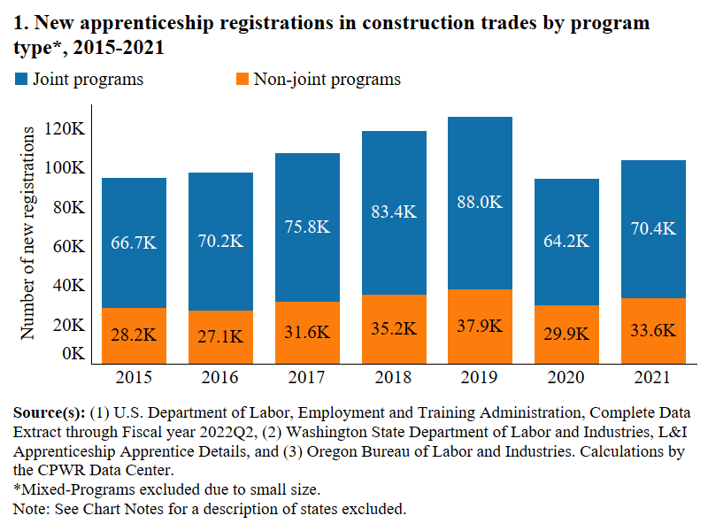

Slide 4
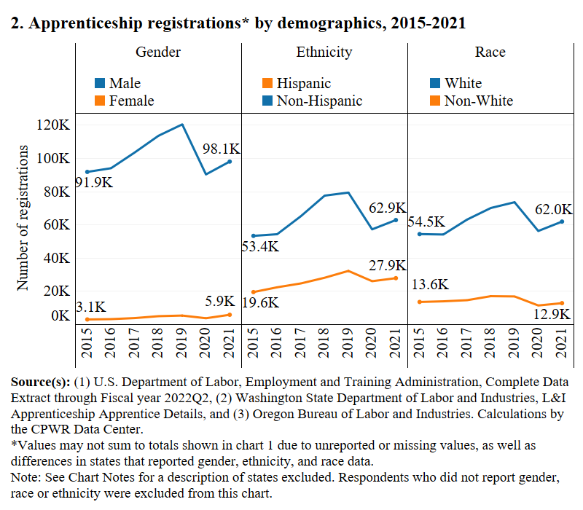

Slide 5
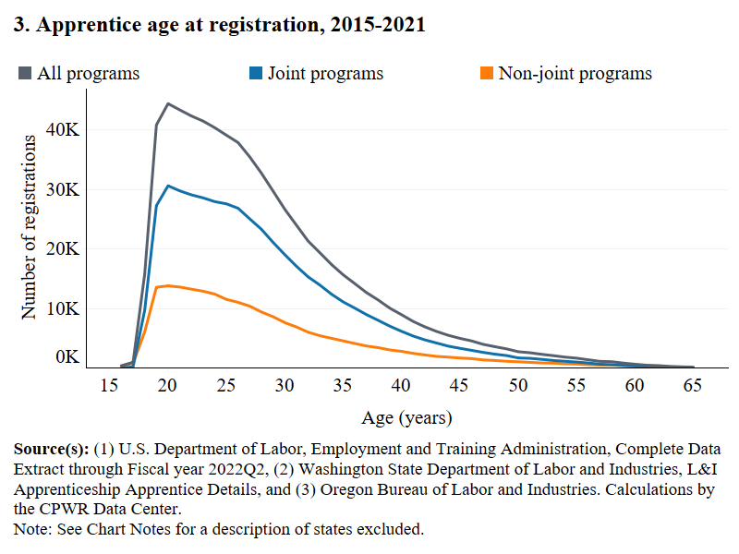

Slide 6
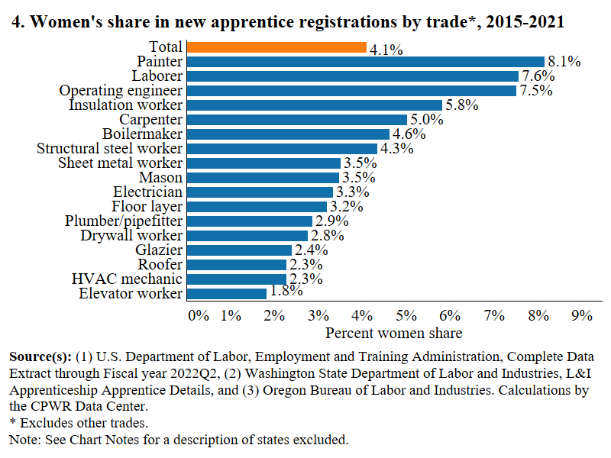

Slide 7
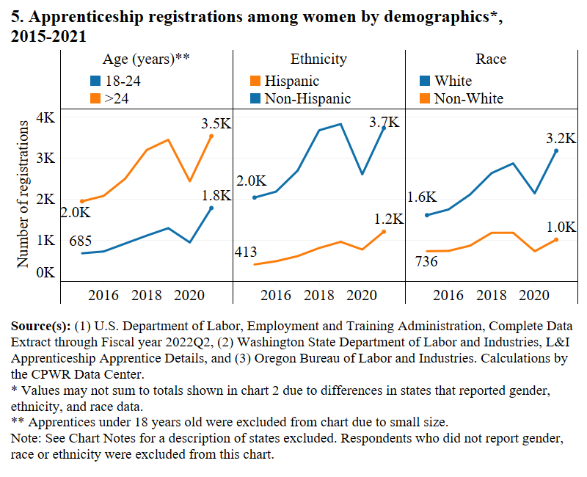

Slide 8
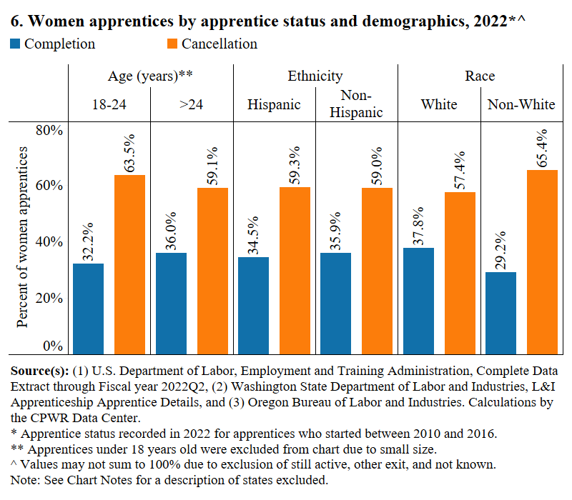

Slide 9
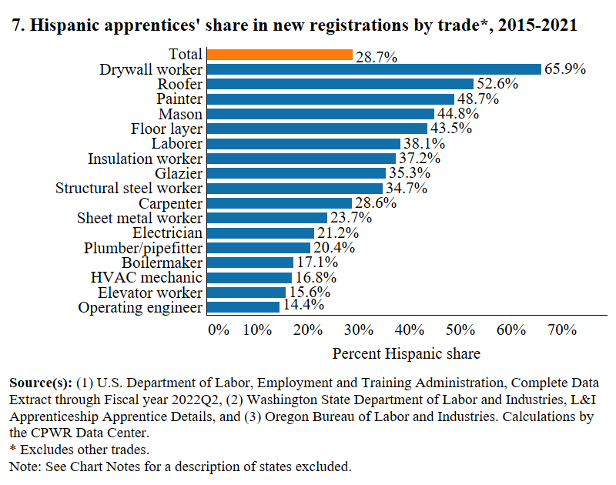

Slide 10
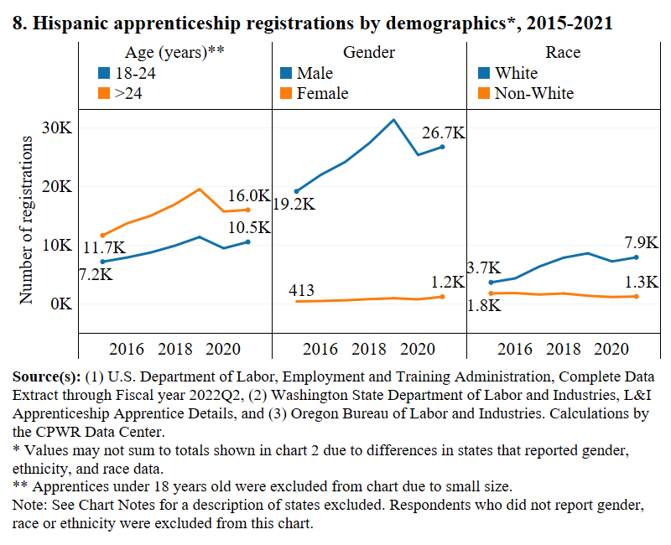

Slide 11
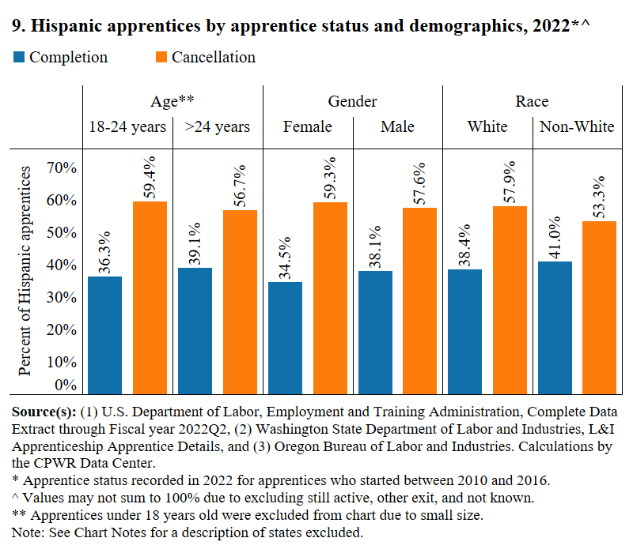

Slide 12
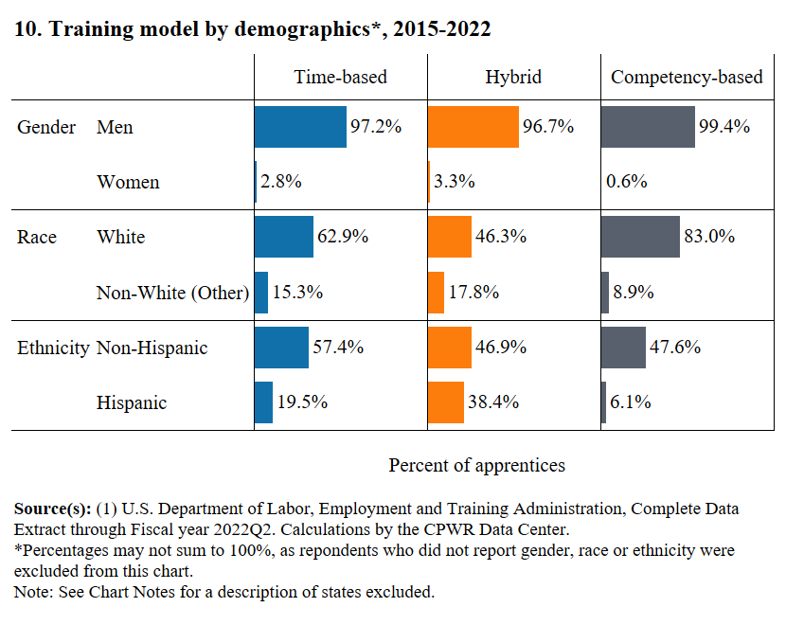

Slide 13
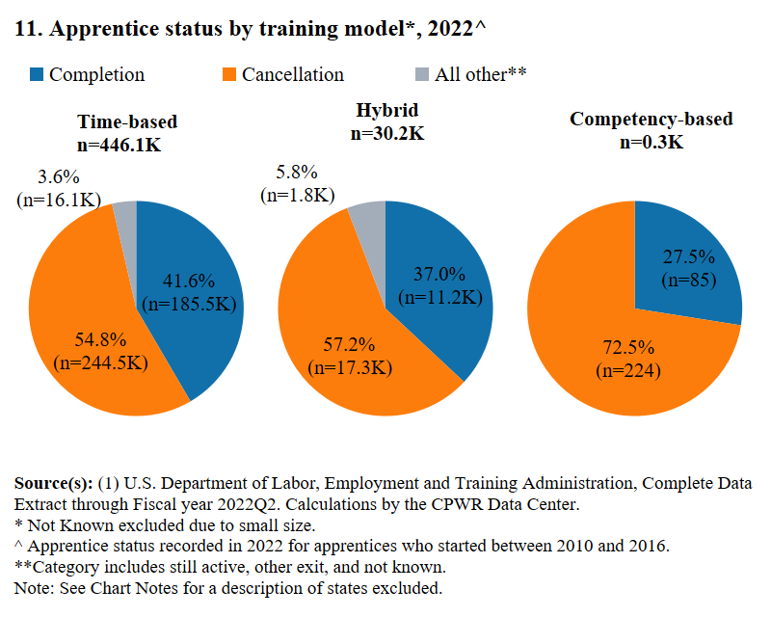

Slide 14
