Slide 1
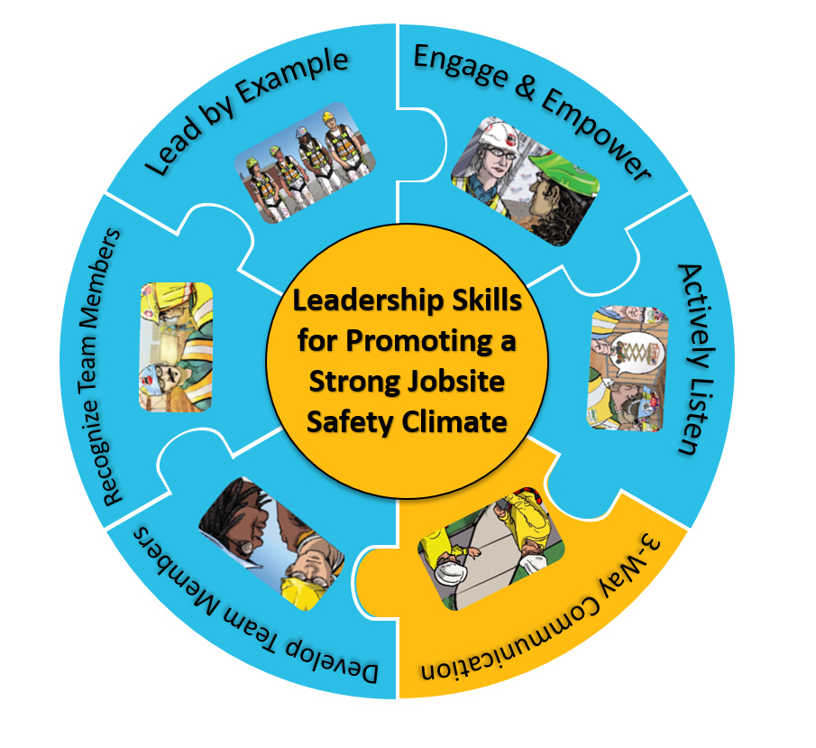

Slide 2
Paper Airplane Exercise
Can be done with 1 or 2 Instructors
Give each student 2 sheets of 8.5” X 11” paper
Exercise has two-parts
  Break class into Group A and B or
  Whole class does part A followed by part B
Notes:
The paper airplane exercise can be done with 1 instructor acting as the foreman who’s asking the students to make the airplane or with 2 instructors where one acts as the superintendent who’s asking the foreman (the other trainer) to get paper airplanes made immediately. First, give each student two sheets of 8.5” X 11” paper. The activity has 2 parts so you can either break the class into Group A (does not benefit from communication skills) and Group B (benefits from communication skills) or you can have the group as a whole do part A followed by part B. Here’s how it goes

Slide 3
“I need paper airplanes NOW!”
Notes:
First, say, “I need paper airplanes now” and you have 3 minutes to make one. Don’t give them any construction drawings and don’t show them the video. After 2 or 3 minutes have them hold up what they’ve produced.

Slide 4
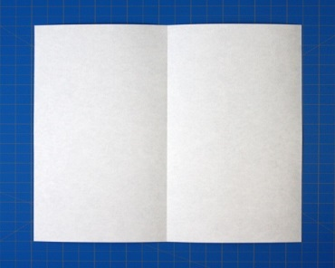
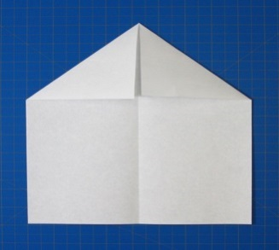
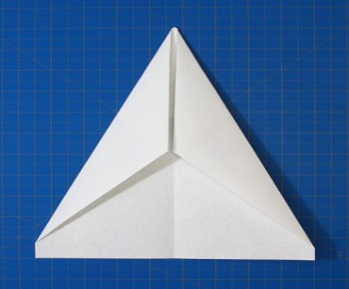
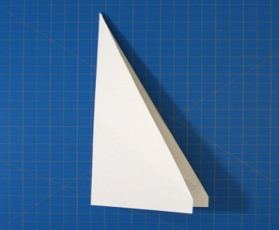
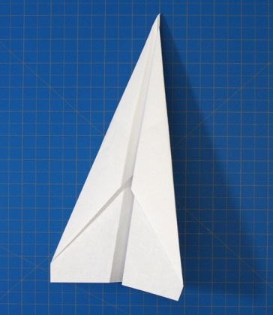
“I need paper airplanes NOW!”
Fold the paper in half, lengthwise
Unfold and fold corners into center line
Fold the top edges to the center
Fold the plane in half
Fold the wings down to meet the bottom edge of the planes body.
Notes:
After they’ve handed in or shown their airplanes, do the exercise again but this time give them instructions and ask 1 person to repeat the instructions back to you.

