Slide 1
Building Resilience
Training Activities to Help Overcome the Mental Health and Substance Use Challenges in our Construction Community
VERSION rev. 1/30/23

Slide 2
Introduction
The construction sector has more suicides and overdoses than any other industry
We can reverse these trends by understanding why and taking action on mental health and substance use
Taking action means:
Get Information
Get more information and share it
Recognize the hazards and prevent or control them
Practice a culture of health and wellness
Support our brothers and sisters in the trades who are struggling
Talk about it – even if it’s uncomfortable -- Eliminate stigma
Recognize
Practice
Support
Talk about it

Slide 3
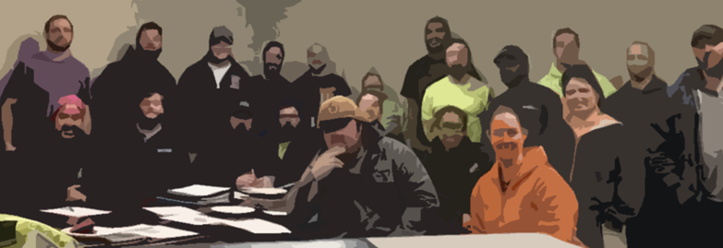
What is Resilience?
We define it as being able to prevent harms where we can and, also, to bounce back with power when struggles occur.

Slide 4
We say: “help is available.”
We think getting help is more than consulting with a mental health professional.
It’s talking with our brothers and sisters to gain a deeper understanding of the root causes of these problems, to live to fight another day, to connect with a struggling brother or sister, and to taking action to change the story.

Slide 5
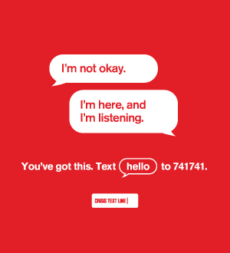
Content Warning and Confidentiality
TRIGGER WARNING – the training activities concern suicide and other disturbing topics. If participating in this discussion is too much, let the instructor know.
KEEP IT IN THE ROOM – let’s use this opportunity to talk honestly about an important topic. Please don’t gossip about what someone has said.
If you or someone you know needs help….Help is available…just ask…

Slide 6
Workbook Content
Member Assistance – Time to Get Uncomfortable
NABTU Resolution #4 – Discussing what’s happening for the sector and what should be done
Motivational Interviewing – How to help someone make changes and get help
Going Upstream – Talking about Prevention
Basic Suicide Prevention – Getting comfortable talking about it
Health is Like a Building – A metaphor to explore the dimensions of health
Mandatory Drug and Alcohol Testing Debate – How does testing promote safety?
Getting the Story Right – A suicide happens – what went wrong and what can we do
What’s Healthy Here? – An annoying conversation at the Roach Coach

Slide 7
Some themes to be discovered and discussed…
There are some construction-specific risk factors for suicide, substance use, and mental and physical health challenges
There are also some construction-specific “resilience” factors that help people cope and avoid harm
People have a lot going on…and then there’s COVID, etc.
Prevention is possible – and where we can’t prevent, we can reduce harm
Bottom line: Support our brothers and sisters who are struggling
©2023, CPWR - The Center for Construction Research and Training. All rights reserved. CPWR is the research and training arm of North America’s Building Trades Unions. Production of this document was supported by cooperative agreement OH 009762 from the National Institute for Occupational Safety and Health (NIOSH). The contents are solely the responsibility of the authors and do not necessarily represent the official views of NIOSH.

