Slide 2
Evaluate Environmental, Health, and Safety
Anticipate Hazards
Recognize
Evaluation
Control Measures
Evaluation

Slide 3
Levels of Control
Engineering
Work Practices
Administration
Personal Protective Equipment

Slide 4
Green Construction Health and Safety
Site Selection, reduce energy, reduce IAQ problems, safe materials, decrease water use, decrease waste
Designing Green Buildings to interact with the surrounding environment
Many of the products that are currently used in the building industry are toxic to human health, and there are alternatives.

Slide 5
Green Buildings
Green buildings are intended to reduce energy usage, minimize indoor air quality problems, recycle water and waste, and provide a comfortable indoor environment for its occupants.
Green buildings are designed to interact with the surrounding environment.
It is assumed that by using environmentally friendly materials, these buildings are safe for everyone. But, are they really?

Slide 6
Green Construction Health and Safety Issues
Are LEED safer than non-LEED projects ?
Green Construction projects
Skylights, Atriums
Recycling, Congestion at worksite
Coal Ash in concrete
Weatherization – Lead, Asbestos, Fiberglass, Electrical
Solar Power – Electrical, Toxics chemicals, burns, Ergonomics

Slide 7
Recommendations
Sustainability – (environmental, economic, resource, and social aspects)
Government, Advocacy and Policy, Unions
Green Building Rating – LEED, Green Globes, Build it Green, Cradle to cradle
Standards and Research
Prevention through design – Engineering, Administrative
Incorporate health & safety into rating systems
Green Chemistry – Cradle to cradle, Life cycle analysis

Slide 8
Recommendations
Integrate safety and health into green elements of contractor specifications
Training
Develop index of “green” chemicals and exposure risks

Slide 9
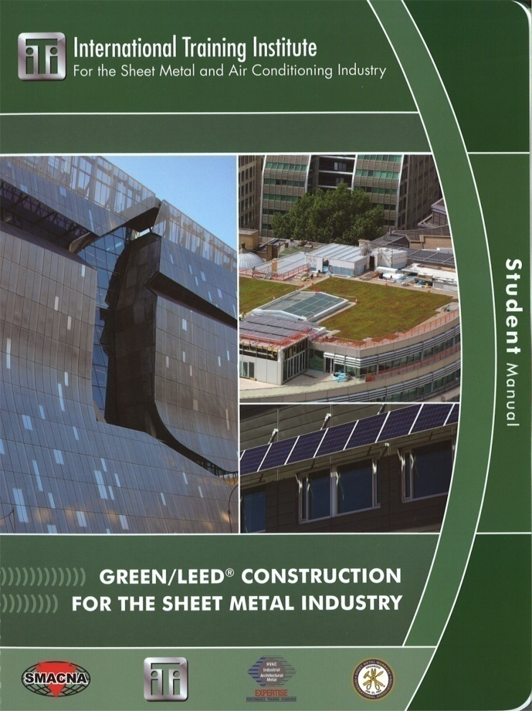
Sheet Metal Workers Green Programs
Green LEED Training
DOL Employment & Training Energy Training Partnership Grant
Factsheet on green products and best practices
Building Information Modeling

Slide 10
Sheet Metal Workers Green Programs
Wellness Program
Health screening program related to exposure

