Slide 1
Demonstration Stations: Proper Body Mechanics for Lifting Tasks
One-person Heft Test, “Straight Lift,” and “Power Lift” of box
One-person lifts of long objects:
2a. Lightweight long object (Golfer’s lift)
2b. Heavyweight long object (Method I)
2c. Heavyweight long object (Method II)
Two-person lifts of a heavyweight long object:
3a. Lift a single object (Method I)
3b. Lift two objects (Method II)
One-person lift of a heavyweight small object
Push versus pull objects

Slide 2
1a. One-Person Heft Test (checking the weight of the box before lifting)
Steps
Approach object from front, feet shoulder-width apart
Move close to object
Bend knees and hips
“Lock” back
Lift box ONLY 1” up from ground and set back down
If weight is acceptable to lift, use straight or power lift to lift box

Slide 3
1a. Heft Test (checking object weight before lift)
Photos courtesy of the Healthy Work Center, Washington University School of Medicine in St. Louis

Slide 4
1b. One-Person “Straight Lift”
Steps
Approach object from front, feet shoulder-width apart and parallel to object on each side
Move close to object
Bend knees and hips
“Lock” back, lift with back straight (DO NOT TWIST)
Use slow, smooth movements

Slide 5
1b. One Person Lifting Box: “Straight lift”
Photos courtesy of the Healthy Work Center, Washington University School of Medicine in St. Louis

Slide 6
1c. One-Person “Power Lift”
Steps
Approach object from front, one foot angled on each side of object
Move close to object
Bend knees and hips
“Lock” back, lift with back straight (NO TWISTING)
Use slow, smooth movements

Slide 7
1c. One Person Lifting Box: “Power lift”
Photos courtesy of the Healthy Work Center, Washington University School of Medicine in St. Louis

Slide 8
2a. One Person Lifting Lightweight Object: “Golfer’s Lift”
Steps
Approach object from end
Bend forward at waist on one leg, lift opposite foot off floor
Grasp object and lift, lowering foot to floor
Use slow, smooth movements

Slide 9
2a. One Person Lifting Lightweight Object: “Golfer’s Lift”
1.
2.
3.
4.
Photos courtesy of the Healthy Work Center, Washington University School of Medicine in St. Louis

Slide 10
2b. One-Person Lift: Heavyweight, Long Object (Method I)
Steps
Approach object (such as a pole) from end and get close
Half kneel or stoop to reach object
Raise end of object to shoulder
Rise to feet while walking object forward on shoulder
At midpoint of object length, balance object on shoulder
Walk forward holding the object with two hands
Note: Place cushion on shoulder if the object is very heavy or has edges

Slide 11
2b. One-Person Lift: Heavyweight, Long Object (Method I)
Photos courtesy of the Healthy Work Center, Washington University School of Medicine in St. Louis

Slide 12
2c. One-Person Lift: Heavyweight, Long Object (Method II)
Steps
Approach object (such as a pipe) from end and get close
Half kneel or stoop to reach object
Rise up to feet and stand object upright (on end)
Stoop down with back straight and shoulder near midpoint of object
Tilt object toward shoulder, grasp to balance, and stand upright.
With object balanced on shoulder, walk facing forward (NO TWISTING)
Note: Place cushion on shoulder if the object is very heavy or has edges

Slide 13
2c. One-Person Lift: Heavyweight, Long Object (Method II)
Photos courtesy of the UA

Slide 14
3a. Two-Person Lift: Heavyweight, Long Object (Method I)
Two workers discuss a plan for their lift
Each approach object (such as a pole) from the end and move close to object
“Lock” back and bend knees and hips
Communicate ‒ “one, two, three lift,” lift with back straight (NO TWISTING)
Use slow, smooth movements
Hold object at waist, front person move to other side
Communicate to lift object to shoulder at the same time
When ready, walk forward in the direction of travel

Slide 15
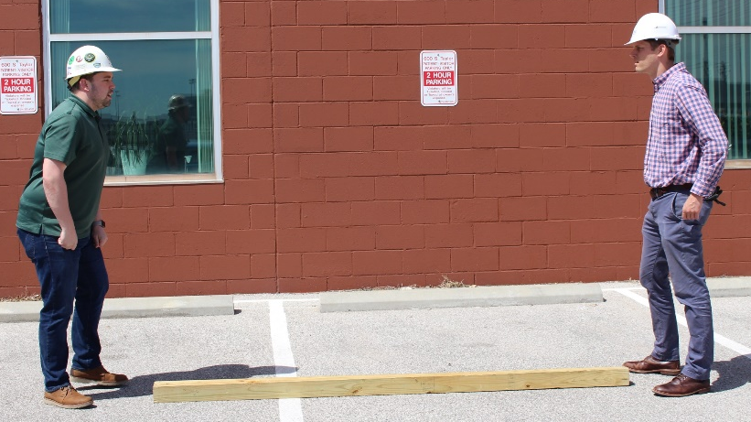
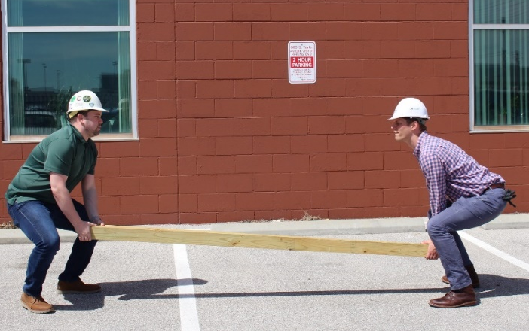
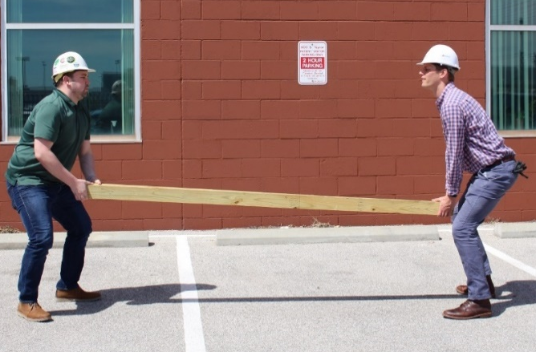
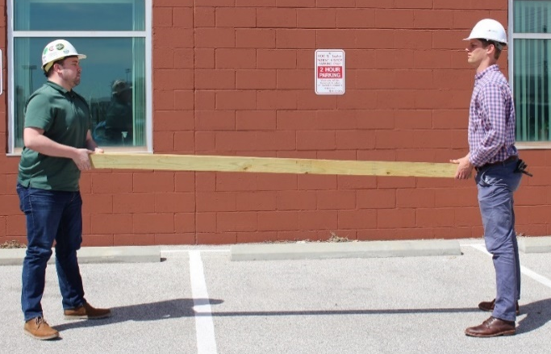
3a. Two-Person Lift: Heavyweight, Long Object (Method I)
1.
2.
3.
4.
5.
Photos courtesy of the Healthy Work Center, Washington University School of Medicine in St. Louis

Slide 16
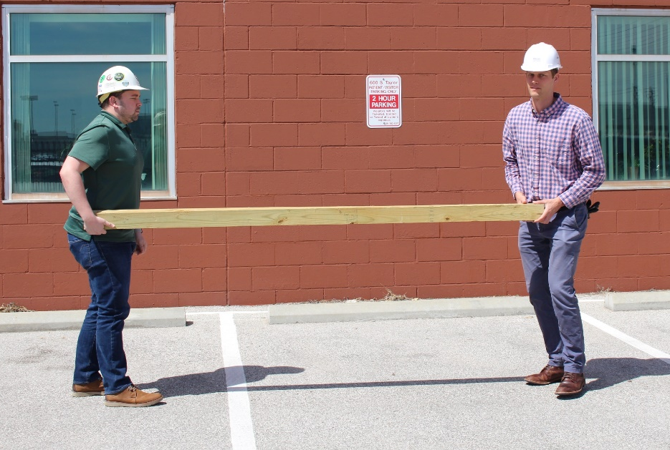
3a. (Continued) Two-Person Lift: Heavyweight, Long Object – Turn And Carry
1.
2.
3.
4.
Photos courtesy of the Healthy Work Center, Washington University School of Medicine in St. Louis

Slide 17
3b. Two-Person Lift: Heavyweight, Long Objects (Method II)
Two workers discuss a plan for their lift
Each approaches ends of objects (such as two pipes), front person turns toward direction of travel
Workers bend knees and hips, grasp objects from end
“Lock” back
Communicate ‒ “one, two, three lift”
Use slow, smooth movements to lift with back straight (NO TWISTING)
Holding objects at the ends, walk forward in the direction of travel

Slide 18
3b. Two-Person Lift: Heavyweight, Long Objects (Method II)
Plan the lift
One worker gives commands
Ideally, lift together
Get your balance
Step together
Photos courtesy of the UA

Slide 19
4. One-Person Lift: Roll a Heavyweight Small Object up Body
Steps
Half kneel directly in front of object
“Lock” back and roll object onto thigh
Roll object to waist, hold close to body firmly
Push off on back foot and rise to stand
Get your balance before moving forward

Slide 20
4. One-Person Lift: Roll a Heavyweight Small Object up Body
1.
2.
3.
4.
5.
6.
Photos courtesy of the Healthy Work Center, Washington University School of Medicine in St. Louis

Slide 21
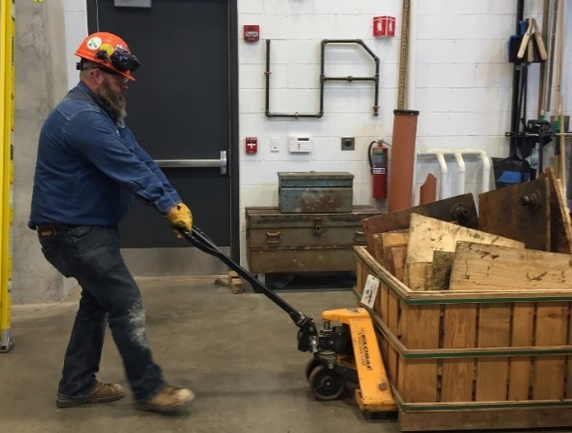
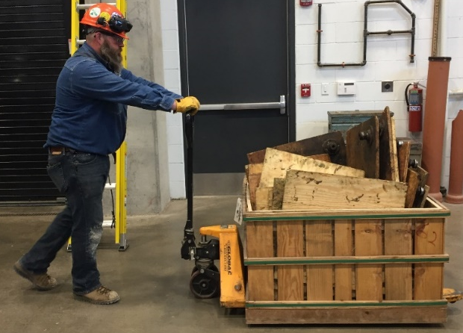
5. Push Versus Pull
Strongest muscles of the body are your legs
Always PUSH objects that are below waist height (e.g., carts, boxes)
Arm biceps are stronger than triceps
Always PULL objects that are above your waist height (e.g., pipe wrench)
Don’t push objects above your waist
PULL objects above your waist
Don’t pull objects on floor
PUSH objects on the floor
Photos courtesy of the UA

