Slide 1

Ergonomics Basics
Reducing the Risks for Soft Tissue Injuries
Part 1 - A
Notes:
NOTES FOR SLIDE 1:
The purpose of this presentation is to provide training on basic ergonomic concepts and practices to raise awareness of the risks and how to reduce them to prevent soft tissue injuries.

Slide 2
Why Did You Decide to Work in Construction?
Reasons:
Enjoy working with your hands
Opportunity to “see” what you built
Solve problems with each new project
Work as a team
Make a good income
Risks:
Work can be physically demanding
Injuries can be common and are often higher among new workers
Notes:
INSTRUCTOR NOTE:
Only show the title of the PowerPoint slide “Why did you decide to work in construction?”
NOTES FOR SLIDE 2:
Ask the class:
Why did you decide to work in construction?
After a brief discussion, click to show the examples and risks listed on the slide.
Tell the class:
There are many reasons – such as the ones mentioned and the ones on this slide:
It’s a good career for individuals who enjoy working with their hands;
You get to see what you helped build;
You can solve problems;
There is strong camaraderie with coworkers; and
The potential to make a good income.
But there are also risks associated with this work that can cause injuries, so it’s important to learn how to protect yourself from these risks.
Today, we’re not going to be talking about traumatic and fatal injuries.
Instead, we are going to talk about the injuries that result from the physical work done every day.
Without safe work practices, this work can break down a worker’s body over time, result in a disability, and force a worker to leave the industry or retire early.
You may not think this will happen to you, but if talk to anyone who’s been in the industry for many years, particularly middle-aged or older construction workers, they will tell you these injuries are common in construction.

Slide 3
Ergonomic Training Goal and Learning Objectives
GOAL:
Provide training to identify the causes of sprains, strains, and soft tissue injuries, understand the risks, and know the steps to take to prevent them.
LEARNING OBJECTIVES:
Identify the ergonomic hazards
Review the basic ergonomic controls for hazards to prevent injuries
Describe the proper body mechanics for lifting tasks to prevent injuries
Describe the risks of using prescription opioids and self-treatment for pain management
Identify the benefits of doing stretching exercises
Demonstrate at least one safe lifting practice
Notes:
INSTRUCTOR NOTE:
This slide includes all of the learning objectives for Parts 1-A and 1-B. If you do not plan to do Part 1-B during the same training session, you should let your trainees know and tell them that you will be covering objectives 1-3 in this first session. You should also let them know when objectives 4-6 will be covered.
NOTES FOR SLIDE 3:
Today’s goal is to provide training to identify the causes of sprains, strains, and soft tissue injuries, understand the risks, and know the steps to take to prevent them.
By the end of today’s training, you should be able to:
Identify the ergonomic hazards
Review the basic ergonomic controls for hazards to prevent injuries
Describe the proper body mechanics for lifting tasks to prevent injuries
Describe the risks of using prescription opioids and self-treatment for pain management
Identify the benefits of doing stretching exercises
Demonstrate at least one safe lifting practice

Slide 4
Sprains, Strains, and Other Soft Tissue Injuries Are Common
Sprains and strains account for 27.3% of all nonfatal injuries in construction each year.
Lifetime risk of overexertion injuries is 21% for all construction trades, although many more suffer chronic pain.
Most overexertion injuries are related to handling heavy building materials.
Construction workers suffer from the highest number of lost days of work from low back injuries.
It is IMPORTANT that you learn how to protect your body from damage.
Notes:
NOTES FOR SLIDE 4:
Let’s start with why it’s critical to reduce sprains, strains, and other soft tissue injuries.
First, they are very common, causing more than one-fourth of nonfatal injuries suffered by construction workers every year.
About 21% of construction workers experience these injuries based on what’s reported, but we know that many more will suffer from chronic or persistent pain.
One type of sprain or strain is caused by overexertion of the body from handling building materials and equipment – particularly heavy or awkward materials or equipment. This often results in low back injuries.
Since you only get one body in your lifetime, it’s important that you learn how to properly handle materials as early as possible in your career and use safe lifting practices every day to protect your body from damage.

Slide 5
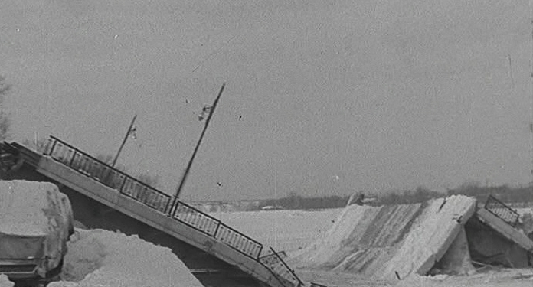
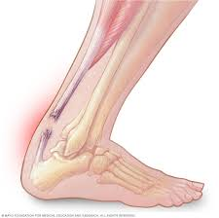
The “Wear and Tear” of Tissues of the Body
All materials become damaged when stressed.
  Metal/concrete ages with weather, degrades, eventually collapses
Highly stressful activities for long periods of time will result in damage to materials.
Our body responds in the same way with damage to the body tissues.
Lethbridge Herald photo, used with permission
Duplessis Bridge, Alberta, Canada
Achilles tendon rupture –
a tear from overexertion
Used with permission of Mayo Foundation for Medical Education and Research, all rights reserved
Notes:
NOTES FOR SLIDE 5:
To understand how to prevent an injury, it’s important to understand what’s happening to your body.
The tissues of your body respond to stress similar to other materials, such as metal, concrete, and wood.
As materials are exposed to physical stress – weight – and environmental exposures – weather, heat, cold, and rain – they break down.
This slide shows examples of this happening. Back in 1951, the Duplessis Bridge collapsed into the St. Maurice River in Alberta, Canada. Even though the bridge was only three years old, it could not stand up against the extreme cold and heavy loads that travelled over it every day.
Just like that bridge, the tissues of your body respond to stress and heavy loads, causing them to gradually breakdown. The bottom right photo of the foot shows an Achilles (“a-kill-ees”) tendon tear from overexertion.
INSTRUCTOR NOTE:
If you would like to include more information on the bridge collapse in your discussion, click on this link: http://anengineersaspect.blogspot.com/2013/04/the-duplessis-bridge-collapse-january.html

Slide 6
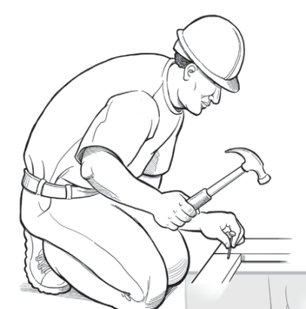
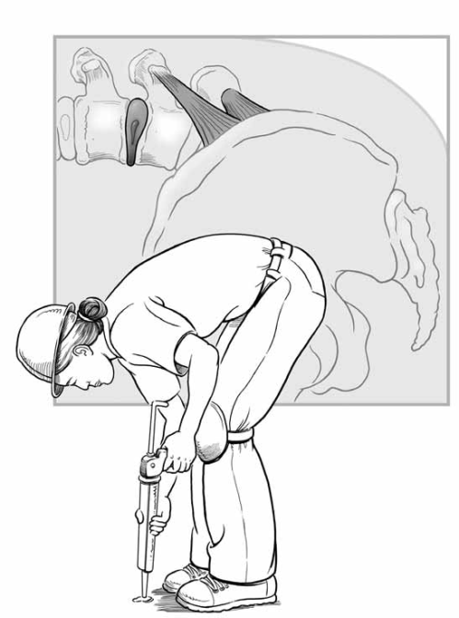
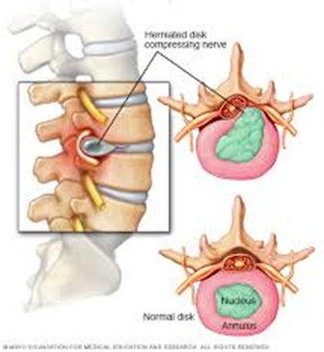
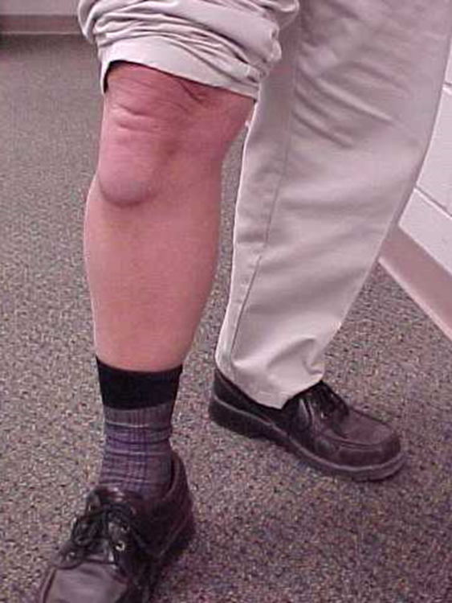

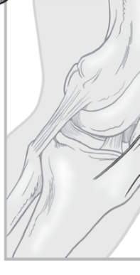
Sprains, Strains, and Other Soft Tissue Injuries or Musculoskeletal Disorders (MSDs)
1) Damage to the musculoskeletal system – muscles, nerves, tendons, ligaments, joints, cartilage and spinal discs.
2) They are cumulative – as opposed to accidents, they happen gradually.
3) They are chronic – the effects last a long time.
Soft disc – jelly pushing on
spinal nerves
Knee bursitis
Photo courtesy of NIOSH
Photo courtesy of Dr. Ann Marie Dale
Photo courtesy of NIOSH
Used with permission of Mayo Foundation for Medical Education and Research, all rights reserved
Notes:
NOTES FOR SLIDE 6:
In the medical world, sprains, strains, and other soft tissue injuries are called musculoskeletal (“musk-u-low-skel-e-tall”) disorders or MSDs.
They include damage to the different soft tissues of your body, your muscles, nerves, bones, and connecting tissues like tendons and ligaments.
The damage is cumulative. It develops over time, not usually from a sudden accident, and may become chronic or persistent. In other words, the damage and pain could last for a long time, possibly the rest of your life.
The photos at the bottom on the left show the structure of your low back ‒ the most common body part injured. The soft disc is a cushion between each bone, but the center “jelly” (in green) may push on the spinal nerves (orange tubes) when the body bends forward. One way to think of it is like a jelly doughnut being compressed.
The back is complex. Once the tissues “wear and tear,” it is very hard to get them to heal.
The bottom right photo shows a worker with knee bursitis caused by kneeling on a hard floor often without the benefit of padding against the floor. His doctor recommended a knee joint replacement. Once you have this procedure, it is difficult to kneel. So, this worker could not go back to doing the same type of work, unless the work could be done in a different way without kneeling.

Slide 7
Development of Sprain, Strain, Soft Tissue Injuries
(Mild Symptoms Develop over Several Weeks or Months)
Pain or Discomfort
Time
Activity
Rest
High
When work stops the pain goes away
Low
Notes:
NOTES FOR SLIDE 7:
As mentioned, soft tissue injuries do not happen suddenly. They develop slowly over time.
This diagram shows that as a worker performs hard physical activity over the course of a day (horizontal axis), the worker may experience a gradual increase in pain or discomfort (vertical axis) – the blue line that is increasing.
But at the end of the day, when the worker stops doing the work, the pain and discomfort go back down or go away. These “mild symptoms” improve as the tissues of the body heal.

Slide 8
Development of Sprain, Strain, Soft Tissue Injuries
(Moderate-Severe Symptoms Develop over Many Months to Years)
Pain or Discomfort
High
Activity
Rest
Pain decreases, but the worker never fully recovers
Low
Time
Notes:
NOTES FOR SLIDE 8:
However, as time goes by a worker’s body may not have enough time to heal between new episodes of work.
This slide shows what happens to the worker when there is not enough time to heal the tissues between each episode of work, even with a long period of rest (such as over a weekend).
The blue line shows increasing pain or discomfort when a worker is performing an activity. The dotted line shows the pain decreasing when the activity stops and during rest.
But as time goes on, the worker never fully recovers and gets all the way back to normal before having to begin the activity again.
Oftentimes, workers experience moderate to severe symptoms that develop over many months or years.

Slide 9
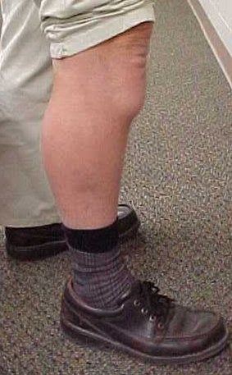
Soft Tissue Symptoms and Injury Risk Continuum
Normal Mild Moderate Severe
100% chance of recovery Unable to regain normal function
medicalstocks/Shutterstock.com
Photo courtesy of Dr. Ann Marie Dale
Importance of Early Awareness
Notes:
NOTES FOR SLIDE 9:
This diagram shows the progression from normal “no symptoms” through developing mild, moderate, or severe symptoms. It underscores why early awareness of what’s happening to your body is important.
Early on, the body can heal to get back to normal ‒ there’s a 100% chance of recovery.
As the worker has moderate to more severe symptoms, even with a lot of rest the body cannot recover completely and the worker is unable to regain normal function.

Slide 10
Treatment and Progression
– Don’t IGNORE Early Symptoms!
Early symptoms, pain with movement: kneel, stoop, walk—CHANGE how you are working or your work tasks
If symptoms don’t improve, consider medical treatment
  Early stage:
    Use Rest, Ice, Compression, Elevation (RICE)
    See a physician who may prescribe medications (anti-inflammatories), therapy, or other treatments
  Late stage: surgery of back, knee, shoulder, hand
Notes:
NOTES FOR SLIDE 10:
That’s why it’s important not to ignore early symptoms and to seek treatment early when you have the greatest chance of recovery.
Construction workers, just like professional athletes, need to take care of their physical health to have a long career and stay employed.
Early symptoms include pain when you kneel, bend over, and walk. When you notice pain and discomfort, change how you are doing your work or your work tasks.
If the symptoms don’t improve, see a physician.
If you wait too long to get medical help, you may require surgery in order to get better.

Slide 11
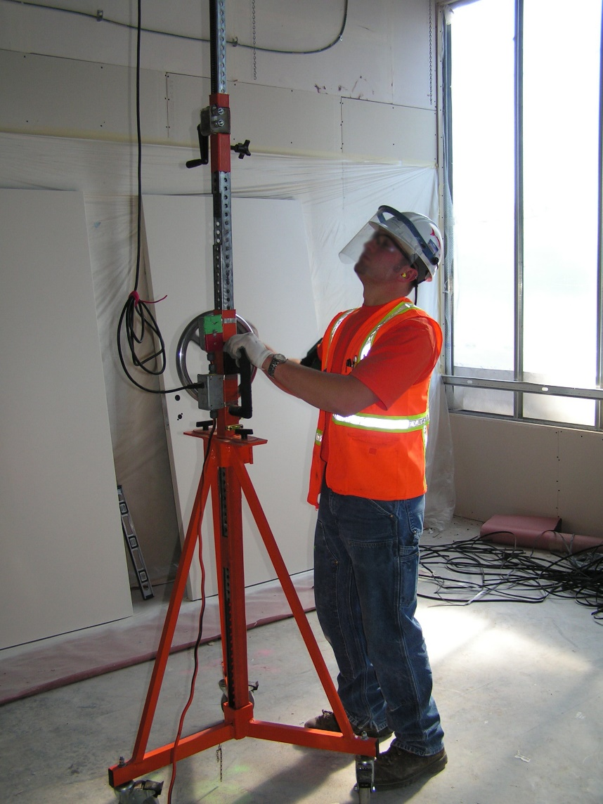
What is Ergonomics?
Ergonomics is the way to prevent injuries:
Fit the tasks, tools, and environment to the physical abilities of the worker
Goal: to reduce or eliminate risk of injuries
Overhead drill press developed as a CPWR research project. Photo courtesy of Dr. David Rempel.
Notes:
INSTRUCTOR NOTE:
Only show the title of the PowerPoint slide “What is ergonomics?”
NOTES FOR SLIDE 11:
Ask the class:
What is ergonomics?
On a whiteboard or flip chart, write down the various descriptions given by the trainees.
Once everyone is done giving a description, advance the PowerPoint slide to show the definition provided.
Tell the class:
Everyone’s body has different abilities in terms of strength, flexibility, and tolerance.
Ergonomics is the way to prevent injuries by setting up the work environment and tools to make the job fit the physical abilities of the worker.
Work should be designed so most workers can do it without tearing down the tissues of the body to get the job done.
Examples are all around you, such as the shape of a tool handle or an extra handle to hold onto.
By working within the physical limits of your body, you will eliminate the risk of overexertion, sprain, and strain injuries.

Slide 12
Prevention: Identify Ergonomic Hazards
High Force*
Poor Postures*
Fast/prolonged Repetition
Stress from body Contact
Hand or body Vibration
Environment (Cold)
Notes:
NOTES FOR SLIDE 12:
There are 6 ergonomic hazards:
High Force
Poor Postures
Fast or prolonged Repetition
Stress from body Contact
Hand or body Vibration
And a cold Environment
While all exist in construction, the most common hazards are high force and poor postures, which are the focus of this training.

Slide 13
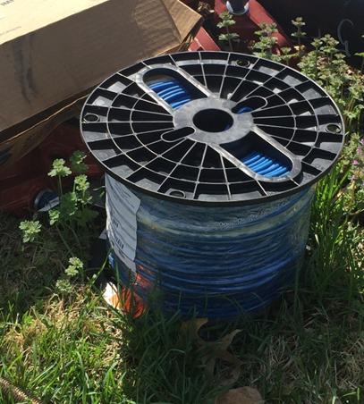
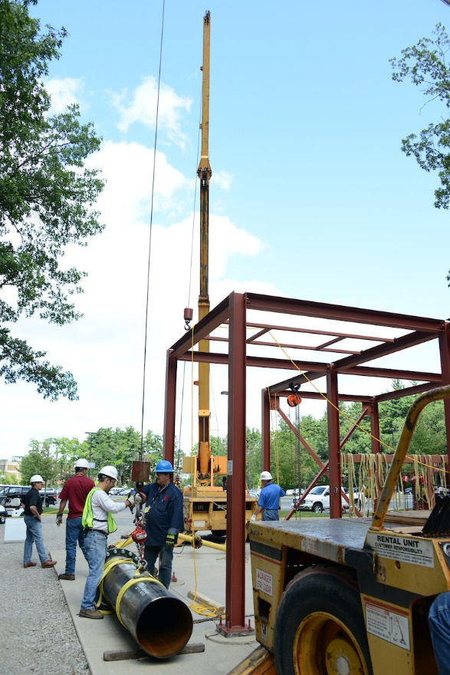
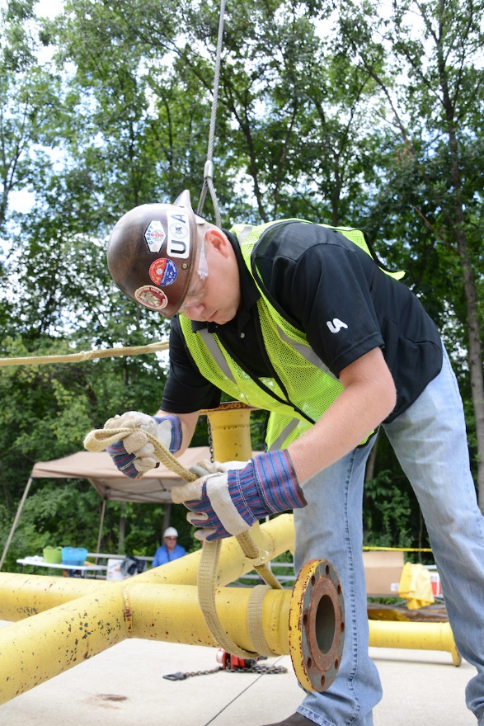
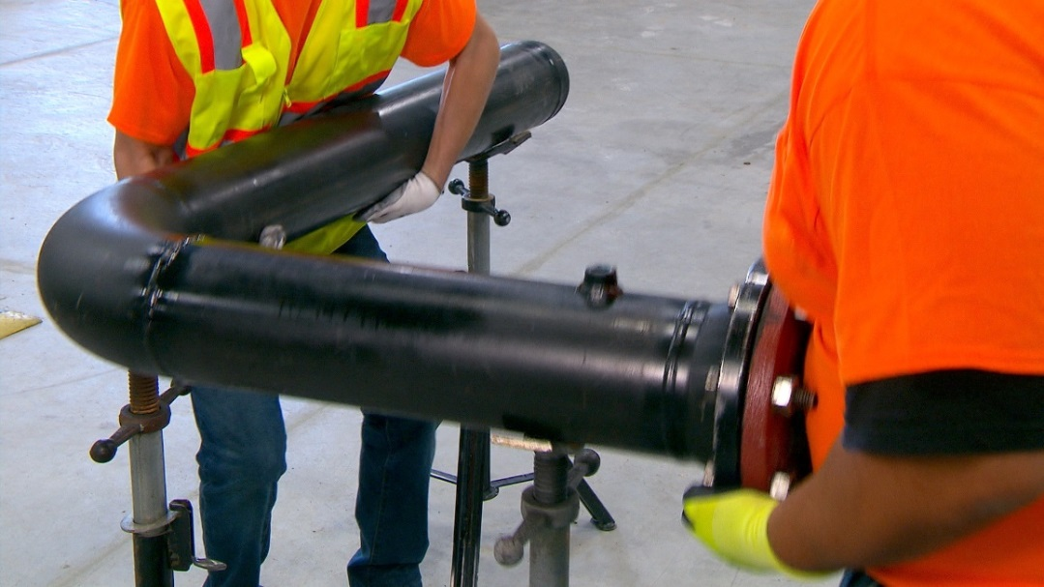
Force is the Physical Power Needed to Move an Object
Can everyone lift the same amount of weight safely?
How do you know when someone is lifting something that is too heavy for them?
Photo courtesy of the Healthy Work Center, Washington University School of Medicine in St. Louis
Photo courtesy of the UA
Photo courtesy of the UA
Photo courtesy of the MCAA
Notes:
NOTES FOR SLIDE 13:
The first ergonomic hazard, force, is the effort needed to move an object, such as lifting a pipe, moving a bag of mortar, or pushing a cart.
Ask the class:
Can everyone lift the same amount of weight safely?
Pause briefly to let one or two people respond.
Ask the class:
How do you know when someone is lifting something that is too heavy for them?
On a whiteboard or flip chart, write down the various descriptions given by the trainees.
Once everyone is done giving an answer, review the examples below.
Jerk to get the movement started
Load falling over time
Frequent rest breaks

Slide 14
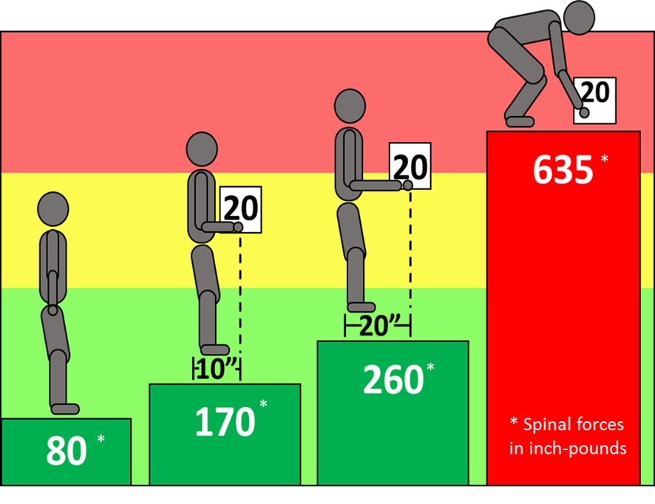
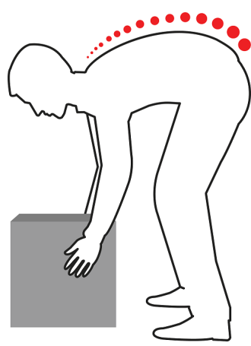
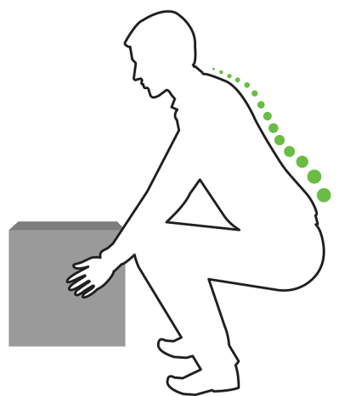
Risk of Injury: Low Back (Spinal) Forces and Lifting:
Effect of Load and Positioning on Spinal Forces
Rounded back, high disc pressure – increased risk for injury
*
Image courtesy of Washington University in St. Louis
Locked back,
low disc pressure – lower risk for injury
*
*
* Spinal forces in inch-pounds
*
Spinal Forces
Maanas/Shutterstock.com
Notes:
NOTES FOR SLIDE 14:
The weight of the load affects the low back.
The weight can be measured through spinal forces in the joints of your low back.
In the diagram on the left, the first figure is standing upright with no load. The spinal force from gravity on his low back is 80 inch-pounds.
The second figure is holding a 20-pound load close to their body ‒ 10 inches from the hands to the low back. This is an IDEAL posture to carry a load. The spinal force goes up to 170 inch-pounds.
If the load is moved away from the body to a distance of 20 inches, the spinal forces increase significantly to 260 inch-pounds. So how close you hold an object makes a BIG difference to your low back forces.
The last figure shows the large increase in spinal forces from lifting an object from the floor. The distance to the box is larger and the body is not upright. The spinal forces have more than tripled from the IDEAL figure of 170 inch-pounds to 635 inch-pounds.
The two figures on the right side of the slide show a curved back posture on the top, a poor posture which causes high spinal disc pressure. The bottom figure shows a “locked” back straight posture. By keeping your back locked in a straight position while lifting, your spinal forces stay low.

Slide 15
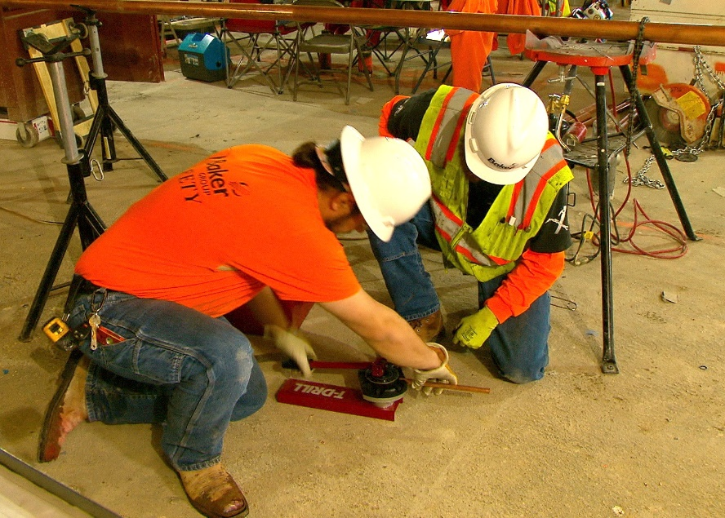
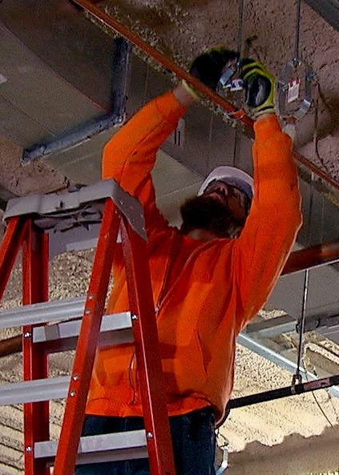
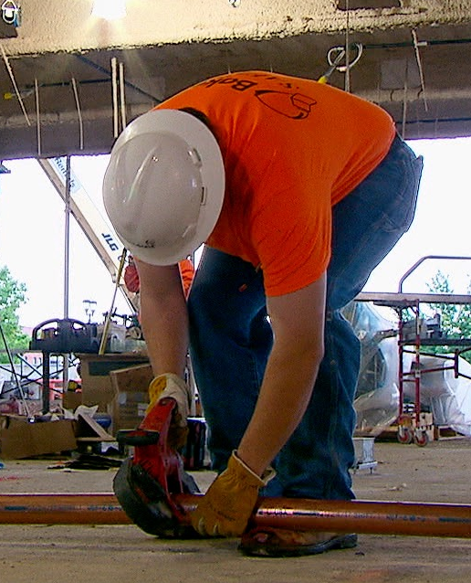
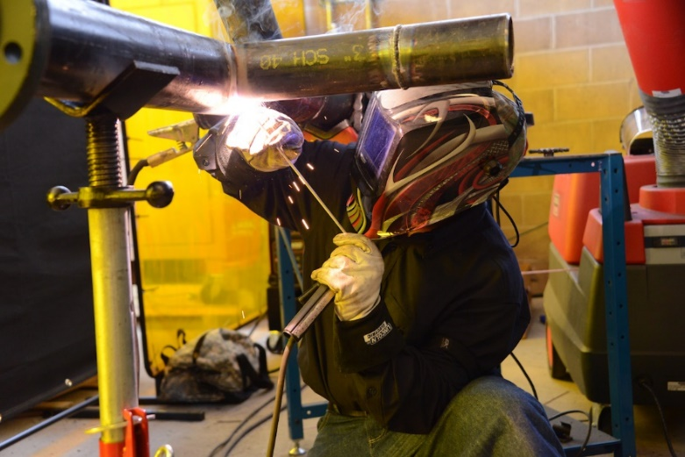
Poor (Awkward) Postures: Near Floor or Overhead
Photo courtesy of the MCAA
Photo courtesy of the MCAA
Photo courtesy of the UA
Photo courtesy of the MCAA
Notes:
NOTES FOR SLIDE 15:
The second ergonomic hazard is poor postures, often called “awkward postures.”
Many workers will work at the floor level using a forward bent back posture. Working in a bent back posture causes increased spinal forces.
Other workers will kneel to work on the floor. This may cause a contact stress between the hard ground surface and your knee. It is helpful to use knee pads or other cushion to eliminate contact stress.
The photo on the far right shows a worker doing overhead work. Anytime your hand is positioned above your head height, there is high stress on your shoulder. Work that is at or below your head height is much easier on your shoulder.

Slide 16
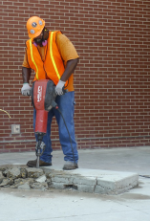
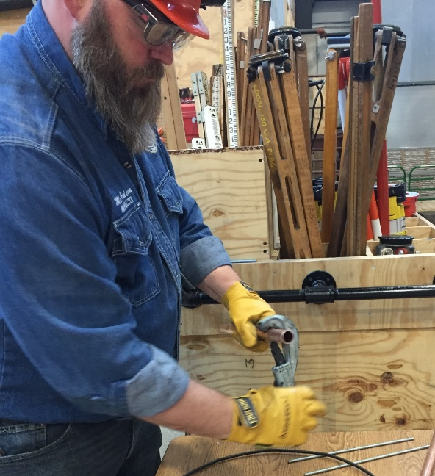
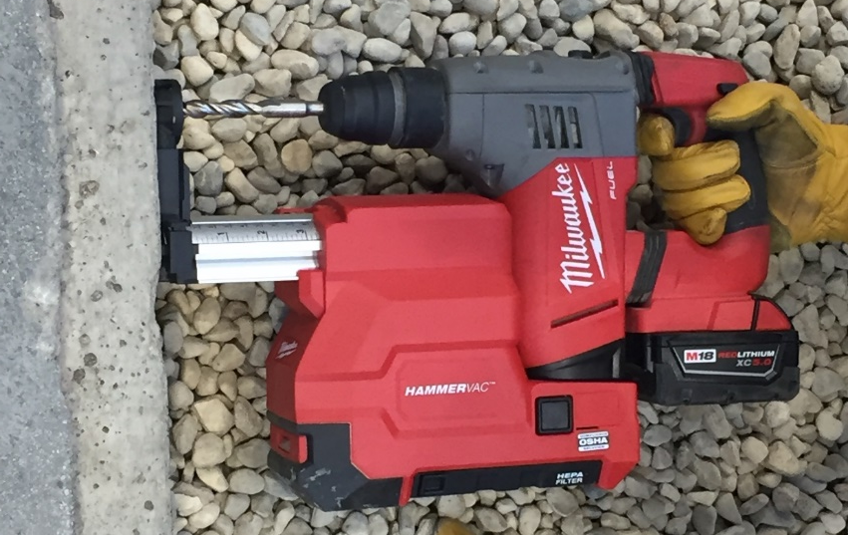
Other Ergonomic Hazards
Repetition
Contact stress
Vibration
Environment (cold weather)
Photo courtesy of the UA
Photo courtesy of the International Masonry Institute and OSHA
Photo courtesy of
Milwaukee Tool
Notes:
NOTES FOR SLIDE 16:
Other ergonomic hazards include highly repetitive work, contact stress (other than knee contact with the floor when kneeling), vibration of the hand, which is common when using power tools like a jack hammer, and vibration of the body if operating powered equipment while sitting.
Solutions are being developed. For example, through CPWR’s research the overhead drill press shown earlier was developed to reduce overhead work, and a lateral drill rig was developed that reduces vibration risks.
INSTRUCTOR NOTE:
To learn more about these solutions: see http://www.choosehandsafety.org for information on how to select hand tools, or visit https://www.cpwr.com/research/research-practice-library/construction-ergonomic-research-solutions for other resources.

Slide 17
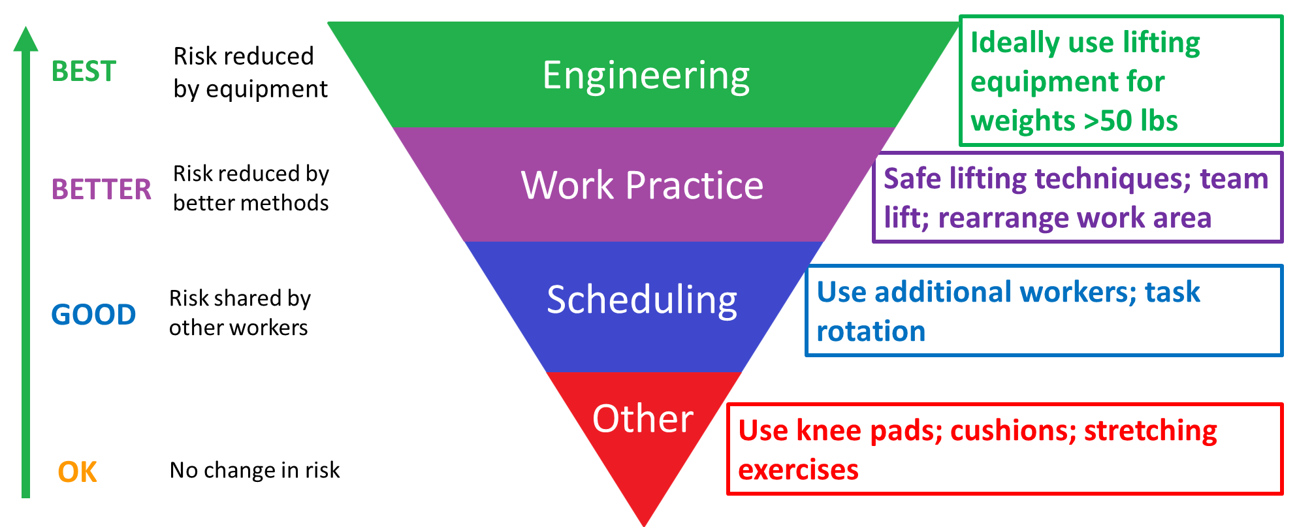
Hierarchy of Ergonomic Controls to Reduce the Risk
Notes:
NOTES FOR SLIDE 17:
There are a number of solutions or controls that reduce the risk of ergonomic hazards.
Some controls reduce the risk better than others.
This figure shows the hierarchy of ergonomic controls. The types of controls at the top of the triangle are “BEST” while the controls at the bottom are just “OK.”
Engineering controls generally use equipment to reduce the risk. An example is to use equipment to lift and move heavy objects. I’ll show you some examples on the next slide.
Work practice controls use the best methods to perform the task. Examples include using safe lifting techniques or team lifts.
Scheduling, or what is more commonly called administrative controls, shares the work between workers. Usually your foreman or superintendent must authorize using this solution.
“Other” is the lowest control that offers the smallest benefit. Examples include knee pads or stretching exercises. If you have no other option, stretching exercises may be helpful.

Slide 18
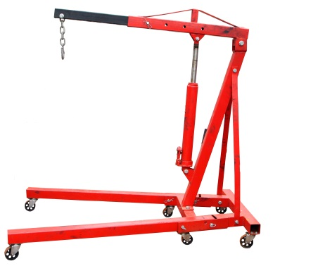
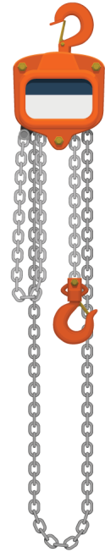
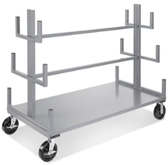
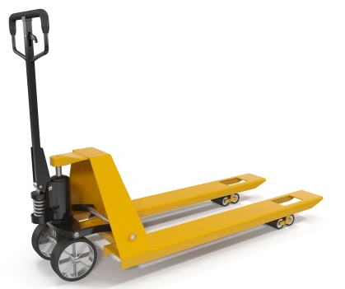
Reduce Force: Move Materials with Lifting Equipment
PLAN YOUR WORK
USE ENGINEERING CONTROLS
  Lift assist to lift large-sized, long, or heavy materials.
  Lifting equipment to transport loads, make fewer trips, and avoid carrying materials on your shoulder.
KEEP FLOORS CLEAR
Portable
lifting hoist
iStock.com/shank_all
Pipe cart
Chainfall
Heavypong/Shutterstock.com
Photo courtesy of Construction Solutions and Uline
3DMI/Shutterstock.com
Pallet jack
Notes:
NOTES FOR SLIDE 18:
To reduce force and prevent injuries, the first step is to “plan your work.” You must think through how you are going to do the work and what equipment will be needed for a safe lift – the engineering controls.
Your employer should provide you with lifting equipment for the heavier loads and train you on how to use it. This slide shows several examples of lifting equipment.
Since many of these tools are on wheels, it is important to keep the work area clear of obstacles and debris – in other words, engage in good housekeeping practices.

Slide 19
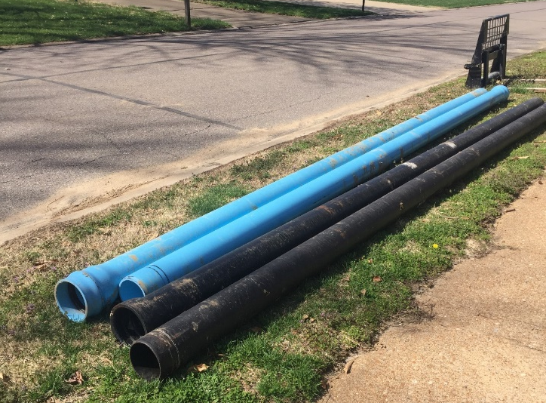
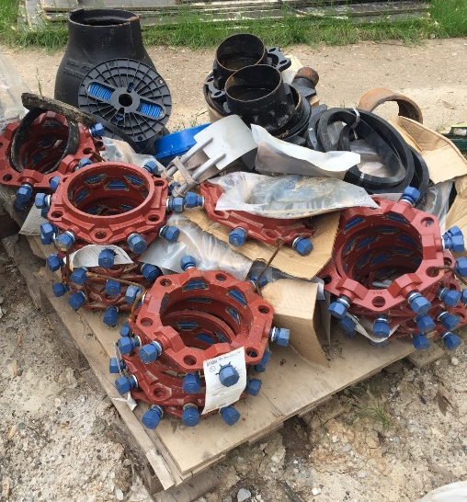
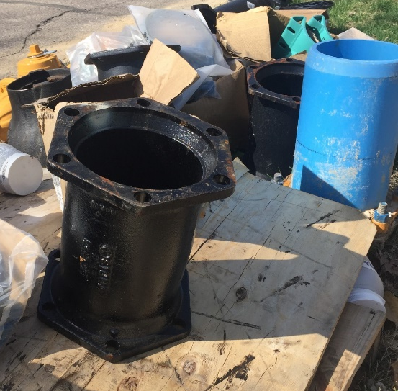
High Force: Lifting/Carrying Recommendations
Use NIOSH’s Lifting Equation
OR
One person should:
  NOT lift more than 50 pounds on their own
  NOT carry heavy objects more than 100 feet
  Keep work tools and materials weighing more than 25 pounds at waist height
Photos courtesy of the Healthy Work Center, Washington University School of Medicine in St. Louis
Notes:
INSTRUCTOR NOTE:
A detailed explanation of the NIOSH Lifting Equation and example of how to use the related app is included in Part 4 since it may be too complex for an introductory class. If you feel your class would benefit from learning about it you can use Slides 17 and 18 from Part 4 at this point in the presentation.
NOTES FOR SLIDE 19:
When planning your work, you should also consider safe work practices.
NIOSH’s lifting equation can help you or your employer determine what a safe weight is for you.
Since using the equation may not always be an option, one person should not lift objects weighing more than 50 pounds on their own and should not carry heavy objects long distances of more than 100 feet.
And work involving tools, equipment, or materials that weigh more than 25 pounds should be handled at waist height ‒ not overhead or on the ground.

Slide 20
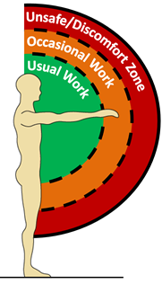
Location, Location, Location:
Prime Real Estate
Green – Keep the work close (between shoulder and wrist). Bring work close to you or your body close to the task.
Orange – Occasional reach to your fingertips.
Red – Do NOT reach beyond your fingertips (can cause shoulder and low back pain).
Image courtesy of Washington University in St. Louis
Notes:
NOTES FOR SLIDE 20:
This slide shows the zone that you should try to work within.
Ideally, work should be located close to your body.
This diagram of your “prime real estate” shows that usual work should be in the green zone ‒ between your wrist and body. Overhead work is close to head height, lower work is just below your waist.
Occasional work may be done outside of that area (in the orange zone).
The red zone is going to put your body in an awkward position. This is the work zone where you have the greatest risk for injury.
If you reach forward to the red zone, you can cause shoulder and low back pain.

Slide 21


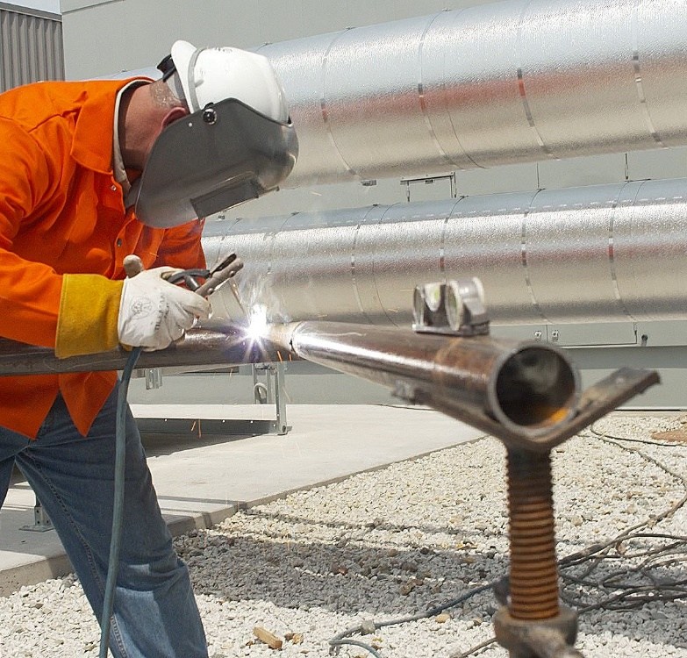
Awkward Posture:
Ground-Level WORK – “RAISE IT UP”
When possible, bring material to waist height using a stand or a cart.
Adjust its position to get close to the task.
Photo courtesy of the MCAA
Photo courtesy of the MCAA
Notes:
NOTES FOR SLIDE 21:
Set up your work area so you can avoid working from the floor or ground, by raising the work up. Use a cart or stand to assemble materials. On this slide, a jig or pipe stand on a tripod is being used so the worker can work at waist level.

Slide 22
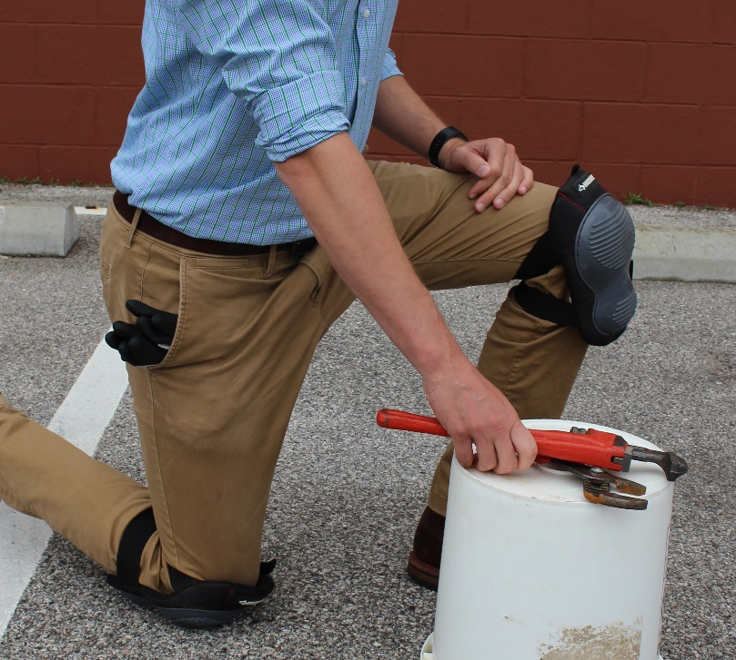
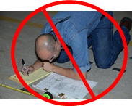
Reduce Work Time On Ground Level
Preassemble at waist height
Sit on floor
Kneel with knee pads or cushion
Photo courtesy of the UA
Photo courtesy of the Healthy Work Center, Washington University School of Medicine in St. Louis
Notes:
NOTES FOR SLIDE 22:
If you must work on the ground, limit the time you spend on the ground. Do part of the work at your waist height.
If you kneel, use knee pads or other cushions.

Slide 23
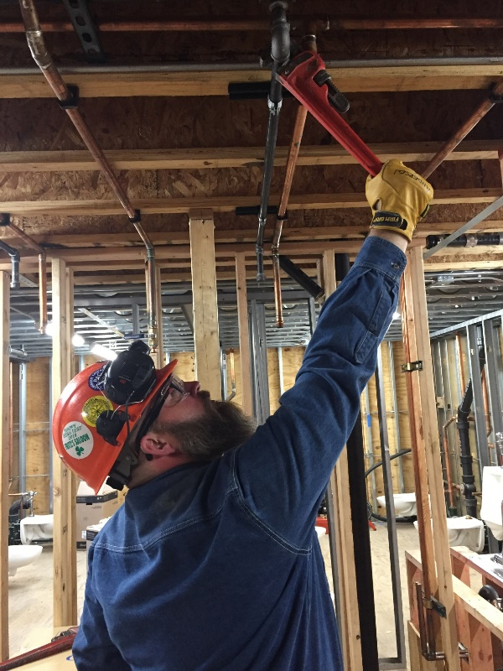
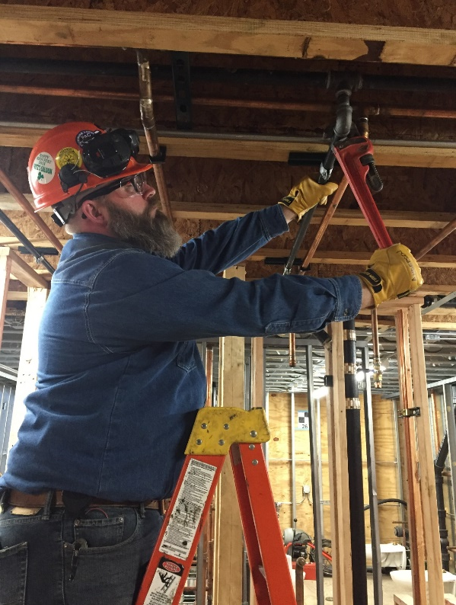
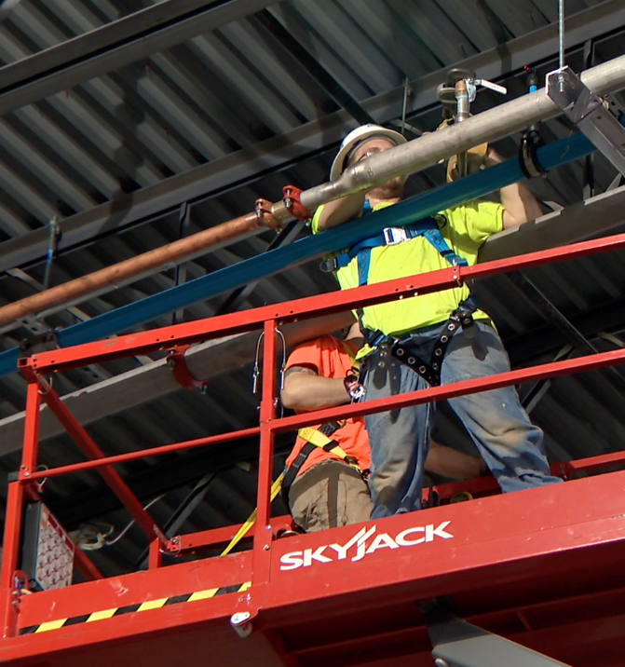
Awkward Posture:
Overhead Work
To avoid straining your shoulder and low back:
Get as close to the task as possible.
Move your lift or move up on your ladder.
Use extended handled tools or tool extensions.
Photos courtesy
of the UA
Photo courtesy of the MCAA
Notes:
NOTES FOR SLIDE 23:
Reaching up overhead to perform a task puts extra strain on your shoulders and low back.
If you work overhead, use a device such as a lift or ladder to raise you up. Position the equipment so the work is at or near your head height.
The top photo shows a worker reaching overhead. The shoulder angle is greater than 90 degrees. This worker could use a taller ladder or a scissor lift to get closer to the work.
Tools with longer handles or extensions can also reduce overhead reaching.

Slide 24
Proper Body Mechanics for Lifting Tasks
One-person heft test, “straight” and “power” lift of box
One-person lift of lightweight, long object
One-person lift of heavyweight, long object (Method I & II)
Two-person lift of heavyweight, long object (Method I & II)
One-person lift of heavyweight, small object
Push versus pull objects – wheeled cart and pipe wrench
Interactive PC- and App-based resources
Notes:
Instructor Note:
Slides 24 – 39 cover safe lifting practices and online resources that reinforce these practices. This information can be used with or without the activities in Parts 2 and 3. However, if you have the time and space, we encourage you to use both the slides in this presentation and the hands-on exercises since they reinforce each other and help with retention. If you cannot do both, consider using the portion you could not do during your initial training as a refresher during a future class.
NOTES FOR SLIDE 24:
As mentioned at the start of this presentation, the most common ergonomic hazard is lifting objects, equipment, or materials. It is important that you learn how to lift objects using “proper body mechanics.”
We’re going to review different ways you can lift objects, including:
Several one-person lifts, including one for testing the weight of an object ‒ called the heft test, different methods for lifting lightweight and heavyweight long objects, and one for lifting a heavyweight small object;
Two-person or team lifts; and
When you should push versus pull objects.
I’m also going to introduce some interactive online resources that you can use on your own as refreshers on safe practices.
IF YOU WILL BE DOING PART 2 “PROPER LIFTING METHODS: HANDS-ON DEMONSTRATION STATIONS” AS PART OF THE CURRENT CLASS ‒ TELL THE CLASS:
Listen carefully as you will be expected to demonstrate these lifts.
IF YOU WILL BE DOING PART 3 “INTERACTIVE RESOURCES TO REDUCE MANUAL MATERIAL HANDLING RISKS: COMPUTER/APP-BASED TRAINING” ‒ TELL THE CLASS:
We’re also going to have a computer station set up so that you can try out some interactive online resources that let you try out safe lifting practices and stretching exercises, and provide a refresher on the materials covered in this training program.
IF YOU WILL NOT BE DOING DEMONSTRATION WORKSTATIONS AS PART OF THE CURRENT CLASS AND DOING IT AT A FUTURE CLASS ‒ TELL THE CLASS:
Listen carefully because in one of our future classes you will be expected to demonstrate these lifts.

Slide 25
Plan Your Lift: Select the Best Method to Lift an Object
Plan task
  Assess weight of object
  Assess size of object
  Assess distance and obstacles in the path to the destination
Choose best method to lift and move object
  One-person lift
    Weight is 50 pounds or less
    Distance is acceptable and without obstacles
  Two-person lift
    Weight is more than 50 pounds (a reasonable weight for two people)
    Distance is acceptable and without obstacles
Notes:
NOTES FOR SLIDE 25:
Before we get into the lifting methods, as mentioned earlier, prior to doing any lift, it’s important to plan how you will safely perform the lifting task.
You’ll need to determine the weight of the object, its size, how far you will have to move it, and whether the path is clear of obstacles. Then you need to choose the best lifting method. As a reminder:
A one-person lift is ok for an object that weighs 50 pounds or less
And you need to make sure the carrying distance is acceptable ‒ usually less than 100 feet – and free of obstacles that could create a trip or slip hazard
If it weighs more than 50 pounds, you should use a two-person lift team and make sure the carrying distance is acceptable and free of obstacles
Now we’re going to review several safe lifting methods.

Slide 26
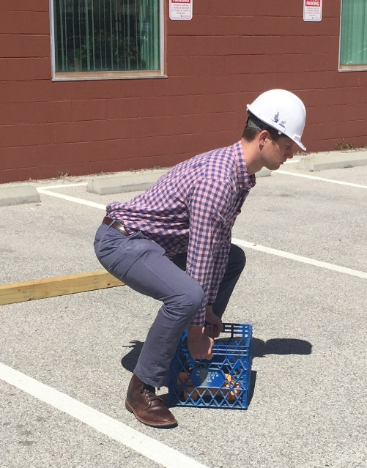
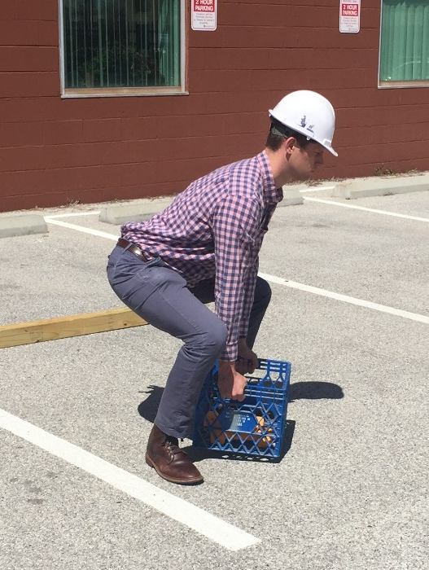
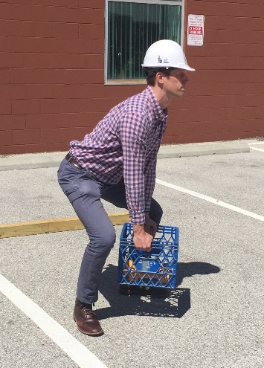
One Person Lifting A Box – Ground to Waist:
Heft Test (Check Weight Before Lifting)
Photos courtesy of the Healthy Work Center, Washington University School of Medicine in St. Louis
Notes:
NOTES FOR SLIDE 26:
The heft test is the method used to check the weight of an object before performing the full lift. The idea is to position yourself as if you are going to conduct the lift, but only lift the object about 1 inch off the floor.
This allows you to assess the weight of the object and test your ability to lift it without risk of injury. If you have to jerk the object to raise it off the ground, you need to get help.
There are three steps in the heft test:
First, approach the object from the front, with your feet shoulder-width apart, and move close to the object;
Then, bend your knees and hips, “lock” your back, and lift the box ONLY 1” up from the ground – as shown in the middle photo – and set the object back down;
If the weight is acceptable to lift, use the straight or power lift to lift box – as shown in the final image.
Remember:
Avoid letting your knees extend beyond your feet, don’t just squat down to lift something, and always keep your core tight.
When you lower the object down, lock your back and move smoothly, bending your knees and hips only.
INSTRUCTOR NOTE:
The interactive training and coaching resources and games for smartphones/tablets described in Part 3 and introduced at the end of the module include information on putting materials down.

Slide 27
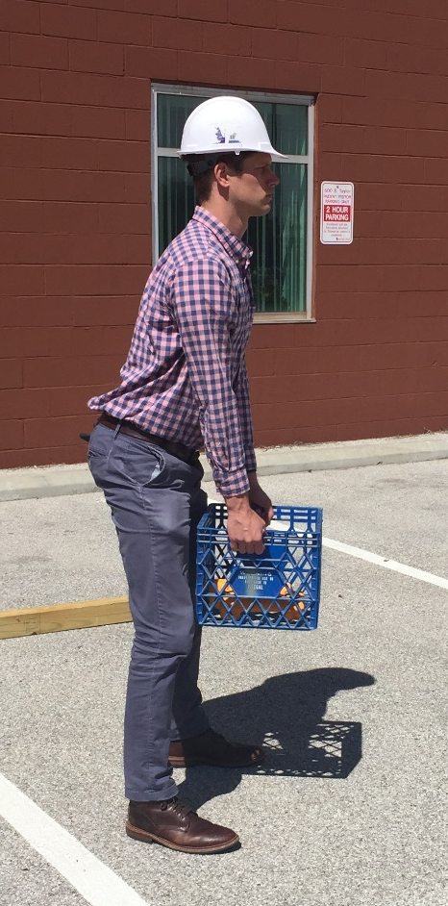
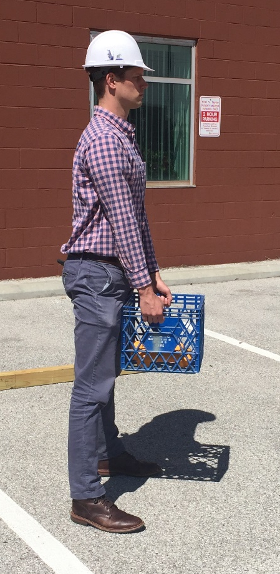
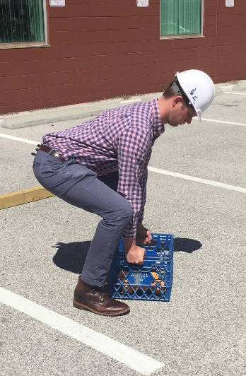
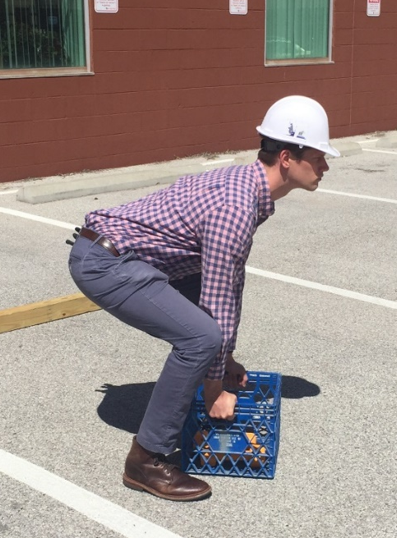
One Person Lifting a Box: “Straight Lift”
Approach object from front, feet parallel on each side
Move close to object
Bend knees and hips
“Lock” back, lift with back straight (DO NOT TWIST)
Use slow, smooth movements to lift
Photos courtesy of the Healthy Work Center, Washington University School of Medicine in St. Louis
Notes:
NOTES FOR SLIDE 27:
The straight lift is used for rigid objects located in a confined area or against a wall. For this lift, you need to:
Approach the object from the front with your feet shoulder-width apart and parallel to the object;
Move close to the object, and bend your knees and hips;
“Lock” your back, and lift with your back straight ‒ DO NOT TWIST;
Then use slow, smooth movements to lift the object.

Slide 28
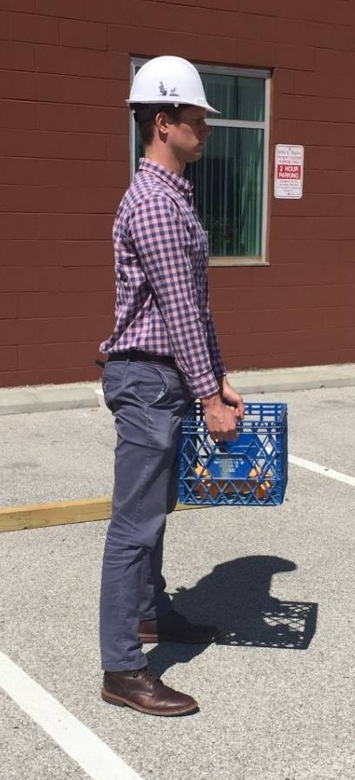
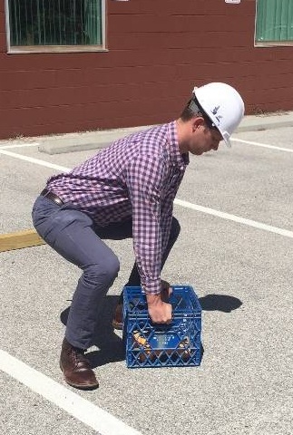
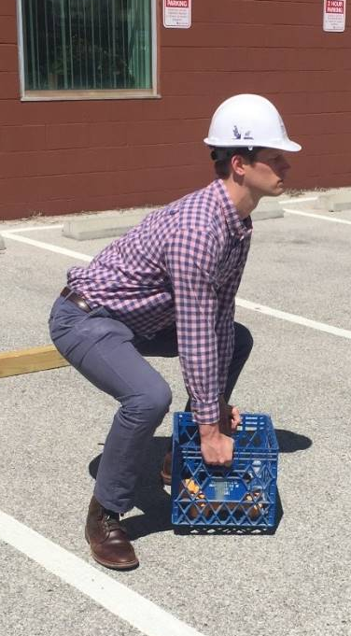
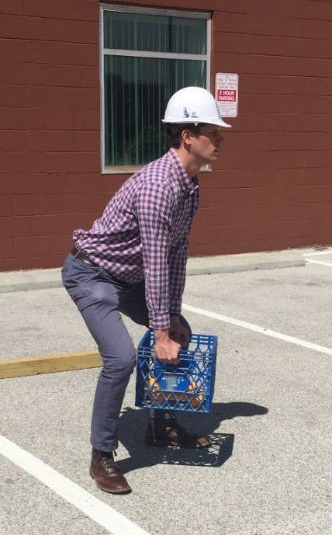
One Person Lifting a Box: “Power Lift”
Approach object at an angle, one foot angled on each side of object
Move close to object
Bend knees and hips
“Lock” back, lift with back straight (NO TWISTING)
Use slow, smooth movements
Photos courtesy of the Healthy Work Center, Washington University School of Medicine in St. Louis
Notes:
NOTES FOR SLIDE 28:
A power lift is used for a rigid object located in an open area. So unlike the straight lift, which you would use in a confined space because you have less room to move, for this lift you can angle your feet AND get close to the object.
For a power lift you would:
Approach the object from the front, with your feet on each side or at an angle;
Move close to the object, and bend your knees and hips;
“Lock” your back, and lift with your back straight ‒ no twisting;
Then use slow, smooth movements to lift the object.

Slide 29
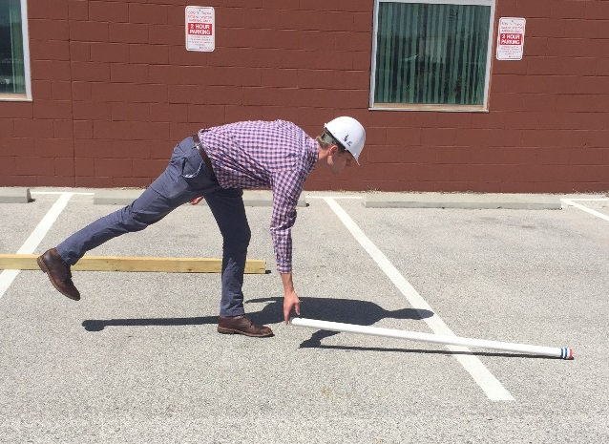



One Person Lifting a Lightweight Object: “Golfer’s Lift”
Approach object from end
Bend forward at waist on one leg, lift opposite foot off floor
Grasp object and lift, lowering foot to floor
Use slow, smooth movements
Photos courtesy of the Healthy Work Center, Washington University School of Medicine in St. Louis
Notes:
NOTES FOR SLIDE 29:
This one-person lift, also called a Golfer’s lift, is ideal for picking up lightweight objects. If you play or watch golf, you’ll notice that experienced golfers use this technique because it reduces the spinal forces when bending forward to reach the floor.
To use a golfer’s lift, you would:
Approach the object from one end;
Bend forward at your waist on one leg, lift opposite foot off the floor; and
Grasp the object and lift, lowering your foot to the floor as you use slow, smooth movements to lift the object.

Slide 30






One Person Lifting a Heavyweight, Long Object
[Method I]
Place cushion on shoulder if the object is very heavy or has edges
Approach object (such as a pole) from end and get close
Half kneel or stoop to reach object
Raise end of object to shoulder
Rise to feet while walking object forward on shoulder
At midpoint of object length, balance object on shoulder
Walk forward holding object with two hands
Photos courtesy of the Healthy Work Center, Washington University School of Medicine in St. Louis
Notes:
NOTES FOR SLIDE 30:
This slide and the next one show two common methods for lifting a heavyweight, long object. While the pole in the images is shorter than the one commonly used for this technique, it will give you a sense of the steps involved in the lift.
For both methods you should check before you start to make sure that no one could be hit by the object during the lift. You may also want to place a cushion on your shoulder if an object is very heavy or has edges.
This first example shows one person lifting a heavyweight, long object.
First, approach the object from the end and get close;
Then, half kneel or stoop to reach the object and raise the end of the object to your shoulder;
Rise to your feet while walking the object forward on your shoulder, and at the midpoint of the object’s length, balance it on your shoulder;
Walk forward holding the object with two hands, while avoiding hitting other workers or objects with the front or back end of the object.

Slide 31






One Person Lifting a Heavyweight, Long Object
[Method II]
Photos courtesy of the UA
Place cushion on shoulder if the object is very heavy or has edges
Half kneel or stoop to reach pole
Raise end of pole to shoulder
Rise to feet while walking pole forward on shoulder
At midpoint of pole length, balance pole on shoulder
Walk forward holding pole with two hands
Notes:
NOTES FOR SLIDE 31:
This slide shows another method for a one-person lift of a heavyweight, long object. This method is often used to carry a heavier object – such as a heavy pipe, but CAUTION should be used to lift the pipe at the midpoint to avoid the weight of the pipe causing your back to bend backward. Like the other example, you may also want to place a cushion on your shoulder if an object is very heavy or has edges.
For this lift:
Approach the object from the end and get close;
Half kneel or stoop to reach the object, rise up to your feet, and stand the object upright (on end);
Stoop down, “lock” your back, place your shoulder near the midpoint of the object, and tilt the object toward your shoulder. Grasp the object to balance it and stand it upright;
Then, with the object balanced on your shoulder, walk facing forward (no twisting), and avoid hitting other workers or objects with the front or back end of the object.

Slide 32
Two-Person Lift: Heavyweight Long Object [Method I]
Two workers discuss to plan for lift
Each approach object from end and move close to object
Bend knees and hips
“Lock” back
Communicate – “one, two, three lift,” lift with back straight (NO TWISTING)
Use slow, smooth movements
Hold pole at waist, front person move to other side
May lift to shoulder (optional)
Walk forward in the direction of travel
Notes:
NOTES FOR SLIDE 32:
The next few slides describe using a two-person lift method to lift a heavyweight long object.
This method is good for carrying one very long object or a shorter one that is too heavy for one person to handle.
When two people are involved with a lift, they should first discuss how they plan to do the lift.
For this lift, each worker approaches the object from an end and moves close to the object, feet shoulder-width apart;
Next, both workers should “lock” their backs and bend their knees and hips;
Then communicating ‒ “one, two, three lift” ‒ lift with backs straight with no twisting, using slow, smooth movements to complete the lift to waist height;
Then the person in front should move around to the side of the object, and they should both walk forward in the direction of where they need to deliver the object.

Slide 33





Two-Person Lift: 10’ Object, Ground to Waist
Photos courtesy of the Healthy Work Center, Washington University School of Medicine in St. Louis
Notes:
NOTES FOR SLIDE 33:
This slide shows two workers using the method just described with a 10-foot object.
The two workers start by planning how they will carry out the lift.
Once they’ve done that, they each approach the object from the ends and move close to the object, feet shoulder-width apart, with their backs “locked” and knees and hips bent;
They communicate ‒ “one, two, three lift” – and then lift with backs straight with no twisting, using slow, smooth movements;
They hold the object at their waist, with the front person moving to the side before they start moving forward.

Slide 34




Two-Person Lift – 10’ Object, Turn and Carry
Photos courtesy of the Healthy Work Center, Washington University School of Medicine in St. Louis
Notes:
NOTES FOR SLIDE 34:
For a situation involving a two-person lift that requires both people to turn and carry an object, the front person must step to the side of the object, facing forward.
Like the earlier example, both workers would need to plan the lift and follow commands to lift the object to their shoulder: “One, two, three lift,” and use verbal cues to begin walking forward in the direction of travel.

Slide 35





Two-Person Lift: Two 10’ Objects [Method II]
Plan the lift
One worker gives commands
Ideally, lift together
Get your balance
Step together
Photos courtesy of the UA
Notes:
NOTES FOR SLIDE 35:
A two-person lift is also a good method for carrying two heavyweight long objects, as long as the combined weight is an acceptable load for the workers, since it may provide better balance across the body than carrying one object.
This slide shows the steps involved. Like the earlier lifts, the two workers should discuss their plan for the lift first.
Then, each approaches the ends of the objects and the front person turns toward the direction of travel;
They each “lock” their back, bend their knees and hips, grasp the objects from the ends, and communicate ‒“one, two, three lift”;
They use slow, smooth movements to lift with their backs straight with no twisting. They then hold the objects at each end and walk forward.

Slide 36






One-Person Lift: Roll a Heavyweight Object up Body
Half kneel directly in front of object
Lock back and roll object onto thigh
Roll object to waist, hold firmly close to body
Push off on back foot and rise to stand
Get your balance before moving forward
Photos courtesy of the Healthy Work Center, Washington University School of Medicine in St. Louis
Notes:
NOTES FOR SLIDE 36:
A good one-person lift method for small, heavy objects or non-rigid objects, such as a sack of materials, involves rolling a heavyweight object up the body.
To use this lifting method, a worker would:
Half kneel directly in front of the object;
“Lock” their back and roll the object onto their thigh;
Roll the object to their waist, holding it firmly close to their body; and
Push off on their back foot to rise to a stand;
Once the worker gets their balance they would move forward.

Slide 37




Push Versus Pull
Strongest muscles of the body are your legs
  Always PUSH objects that are below waist height (e.g., carts, boxes)
Arm biceps are stronger than triceps
  Always PULL objects that are above your waist height (e.g., tools, levers)
Don’t push objects above your waist
PULL objects above your waist
Don’t pull objects on floor
PUSH objects on the floor
Photos courtesy of the UA
Notes:
NOTES FOR SLIDE 37:
In addition to safe lifting practices, there are other safe practices that can be used.
As this slide shows, since the strongest muscles of the body are your legs, you should always PUSH using your leg muscles to move objects that are located below your waist, and you should select carts or other devices that will allow you to push objects located on the floor.
To move objects that are located above your waist, you should PULL since your biceps are stronger than your triceps.
When engaging in this practice, position your body so you can pull objects located above your waist toward you.
If the object is tall and you cannot see over it, you should have a coworker assist with moving the object so either:
1) One pushes and the other guides the object; or
2) Both stand in back on either side of the object, so they have a clear view in front of the object, and push.

Slide 38

Other Lifting and Carrying Practices
Use gloves with rubber dots to increase grip stability
Add padding or a clamp-on handle to bucket or pail handles
Alternating the hand or shoulder used to carry materials
Use padding on your shoulder
Photo courtesy of Construction Solutions and Dura-Tech
Notes:
NOTES FOR SLIDE 38:
When lifting and carrying materials with handles, consider using gloves with rubber dots to increase grip stability, and using padding or a clamp-on handle to make bucket or pail handles easier to grasp.
Alternating the hand or shoulder you use to carry materials, and as mentioned earlier, using padding on your shoulder can also help.
INSTRUCTOR NOTE:
Additional examples can be found in NIOSH’s “Ergonomic Guidelines for Manual Material Handling.” While this document is not specific to construction, it offers ideas for engineering and work practice controls that may be application to your trade:
www.cdc.gov/niosh/docs/2007-131/pdfs/2007-131.pdf

Slide 39




Interactive Training & Coaching Resources and Games @ www.bestbuiltplans.org
Free resources for everyone – from the apprentice to the contractor – to help reduce the risk for injury.
Training & Coaching –
Learn about importance of planning, try out safe lifting practices, and stretching exercises.
For use on a PC or as an app for tablets/smartphones.
Games –
Play the games to practice what you learned.
Available for Apple and Android smartphones.
Notes:
NOTES FOR SLIDE 39:
While the lifting practices we’ve just reviewed are important, I want to emphasize that whenever possible it’s best to follow the hierarchy of controls.
As discussed earlier, to prevent strain and sprain injuries the best option would be to use lifting equipment to reduce the risk.
If that’s not an option, then use the lifting practices we’ve just reviewed.
These two options would be followed by administrative controls, such as rotating the work so you’re not always lifting and moving materials, and at the bottom of the list, using knee and other types of padding to reduce contact stress, or stretching exercises.
The interactive training and coaching resources and games reinforce the hierarchy of controls and the importance of planning for how materials will be lifted and moved. They also introduce equipment options, and let you try out different movements and test your knowledge of the risks and safe practices.
Instructor Note:
If you plan to do Parts 1-A and 1-B as a single session, you would continue on to Part 1-B. You may also use Part 3 as an in-class presentation or demonstration of the interactive training and coaching resources and games before moving on to Part 1-B.
If you plan to use the hands-on exercises in Part 2 and/or use Part 3 as a computer lab, you would stop here, divide the group up (if needed) so that each group starts at a different station, and cycle through all of the stations. Then you would reconvene to do Part 1-B.

