Slide 1
Ergonomics Basics Reducing the Risks for Soft Tissue Injuries
Part 1 - B
Notes:
Instructor Note:
If you conducted the demonstration workstations and/or the computer station, this is a good opportunity to learn about ways to improve the demonstration stations.
You may want to write trainees’ questions and/or suggestions on a flip chart or whiteboard so you can use them to improve future training sessions.
If you did not conduct the demonstration workstations and/or the computer station you can skip this slide and proceed to Slide 2.
NOTES FOR SLIDE 1:
Ask the class:
Before we begin the last part of this course, does anyone have any questions or comments about the demonstration workstations/computer station?

Slide 2
Ergonomic Training Learning Objectives
Identify the ergonomic hazards
Review the basic ergonomic controls for hazards to prevent injuries
Describe the proper body mechanics for lifting tasks to prevent injuries
Describe the risks of using prescription opioids and self-treatment for pain management
Identify the benefits of doing stretching exercises
Demonstrate how to perform at least one stretching exercise
* Ergonomic Training Exercise – test your knowledge
Notes:
NOTES FOR SLIDE 2:
Earlier, we covered the first three objectives. The goal of this part of the training is to review what’s been learned so far and to focus on the remaining learning objectives.
By the end of this portion of the training, you should be able to:
Describe the risks of using prescription opioids and self-treatment for pain management;
Identify the benefits of doing stretching exercises; and
Demonstrate at least one safe lifting practice.
INSTRUCTOR NOTE:
Give all trainees a copy of handout #2 ‒ Ergonomic Training Exercises (located in Appendix A)
Before we introduce new information, let’s start with a review of what’s been learned so far.
I’m going to pass out a brief quiz so that you can self-assess what you’ve learned so far, and I can find out what areas I may need to focus on more in future classes.
I’m going to have you pass them in after we’ve reviewed the correct answers, but you don’t need to put your name on it.
Give students 5-10 minutes to complete the quiz. Then use Slides 3 & 4 to review the correct answers.

Slide 3
Ergonomic Training Exercises – Answers
Notes:
Instructor Note:
Appendix B contains the quiz shown on these slides with the correct answers marked. Once you’ve reviewed the questions and answers, collect the quizzes. If there are questions that students struggled with, you should plan to cover the information they did not understand at a later class.
NOTES FOR SLIDE 3:
Now let’s review the answers.
As you go through each question ask the class how many got the correct answer.

Slide 4
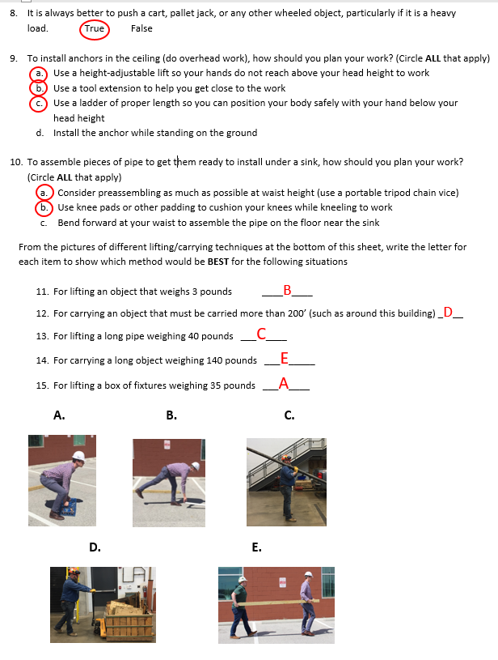
Ergonomic Training Exercises – Answers
Notes:
NOTES FOR SLIDE 4:
After going through all the answers, ask:
How many did you answer correctly? How many of you got them all right? How many got more than half right?
OR at the end ask them:
Based on the quiz you took earlier, are there any areas that it would be helpful to cover at a later class?

Slide 5
Treatment and Progression – Don’t IGNORE Early Symptoms!
Painful to move: kneel, stoop, walk
Treatment
Early:
Rest, Ice, Compression, Elevation (RICE)
Physician prescribed medications (anti-inflammatories), therapy, splint
Late: surgery of back, knee, shoulder, hand
Notes:
NOTES FOR SLIDE 5:
Earlier we talked about why it’s important to understand how an injury progresses and the symptoms.
As this slide shows, when the symptoms are mild you have a 100% chance of recovery, but if they get worse, you may reach a point where it becomes too painful to do basic things like kneel, stoop, or walk.
Early recognition of the symptoms and treatment such as rest, ice, compression, and elevation – or RICE for short – is important.
Your doctor might prescribe medication such as anti-inflammatories, therapy, or a splint.
If the symptoms are more severe, you may need surgery.

Slide 6
Risk of Opioid Dependence
Construction work can result in painful injuries; many are treated with prescription opioids (i.e., codeine, morphine, hydrocodone, hydromorphone, oxycodone).
1 out of 4 people prescribed opioids for long-term pain become addicted.*
Actions:
Opioids are addictive and should be the last option to treat your pain.
If you are injured, talk to your doctor about non-addictive medications or physical therapy to treat the pain.
DO NOT take opioids for more than 30 days without consulting with your doctor.
iStock.com/Darwin Brandis
*Centers for Disease Control and Prevention. Promoting Safer and More Effective Pain Management. https://tinyurl.com/overdosefacts
Notes:
NOTES FOR SLIDE 6:
That leads to this slide. Because construction workers are at risk for painful injuries, opioids are commonly prescribed for pain relief. As a result, opioid dependence has become a serious issue for construction workers and the industry.
According to the Centers for Disease Control and Prevention, 1 out of 4 people prescribed opioids for long-term pain become addicted.
The goal of this program is to provide you with information on how to prevent the injuries and pain up front so that you never need pain medication.
But, if you do get injured it’s important to remember that opioids are strong, addictive medications so they should only be used if they are prescribed by a doctor and determined to be the best option to manage the pain.
Misuse of opioids prescriptions, including taking more than the dose prescribed, taking someone else’s prescription, taking multiple opioid medications, or taking high doses for long periods of time, can all lead to opioid dependency and addiction.
Before taking prescription opioids, FIRST ask your doctor for information on ALL available treatments for pain. There may be non-addictive medications or treatments available.
Remember, only take opioids if they are the best option, and follow the dosage prescribed. DO NOT take opioids for long periods of time (more than 30 days) without consulting with your physician.
INSTRUCTOR NOTE:
At this point, or before the class ends, distribute handout #3 the Physicians’ Alert ‒ Pain Management for Construction Workers, and handout #4 the Hazard Alert Card ‒ Opioid Deaths in Construction (located in Appendix A). Copies of the pocket size version of the card can be ordered by emailing cpwr-r2p@cpwr.com.
If you would like additional training resources focused on preventing opioid dependence, including training materials developed by CPWR and the NIEHS, contact CPWR’s Training Department at training@cpwr.com.

Slide 7
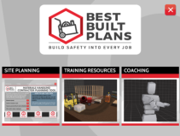
Stretching Exercises
Stretching Benefits: Improves flexibility, movement, and posture. Do stretches throughout the day to relieve tightness.
CAUTION – Avoid pain while stretching. Use slow, smooth movements, hold the posture for 15 seconds.
Exercises in the “Coaching” section of Best Built Plans can help.
Notes:
NOTES FOR SLIDE 7:
To prevent an injury and the need for pain medicine, as we discussed earlier, you need to be aware of the hazards, use lifting equipment and safe lifting practices, and get early treatment if injured.
Stretching exercises can also help and are recommended to improve flexibility, movement, and posture, and relieve muscle and joint tightness. But they only help if you do them properly.
You should ALWAYS use caution when stretching so you do not feel pain. And always use slow, smooth movements, and hold the posture for about 15 seconds when you stretch.
The Coaching section of the interactive resources mentioned earlier walks you through different stretches, lets you try them out on your computer, tablet, or smartphone, and shows you what you are doing right and wrong.

Slide 8
Stretching
Low Back Stretch: Do after working with back bent forward.
With your hands on your low back, lean backwards slightly. Hold.
Neck Stretch: Do after working in an awkward head/neck position.
Remove hard hat. Tilt head to the right, hold, tilt head to the left, hold.
Photos courtesy of the Healthy Work Center, Washington University School of Medicine in St. Louis
Notes:
Instructor Note:
Describe each exercise and then have the class stand up and try them as you describe the steps.
NOTES FOR SLIDE 8:
The following two slides show a few examples that we can try today. I’m going to briefly describe each one and then we’ll try them out.
The low back stretch is a good “reverse” stretch, particularly if you’ve been working in a forward bent back position, such as working at floor level.
Ask the class to do the stretch as you tell them the steps:
To do the stretch, put your hands on your low back, and gently lean backwards slightly. Hold.
Tell the class:
A neck stretch is a good stretch if you’ve been working in an awkward head/neck position.
Ask the class to do the stretch as you tell them the steps:
Tilt your head gently to the right and hold. Then gently tilt your head to the left and hold.

Slide 9
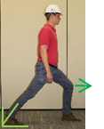
Stretching
Hamstring & Calf Stretch: Extend one leg forward, with heel on floor, point toes up. Extend one leg back with foot on ground. Bend front knee to stretch calf of back leg.
Forearm Stretch: With arm straight and hand up, GENTLY pull PALM back toward body, hold. Then bend wrist down and pull hand toward body.
Shoulder Rolls: Do after working with hands overhead or reaching away from body
Slowly roll shoulders up and backwards.
Photos courtesy of the Healthy Work Center, Washington University School of Medicine in St. Louis
Notes:
Instructor Note:
Describe each exercise and then have the class stand up and try them as you describe the steps.
NOTES FOR SLIDE 9:
Shoulder rolls are good to release tension in your head, neck, and upper back, particularly if you’ve been working with your hands overhead or reaching with your arms away from your body for a period of time.
Ask the class to do the stretch as you tell them the steps:
Slowly, roll your shoulders up and back and around. Repeat 10 times.
Tell the class:
Another good stretch is the forearm stretch.
Ask the class to do the stretch as you tell them the steps:
Reach your right arm out, and with your elbow straight, gently pull your hand back ‒ hold. Then bend your wrist down and pull your hand toward your body.
Now, let’s do it with the left arm. Reach your left arm out, and with your elbow straight, gently pull your hand back ‒ hold. Then bend your wrist down and pull your hand toward your body.
Tell the class:
Most of us have tightness in our hamstring and calf muscles.
Ask the class to do the stretch as you tell them the steps:
To stretch your hamstrings, extend one leg forward with your heel on the floor and your toes pointed up ‒ hold. Let’s repeat with the other leg.
Now let’s stretch your calf ‒ extend one leg back with your foot flat on the ground. Then gently bend your front knee. Feel the stretch on the calf of your back leg ‒ hold. Let’s repeat with the other leg.

Slide 10
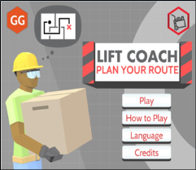
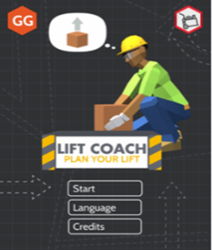
Best Built Plans: Interactive Resources www.bestbuiltplans.org
Training & Coaching –
Learn about importance of planning, try out safe lifting practices, and stretching exercises.
For use on a PC or as an app for tablets/smartphones.
Games –
Play the games to practice what you learned.
Available for Apple and Android smartphones.
Notes:
Instructor Note:
If you used Part 3 as a computer station or as part of your presentation, you can use this slide to remind trainees of the resources available and why they should use them.
If you did not use Part 3 as a computer station or as part of your presentation, then you can use the in-class portion of Part 3 at this point if there is time or use this slide to introduce them to the resources. If you only use this slide, make sure to provide them with the handouts for Part 3 – handout #5 – Instructions for Downloading the Best Built Plans Training & Coaching Resources and Playing the Games, and handout #8 – Exercise Instructions for Best Built Plans Training and Coaching Resources (located in Appendix A).
NOTES FOR SLIDE 10:
The Best Built Plans program has interactive training and coaching resources that you can use on a PC or by downloading the app to learn more about 1) planning for how materials will be lifted and moved and 2) using the safe lifting methods and stretching exercises we covered in this training program. There are also smartphone games that you can play to test your knowledge of how to plan for and conduct a safe lift.

Slide 11
Questions?
©2019, CPWR-The Center for Construction Research and Training. All rights reserved. CPWR is the research and training arm of NABTU. Production of this document was supported by cooperative agreement OH 009762 from the National Institute for Occupational Safety and Health (NIOSH). The contents are solely the responsibility of the authors and do not necessarily represent the official views of NIOSH.
Notes:
Instructor Note:
Additional handouts located in Appendix A that you may want to give out:
Handout #6 Hazard Alert Card – Back Injuries
Handout #7 Ergonomic Tips Cards (optional)
See Appendix E for instructions on how to make handout #7 into small cards that can be clipped together and attached to a lunch box or tool bag. Contact CPWR-r2p@cpwr.com for an editable version of the handout that you can tailor to your trade.
NOTES FOR SLIDE 11:
Any final questions before we end?
If not, then I have some more handouts to use as reminders of what we learned.

