Slide 1
Ergonomics Basics Reducing the Risks for Soft Tissue Injuries
Part 3 – Interactive Training and Coaching Resources & Games
Notes:
NOTES FOR SLIDE 1:
This presentation will introduce you to the interactive training and coaching resources that are available through CPWR’s Best Built Plans program.
You should each have two items in front of you. The first [hold up Handout #8] is an instruction sheet that walks you through a few quick exercises to introduce you to the program.
The second one [hold up Handout #5] includes instructions for how you can access this program on your own and two games that you can play on your smartphones.
I’d encourage you to use the information in the handouts to download these resources and try them out on your own. They’re not only fun to use, but they also are good reminders of safe practices and how they can prevent injuries.

Slide 2
Notes:
NOTES FOR SLIDE 2:
This slide shows the homepage. The two clickable boxes we’re going to focus on are the Training Resources and Coaching.
We’ll start with what you’ll find if you click on Training Resources.

Slide 3
Introduction
Notes:
NOTES FOR SLIDE 3:
Before we get started, I want to mention that there are notes throughout the interactive resources that provide instructions on how to use the resources and explanations of the safe practices. There’s also a narrator reading the text.
As noted on this slide, this training resource is intended to increase the user’s understanding of the need to plan lifts, and introduces equipment, work practices, and lifting techniques that can help reduce the risk for injury.

Slide 4
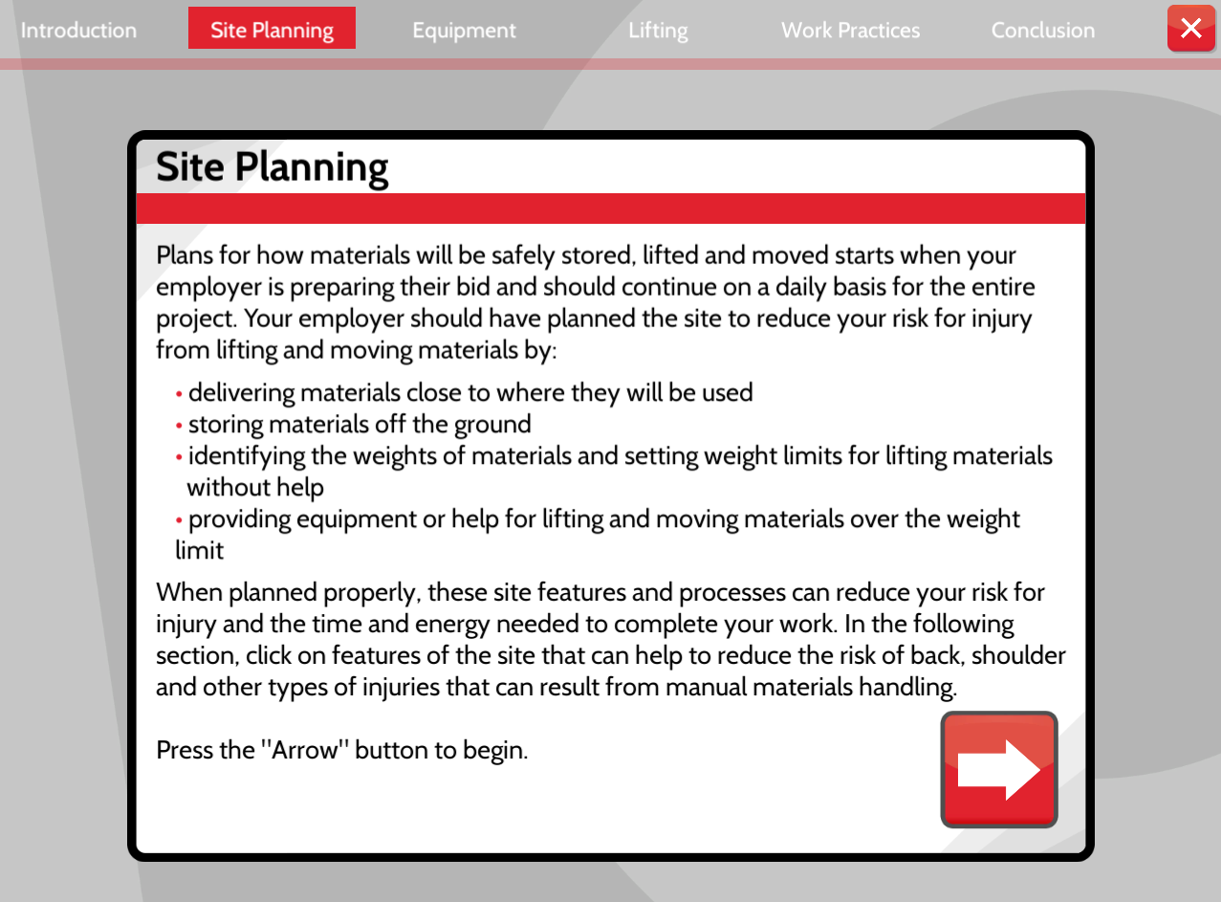
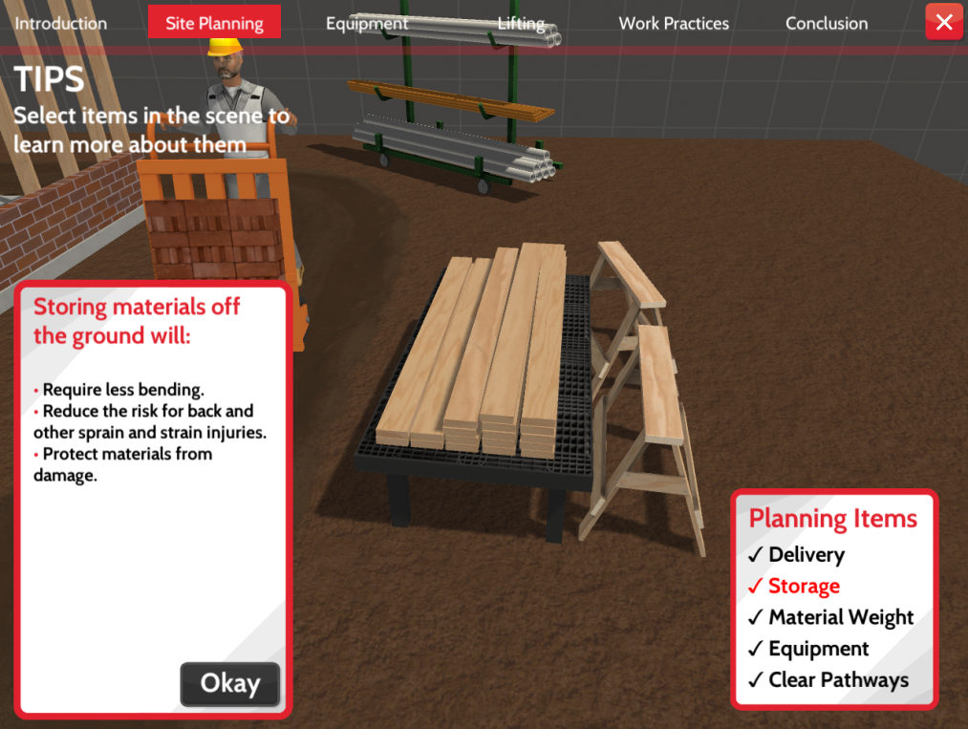
Site Planning
Notes:
NOTES FOR SLIDE 4:
The first section is Site Planning, which explains why it’s important to think through and plan for how materials will be delivered, stored, and moved on the job site.
To move through this section, you would click on the arrow in the corner to continue.
In this section, you can click on an item on the screen and it will explain why it’s important for reducing injuries. There’s a menu on top that lets you know where you are in the program.
If you clicked on the stack of wood, for example, a screen pops up that explains why it’s important to store materials – in this case lumber – off the ground.
You would then click on the Okay button in the box to continue.

Slide 5
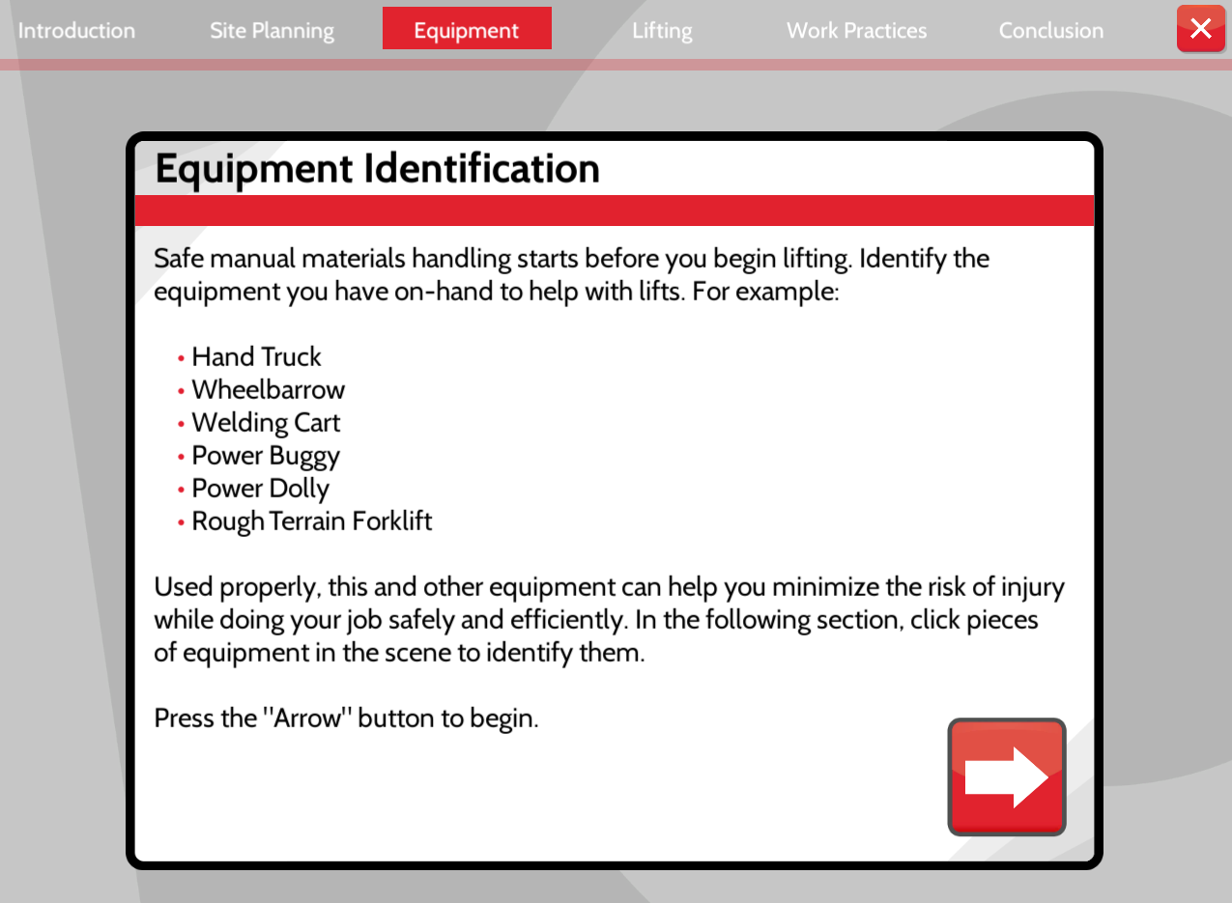
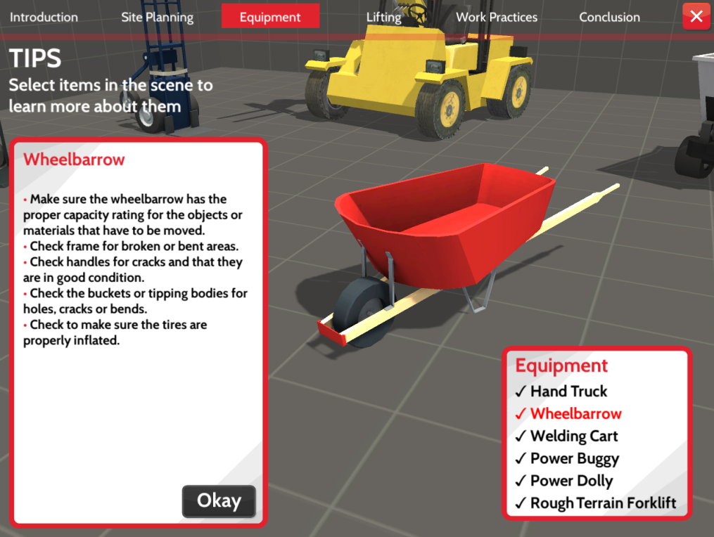
Equipment
Notes:
NOTES FOR SLIDE 5:
If we click on Equipment on the menu bar at the top – it’s in red on this screen – it takes us to the Equipment Identification screen which explains why using lifting equipment can help. When you click on the arrow in the corner, you’re taken to a screen that shows different types of equipment, and information on how to safely use common lifting equipment.
If you click on the wheelbarrow, for example, a box pops up explaining how to use it for safe lifting.

Slide 6
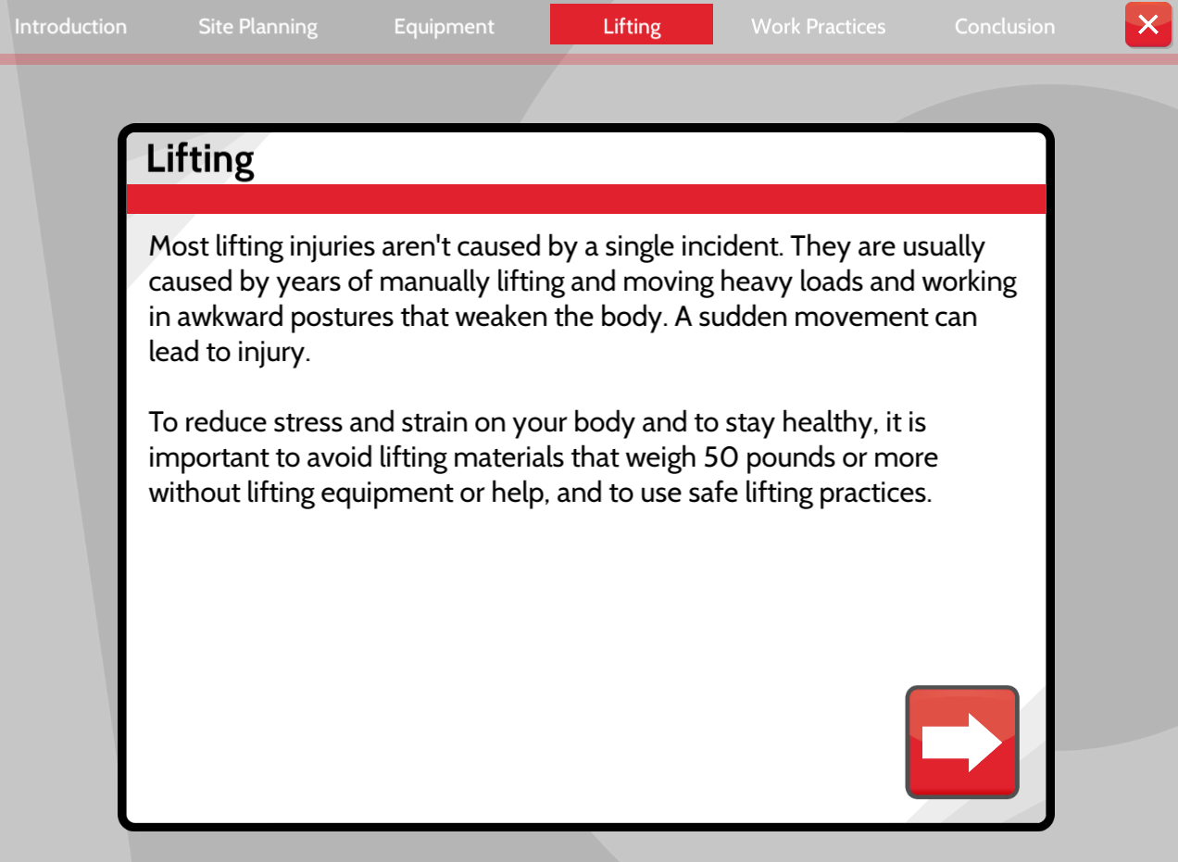
Lifting
Notes:
NOTES FOR SLIDE 6:
When you click on the Lifting tab on the menu bar there are a series of screens that provide a refresher on safe lifting practices [we covered these in Part 1-A and/or the Demonstration Stations] including ones that focus on the proper lifting stance, the need to bend at the knees, get close to the material, and move your feet first.

Slide 7
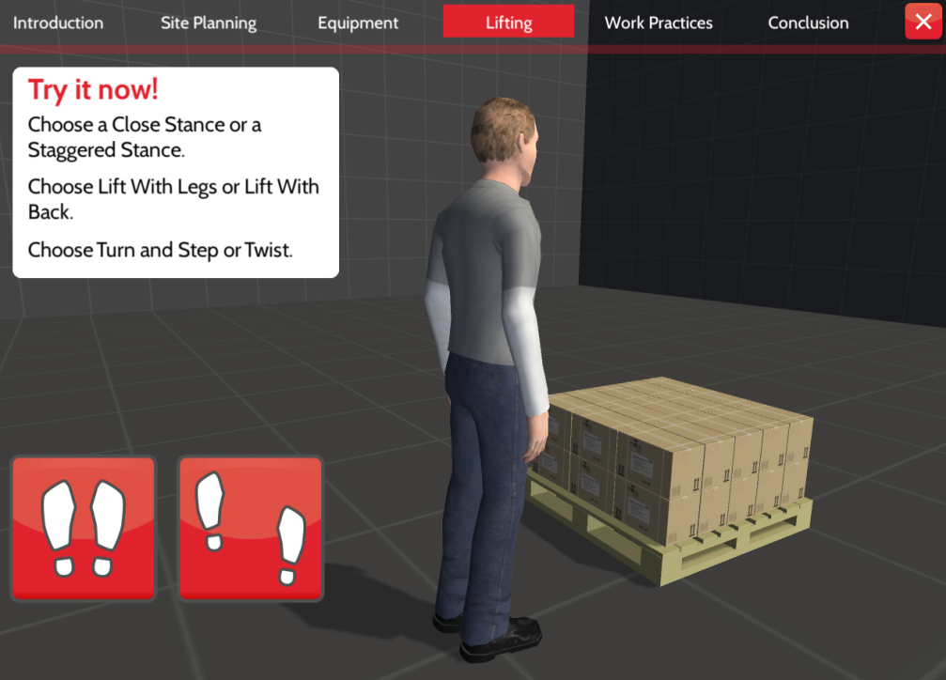
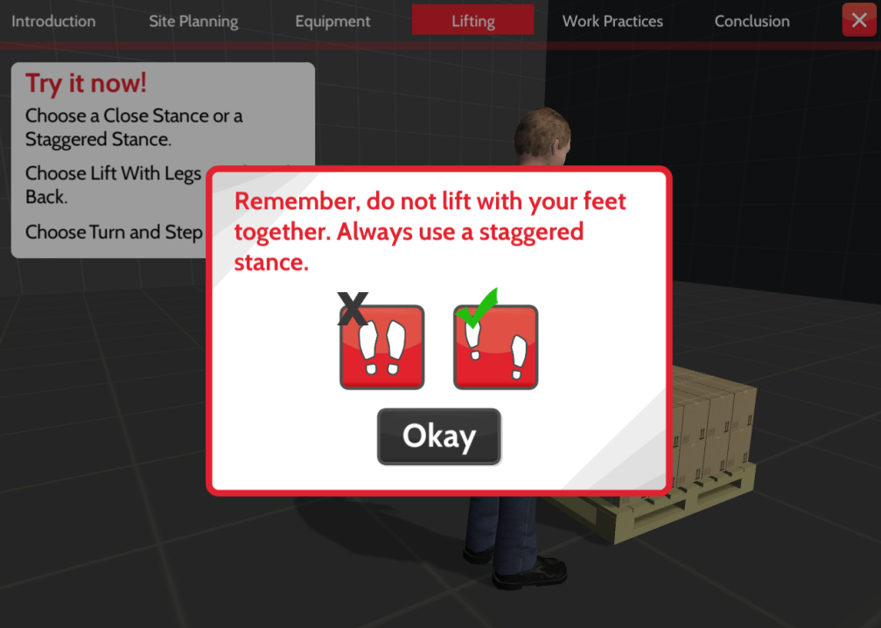
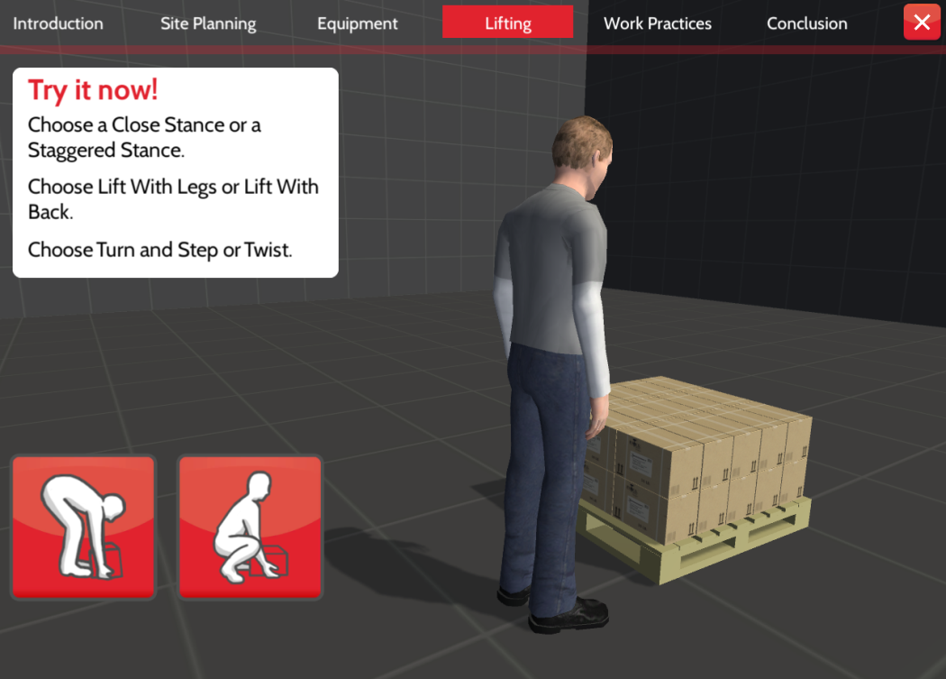
Try it Now!
Notes:
NOTES FOR SLIDE 7:
Once you’ve gone through the quick refresher, you end up in a section that lets you try out what you learned. In this section, you are prompted to choose the best practice for lifting. If you don’t select the right option, a screen will pop up that reminds you about the safer option.
For example, on the first screen, you’re given the option of two different ways to position your feet for a lift. When you select an option, the figure demonstrates the practice, and then a screen pops up telling you that you made the right selection or reminding you of the safer practices. When you click Okay the screen will automatically advance to the next exercise, which focuses on the proper stance for lifting.

Slide 8
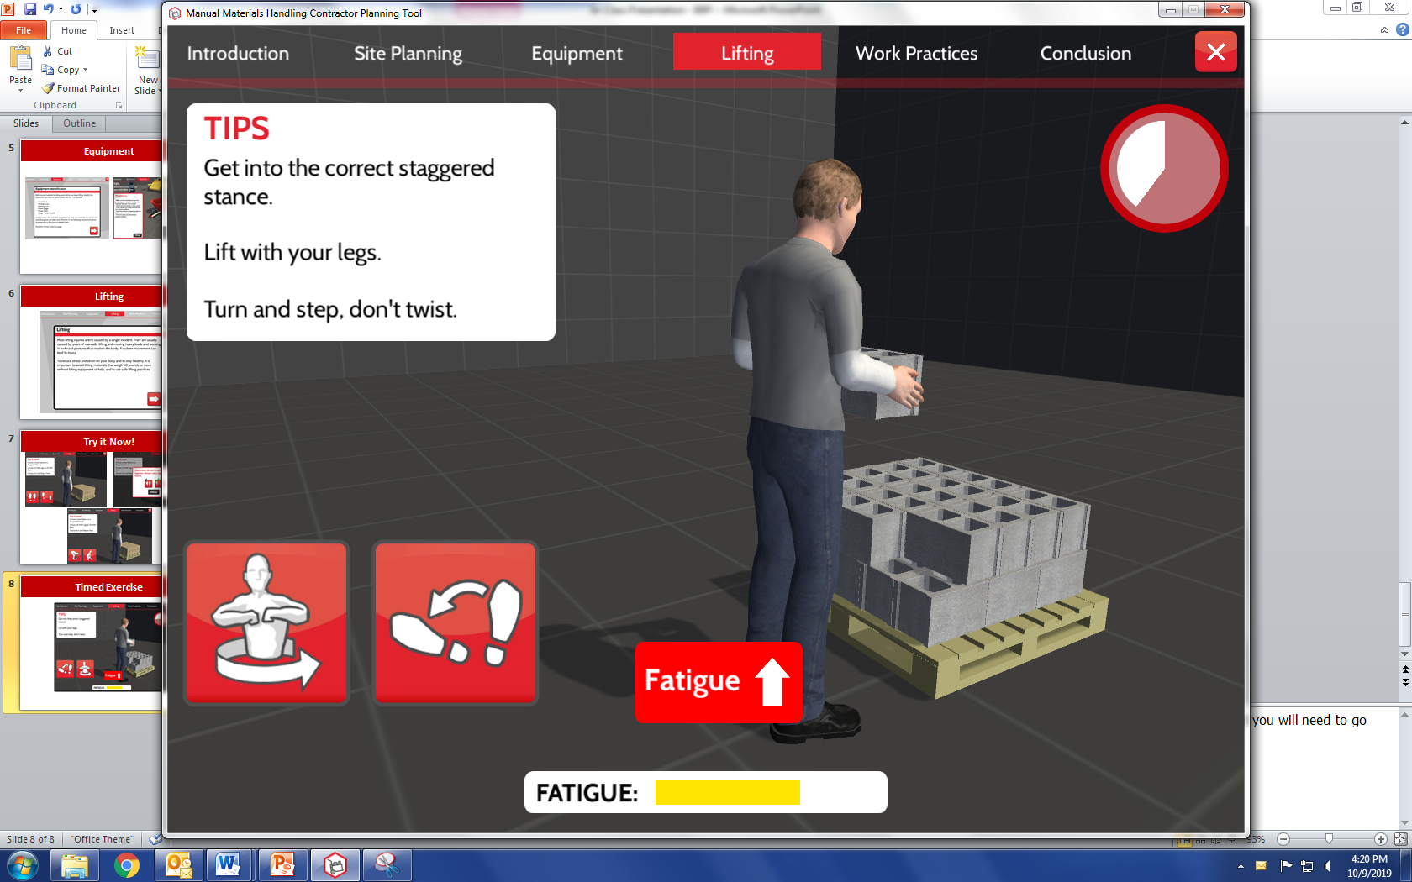
Timed Exercise
Notes:
NOTES FOR SLIDE 8:
Once you’ve gone through the refresher exercises, you get to test your knowledge and see how your decisions impact your risk for injury – which is measured by the fatigue bar at the bottom of the screen.

Slide 9
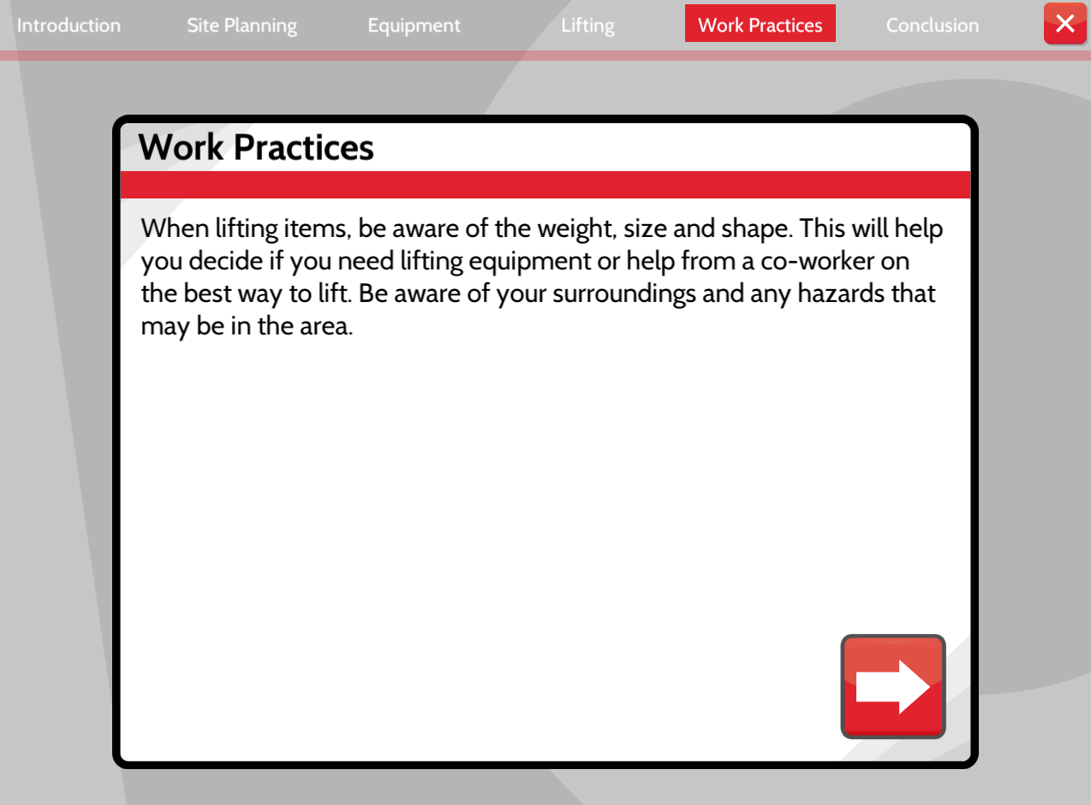
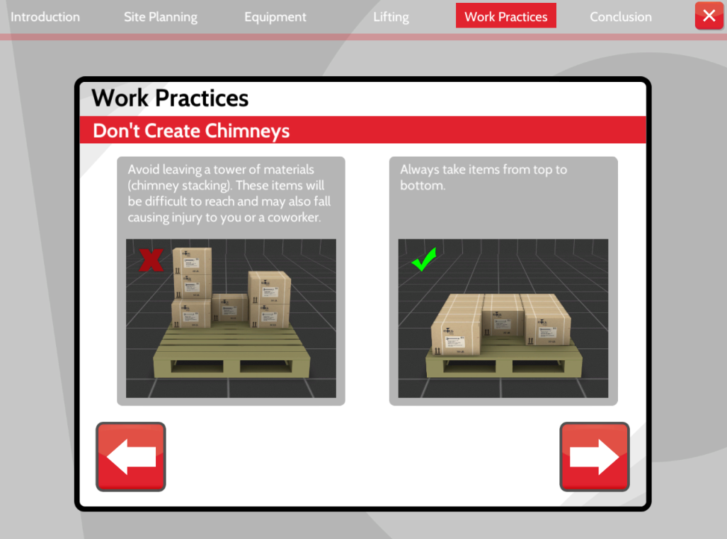
Work Practice
Notes:
NOTES FOR SLIDE 9:
The final interactive exercise in this section is the Work Practice menu item on the top bar. This section builds on what we learned about safe lifting techniques and applies them to different practices, such as the one shown on this slide about the risks associated with how materials are stored, the position of the materials and your body, the benefits of using two hands to lift, and introduces team lifts.

Slide 10
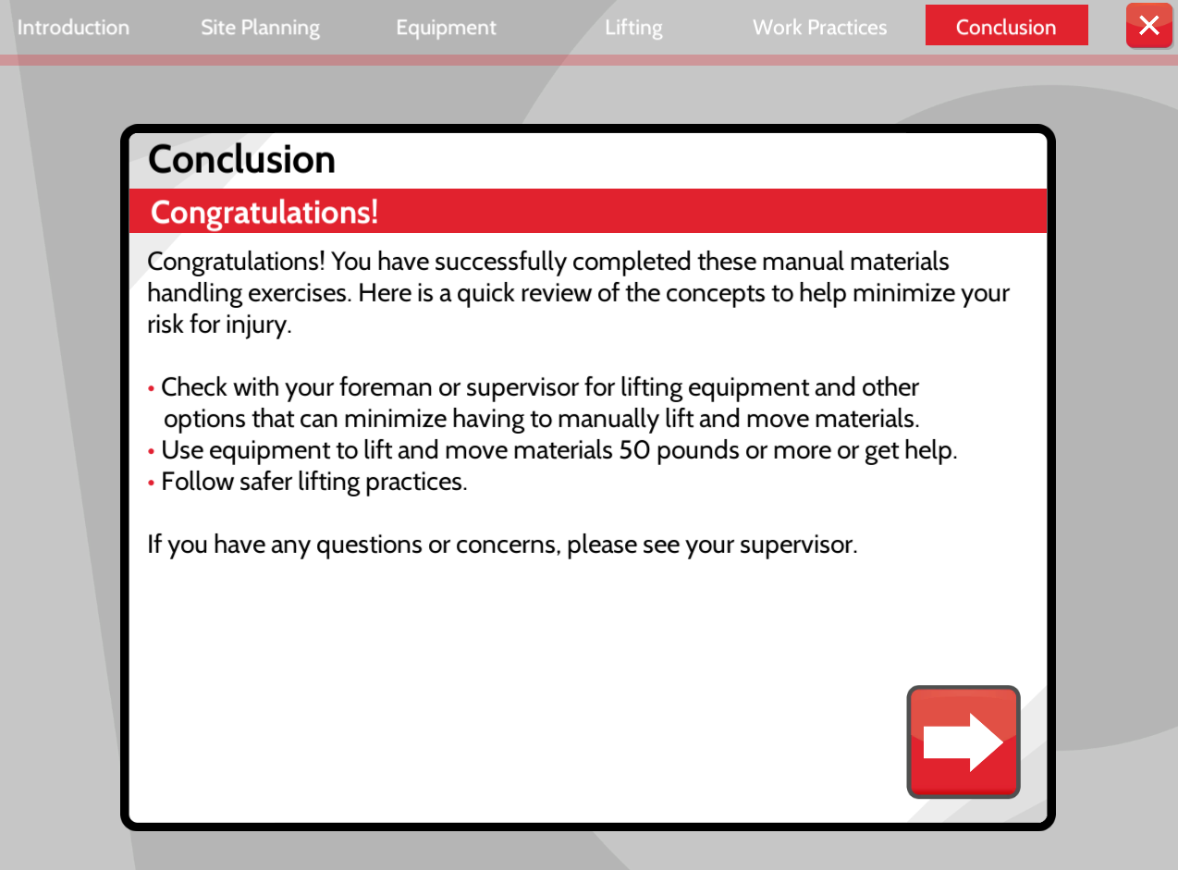
Conclusion
Notes:
NOTES FOR SLIDE 10:
The final menu item in the training resources is the Conclusion congratulating you on completing the section and providing a few additional reminders for when you’re moving materials on the job.
When you click on the red X you’re taken back to the main menu where you can select the Coaching interactive activities.

Slide 11
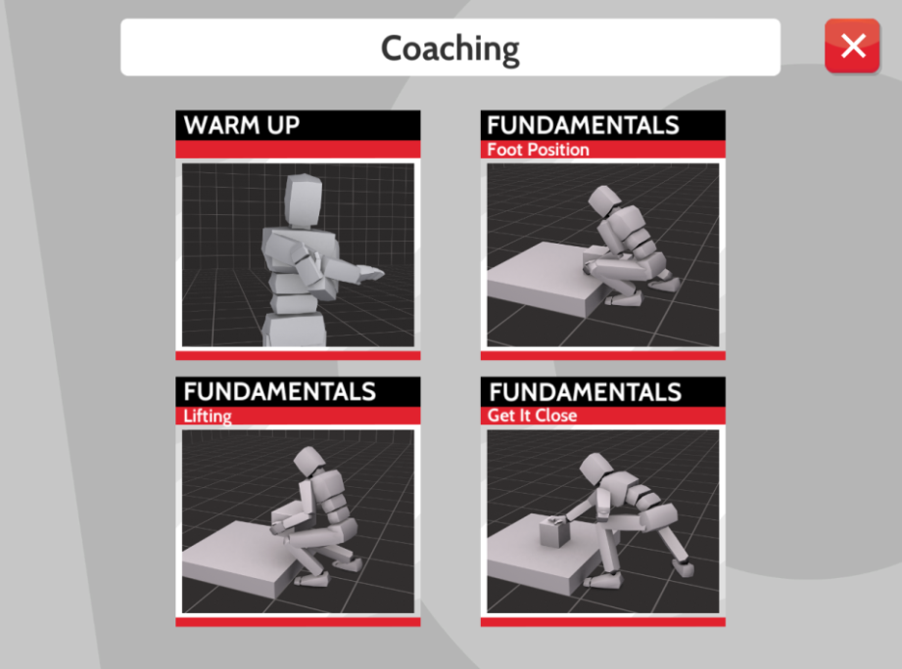
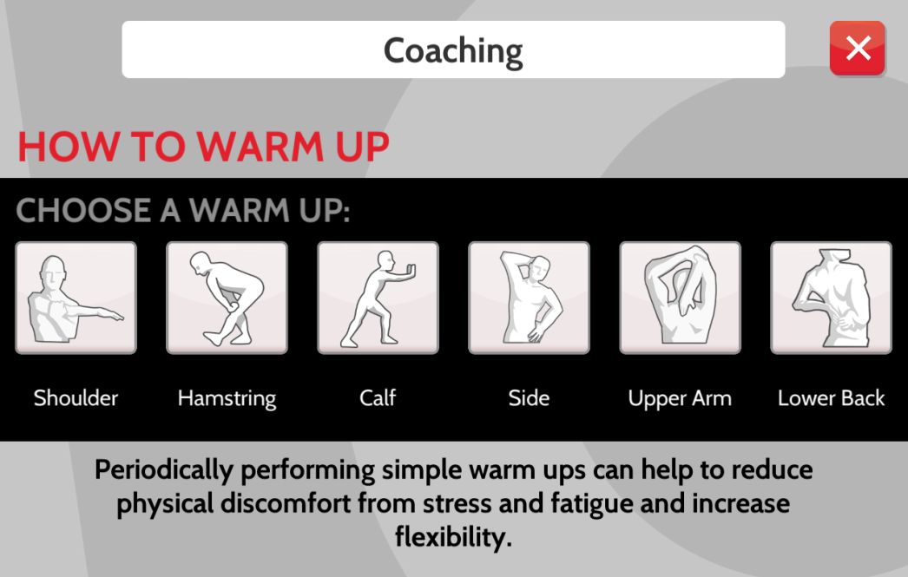
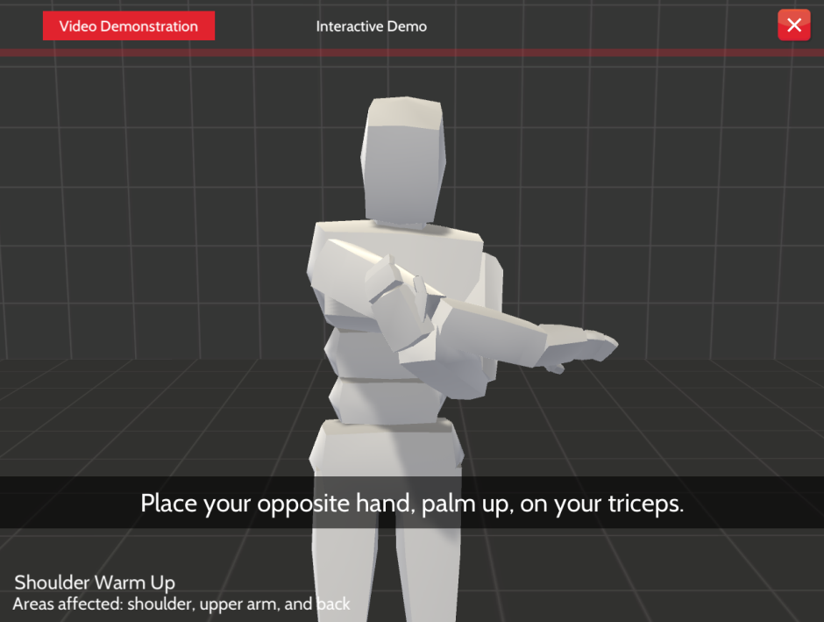
Coaching Resources
Notes:
NOTES FOR SLIDE 11:
The Coaching section focuses on what’s happening with your body during warm up stretches and lifting.
If you click on the Warm Up option, you can select different types of warm up stretches. If we selected the Shoulder, for example, you’d be taken to a screen with two options – the first shows you a 30 second demonstration of how to do the stretch safely.

Slide 12
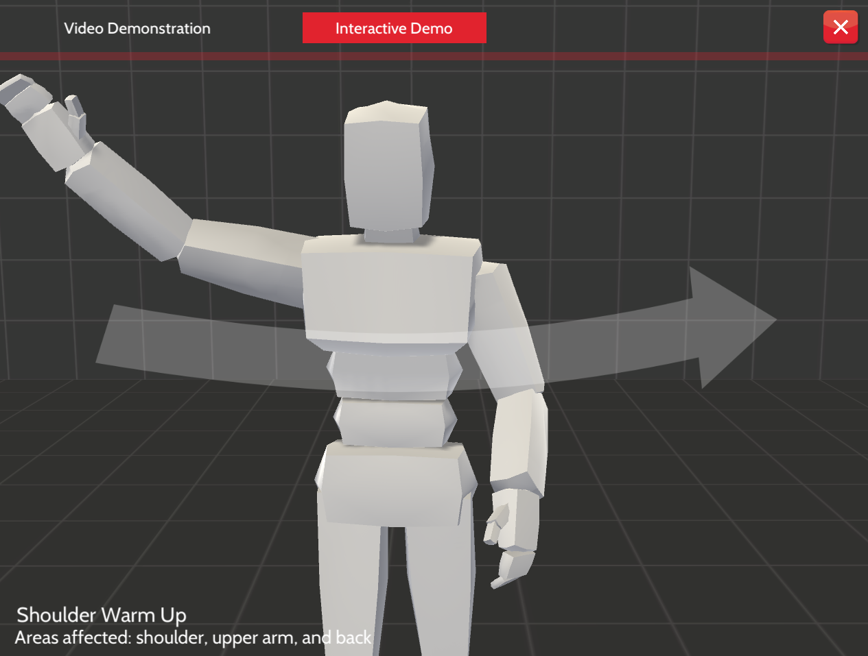
Interactive Demo
Notes:
NOTES FOR SLIDE 12:
Then you can try doing it yourself using a mouse, touchpad or the touchscreen on your device.
When you’re done, your results will pop up and let you know if you held the position too long or not long enough, or reached too far or not far enough.

Slide 13
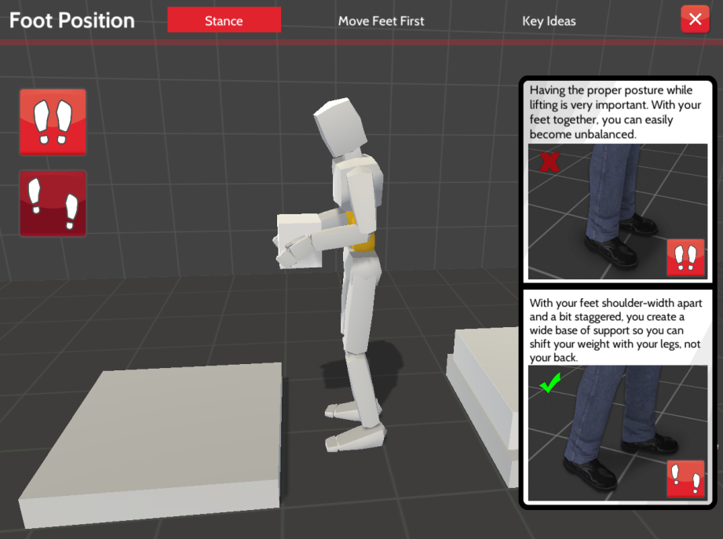
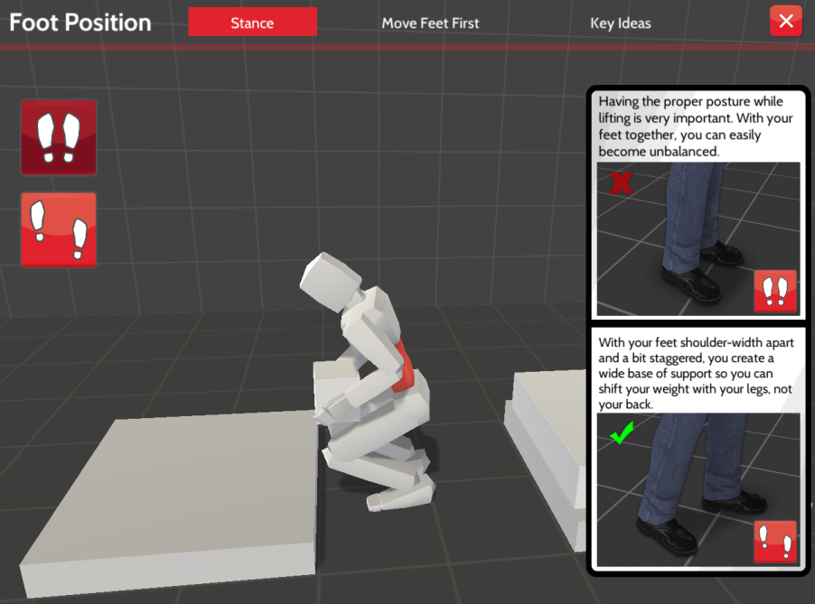
Fundamentals: Foot Position
Notes:
NOTES FOR SLIDE 13:
The other three coaching options show the lifting techniques we learned about earlier and use the figure to show the impact on your body. If we clicked on the Foot Position option, for example, the figure starts out using a staggered stance, and the color on the figures back is yellow – indicating no strain. If you select the close stance foot position, you can see how it impacts the figures back – turning it from yellow to red – the sign of back strain and increased risk for injury.

Slide 14
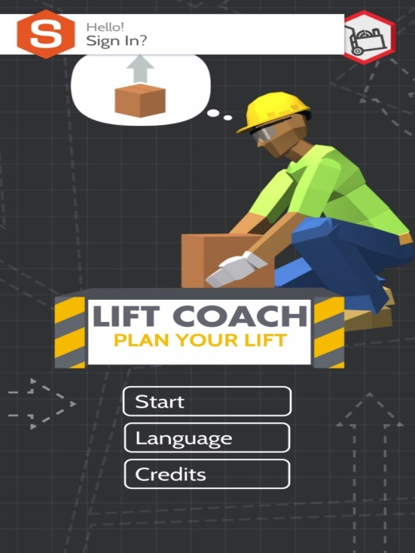
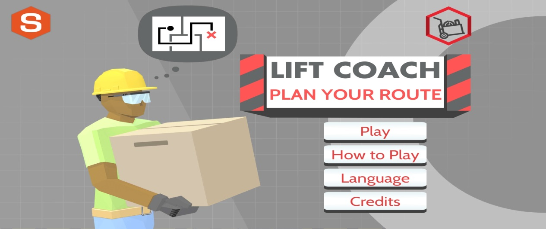
Games
Notes:
INSTRUCTOR NOTE:
If do not have additional time or the ability to demonstrate the games, you can end this presentation now and just remind the class that they have instructions for using the interactive training and coaching resources and the games available for their smartphones or tablets in the handouts.
NOTES FOR SLIDE 14:
That was a quick overview of the training and coaching resources.
Please remember to take your handouts with you so that you can try these and the smartphone games on your own. As we’ve discussed, preventing these injuries is important for both your personal and professional health.
INSTRUCTOR NOTE:
If you have more time in the class, you can introduce the games. You will need to connect your smartphone or tablet to the projector now to show the games on screen.
That was a quick overview of the training and coaching resources. Now I am going to introduce you to two free games you can play on your smartphone or tablet that are fun to play and also reinforce the safe work practices that you learned about today.
This handout [hold up handout #5] includes instruction for how you can access these games. They are available in both English and Spanish for Android and iOS users.

Slide 15
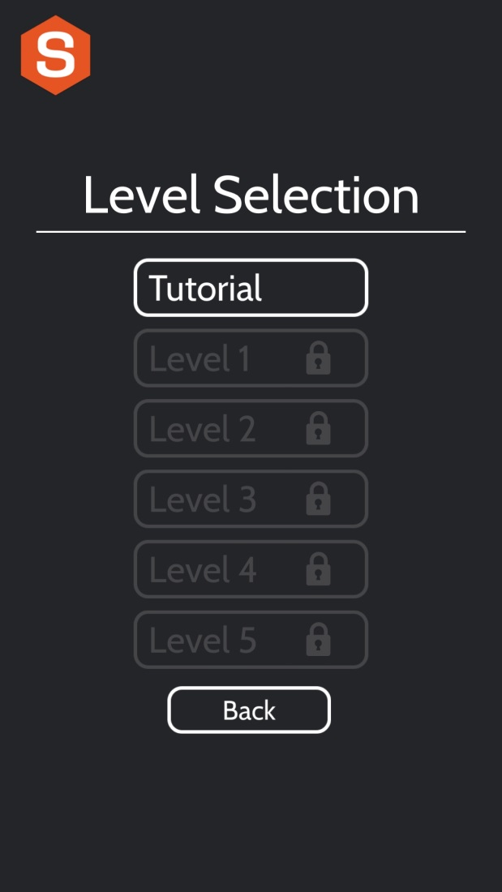
Plan Your Lift
Notes:
NOTES FOR SLIDE 15:
The first game I am going to introduce you to is called Lift Coach: Plan Your Lift. In this game, you must correct the on-screen character’s actions as they lift and move materials. The goal is to avoid actions that can increase your risk of injury. You need to pay attention to avoid building up too much strain and getting hurt. Each level will increase in difficulty. There’s a tutorial that you can go through to learn how to play.

Slide 16
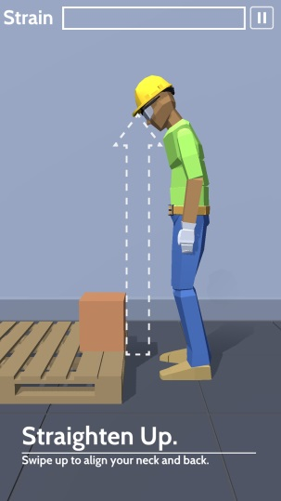
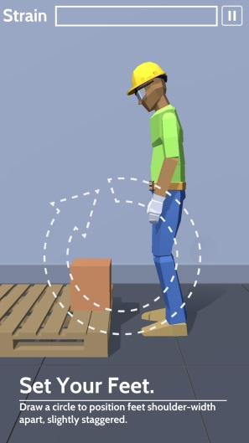
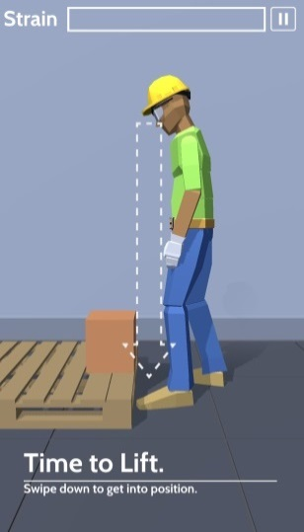
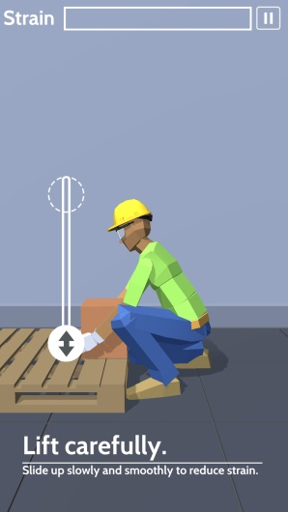
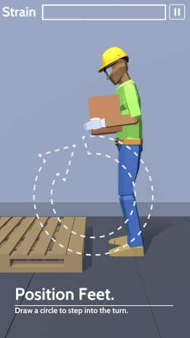
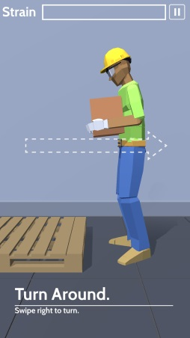
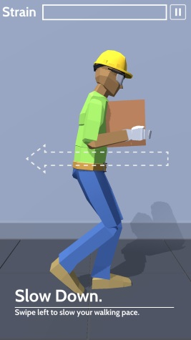
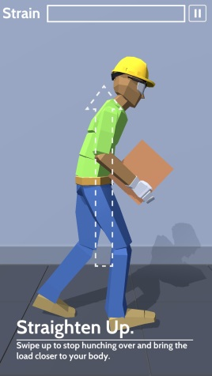
Plan Your Lift (continued)
Notes:
NOTES FOR SLIDE 16:
The tutorial introduces the different lifting and moving actions used in the game and how to move the figure.

Slide 17
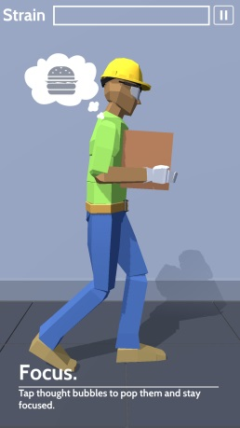
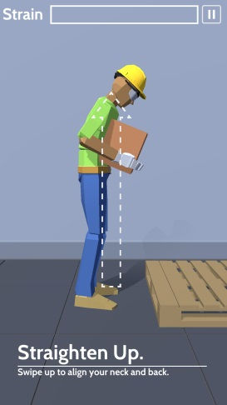
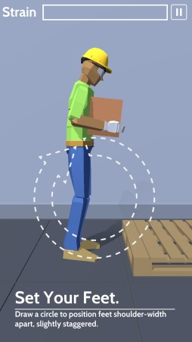
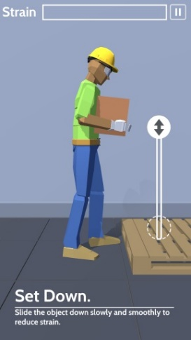
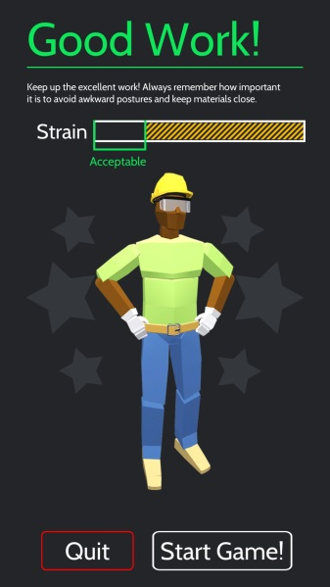
Plan Your Lift (continued)
Notes:
NOTES FOR SLIDE 17:
It also addresses what to keep in mind once you’ve lifted a material, begin to move while carrying the material, and when you put it down. At the end you’ll receive your score and find out if the actions you took increased or decreased your risk for an injury.

Slide 18
Plan Your Route
Notes:
NOTES FOR SLIDE 18:
The second game I’m going to introduce you to is called Lift Coach: Plan Your Route. In this game, you must plan for how you’ll lift and move materials on a job site. Your risk of strain/sprain injury changes depending on the decisions you make. The job site becomes larger and more complex as you advance through the game.

Slide 19
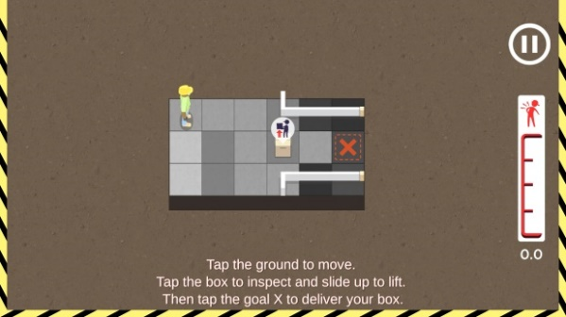
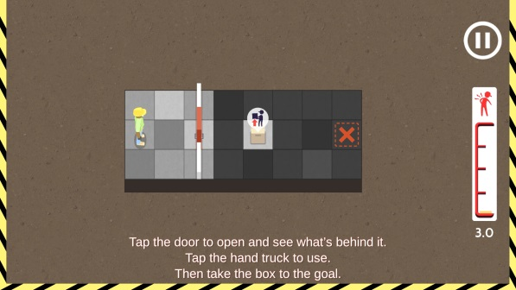
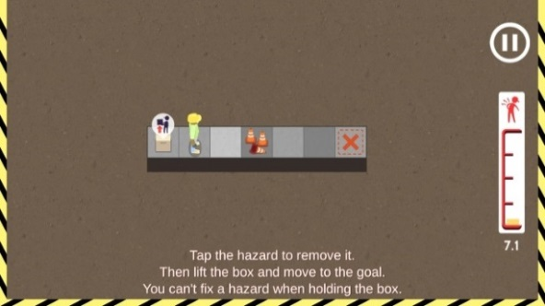
Plan Your Route (continued)
Notes:
NOTES FOR SLIDE 19:
This game also has a tutorial that introduces the different features and commands you’ll use to play the game. For example, you need to click on the box to move the figure toward it and find out how much it weighs. There are instructions for how you get help with a lift from a co-worker or a piece of equipment, as well as how to clear a path.
As you move through the game you’ll be told if you do something that results in an injury. The meter on the side shows how your decisions are impacting your body. At the end you’ll see how you did.

Slide 20
Questions?
©2019, CPWR-The Center for Construction Research and Training. All rights reserved. CPWR is the research and training arm of NABTU. Production of this document was supported by cooperative agreement OH 009762 from the National Institute for Occupational Safety and Health (NIOSH). The contents are solely the responsibility of the authors and do not necessarily represent the official views of NIOSH.
Notes:
NOTES FOR SLIDE 20:
Any questions? I’d encourage you to use the information in your handouts to download and play the games as well as the interactive training and coaching resources that we reviewed. As we’ve discussed, preventing these injuries is important for both your personal and professional health.

