Slide 1

Ergonomics
Reducing the Risks for Soft Tissue Injuries
Part 4 – Refresher
©2019, CPWR-The Center for Construction Research and Training. All rights reserved. CPWR is the research and training arm of NABTU. Production of this document was supported by cooperative agreement OH 009762 from the National Institute for Occupational Safety and Health (NIOSH). The contents are solely the responsibility of the authors and do not necessarily represent the official views of NIOSH.
Notes:
NOTES FOR SLIDE 1:
This presentation is intended as a refresher and to introduce more advanced information on preventing soft tissue injuries.

Slide 2
Objectives:
  Review ergonomic hazards
  Assess and control them
  Incorporate safe practices when planning work
  Identify early symptoms and appropriate treatment (risks from opioids and medical management)
Notes:
NOTES FOR SLIDE 2:
During your basic ergonomics training we talked about why ergonomics training is important, types of ergonomic hazards in construction, proper lifting methods, and online resources that can be used as reminders or to reinforce what you learned.
The objectives for this training are to review:
How to recognize an ergonomic hazard;
How to assess and control these hazards;
How to incorporate best practices when you plan your work; and
How to identify early symptoms and obtain appropriate treatment, including risks of opioid use associated with ergonomic injuries and medical management.

Slide 3
Sprains, Strains, and Other Soft Tissue Injuries
Are Common
Sprains and strains account for about 1 out of 4 of all nonfatal injuries in construction each year.
Lifetime risk of overexertion injuries is 21% for all construction trades, although many more suffer chronic pain.
Most overexertion injuries are related to handling heavy building materials.
Construction workers suffer from the highest number of lost days of work from low back injuries.
It is IMPORTANT that you learn how to protect your body from damage.
Notes:
NOTES FOR SLIDE 3:
Let’s start by revisiting why it’s critical to reduce sprain and strain injuries to the body’s soft tissues.
First, they are very common among construction workers, causing more than one-fourth of nonfatal injuries every year. About 21% of construction workers experience these injuries over their career based on what’s reported, but we know that many more will suffer from chronic or persistent pain.
One type of sprain or strain is caused by overexertion of the body from handling building materials and equipment – particularly heavy or awkward materials or equipment. This often results in low back injuries.
Since you only get one body, it’s important that you learn how to properly handle materials as early as possible in your career and use safe lifting practices every day to protect your body from damage.

Slide 4
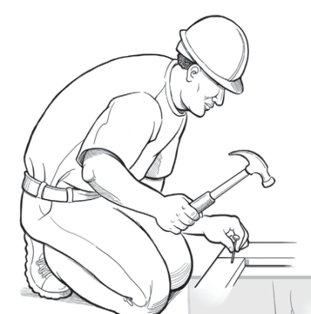
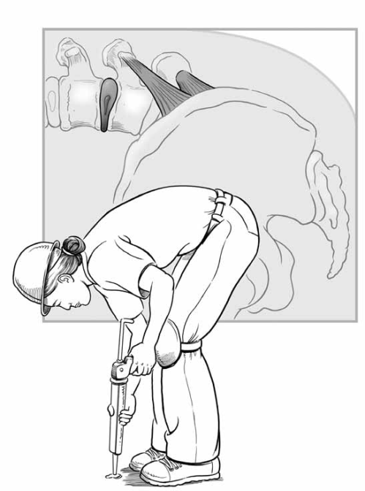
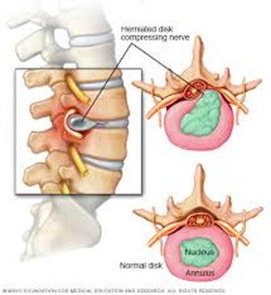
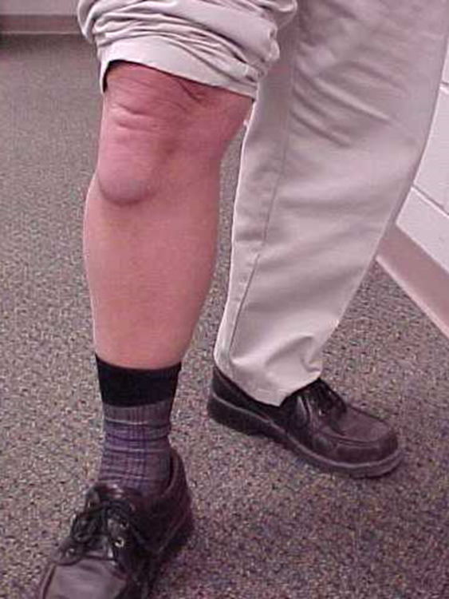

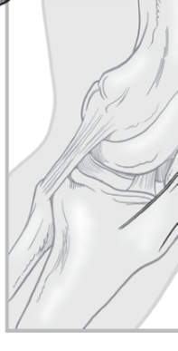
Sprains, Strains, and Other Soft Tissue Injuries or Musculoskeletal Disorders (MSDs)
1) Damage to the musculoskeletal system – muscles, nerves, tendons, ligaments, joints, cartilage and spinal discs.
2) They are cumulative – they happen gradually, as opposed to accidents.
3) They are chronic – the effects last a long time.
Soft disc – jelly pushing on
spinal nerves
Knee bursitis
Photo courtesy of NIOSH
Photo courtesy of Dr. Ann Marie Dale
Photo courtesy of NIOSH
Used with permission of Mayo Foundation for Medical Education and Research, all rights reserved
Notes:
NOTES FOR SLIDE 4:
In the medical world, sprains, strains, and other soft tissue injuries are called musculoskeletal (“musk-u-low-skel-e-tall”) disorders or MSDs.
They include damage to the different soft tissues of your body ‒ your muscles, nerves, bones, and connecting tissues like tendons and ligaments.
The damage is cumulative. It develops over time, not usually from a sudden accident, and may become chronic or persistent. In other words, the damage and pain could last for a long time, possibly the rest of your life.
The photos at the bottom on the left show the structure of your low back ‒ the most common body part injured. The soft disc is a cushion between each bone but the center “jelly” (in green) may push on the spinal nerves (orange tubes) when the body bends forward. The back is complex. Once the tissues “wear and tear,” it is very hard to get them to heal.
The bottom right photo shows a worker with knee bursitis caused by kneeling on a hard floor most days without the benefit of padding. His doctor recommended a knee replacement. What does that mean for the worker? Once he had this procedure, he would have difficulty kneeling and could not go back to doing the same type of work – at least the way he used to work, by kneeling.

Slide 5
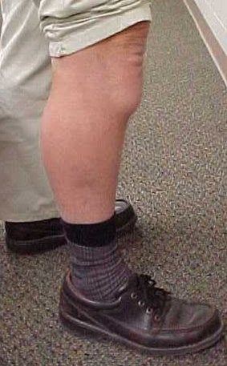
Soft Tissue Symptoms and Injury Risk Continuum
Normal Mild Moderate Severe
100% chance of recovery Unable to regain normal function
medicalstocks/Shutterstock.com
Photo courtesy of Dr. Ann Marie Dale
Importance of Early Awareness
Notes:
NOTES FOR SLIDE 5:
This diagram shows the progression from normal “no symptoms” through developing mild, moderate, or severe symptoms.
In the lower levels of the continuum, the body can heal to get back to normal – there’s a100% chance of recovery.
In the higher levels, the body has moderate to more severe symptoms.
At this stage, even with a lot of rest, the body cannot recovery completely and a worker will be unable to regain normal function.

Slide 6
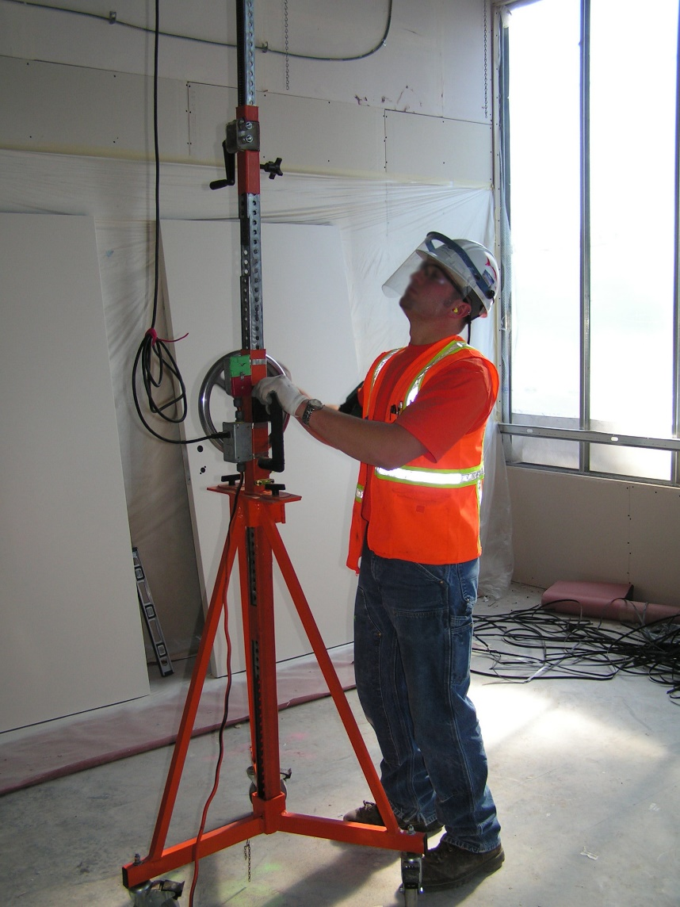
What is Ergonomics?
Ergonomics is the way to prevent injuries:
Fit the tasks, tools, and environment to the physical abilities of the worker
Goal: to reduce or eliminate risk of injuries
Photo courtesy of Dr. David Rempel
Notes:
INSTRUCTOR NOTE:
Only show the title of the PowerPoint slide “What is Ergonomics?”
NOTES FOR SLIDE 6:
Ask the class:
What is ergonomics?
On a whiteboard or flip chart write down the various descriptions given by the trainees.
Once everyone is done giving a description, advance the PowerPoint to show the examples provided.
Tell the class:
Examples are all around you – you see it in how chairs are designed, the shape of a computer mouse, and in construction with the shape of tool handles.
Ask the class:
What are some examples of ergonomically designed tools you might use on the job?
On a whiteboard or flip chart write down the various tools given by the trainees.
INSTRUCTOR NOTE:
If trainees are unable to identify any tools, be prepared to list ergonomically designed tools and equipment used by the individuals in the class on a typical project.
Tell the class:
Ergonomics is setting up the environment and tools to make the job fit the physical abilities of the worker. This means the worker is not tearing down the tissues of the body to get the job done.
By working within the physical limits of your body, you eliminate the risk of soft tissue injuries and overexertion, sprain, and strain injuries.
Everyone’s body has different abilities: strength, flexibility, and tolerance. Work should be designed so most workers can do the job.
The goal of ergonomics is to reduce or eliminate the risk of injuries.

Slide 7
Review: Identify Ergonomic Hazards
High Force
Poor Posture
Fast/prolonged Repetition
Stress from body Contact
Hand or body Vibration
Environment (cold)
Notes:
NOTES FOR SLIDE 7:
There are 6 ergonomic hazards:
Force is the physical effort needed to move a load.
Poor posture is the position of the body that is not in alignment ‒ in other words upright.
Repetition is repeatedly moving a part of the body to perform a task.
Stress from contact occurs when your body comes in contact with an object, such as kneeling on a hard surface, pushing a tool into the palm of your hand, or using your hand as a hammer to bang something in place. The soft tissues of your body are vulnerable to damage and injury by pushing or applying external pressure to the body.
Hand vibration is common when using a power tool, like a hammer drill, and body vibration is common when operating powered equipment while sitting.
Environment - cold temperatures causes muscles to tighten and feel stiff. In cold conditions, workers need to wear warm clothes and to warm up and stretch muscles before work.
A construction task may include one or more of these hazards.
The most common hazards in construction are high force and poor postures.
We will focus on these two hazards in this training.

Slide 8
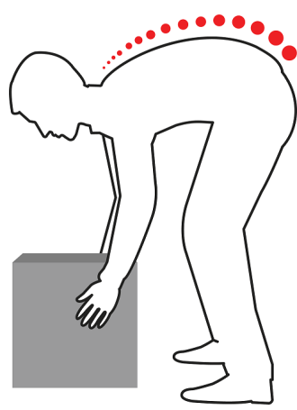
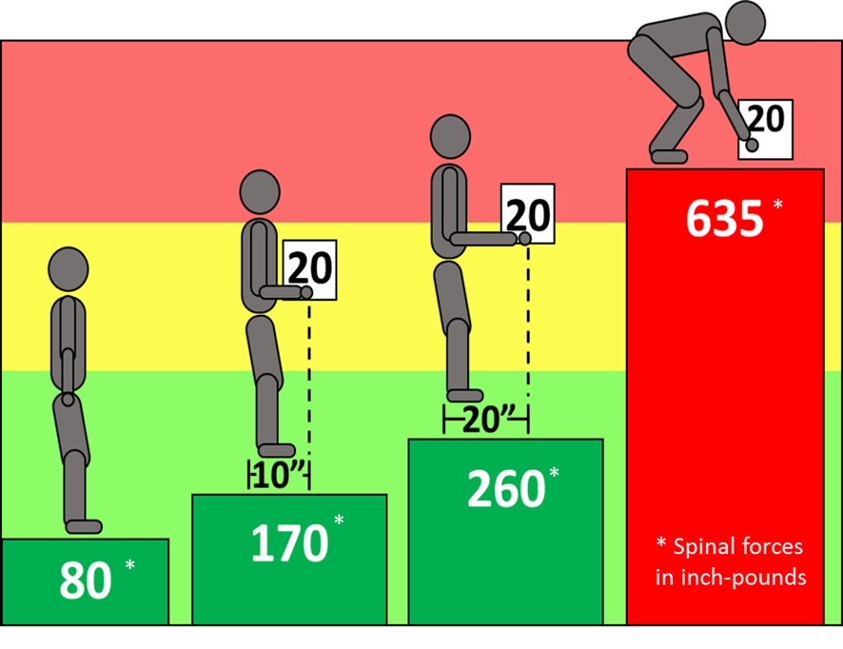
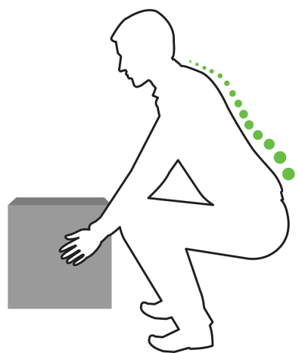
How Does the Weight of the Load Affect Your Low Back?
Rounded back, high disc pressure
*
Image courtesy of Washington University in St. Louis
*
Locked back,
low disc pressure
*
* Spinal forces in inch-pounds
*
Spinal Forces
Maanas/Shutterstock.com
Notes:
INSTRUCTOR NOTE:
Only show the title of the PowerPoint slide “How Does the Weight of the Load Affect Your Low Back?”
NOTES FOR SLIDE 8:
Ask the class:
How does the weight of the load affect your low back?
On a whiteboard or flip chart write down the various responses given by the trainees.
Once you have responses, advance the PowerPoint to show images.
Tell the class:
Lifting loads ‒ or materials and equipment ‒ is the most common ergonomic hazard in construction.
Working with the back bent forward is the second most common ergonomic hazard.
As this slide shows, the weight can be measured through spinal forces in the joints of your low back.
In the colorful diagram, the figure to the left is standing upright with no load. The spinal forces from gravity on his low back are 80 inch-pounds.
The second figure is holding a 20-pound load close ‒ 10 inches from the hands to the low back. This is an IDEAL posture to carry a load. The spinal force goes up to 170 inch-pounds.
If the load is moved away from the body to a distance of 20 inches, the spinal forces increase significantly to 260 inch-pounds. SO how close you hold an object makes a BIG difference to your low back forces.
The last figure shows the large increase in spinal forces from lifting an object from the floor. The distance to the object is larger and the body is not upright. The spinal forces have more than tripled from the IDEAL figure ‒ 170 inch-pounds to 635 inch-pounds.
The two figures on the right side of the slide show a curved back posture on the top which causes high spinal disc pressure – this is POOR posture. The bottom figure shows a “locked” back straight posture. By keeping your back locked in a straight position while lifting, your spinal forces stay low.

Slide 9




What Is the Hierarchy of Ergonomic Controls?
BEST
BETTER
GOOD
OK
Notes:
NOTES FOR SLIDE 9:
Ask the class:
Let’s fill in this inverted pyramid – what is the hierarchy of ergonomic controls?
On a whiteboard or flip chart write down the various responses given by the trainees.
Once you have responses, continue to the next slide to show images.

Slide 10
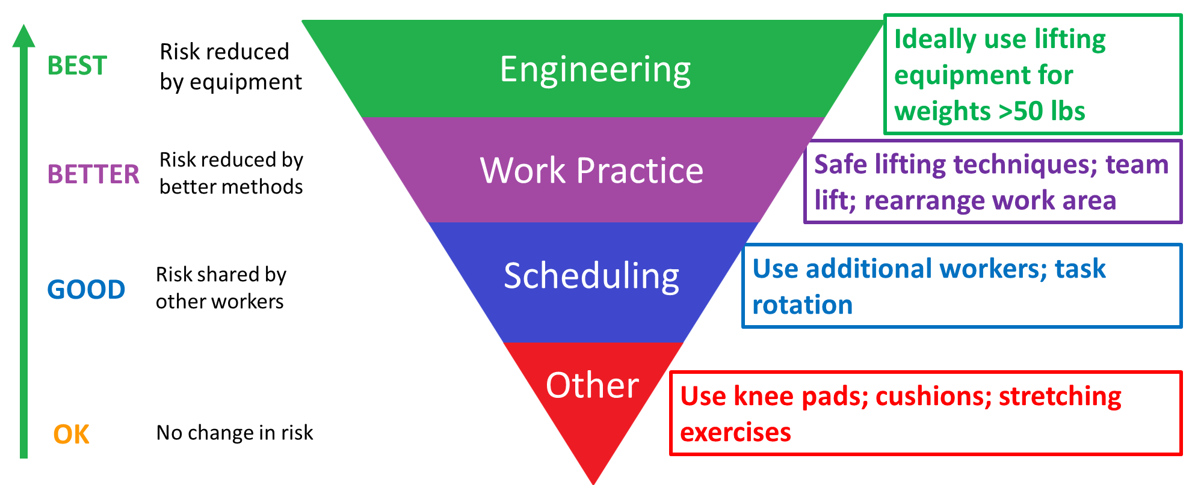
Hierarchy of Ergonomic Controls to Reduce the Risk
Notes:
NOTES FOR SLIDE 10:
When planning how you will lift and move materials, you should follow the Hierarchy of Ergonomic Controls to select the best practice.
If possible, always choose a higher-level control – an engineering or work practice control over other lower level controls to reduce risk.
Ask the class:
Can you give examples of engineering or work practice controls for ergonomic hazards on your job sites?
On a whiteboard or flip chart write down the various examples given by the trainees.
Once everyone is done giving responses, continue to the next slide.

Slide 11
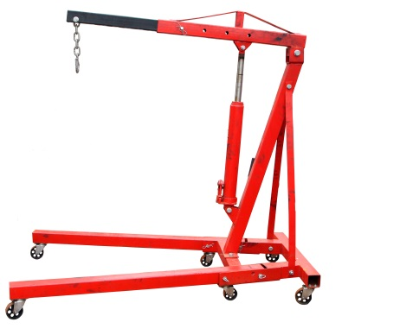
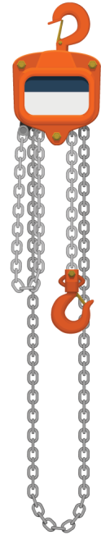
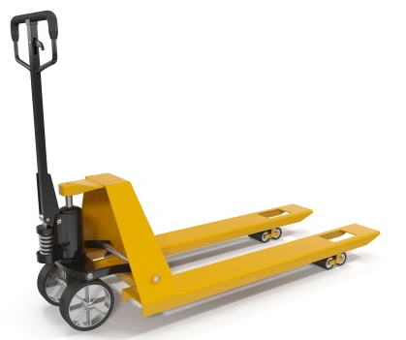
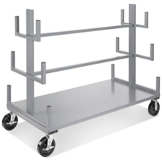
Reduce Force: Move Materials with Lifting Equipment
PLAN YOUR WORK
Use lift assists to lift large-sized, long, or heavy materials.
Use lifting equipment to transport loads, make fewer trips, and avoid carrying materials on your shoulder.
Keep work area clear of obstacles to minimize trip hazards and make use of wheeled carts or equipment easier.
Portable lifting
hoist
iStock.com/shank_all
Chainfall
Heavypong/Shutterstock.com
3DMI/Shutterstock.com
Pipe cart
Photo courtesy of Construction Solutions and Uline
Pallet jack
Notes:
NOTES FOR SLIDE 11:
The first step in “planning your work” is to think through how you are going to move the materials. For heavy or large loads, this ideally includes the use of lifting equipment.
This slide shows a few examples.
Whether or not lifting equipment is available depends on how well the employer planned for safe lifting on the job. Your foreman should know what lifting equipment is available on the project and be able to show you how to use it. If you don’t know how to use equipment, you should ask.
You should also look for and make suggestions to your foreman on methods that will make it easier to move loads or equipment. Oftentimes, making a move easier also leads to better productivity.
In addition to selecting lifting equipment, since many of these tools are on wheels, it is important to keep the work area clear of obstacles and debris – in other words, maintain good housekeeping.

Slide 12
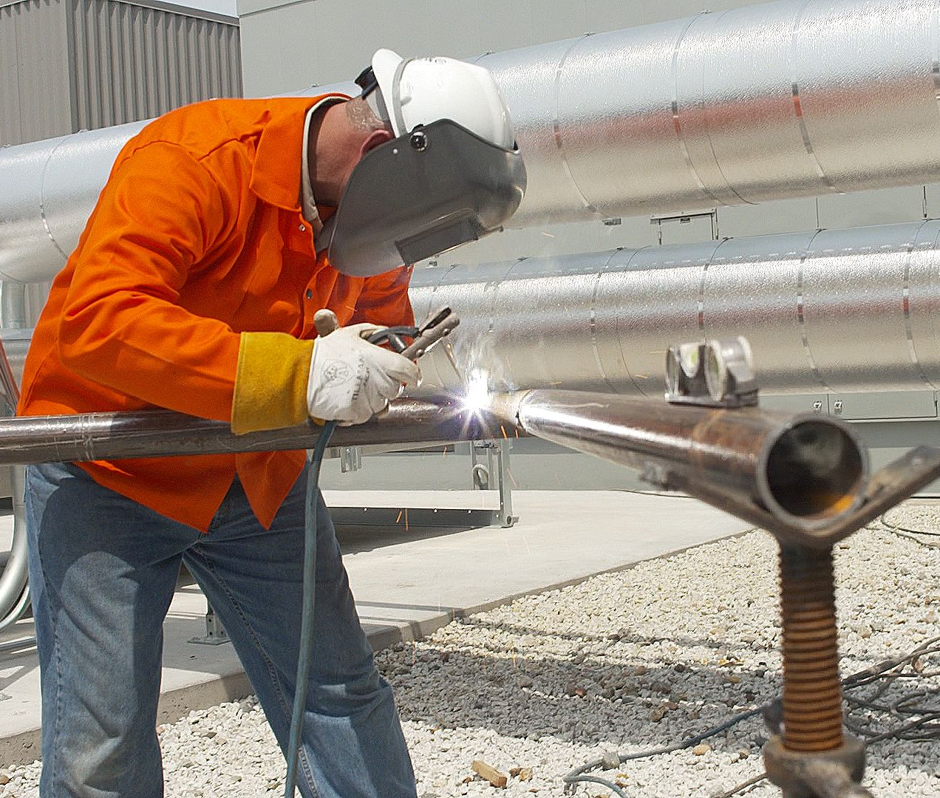
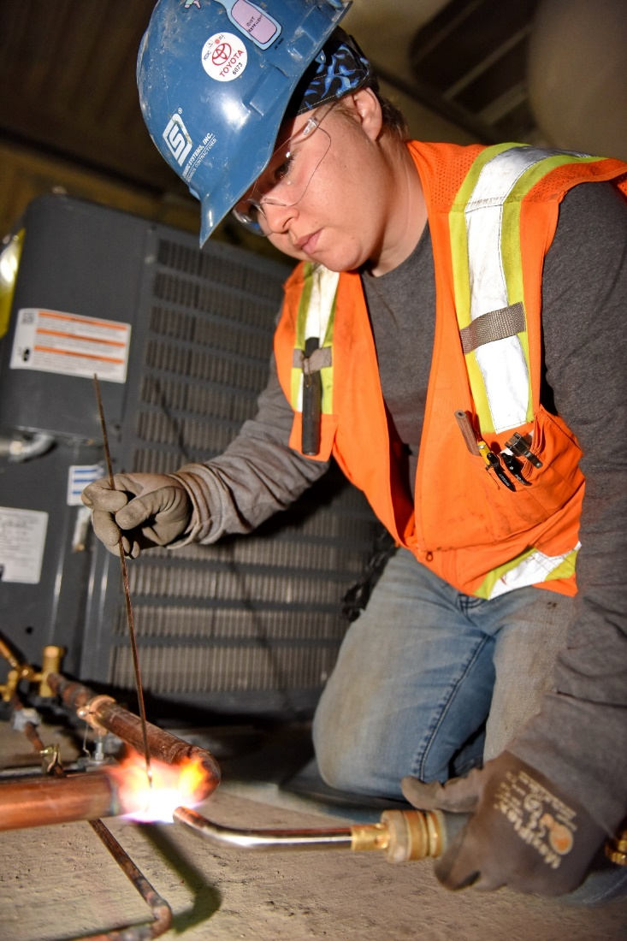
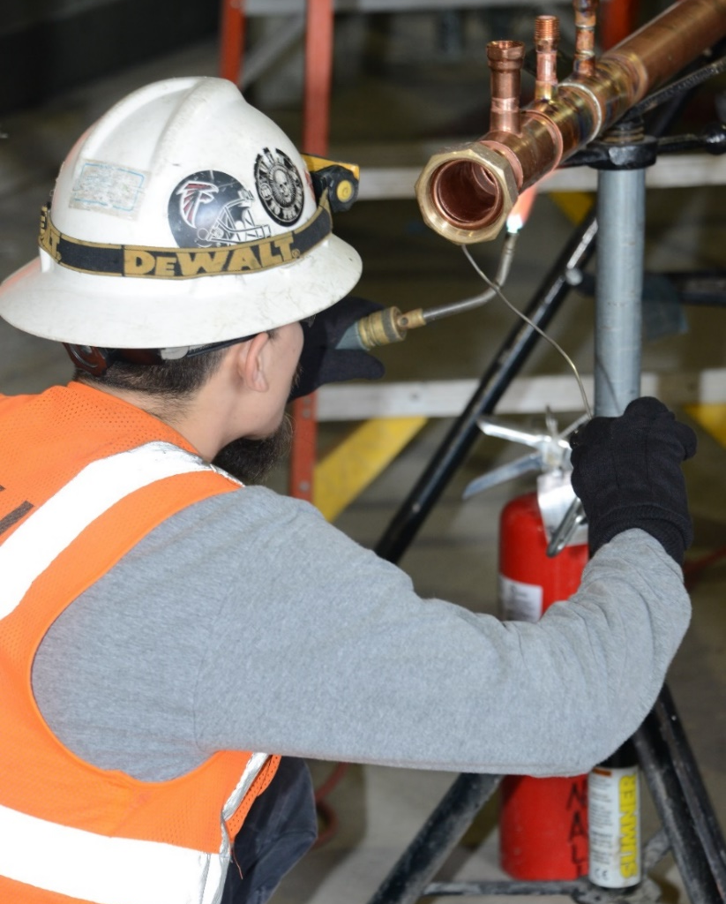
Ground-Level Tasks
Photo courtesy of the UA
Photo courtesy of the UA
Photo courtesy of the MCAA
Notes:
NOTES FOR SLIDE 12:
In addition to the risks associated with lifting and moving, the second ergonomic hazard is Poor Postures, often called “awkward postures.”
Many workers will work at the floor level using forward bent back postures (not shown in any of these photos). Working in a bent back posture causes increased spinal forces.
Other workers will kneel to work on the floor. This may cause a contact stress between the hard ground surface and your knee. It is helpful to use knee pads or other cushions to eliminate contact stress.
You can improve work postures and reduce contact stress by:
Raising work to waist height;
Preassembling work at work height before installing it at the floor level or overhead; or
Wearing knee pads to cushion your knees while kneeling, or gloves to cushion your hands for some tools.
Ask the class:
Can you think of examples of ergonomic controls to help with work postures?
On a whiteboard or flip chart write down the various examples given by the trainees.
Once everyone is done giving responses, continue to the next slide.

Slide 13
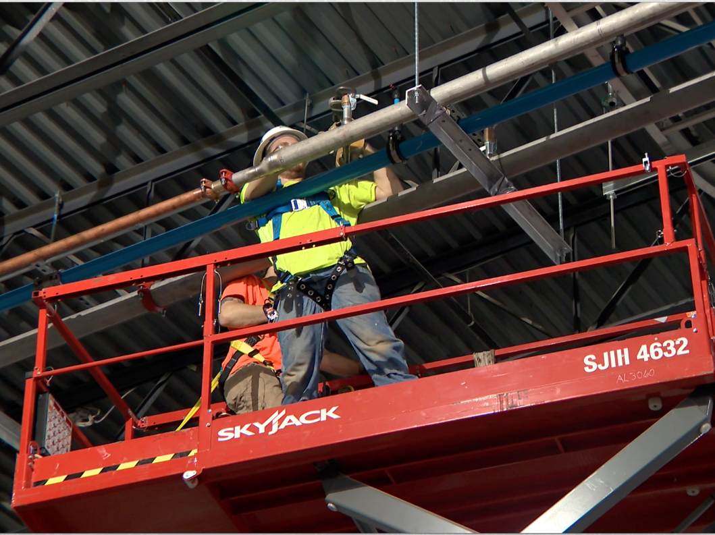
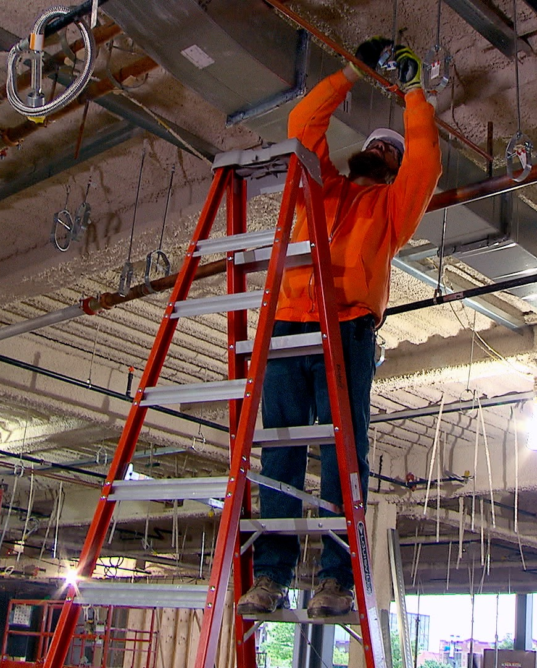
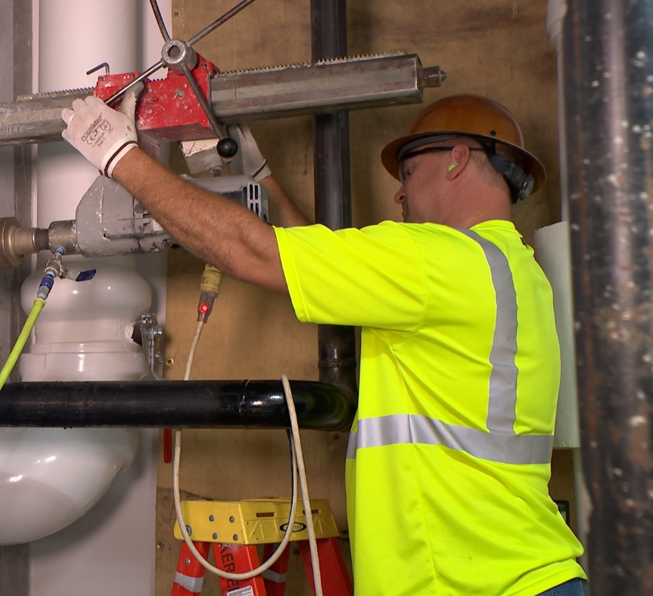
Overhead Work (Ladder, Lift)
Select and locate equipment for safety and for ideal body position
Photos courtesy of the MCAA
Notes:
NOTES FOR SLIDE 13:
There are also risks associated with doing overhead work. Anytime your hand is positioned above your head height, there is high stress on your shoulder. Work that is at or below your head height is much easier on your shoulder.
Ask the class:
Look at the three pictures on the slide and identify the good practices and the bad practices being done. What are some good and bad practices being done?
On a whiteboard or flip chart write down the good and bad practices identified by the trainees.
Once everyone is done giving responses, continue to the next slide.
INSTRUCTOR NOTE:
There are both good and bad practices shown in the three pictures:
Photo 1 ‒ problem with hands positioned above the head; ladder positioned poorly (for safety); reposition ladder and have worker step up to get closer to the work; may improve the position by using a lift.
Photo 2 ‒ good height on the ladder; good reach posture; gloves may improve tool-hand interface.
Photo 3 ‒ lift allows worker to position above the pipe in a good posture.

Slide 14
Best Practice Matrix: Hierarchy of Ergonomic Controls
Hierarchy of Controls (HOC) level | Ergonomic Hazards
 | Manual material handling | Work below knee | Arms overhead
Engineering | Use mechanical assist | Preassemble at shop/in field | Mechanical assist: scissor lift, hoist
Work Practices | Position material close | Raise height of work | Assemble at ground level
Administrative | Assign more workers | Rotate workers | Rotate workers
PPE | Stretch after task | Knee pads, stretch after task
BEST
BETTER
GOOD
OK
Notes:
NOTES FOR SLIDE 14:
This “best practice matrix” lists common tasks or risks in each column and ways to control the risk for each level of the hierarchy of ergonomic controls.
For example, engineering controls could be specific mechanical lifting/transporting devices, equipment to raise work to waist height ‒ like a pipe stand ‒ and tools with extension handles to reach overhead.
Work practices could be a two-person lifting team for specific items, or preassembling work before installing it.

Slide 15
How Would You Fill in This Table?
Hierarchy of Controls (HOC) level | Ergonomic Hazards
 | Manual material handling | Work below knee | Arms overhead
Engineering
Work Practices
Administrative
PPE
BEST
BETTER
GOOD
OK
Notes:
NOTES FOR SLIDE 15:
Now let’s think about your job sites.
Ask the class:
How would you fill in this table?
On a whiteboard or flip chart write down ideas for each box on this chart.
Once everyone is done giving responses, continue to the next slide.

Slide 16
Sample Job Hazard Assessment with Ergonomics
Task to be performed | Potential hazards | Prevention methods
Install pipe fabrication and hangers at height | Awkward body position | Position body, whether in boom lift or on ladder, not to put your body in strained position. If lifting heavy object, get help.
Unloading trucks/material handling | Manual lifting | Use good housekeeping, know where material will be staged, have a clear path.
Manual lifting | Muscle strains/pulls/tears; fatigue | Lift with your legs, not your back; get help; stretch prior to heavy lifting; utilize cranes, forklifts, chainfalls, or any other kind of lifting equipment whenever possible.
Notes:
NOTES FOR SLIDE 16:
Some contractors require job hazard assessments before work begins. If you have the opportunity to be involved in this process, it’s important to consider ergonomic hazards. This slide shows an example of tasks, ergonomic hazards, and prevention methods.
Ask the class:
Can you think of examples of other tasks, hazards, and prevention methods?
On a whiteboard or flip chart write down the various descriptions given by the trainees.
Once the class has had time to respond, continue to the next slide.

Slide 17
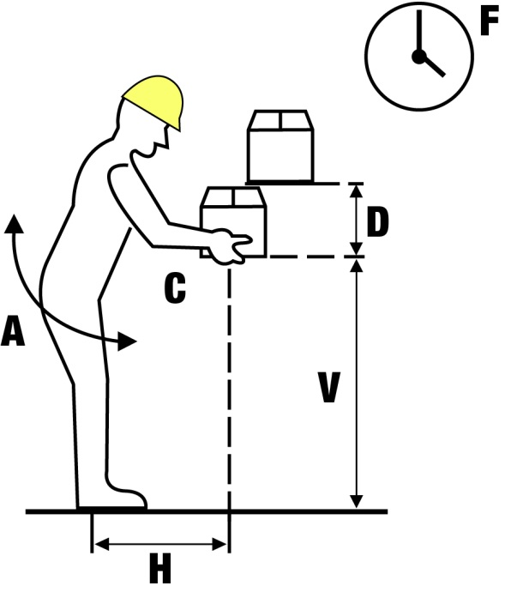
NIOSH Lifting Equation
Calculates a recommended weight limit (RWL) for a load that nearly all healthy workers could lift over an 8-hour day without increasing their risk of developing lower back pain.
RWL = LC (51) x HM x VM x DM x AM x FM x CM
  LC = Load constant (always 51 lb)
  H = Distance the object is from the body
  V = Height of the object from the floor
  D = Vertical distance between the start (origin) and the
  end (destination) of the lift
  A = The degree to which the body is required to twist or turn
  during the lifting task
  F = Frequency and duration of lifting activity
  C = Quality of the worker’s grip on the object
Calculates a lifting index (LI), which is an estimate of the physical stress and injury risk associated with a manual lifting job.
LI = Load weight/RWL
  > 1.0 = High risk of injury
  < 1.0 = Very small risk of injury
  The goal is to design all lifting tasks to have an LI of less than 1.0
Image courtesy of the Canadian Centre for
Occupational Health and Safety
Notes:
NOTES FOR SLIDE 17:
The NIOSH Lifting Equation provides guidelines for evaluating the risk of injury associated with two-handed manual lifting tasks.
It calculates a recommended weight limit (RWL) for a load that nearly all healthy workers could lift over an 8-hour day without increasing their risk of developing lower back pain.
The equation (RWL = LC x HM x VM x DM x AM x FM x CM) always uses a load constant (LC) of 51 pounds, because it represents the maximum recommended load weight to be lifted under ideal conditions.
It also includes six task variables (H, V, D, A, F, and C) that are expressed as multipliers (in the equation, M = multiplier). As these variables deviate from the ideal, the amount of weight that can safely be lifted by an employee decreases.
To use the equation to determine the recommended weight limit, you will need to measure the following six task variables in order to calculate the multipliers used in the equation:
H = Horizontal location of the object relative to the body (i.e., the distance the object is from the body)
V = Vertical location of the object relative to the floor (i.e., the height of the object from the floor)
D = Vertical distance between the origin and the destination of the lift
A = The degree to which the body is required to twist or turn during the lifting task
F = Frequency and duration of lifting activity
C = Quality of the worker’s grip on the object (rated as good, fair, or poor)
The NIOSH Lifting Equation also calculates the lifting index (LI), which provides an estimate of the physical stress and injury risk associated with a manual lifting job. To calculate it, you take the load weight of what you are lifting and divide it by the recommended weight limit you calculated (LI = Load weight/RWL).
If the value is greater than 1.0, then there is a high risk of low back injury. If the value is less than 1.0, there is only a small risk of injury. The goal is to design all lifting tasks to have an LI of less than 1.0!

Slide 18
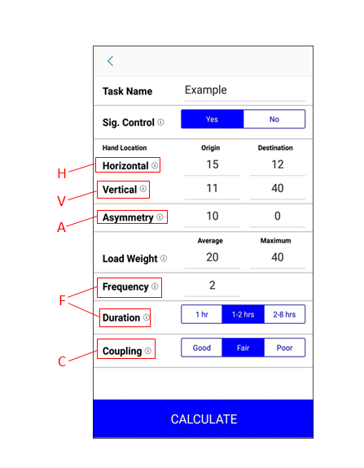
NIOSH Lifting Equation App
Step 1: Determine whether significant control is or isn’t required
Step 2: Measure variables and record them in the app
Step 3: Press calculate to get the RWL and LI for a particular lifting task
Example:
A worker bends down to take an object off the bottom shelf of a storage rack (origin) and places
it on a cart to be moved (destination). Significant control is required because the object needs
to be placed carefully on the cart.
H = Horizontal: When the object is taken off the shelf, the worker’s hands are 15 inches (origin) away from the midpoint of their ankles. When the worker stands up and places the object on the cart, they are 12 inches away (destination).
V = Vertical: The worker’s hands are 11 inches above the ground when the object is taken off the shelf (origin), and 40 inches above the ground when it is placed on the cart (destination).
A = Asymmetry: The worker twists their body 10 degrees to pick up the object (origin), but their body is straight when they place it on the cart (destination).
Load Weight: The type of object the worker lifts weighs 20 pounds on average, and has a maximum weight of 40 pounds.
F = Frequency: The worker lifts an average of 2 of these objects per minute over a 15 minute period. Duration: The worker lifts boxes for 1 -2 hours per day, with recovery time.
C = Coupling: The box is optimally designed for the worker to grasp onto, but it does not have handles or cut-outs, so it is rated as “fair.”
Notes:
INSTRUCTOR NOTE:
Distribute copies of handout #1 – The NIOSH Lifting Equation App (located in Appendix A).
NOTES FOR SLIDE 18:
This handout includes all of the information shown on this slide for the NIOSH Lifting Equation App. This app allows you to plug in selected task variables for a particular lifting task into the calculator, and it will automatically calculate the recommended weight limit, or RWL, and the Lifting Index, or LI, for you.
INSTRUCTOR NOTE:
The calculator does not show the load constant (LC) or the vertical distance between the start (origin) and the end (destination) of the lift (D) because these variables are already included or are calculated automatically.
To use the app, you can download it for free. Next, you will need to determine whether significant control of the object being lifted or lowered is required at the destination of the lift. In other words, does the task require precision placement of the load at the destination of the lift? Significant control is needed when, for example, an object is fragile and careful placement is needed to protect the object from damage. Or, the worker needs to change grip or hold or guide the object when lifting or lowering it to its destination.
If significant control at the destination is required, then you will need to collect the task variables H, V, and A at the start and end of the lift to determine the RWL. If significant control is not required, the only measurement you will need at the destination is the vertical location (V) to determine the vertical travel distance (D) from the origin of the lifting task. You will also need the task variables F and C, and the average and maximum load weights of the object you are lifting.
Once you have inputted all of the variables into the calculator, you can press the Calculate button, and you will get the RWL and LI. You will also get recommendations for how to improve the design of the lift based on the individual variables you entered. You can then use the LI to compare the injury risk of two or more job designs and to help prioritize ergonomic redesign efforts.
Let’s walk through an example of how to use the app:
INSTRUCTOR NOTE:
This example is shown in the image on the screen.
Say a worker bends down to take a box off the bottom shelf of a storage rack (the origin) and places it on a cart to be moved (the destination). Because significant control is required (the box needs to be placed carefully on the cart) we are going to select the “Yes” button in the app.
When the box is taken off the shelf, the worker’s hands are 15 inches away from the midpoint of their ankles. When the worker stands up and places the box on the cart, they are 12 inches away. This is the horizontal location.
The worker’s hands are 11 inches above the ground when the box is taken off the shelf, and 40 inches above the ground when it is placed on the cart. This is the vertical location.
The worker twists their body 10 degrees to pick up the box, but their body is straight when they place the box on the cart, so we put 0 in the destination column. This is known as asymmetry.
For the load weight, the worker lifts boxes that weigh 20 pounds on average, and have a maximum weight of 40 pounds.
For the frequency, the worker lifts an average of 2 boxes per minute over a 15 minute period.
For the duration, the worker lifts boxes for 1-2 hours per day, with recovery time.
The box is optimally designed for the worker to grasp onto, but it does not have handles or cut-outs, so we classify it as “fair.” This is known as coupling.
INSTRUCTOR NOTE:
If you would like more information on how to measure these variables, visit: https://www.cdc.gov/niosh/docs/94-110/pdfs/94-110.pdf?id=10.26616/NIOSHPUB94110.

Slide 19
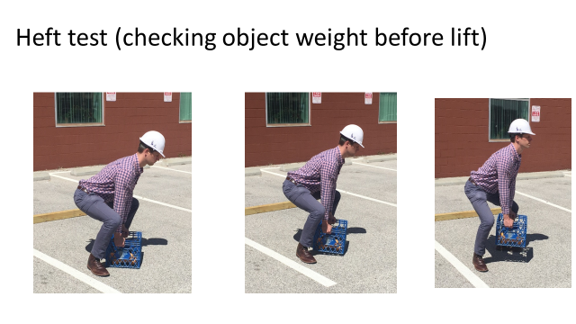
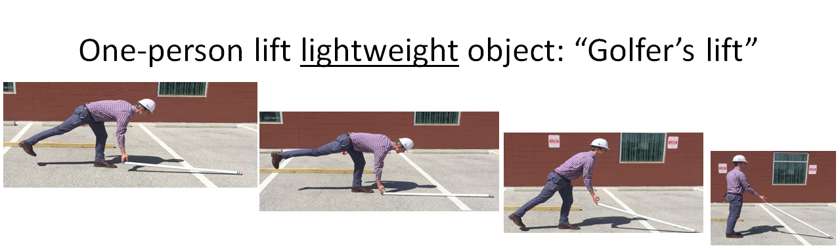
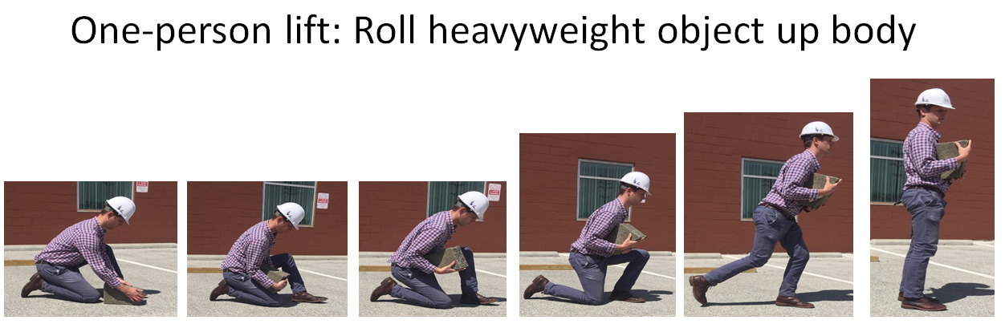
Review of Safe Lift Training Methods
Photos courtesy of the Healthy Work Center, Washington University School of Medicine in St. Louis
Notes:
NOTES FOR SLIDE 19:
In addition to following the hierarchy of controls, as you learned in the basic training, it’s also important to use safe lifting methods.
Let’s quickly review them. This slide shows the “heft test,” which involves checking the object’s weight before lifting.
To do this lift:
Approach the object from the front, with your feet shoulder-width apart;
Next, move close to the object;
Bend your knees and hips, “Lock” your back, and lift box ONLY 1” up from the ground – then set the object back down;
If the weight is acceptable to lift, use straight or power lift to lift object.
The “golfer’s lift” for lightweight objects involves:
Approaching the object from the end;
Bending forward at your waist on one leg, lifting the opposite foot off floor; and
Grasping the object and lowering your foot to the floor as you use slow, smooth movements to lift the object.
For the one-person roll up for a small heavyweight object, you:
Half kneel directly in front of the object;
“Lock” your back and roll the object onto your thigh;
Roll the object to your waist, hold it firmly close to your body; and
Push off on your back foot to rise to stand;
Once you’re balanced, move forward.

Slide 20
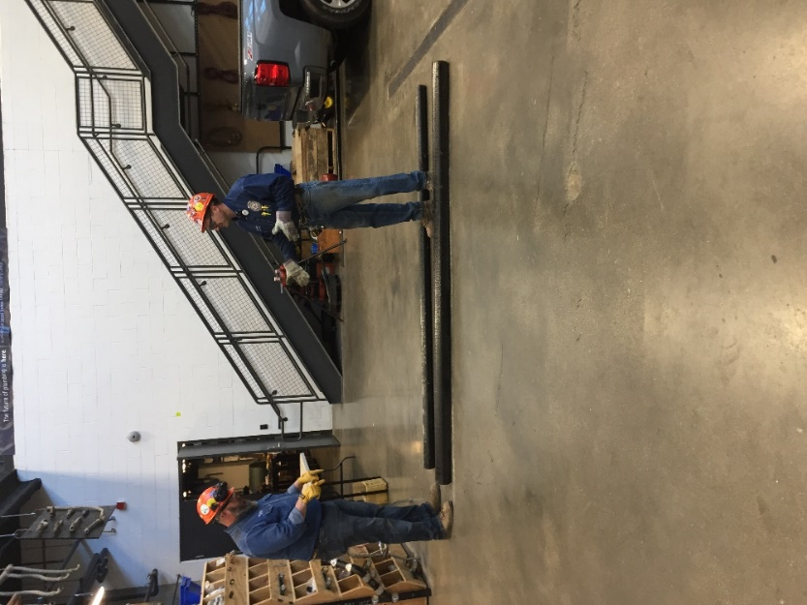
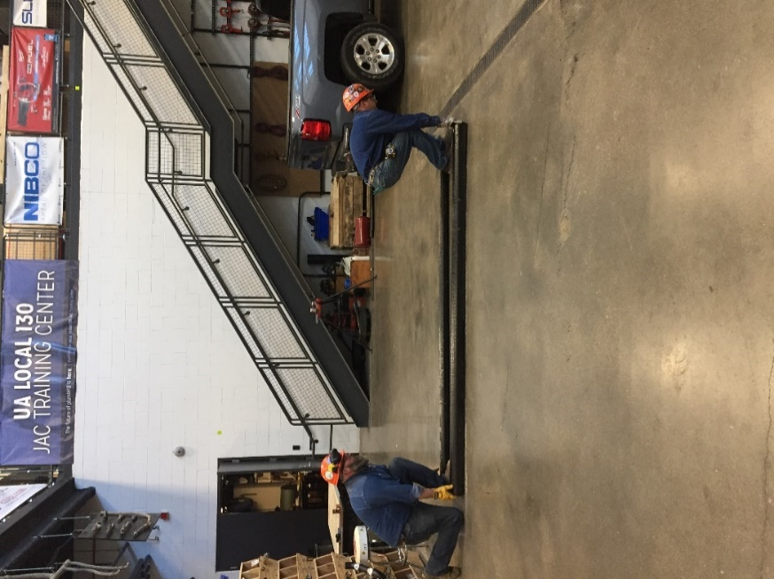
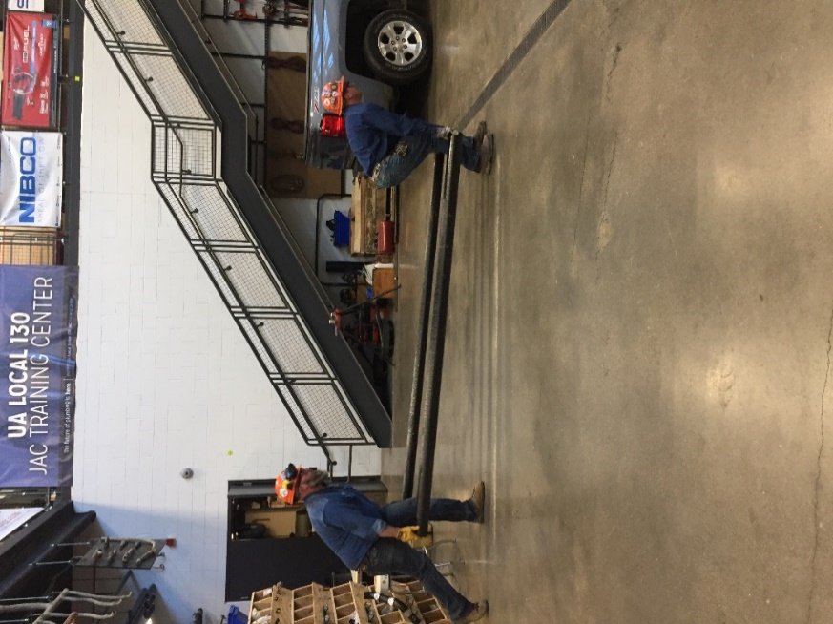
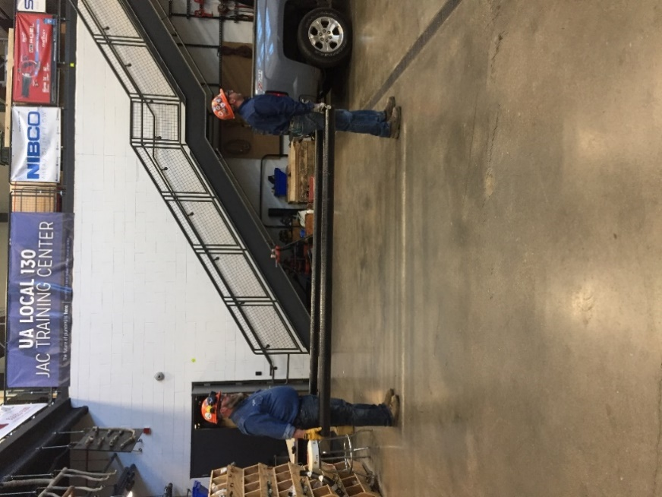
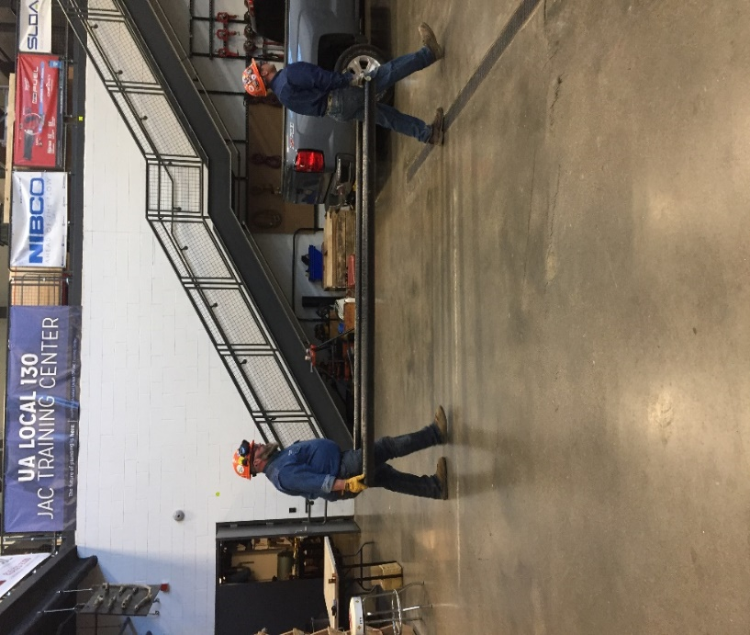
Two-Person Lift – 10’ Pole, Method II
Plan the lift
One worker gives commands
Ideally, lift together
Get your balance
Step together
Photos courtesy of the UA
Notes:
NOTES FOR SLIDE 20:
This slide shows two workers using a two-person lift method with a 10-foot pole.
The two workers start by planning how they will conduct the lift.
Once they’ve done that, they each approach the pole from the ends and move close to the object, feet shoulder-width apart, with their backs “locked” and knees and hips bent. The front person turns toward the direction of travel.
They communicate ‒ “one, two, three lift,” and lift with backs straight (no twisting), using slow, smooth movements.
They hold the pole at their waist and walk forward.

Slide 21
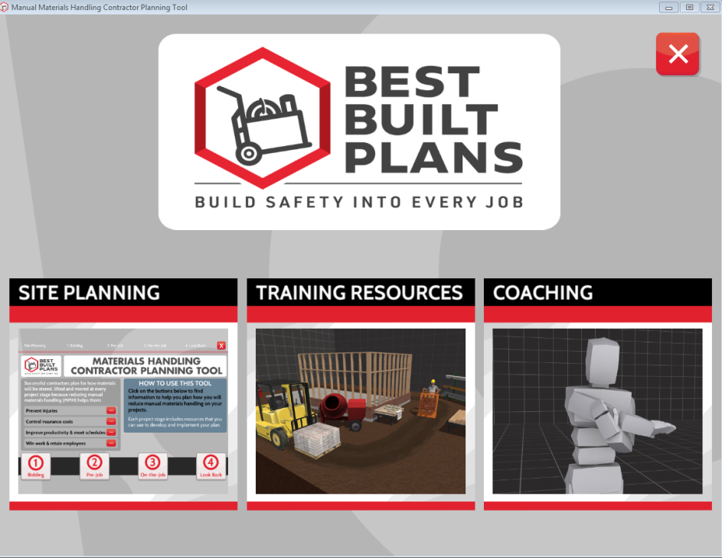
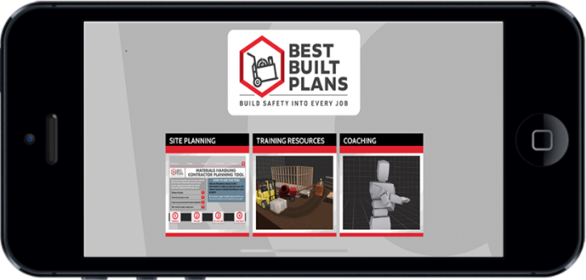
Interactive Training and Coaching Resources to Reduce Manual Material Handling Risks
Notes:
INSTRUCTOR NOTE:
The following slides provide a brief review of the interactive resources for workers available through the Best Built Plans program.
If you have not already used the materials in Part 3 as a hand-on demonstration station or separate in-class presentation, and have additional time (15 to 30 minutes), you may want to do a more detailed presentation on these materials at this juncture using the in-class presentation from Part 3.
If you do not have the time, proceed to Slide 22.
NOTES FOR SLIDE 21:
Since everyone from the apprentice to the contractor has a role to play in preventing the risk for injuries, CPWR’s Best Built Plans Program includes materials that contractors can use to plan for how materials will be safely lifted and moved on job sites, and interactive training and coaching resources that you can use on your own to practice or as a refresher. These materials are designed to reinforce the importance of 1) planning for how materials will be lifted and moved, and 2) using safe lifting techniques (including equipment and team lifts) and practices.
You can download them to your PC or use the app available for Android and Apple smartphones and tablets.

Slide 22
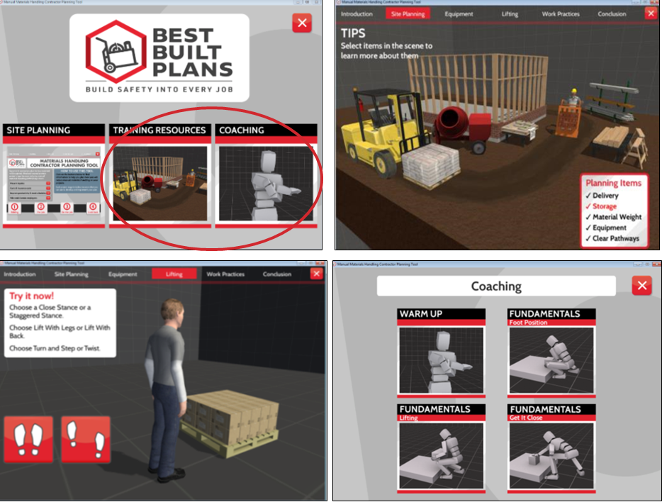
Interactive Training & Coaching Resources
  Site planning
  Equipment
  Lifting
  Work Practices
  Coaching
Notes:
NOTES FOR SLIDE 22:
The interactive Training Resources have a voiceover that allows you to click on items to learn more about planning and selecting equipment to lift and store materials.
The Lifting and Work Practice sections of the Training Resources walks you through a refresher of safe lifting practices and then lets you use a mouse or touchscreen to move a figure through different lifts. The Fundamentals part of the Coaching section lets you move the figure during different lifts and shows you what happens to the body when the lifts are done right and wrong.

Slide 23
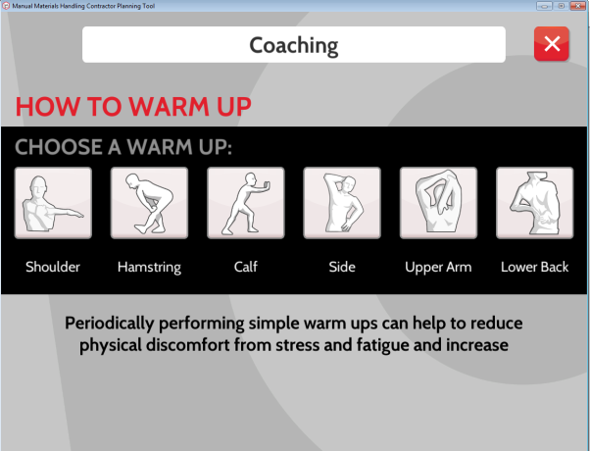
Notes:
NOTES FOR SLIDE 23:
The Coaching section also includes a Warm Up section that lets you try different stretching exercises that can help prevent an injury. Like the other interactive exercises, you can see what happens to the body when they’re done right and wrong.

Slide 24
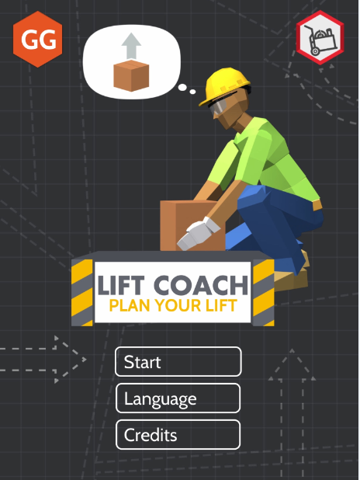
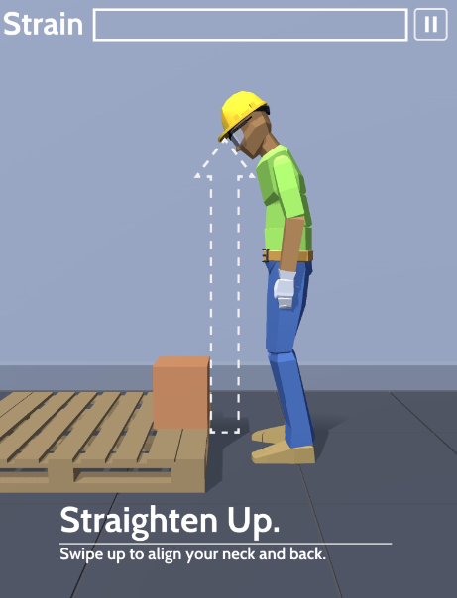
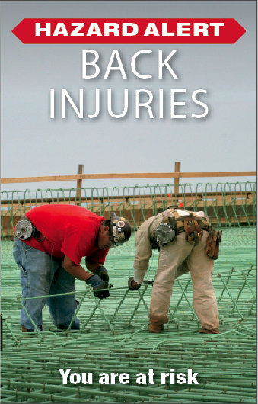
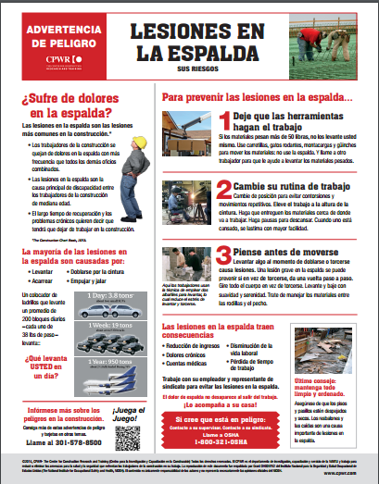
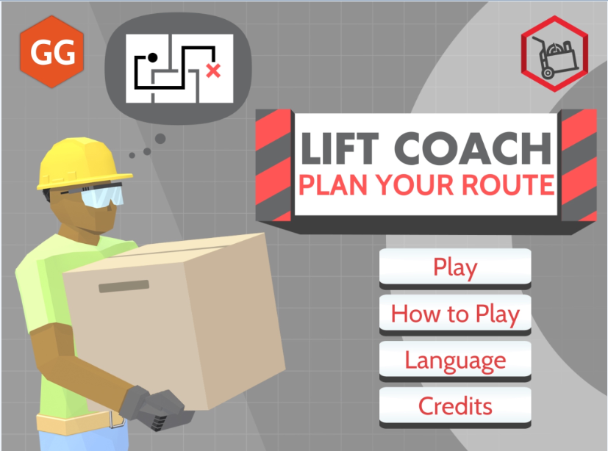
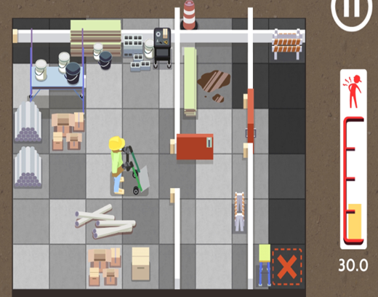
Games to Play on Smartphones
Notes:
NOTES FOR SLIDE 24:
There are also two games that you can play on your smartphones to test what you learned. We know they’re not for everyone, but they’re a fun way to test your knowledge. You advance through the games by making safe decisions.
You can get to the games directly through the app stores or by scanning the QR code on the hazard alert.
The first game raises awareness of the impact on your body of lifting from an awkward position or lifting heavy materials without assistance.
And the second game focuses on the job site and the importance of planning how you’ll lift and move materials, what equipment or help you may need, and if your pathway is clear. As this game advances, the construction site becomes more complex and injuries are tracked on the strain bars.

Slide 25
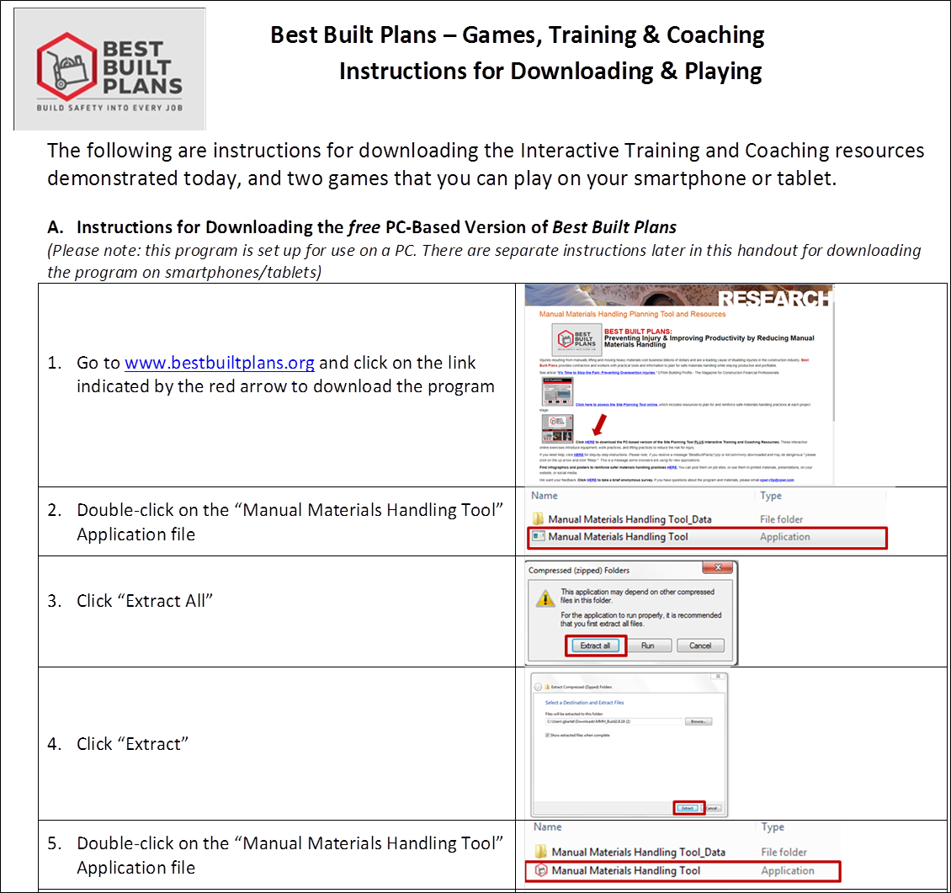
Instructions for Downloading the Interactive Training & Coaching Resources and the Games
Download PC version at www.bestbuiltplans.org
& the App version at:
Google Play: https://play.google.com/store/apps/details?id=com.simcoachgames.MMHTool
Amazon: https://www.amazon.com/Simcoach-Games-Best-Built-Plans/dp/B07SBK3SNQ
iTunes: https://itunes.apple.com/us/app/best-built-plans/id1457992967?ls=1&mt=8
Notes:
INSTRUCTOR NOTE:
Give all attendees a copy of handout #5 ‒ “Instructions for Downloading the Best Built Plans Training & Coaching Resources and Playing the Games”
NOTES FOR SLIDE 25:
You have a handout with instructions on how to download and use these resources.
I’d encourage you to try them out.

Slide 26

Why Is It Important to Always Follow Safe Lifting Practices?
Prescription opioids MAY lead to prescription drug abuse
Opioids are addictive medications
Taking more pills than prescribed, someone else’s medication, or high doses of medication for long periods of time will likely lead to dependency and addiction
FIRST ask your doctor for information on all available treatments for pain
ONLY take opioids if it is the best option, and follow the dosage prescribed by your doctor
Notes:
INSTRUCTOR NOTE:
Only show the title of the PowerPoint slide “Why Is It important to Always Follow Safe Lifting Practices?”
NOTES FOR SLIDE 26:
Ask the class:
Why is it important to always follow safe lifting practices?
On a whiteboard or flip chart write down trainees’ answers.
Once everyone is done giving responses, continue to the next slide.
Tell the class:
Those are all good reasons. But the one I want to focus on now is how preventing pain upfront, you can avoid pain medications – such as opioids, which may lead to addiction.
While opioids are commonly prescribed for pain relief by physicians, they are strong, addictive medications, so they should only be used if they are the best option to manage pain.
Misuse of opioids prescriptions, including taking more than a prescribed dose, taking someone else’s prescription, taking multiple opioid medications, or taking high doses for long periods of time can all lead to opioid dependency and addiction.
Think about the risk – 1 out of 4 people prescribed opioids for long-term pain become addicted.
Thousands of people die from overdoses each year. In 2017 alone, more than 49,000 people died from an opioid overdose, and overdose deaths on the job are on the rise.

Slide 27
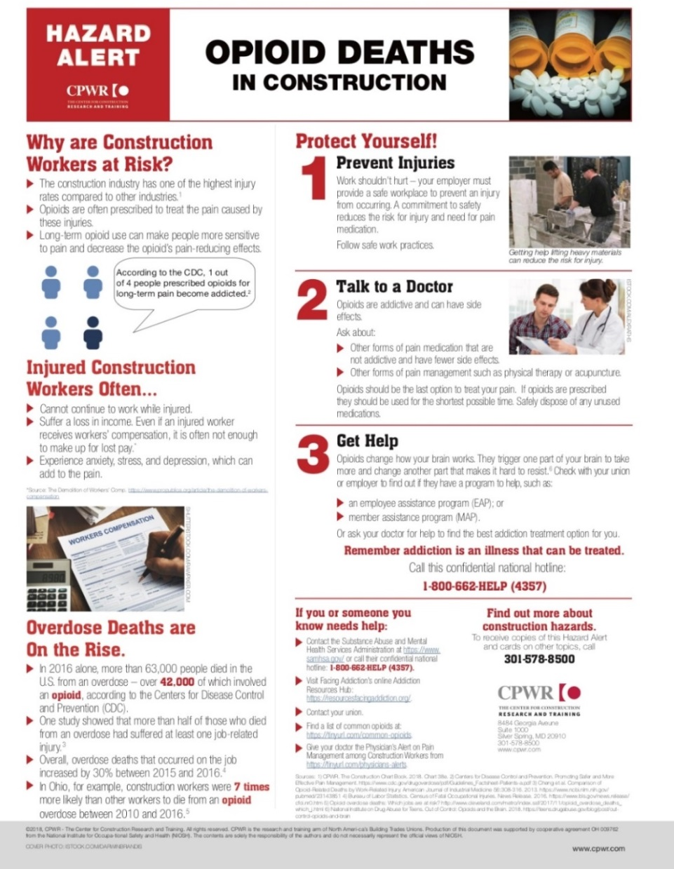
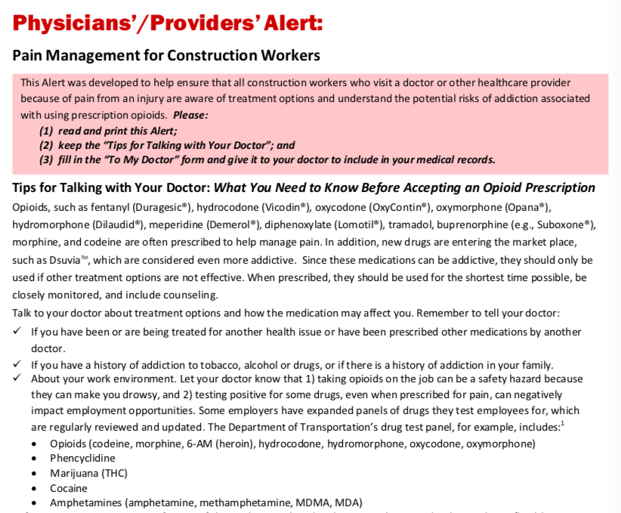
Resources to Help You Protect Yourself
Notes:
INSTRUCTOR NOTE:
Give all trainees a copy of the handouts: Physicians’ Alert – Pain Management for Construction Workers (Handout #3) and Hazard Alert Card – Opioid Deaths in Construction (Handout #4)
NOTES FOR SLIDE 27:
Before taking prescription opioids, it’s important that you FIRST ask your doctor for information on all available treatments for pain.
And then only take opioids if they are the best option, and follow the dosage prescribed.
DO NOT take opioids for long periods of time (more than 30 days) without consulting with your doctor.
CPWR has developed several resources to help you understand the risk and get proper treatment if you are injured and in pain.
This slide shows the online version of the Hazard Alert Card and a Physicians’ Alert.
The Hazard Alert card covers some of the statistics I just covered, as well as steps you can take to prevent addiction or get help.
The Physicians’ Alert has two parts. The first part provides information for you on the risk and how to talk to your doctor about treating your pain.
The second part is to give to your doctor so they can better treat you. It includes information on, for example, how some jobs require drug testing and the drugs workers are commonly tested for.

Slide 28
Questions?
©2019, CPWR-The Center for Construction Research and Training. All rights reserved. CPWR is the research and training arm of NABTU. Production of this document was supported by cooperative agreement OH 009762 from the National Institute for Occupational Safety and Health (NIOSH). The contents are solely the responsibility of the authors and do not necessarily represent the official views of NIOSH.
Notes:
NOTES FOR SLIDE 28:
Any questions?

