Slide 1
Evaluating
Safety Culture and Climate:
Key Measurement Issues
Tahira M. Probst, Ph.D.
Washington State University Vancouver
June 11, 2013

Slide 2
Key Measurement Issues
What are we measuring? Culture or Climate
  Substantive vs. Semantic Differences
Shared Perceptions vs. Individual Attitudes
  Appropriate Level of Aggregation
Global vs. Multi-dimensional Scale
Scientist-Practitioner Differences
  Priorities, Goals, Intended Use of Resulting Data
Home-grown vs. Validated Measures
General vs. Specific to Construction Industry
Response scales
  Even (prevent fence-sitting) vs. odd # of options
Single-item vs. Multi-item Scales

Slide 3
Organizational Culture: Historical Origins
Two events in 1986 brought organizational culture to the forefront
  The Chernobyl nuclear disaster
  The Challenger space shuttle explosion
Both accident investigations identified “poor culture” as contributing factor
  Since then, practitioners have tended to refer to “safety culture”
  Organizational researchers, however, tend to focus on “safety climate”

Slide 4
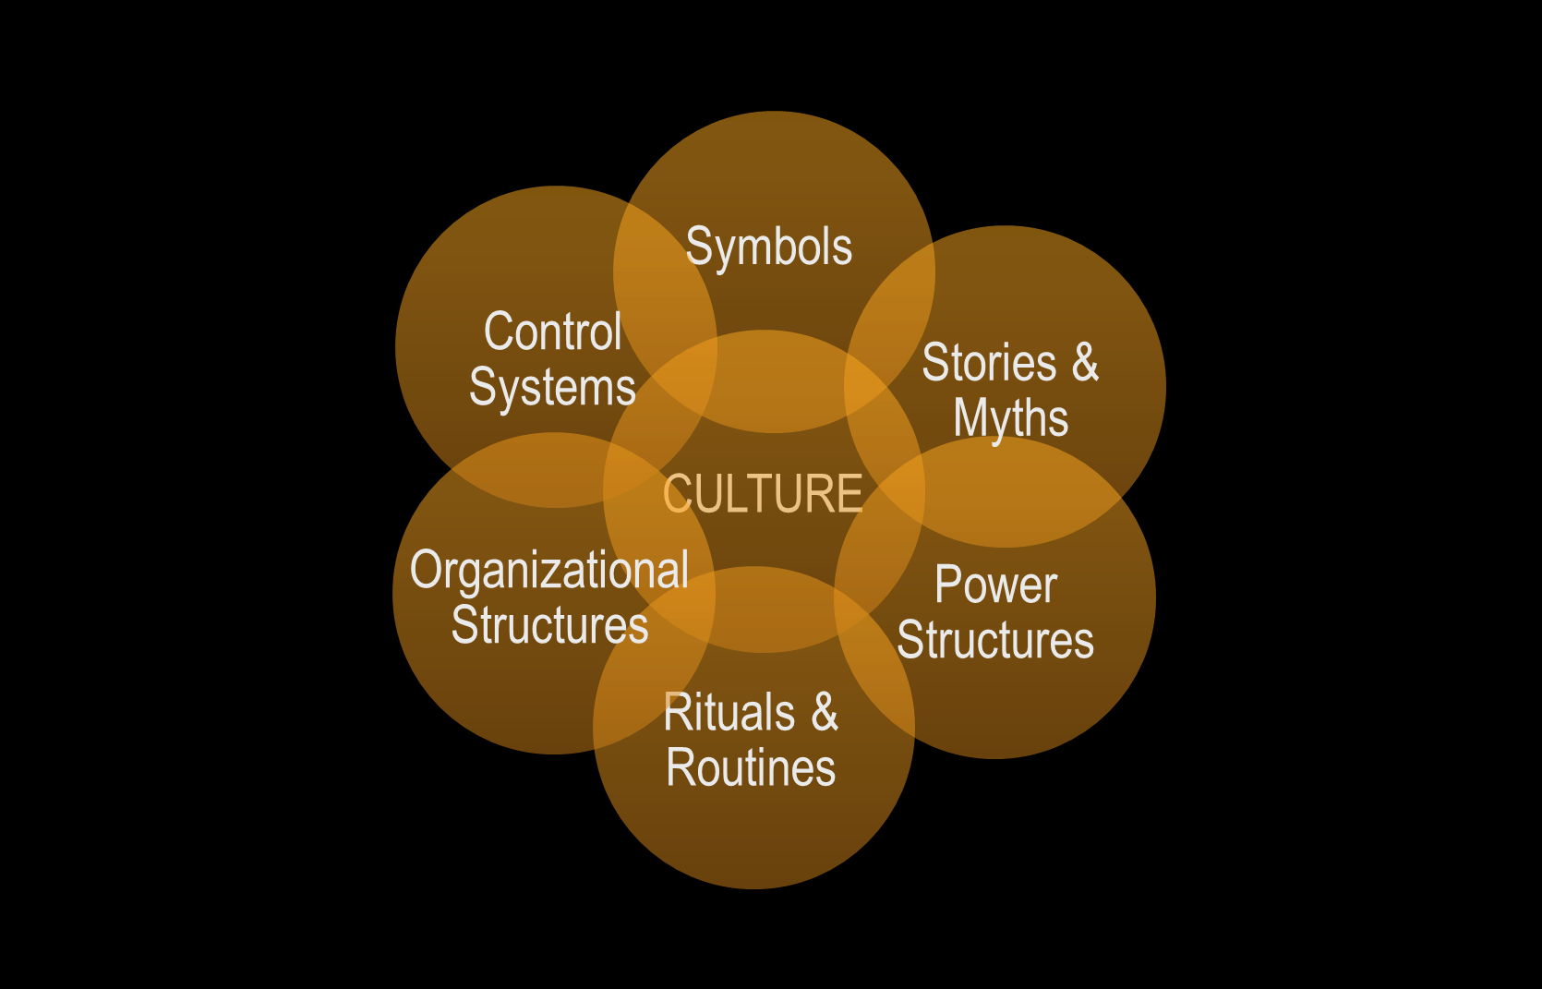
Organizational Culture
  Assumptions, values, and philosophies that permeate multiple facets of an organization (Schneider & Gunnarson, 1996)

Slide 5
Where Does Climate Fit In?
Climate reflects the surface features of the safety culture (Flin et al., 2000)
  Observable attitudes and behaviors of organizational members (Moran & Volwein, 1992)
  Practices, procedures, and rewarded behavior (Schneider & Gunnarson, 1996)
Climate is what we can measure.
So, is it just a semantic difference?
  Depends on who you talk to!
Notes:
These definitions of climate explain why organizational researchers tend to be more interested in climate than culture
➔ It’s much easier to measure perceptions regarding what is valued within an organization than to try to determine what are the unspoken basic assumptions within a particular organization.

Slide 6
Shared vs. Individual Perceptions
Climate is the shared perceptions regarding what is rewarded, expected, valued, and reinforced in the workplace
Not everyone will necessarily have the same perceptions.
  The extent to which those views are shared reflects the strength (or intensity) of the climate.
Strong Negative | Strong Positive
Weak Negative | Weak Positive
Climate Strength
Climate Level

Slide 7
Appropriate Level of Aggregation
Organizational Climate
Departmental Climate
Workgroup Climate
Psychological Climate
Organization ➔
⬅ Or Job Site
Supervisor ➔
Employee ➔

Slide 8
Global vs. Multi-Dimensional Measures of Safety Climate
Zohar (1980)
Brown & Holmes (1986)
  Importance of safety training programs
  Management attitudes toward safety
  Effects of safe conduct on promotions
  Effects of safe conduct on social status
  Level of risk in the workplace
  Effects of required work pace on safety
  Status of safety officer
  Status of safety committee
Management attitudes
  Concern for employee well-being
Management action
  Responsive to employee safety concerns
Level of physical risk
Neal, Griffin & Hart (2000)
Management values
Safety communication
Safety training
Safety systems

Slide 9
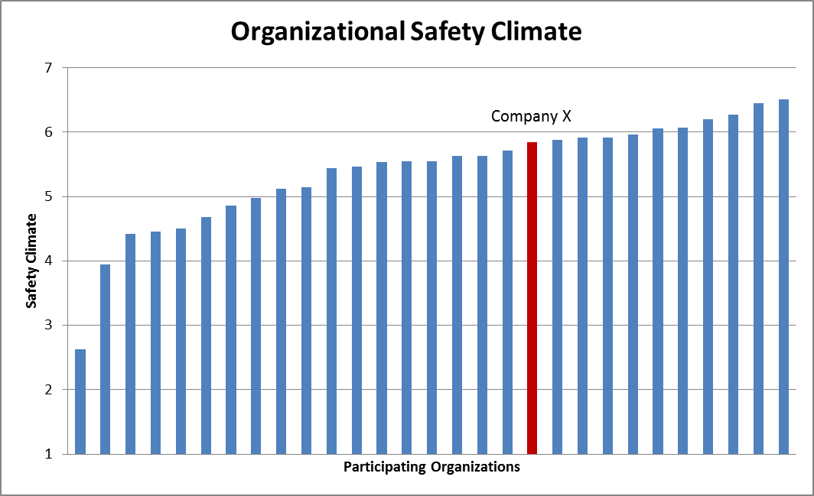
Benchmarking vs. Actionable Information
“Company X falls at the 66th percentile.”
Global number good for benchmarking, but doesn’t really provide actionable information regarding how to improve.
By considering each of the dimensions separately, we could tell Company X that they were doing well on safety communication, but poorly with respect to safety systems.

Slide 10
Scientist-Practitioner Differences
Researchers and practitioners may have different priorities, goals, and/or intended use of the resulting data
    To improve safety or address a particular safety concern within a specific organization
    vs.
    To contribute generalizable knowledge that will increase our scientific understanding of safety and potentially benefit all organizations.
These differences can potentially affect our measurement of safety climate.

Slide 11
Home-grown/Specific vs. Validated/General Measures
Need to consider the pros and cons of different types of safety climate measures.
Tend to be well-validated
Provides generalizable information across industries
General Measure of Safety Climate
Industry-Specific Measure of Climate
Organization-Specific Measure of Climate
Perhaps too general to provide actionable information within a specific organization
If well-validated, can provide more specific actionable information, but few organizations have resources to develop such scales
Tend to be idiosyncratic
Unknown reliability or validity

Slide 12
Other Issues
Response scales
  “Employees are able to discuss their concerns about safety issues with management”
  Strongly Disagree to Strongly Agree
    Even: 1-4 or 1-6 (prevents fence-sitting)
    Odd: 1-5 or 1-7 (allows for greater variability and neutral midpoint)
Single-item vs. Multi-item Scales
  Single-items are generally of unknown reliability and validity
    For example, does the above question capture everything an organization should know about “safety communication”? What about downward communication?
  Lengthy multi-item scales can be extremely time-consuming to administer

