Slide 1
Construction Noise
&
Hearing Loss Prevention
30 Minute Elective Module
Notes:
The topic of this presentation is Construction Noise and Hearing Loss Prevention.

Slide 2
Goal
2
Provide the necessary training to identify a noise hazard, understand the risk for hearing loss, and know what steps should be taken to work safely to prevent hearing loss
Notes:
Participants will be introduced to the signs of hearing loss and long-term consequences, sources of hazardous noise, and the importance and proper use of hearing protection. This is a shortened version of the 1 Hour Elective Program. The longer program includes more interactive activities and videos.
The Construction & Hearing Loss Prevention Module provides awareness training on the risk for hearing loss, how to identify a noise hazard, and know what steps should be taken to work safely to prevent hearing loss.
ASK CLASS:
Do you know anyone that suffers from hearing loss as a result of working in construction?
OR
Introduce an example from your own experience of someone you know that developed hearing loss because of their years working in construction.
After a brief discussion let them know you’ll be talking about ways they can protect their hearing throughout the class.

Slide 3
After completing this training you will be able to:
3
Explain why noise and hearing loss is an important issue for construction workers
Recognize the signs and effects of hearing loss and tinnitus
Identify hazardous noise, types of noise, and common noise sources
Notes:
We expect by the end of this presentation each of you will be able to:
Explain why noise and hearing loss is an important issue for construction workers
Recognize the signs and effects of hearing loss and tinnitus
Identify hazardous noise, types of noise, and common noise sources

Slide 4
After completing this training you will be able to:
Know how to measure noise using common indicators and free mobile applications (apps)
Describe several ways to control noise exposure
Understand the different types of hearing protection devices used in construction and how to use them correctly
Notes:
Know how to measure noise using common indicators and free mobile applications (apps)
Describe several ways to control noise exposure
Understand the different types of hearing protection devices used in construction and how to use them correctly

Slide 5
Why care about hearing loss?
Notes:
Many construction workers lose their hearing at a young age; it is not just a problem for older workers.
In fact, construction workers experience hearing loss at a younger age than the general population. According to NIOSH, the average 25-year-old construction worker has the hearing of a 50-year old person.
Too often construction workers think that too much noise is just part of the job and nothing can be done about it. This is not the case and that’s why it’s important to know when noise levels are dangerous and what can be done to control the noise level and protect your hearing.

Slide 6
Have you experienced the following…
Have trouble hearing people talk when there is background noise
People sound like they are mumbling
Often have to ask people to repeat what they say
Turn up the radio or TV a lot
Have difficulty hearing people on the phone
Have constant ringing in your ears
Notes:
Read each item on the slide. After each item, ask the class to make a note to themselves if they have experienced it.
After you read all of them
TELL THE CLASS:
These are all symptoms of hearing loss. Hearing loss occurs gradually over time so you won’t notice small changes or loss in hearing immediately.

Slide 7
Tinnitus
Ringing in ears (or hissing, buzzing, roaring, chirping, or whistling sound)
50 million people in the U.S. have tinnitus
Notes:
The last item on the previous slide is a sign of tinnitus (pronounced either ti-NIGHT-us or TIN-i-tus.)
In addition to a ringing sound, tinnitus can sound like a hissing, buzzing, roaring, chirping, or whistling sound. It is a sign that something is wrong in the auditory system, which includes the ear, the auditory nerve that connects the inner ear to the brain, and the parts of the brain that process sound.
Tinnitus can be caused by noise-induced hearing loss, and some health conditions, including ear and sinus infections, brain tumors, and certain medications and drugs.
The American Tinnitus Association (ATA) estimates over 50 million Americans experience tinnitus. Of these, 12 million have tinnitus severe enough to seek medical attention and approximately 2 million people are so debilitated they cannot function at a normal level on a day-to-day basis.
Nothing can be done to fix your hearing once it is permanently damaged – but the good news is that noise-induced hearing loss is preventable.

Slide 8
Are You Talking to Me?
8
What it’s like to lose your hearing
Developed by and used with the permission of Dr. Robert M. Ghent and Brad K. Witt of Honeywell Safety Products, San Diego, CA.
Notes:
When you work in construction, you are exposed to noise created by the work you’re doing and noise created by other work on the jobsite.
Being able to hear what’s going on around you has a direct impact on your safety and your life.
Let’s do a listening activity that will help us experience what it’s like not to be able to hear.
Hand out a copy of the worksheet – Are you talking to me? (“Are You Talking to Me? Worksheet) to each participant.
TELL THE CLASS:
We’re going to go through three hearing exercises – there’s a column for each on your worksheet. For each one, I’m going to play an audio file. Each audio file has 10 words in it. As you listen – try to write down each word that you can hear in the correct column of your worksheet. Feel free to make a guess. At the end of this exercise, we will see how many we got correct.
I’m not going to collect the worksheets. The worksheets are so that you can keep track of what you hear for our discussion.
ADDITIONAL INSTRUCTOR NOTES
Slides 9-11 contain audio files.
Play each of the audio files. At the end, show the slide that lists all of the words in the order they were said in the audio files and ask the class to check it against their worksheet.
The files include 10 words that are repeated. The ten words were picked to include a wide variety of speech sounds, but with particular emphasis on sounds that can be significantly affected by hearing loss.
The first file simulates what it would be like to have severe hearing loss on a construction site.
The second file simulates what it would be like to have mild hearing loss on a construction site.
The third file simulates what it is like to hear the words with normal hearing on a construction site.
Used by permission from Dr. Robert M. Ghent and Brad K. Witt of Honeywell Safety Products, San Diego, CA. The hearing loss simulations were applied using the CDC/NIOSH Hearing Loss Simulator at http://www.cdc.gov/niosh/mining/works/coversheet1820.html. The original speech materials were developed and produced by Dr. Richard W. Harris, Dr. Ron W. Channel, and Dr. Shawn Nissen, Department of Communication Disorders, Brigham Young University.

Slide 9
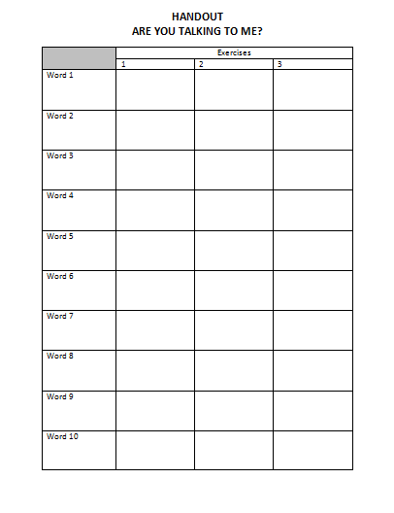
9
Developed by and used with the permission of Dr. Robert M. Ghent and Brad K. Witt of Honeywell Safety Products, San Diego, CA.
Notes:
Let’s start with the first audio file. You’re going to fill in the first column. As you hear words, write them down in the order that you hear them – don’t wait until the audio ends.
Play the audio file by clicking the sound image or play button on the screen.
After the audio file finishes:
ASK THE CLASS:
Was it easy to make out the words? What level of hearing loss do you think this represents?
Give the class a few minutes to respond then.
TELL THE CLASS:
This audio was an example of severe hearing loss with a man saying 10 words overtop background noise from a construction site.

Slide 10
10
Developed by and used with the permission of Dr. Robert M. Ghent and Brad K. Witt of Honeywell Safety Products, San Diego, CA.
Notes:
Now let’s listen to the second audio file – write down what you hear in the second column.
Play the audio file by clicking the sound image or play button on the screen. Have the class write what they hear in the second column of their worksheet.
After the audio file finishes:
ASK THE CLASS:
Was it easy to make out the words? What level of hearing loss do you think this represents?
Give the class a few minutes to respond then.
TELL THE CLASS:
This audio was an example of mild hearing loss with a man saying 10 words overtop background noise from a construction site.

Slide 11
11
Developed by and used with the permission of Dr. Robert M. Ghent and Brad K. Witt of Honeywell Safety Products, San Diego, CA.
Notes:
Now let’s listen to the third audio file – write down what you hear in the last column.
Play the audio file by clicking on the sound image or the play button on the screen.
After the audio file finishes:
ASK THE CLASS:
Was it easy to make out the words? What level of hearing loss do you think this represents?
Give the class a few minutes to respond then.
TELL THE CLASS:
This audio was an example of no hearing loss with a man saying 10 words overtop background noise from a construction site.

Slide 12
12
 | Exercises
 | 1 | 2 | 3
Word 1 | Star | Star | Star
Word 2 | Few | Few | Few
Word 3 | Bathe | Bathe | Bathe
Word 4 | Cap | Cap | Cap
Word 5 | West | West | West
Word 6 | Thin | Thin | Thin
Word 7 | Farm | Farm | Farm
Word 8 | Pie | Pie | Pie
Word 9 | Three | Three | Three
Word 10 | Gave | Gave | Gave
Notes:
Tell the class to take a few minutes to check what they wrote down against the results.
Here are the words that were in each audio file. Take a few minutes to check how you did.
ASK THE CLASS:
Raise your hand if you were surprised by how you did.
THEN ASK THE CLASS:
How did the jobsite noise in the background effect what you could hear?
Give the class a few minutes to respond.
TELL THE CLASS:
Experts tell us that in the first stages of hearing loss, it becomes difficult to hear high frequencies. For example, you may have difficulty hearing or understanding the high-pitched voices of children. People with hearing loss often have difficulty differentiating words that sound alike, especially words that contain S, F, SH, CH, H, TH, T, K, or soft C sounds. The words on the audio files we heard today contained letter combinations that are usually affected by work-induced hearing loss.

Slide 13
Effects of Hearing Loss
13
Temporary hearing loss
Difficulty hearing warning signals on the job
Increase the risk of falling
Contribute to loneliness and depression
Increase stress, blood pressure, hypertension and cardiovascular disease
Lead to nervousness, sleeplessness and fatigue
Notes:
Being exposed to loud noises can result in temporary hearing loss lasting 16 to 48 hours.
While the effect may seem temporary, there may be lasting damage to your hearing and have other effects that you might not think about.
Hearing loss can interfere with communication on jobsites, making it difficult to hear warning signals.
It can impact a person’s sense of balance leading to an increased risk of falling.
Hearing loss can also have a huge effect on social interactions – leading to feelings of loneliness and depression. Recent research has also shown that hearing loss may play an important role in brain health as an individual ages, from mild impairments to dementia. (Source: https://www.aarp.org/health/brain-health/info-07-2013/hearing-loss-linked-to-dementia.html)
Exposure to excessive noise can also increase stress and blood pressure, and can lead to nervousness, sleeplessness and fatigue.

Slide 14
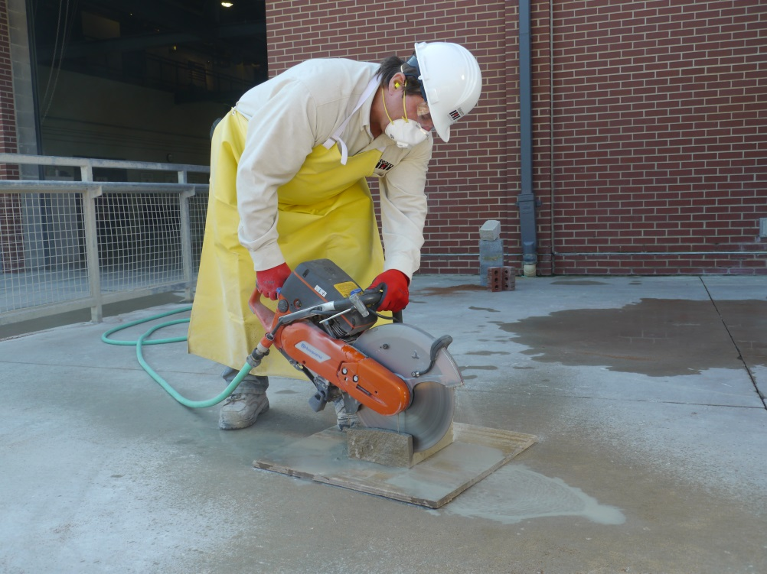
What causes hearing loss?
14
Exposure to loud noise
Certain drugs and chemicals
Aging
Heredity
Head injury
Headphone use
Childhood illness
Photo courtesy of the International Masonry Institute & OSHA
Notes:
The most common cause of hearing loss is exposure to loud noises. Called Noise-Induced Hearing Loss, it can be caused by a one-time exposure to a loud sound like and explosion or by repeated exposure to sounds over 85 decibels for an extended period of time.
Other causes include:
Ear-damaging drugs, medications and chemicals, such as some solvents used in construction. These are called ototoxic drugs and chemicals.
Aging – approximately one in three people between the ages of 65 and 74 has hearing loss.
Heredity
A head injury
Childhood illnesses – such as an ear infection.
Headphone use – listening to loud music or noises using headphones, particularly ear buds, have been shown to cause some damage to cochlea, which may become permanent
INSTRUCTOR NOTE:
The following are links to additional resources on causes of hearing loss from childhood illnesses, drugs, chemicals, and headphone use:
Childhood hearing loss: https://www.asha.org/public/hearing/Causes-of-Hearing-Loss-in-Children/
Ototoxic drugs: https://www.asha.org/public/hearing/Ototoxic-Medications/
Ototoxic chemicals: https://www.osha.gov/dts/shib/shib030818.html
Headphone use: http://www.scielo.br/scielo.php?pid=S1516-18462014000300779&script=sci_arttext&tlng=en & http://www.osteopathic.org/osteopathic-health/about-your-health/health-conditions-library/general-health/Pages/headphone-safety.aspx

Slide 15
How do you know if it’s too loud at work?
15
You have to:
Shout to be heard an arm’s length away (2-3 feet)
Turn equipment off to be heard
Move to another location to talk & be heard
Turn up the car radio at the end of the day
Notes:
Only show the title of the PowerPoint slide “How do you know if it’s too loud at work?”
ASK THE CLASS:
Does anyone know a way to determine if the noise level is too loud while you are at work?
Give them a few minutes to answer – if no one knows, click to bring up the rest of the slide.
This slide lists a few easy ways to know if it’s too loud:
You have to shout to be heard when you’re an arm’s length – about 2 or 3 feet away from the person you’re talking to.
You need to turn off the equipment you’re using to be heard.
You need to move to another location to talk and be heard.
You have to turn the sound on your car radio up after the shift.
TELL THE CLASS:
For your take-home assignment, the next time you drive to work, turn your radio on to the lowest level where you can hear it without having to strain to listen. Don’t change the settings before you get out of the car. After work, see if you need to turn up the sound – if you need to, that’s a sign you’ve been exposed to hazardous noise levels during the day.

Slide 16
How Sound Is Measured
Sound is measured in units called decibels (dB) using A-weighted sound levels (dBA)
A reduction of 3 dBA cuts the noise energy in half
Notes:
Those are informal measures.
But how is sound actually measured?
It’s measured in units of sound pressure levels called decibels (named after Alexander Graham Bell) using A-weighted sound levels (dBA). The A-weighted sound levels closely match the perception of loudness by the human ear.
The decibel scale is a logarithmic scale – meaning that a small increase in dBA numbers represents a huge change. For example, using equipment just 3 decibels lower can cut the noise energy reaching your ears by half. That’s why even a small increase or decrease in a piece of equipment’s noise level can make a big difference for your hearing.

Slide 17
OSHA Noise Limits In Construction
17
Permissible Noise Exposure Limits (dBA)
Duration per day in hours | NIOSH (recommended) | OSHA (Construction Standard)
8 4 2 1 ½ ¼ | 85 88 91 94 97 100 | 90 95 100 105 110 115
Source: NIOSH, Occupational Noise, Revised Criteria, 1998. Table 1-1, and OSHA, 1910.95 (b)(2); Table G-16
Notes:
The table in the slide shows the limits set by NIOSH and OSHA for the amount of noise workers can be exposed to on the job by the length of time.
The NIOSH Recommended Exposure Limit or REL is 85 decibels for an 8 hour day. OSHA’s Permissible Exposure Limit or PEL for noise is 90 decibels for an 8 hour day.
OSHA states: “If you are exposed to an average of 90 decibels for 8 hours…that ‘feasible’ administrative and engineering controls must be used,” and “If these fail to reduce sound levels to the PEL, workers must wear hearing protection devices (HPDs) and be trained on how to properly use them.”
While the PEL is the legal limit, averaged over an 8-hour workday, for exposure to workplace noise (unless you use special protection or controls), NIOSH has recommended OSHA update their PEL to the REL of 85 decibels for an 8 hour day stating, “Exposures at and above this level are considered hazardous.”
As this chart shows, the louder a noise is (the last two columns), the less time it takes to have been exposed above the NIOSH REL and the OSHA PEL (the first column).

Slide 18
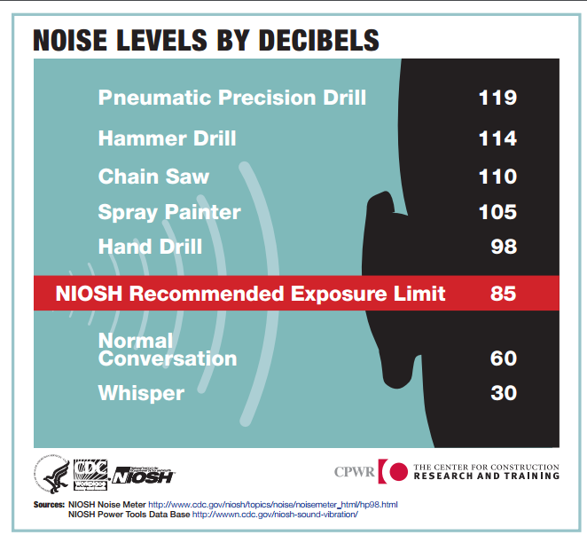
Noise Levels
18
NIOSH Power Tools Database: https://www.cdc.gov/niosh/topics/noise/noise_levels.html
Notes:
This slide shows noise levels for common tools compared to the NIOSH REL, normal conversation, and a whisper.
As you can see, even a hand drill – which can be found on most job sites – produces dangerous noise levels that can damage hearing.
One resource you can use to get a rough idea of the noise produced by a given tool is the NIOSH power tools database. While it does not have every tool, it has enough to give you a good idea of whether or not the one you are using may be putting your hearing at risk. You can find it at: https://www.cdc.gov/niosh/topics/noise/noise_levels.html.

Slide 19
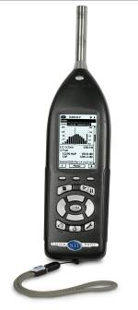
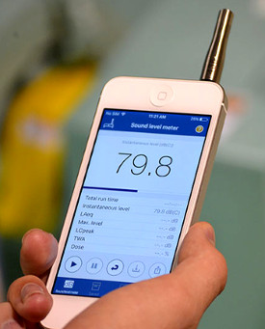
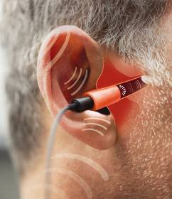
Noise Measurement Devices
PERSONAL DOSIMETER
IN-EAR DOSIMETER
SOUND LEVEL METER
iPhone https://www.cdc.gov/niosh/topics/noise/app.html
Android SoundMeter App
Source: State Building & Construction Trades Council of California, AFL-CIO: Construction Noise & Hearing Loss Prevention training program, Funded by Federal OSHA, 2015 (courtesy of Howard Leight, Honeywell).
Source: State Building & Construction Trades Council of California, AFL-CIO: Construction Noise & Hearing Loss Prevention training program, Funded by Federal OSHA, 2015 (courtesy of Howard Leight, Honeywell).
Notes:
While the simple signs mentioned earlier and the noise levels assigned to specific pieces of equipment may alert you to hazardous noise, the only way to accurately know how much noise you are being exposed to is by monitoring the noise while it’s happening.
If you have a sound meter, personal dosimeter, and/or an in-ear dosimeter show them to the class.
There are different ways to measure noise.
Two commonly used methods to monitor noise levels at the workplace are personal (worker) sampling using a noise dosimeter and area sampling using a sound level meter.
A noise dosimeter is worn by the worker to measure the amount of noise the worker is exposed to during the work shift or sampling period. The dosimeter stays on the worker for a certain sampling period – several hours, or even the entire workday – and continuously monitors the noise. At the end of the sampling period, a read-out shows the average noise level.
The newest method to measure exposure is to directly measure the individual’s protected exposure with “in-ear dosimetry.” Integrated into earplugs or earmuffs, an in-ear dosimetry device measures and records the actual amount of noise the worker is exposed to, with and without hearing protection, over their entire work shift.
A person has to be trained to use both of these methods.
A sound level meter (SLM) is the basic instrument for measuring noise levels. Any worker can use a SLM. Some common uses for sound level meters include to:
Spot check noise levels in the work area
Determine an individual employee's noise levels
Check an individual noise source – such as a piece of equipment or task being performed.

Slide 20
Sound Level Meter Apps
20
NIOSH SLM for iPhones
https://itunes.apple.com/us/app/niosh-slm/id1096545820?mt=8Iphoneapp
Sound Meter for Android https://play.google.com/store/apps/details?id=com.gamebasic.decibel
Notes:
There are also free sound level meter apps you can put on a smart phone. While not as accurate as the equipment we just discussed, these mobile apps are readily accessible and they keep improving.
The new sound level meter app developed by NIOSH for the iPhone is considered very good. In addition to measuring sound levels in the workplace, it includes recommendations to reduce hearing loss. It can be downloaded on any iPhone https://www.cdc.gov/niosh/topics/noise/app.html.
For those with an Android device, NIOSH recommends the SoundMeter App - https://play.google.com/store/apps/details?id=com.gamebasic.decibel.
Apps for Android devices vary in accuracy and generally are not as accurate as the iPhone app because the phone manufacturers vary. As a result, the android apps in particular work better if you install an external microphone on your phone.
If you have an app installed on your phone, show it to the class and demonstrate how it works by measuring the noise in the room.
ASK THE CLASS:
Can you think of some ways that a noise app could be used as part of your training or on the job?
Write their responses on a flip chart or white board – after the class, share the ideas with CPWR’s Training Department so that the ideas can be shared with other trainers and incorporated into future versions of the training program.

Slide 21
Ways To Control Construction Noise
21
Source: NIOSH Workplace Safety & Health Topics, Controls for Noise Exposure
Notes:
So far, we’ve discussed the risk, sources of, and how to measure noise.
Now we’re going to shift to ways to control construction noise.
This slide shows the hierarchy of controls, specific to noise.
The most effective option is to eliminate the noise altogether – this may seem challenging in construction, but research on quieter equipment is moving the industry in that direction. If you can’t eliminate the noise source, then the next best option is to look for ways to reduce the noise levels.

Slide 22
Examples of Engineering and Administrative Controls for Noise
22
Engineering controls
Low noise equipment
Barriers and enclosures
Noise suppression on equipment
Mufflers
Maintain equipment
Belts
Lubrication
Administrative controls
Signs
Designated areas for noisy tasks
Strategic placement of loud equipment
Notes:
Engineering controls are considered the most effective because they get rid of the hazard at the source.
Examples of engineering controls would be low-noise equipment, putting barriers or enclosures around noisy equipment (such as generators), putting noise suppression devices (such as mufflers) on equipment, and making sure equipment is well maintained.
A recent CPWR study on drills found a significant reduction in noise just by replacing a worn drill bit with a new one.
Administrative controls can also help. These are policies and procedures to reduce noise by limiting workers exposure to it. Examples of administrative controls include putting up signs warning workers that noise within a specific area is hazardous, designating specific areas for performing noisy tasks – such as cutting materials with power tools, and placing loud equipment in locations where the fewest number of workers will be exposed.

Slide 23
What Employers Should Do to Protect You
23
Plan: Before the job starts identify noisy tasks and equipment and plan for controlling noise – including buying or renting quieter equipment.
Each day - do a walk-around inspection to make sure the plan is being implemented
Monitor noise levels
Provide different types of hearing protection - one size or style may not fit all workers
Conduct training on each type of hearing protection provided
Notes:
Although it is your hearing that’s at risk, it is the employer’s responsibility to take steps to protect you from exposure to dangerous noise levels.
Here are some steps that an employer can take to reduce their employees’ exposure to dangerous noise levels:
Plan: Before the job starts, identify the noisy tasks and equipment, when and where they will be performed, and the actions that will be taken to reduce noise exposures.
Inspect: Each day, do a walk-around inspection to make sure the plan is being implemented.
Monitor noise levels.
Provide different types of hearing protection - one size or style may not fit all workers.
Conduct training on each type of hearing protection provided.

Slide 24
Types of Hearing Protection
24
Foam (formable) plugs
Reusable earplugs
Custom molded plugs
Banded or semi-aural
Earmuffs
Source: State Building & Construction Trades Council of California, AFL-CIO: Construction Noise & Hearing Loss Prevention training program, Funded by Federal OSHA, 2015 (courtesy of Build It Smart )
Notes:
If you have examples of hearing protection, hold them up as you mention each one.
There are several types of hearing protection:
Foam plugs
Reusable earplugs
Custom molded plugs
Banded or semi-aural
Earmuffs
OSHA requires employers to provide hearing protection at no cost to their employees.

Slide 25
Advantages & Disadvantages of Different Types of Hearing Protection
25
Type | Noise Reduction | Advantages | Disadvantages
Foam Plugs/ Moldable | High | Readily Available | -Hygiene Issues -Take Time to Fit
Reusable (Pre-formed Plugs) | Mid | Quick Fit | -Costly to replace
Banded/ Semi-aural | Low | Quick Fit | -Uncomfortable -If the band is hit it transfers sound to the ear
Earmuffs | High | Quick Fit | -Hot, heavy, cumbersome
Custom | Low to Mid | Quick Fit | -Costly -Replace in 3-5 yrs
Source: State Building & Construction Trades Council of California, AFL-CIO: Construction Noise & Hearing Loss Prevention training program, Funded by Federal OSHA, 2015.
Notes:
Each type of hearing protection has advantages and disadvantages.
Foam plugs and ear muffs provide a high level of protection and tend to be readily available. But they need to be used and maintained properly.

Slide 26
Care and Maintenance
26
Foam roll plugs
dispose of foam roll plugs after each use
Reusable plugs
clean with soap and water, replace when damaged
Custom plugs
wash in mild soapy water
Notes:
The care and maintenance of your hearing protection is critical. OSHA requires employers to make sure hearing protection is provided and properly maintained.
This slide and the next show the basic care that is needed for hearing protection.
Formable foam ear plugs should be replaced after each use.
Reusable plugs should be cleaned with soap and water and replaced when worn or damaged.
Custom plugs should be cleaned with mild soapy water.

Slide 27
Care and Maintenance
27
Banded or semi-aural
Clean and replace pods regularly
Earmuffs
Wipe down with damp cloth, or remove cushions and wash in soapy water
Replace cushions if torn or cracked
Notes:
Banded or semi-aural hearing protection should be cleaned and the pods (the part that goes in your ear) replaced regularly.
Earmuffs should be wiped down with a damp cloth – and if the cushions can be removed, they should be cleaned with soapy water. Cushions that are torn or cracked should be replaced.
Remember, your employer must train you on ways to properly care for this equipment, and the manufacturer will also have instructions for their use.
And ask for new hearing protection if yours is dirty or worn.

Slide 28
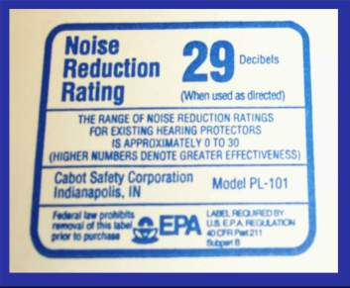
Noise Reduction Rating (NRR)
28
NRR is measured in decibels
The NRR is found on the earmuff or earplug package
The higher the NRR number, the greater the protection
Calculating the level of protection:
(NRR – 7)/2 = NRR reduction
Exposure level – NRR reduction = level of protection
(33-7)/2 = 13 95dBA – 13 = 82 dBA (level of protection)
Source: State Building & Construction Trades Council of California, AFL-CIO: Construction Noise & Hearing Loss Prevention training program, Funded by Federal OSHA, 2015 (courtesy of WISHA)
Notes:
Now that you know they need to be maintained, how do you select the right hearing protection for the noise you are being exposed to?
Hearing protection devices are tested in a laboratory to determine how much noise they block from reaching your ears. This is called the Noise Reduction Rating or NRR. The EPA requires manufacturers to list the NRR on the hearing protection device’s package.
The higher the NRR, the greater the protection, however, since lab conditions are not the same as workplace conditions, the actual noise reduction is at least 7 dBA less than the printed NRR. So if, for example, you select hearing protection with a NRR of 29, you should plan for noise reduction of 22.
Here’s one way to figure out how much your hearing protection is reducing your exposure. If your hearing protection’s NRR is 33, for example. You would subtract 7 from 33 and divide the results by 2 – so 33 minus 7 equals 26. 26 divided by 2 equals 13. Subtracting that number from your noise exposure of 95 dBA will let you know that your exposure with this hearing protection is 82 – below the NIOSH REL and the OSHA PEL.
If you do not have the hearing protection device’s packaging, ask your supervisor or employer for the NRR. Another option is to go online. You can look up the NRR on the manufacturer’s site with the name of the device.

Slide 29
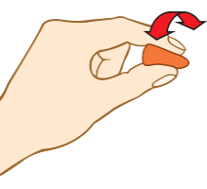
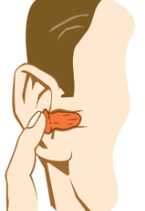
Fitting An Ear Plug
29
1. Roll entire earplug into a crease-free cylinder
2. Pull Back ear by reaching over head with free hand, gently pull top of ear up and out
3. Insert earplug well into ear canal and hold until it fully expands
Source: State Building & Construction Trades Council of California, AFL-CIO: Construction Noise & Hearing Loss Prevention training program, Funded by Federal OSHA, 2015 (courtesy of Howard Leight, Honeywell )
Notes:
Pass out a set of foam ear plugs to each class participant and tell them to follow your instructions.
Now let’s try to insert ear plugs correctly. I’ll walk you through the steps so we’re all doing it together.
First roll foam plug tightly. Make sure there are no creases.
Next, pull your ear back gently at the top to straighten the ear canal.
Insert the plug.
Release your ear while holding the plug for 20-30 seconds. It will expand to the shape of your ear canal.
When plug has expanded, tug on it gently to see if it is secure.
Now let’s do our other ear. Remember:
First roll foam plug tightly. Make sure there are no creases.
Next, pull your ear back gently at the top to straighten the ear canal.
Insert the plug.
Release your ear while holding the plug for 20-30 seconds. It will expand to the shape of your ear canal.
When plug has expanded, tug on it gently to see if it is secure.
Check the fit when you're all done. Cup your hands firmly over your ears and release.
TELL THE CLASS:
You can take them out now.
When you did that last step, the earplugs should have been blocking enough noise so that covering your ears with your hands resulted in no significant change in noise level.
Don’t hesitate to ask me or another instructor how to insert them properly – I guarantee you – we didn’t all do it right the first time.
Give all participants a copy of handout “Steps for Inserting Ear Plugs.”
This handout includes the steps for proper use of ear plugs and the link to the video we watched. I’d encourage you to retry inserting the ear plugs until you’re comfortable that you understand how to do it properly.

Slide 30
What we covered
The Risk for Hearing Loss
How to Identify Noise Sources
Measuring Noise
Ways to Control Noise
Hearing Protection Devices
Real Life Lessons
Notes:
Just to recap – today we covered the risk for hearing loss, sources of noise, how to measure noise levels and control exposures, hearing protection devices, and real life lessons.
If you decide to use any of the optional handouts, distribute them now and tell the class to use them as reminders of what they learned: “The pros and cons of different types of hearing protection;” “When to use hearing protection;” and the “Noise and Hearing Loss Hazard Alert Card.”
Does anyone have any final questions or comments?

Slide 31
Acknowledgments
State Building and Construction Trades Council of California
Dr. Robert M. Ghent and Brad K. Witt of Honeywell Safety Products, San Diego, CA.
©2017, CPWR-The Center for Construction Research and Training. All rights reserved. CPWR is the research and training arm of NABTU. Production of this document was supported by cooperative agreement OH009762 from the National Institute for Occupational Safety and Health (NIOSH). The contents are solely the responsibility of the authors and do not necessarily represent the official views of NIOSH.
Notes:
Instructor Note – bring this slide up and leave on the screen for a few minutes.
Before we close, I just want to note that many of the materials for this module were adapted from a training program produced by the State Building and Construction Trades Council of California (under an OSHA Susan Harwood Grant -SH-26283-SH4) and used with their permission.
The “Are You Talking To Me?” audio tapes and exercise were developed by and used with the permission of: Dr. Robert M. Ghent and Brad K. Witt of Honeywell Safety Products, San Diego, CA.

