Slide 1
How Loud is TOO Loud?
Construction Noise & Hearing Loss Prevention
Exercise A-5
Notes:
INSTRUCTOR NOTES: NOISE TRAINING REFRESHER EXERCISES FOR USE AS PART OF OSHA 10- AND 30-HOUR MODULES (SUCH AS TRAINING ON PPE, USE OF POWER TOOLS, ETC.): Exercise A-5
All equipment options do not have to be discussed. You may select the equipment slides that are most suitable for your class. Options include belt sander, hand drill, impact wrench, bull dozer, spray painter, and a jack hammer.
The equipment is followed by 2 slides showing examples of hearing protection and their Noise Reduction Rates (NRR).
Much of the equipment used on job sites generate loud noises. How loud is too loud? And how do we know? For this activity we are going to quickly look at some common types of construction equipment, their noise levels, and then review different types of hearing protection.

Slide 2
Normal Conversation
Source: NIOSH, Division of Applied Research and Technology
Notes:
Before looking at construction equipment let’s look at the level of decibels for a normal conversation. A normal conversation is about 60 decibels.
Keep in mind that the National Institute for Occupational Safety and Health (NIOSH) has a recommended exposure level – referred to as the REL of 85 decibels, and OSHA has a permissible exposure level or PEL of 90 decibels.
INSTRUCTOR NOTE:
For slides 3 to 8, you may use all of the slides or select those that are most applicable to your class participants.

Slide 3
Belt Sander
Source: NIOSH, Division of Applied Research and Technology
Notes:
Show only the title of the slide.
ASK THE CLASS:
On a scale of 50 to 150 decibels, how loud do you think a belt sander might be?
Give the class a few minutes to respond
Click again to show the full slide.
TELL THE CLASS:
As you can see, the belt sander is 3 decibels over OSHA PEL and 8 over NIOSH’s REL.
Then remind them (you only have to remind them once during this activity)
While it is helpful to know the average noise of equipment we use – what is a quick way we can know if the noise we are around is too loud? A rule of thumb to remember is if you must shout to be heard by someone standing an arm’s length away from you – the noise is too loud and you need protection.

Slide 4
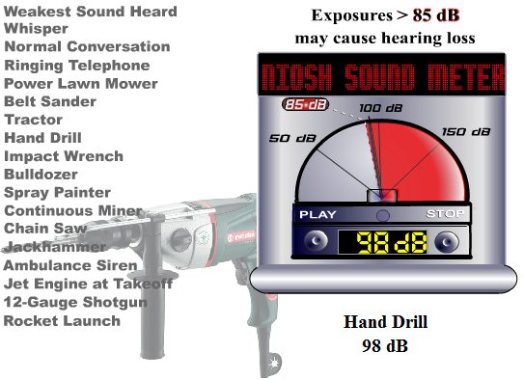
Hand Drill
Source: NIOSH, Division of Applied Research and Technology
Notes:
Show only the title of the slide.
ASK THE CLASS:
On a scale of 50 to 150 decibels, how loud do you think a hand drill might be?
Give the class a few minutes to respond
Click again to show the full slide.
TELL THE CLASS:
As you can see, the hand drill is 8 decibels over OSHA PEL and 13 over NIOSH’s REL.
Then remind them (you only have to remind them once during this activity)
While it is helpful to know the average noise of equipment we use – what is a quick way we can know if the noise we are around is too loud? A rule of thumb to remember is if you must shout to be heard by someone standing an arm’s length away from you – the noise is too loud and you need protection.

Slide 5
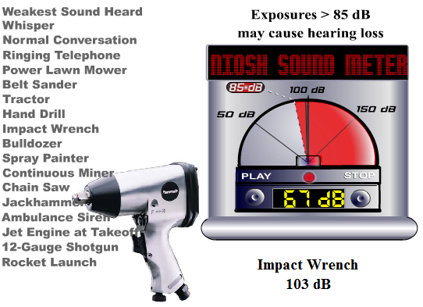
Impact Wrench
Source: NIOSH, Division of Applied Research and Technology
Notes:
Show only the title of the slide.
ASK THE CLASS:
On a scale of 50 to 150 decibels, how loud do you think an impact wrench might be?
Give the class a few minutes to respond
Click again to show the full slide.
TELL THE CLASS:
As you can see, the impact wrench is 13 decibels over OSHA PEL and 18 over NIOSH’s REL.
Then remind them (you only have to remind them once during this activity)
While it is helpful to know the average noise of equipment we use – what is a quick way we can know if the noise we are around is too loud? A rule of thumb to remember is if you must shout to be heard by someone standing an arm’s length away from you – the noise is too loud and you need protection.

Slide 6
Bulldozer
Source: NIOSH, Division of Applied Research and Technology
Notes:
Show only the title of the slide.
ASK THE CLASS:
On a scale of 50 to 150 decibels, how loud do you think a bulldozer might be?
Give the class a few minutes to respond
Click again to show the full slide.
TELL THE CLASS:
As you can see, the bulldozer is 15 decibels over OSHA PEL and 20 over NIOSH’s REL.
Then remind them (you only have to remind them once during this activity)
While it is helpful to know the average noise of equipment we use – what is a quick way we can know if the noise we are around is too loud? A rule of thumb to remember is if you must shout to be heard by someone standing an arm’s length away from you – the noise is too loud and you need protection.

Slide 7
Spray Painter
Source: NIOSH, Division of Applied Research and Technology
Notes:
Show only the title of the slide.
ASK THE CLASS:
On a scale of 50 to 150 decibels, how loud do you think a spray painter might be?
Give the class a few minutes to respond
Click again to show the full slide.
TELL THE CLASS:
As you can see, the spray painter is 15 decibels over OSHA PEL and 20 over NIOSH’s REL.
Then remind them (you only have to remind them once during this activity)
While it is helpful to know the average noise of equipment we use – what is a quick way we can know if the noise we are around is too loud? A rule of thumb to remember is if you must shout to be heard by someone standing an arm’s length away from you – the noise is too loud and you need protection.

Slide 8
Jack Hammer
Source: NIOSH, Division of Applied Research and Technology
Notes:
Show only the title of the slide.
ASK THE CLASS:
On a scale of 50 to 150 decibels, how loud do you think a jackhammer might be?
Give the class a few minutes to respond
Click again to show the full slide.
TELL THE CLASS:
As you can see, the jackhammer is 20 decibels over OSHA PEL and 25 over NIOSH’s REL.
Then remind them (you only have to remind them once during this activity)
While it is helpful to know the average noise of equipment we use – what is a quick way we can know if the noise we are around is too loud? A rule of thumb to remember is if you must shout to be heard by someone standing an arm’s length away from you – the noise is too loud and you need protection.

Slide 9
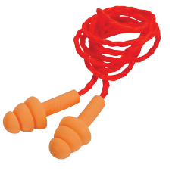
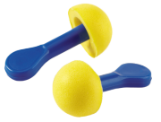
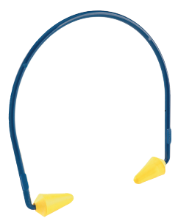
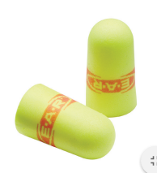
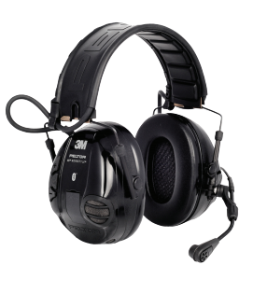
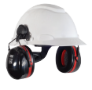
Examples of Hearing Protection: 20 + dB
Ultrafit Silicone
NRR: 24
E-A-Rsoft Superfit
NRR: 33
E-A-R Express Plug Pod
NRR: 25
E-A-R Caboflex
NRR: 17-20
PELTOR WS 100 Headset
NRR: 20
CALCULATING THE LEVEL OF PROTECTION:
(NRR – 7) = NRR reduction
2
Exposure level – NRR reduction = level of
protection
(33-7) = 13
2
95dBA – 13 = 82 dBA (level of protection)
PELTOR Optime 105
NRR: 27
Photos from 3M Hearing Solutions Catalog 2015
Notes:
This slide shows examples of hearing protection with a Noise Reduction Rate of 20 or higher.
Now that you know how loud some construction equipment is, how do you select the right hearing protection for the noise you are being exposed to?
TELL THE CLASS:
Here are some examples of hearing protection. It’s important to keep in mind that there are different levels of hearing protection within one type. For example – some ear plugs protect around 15 decibels, while others protect against 33 decibels.
It is also important to pay attention to the Nose Reduction Rating, also referred to as the NRR, of the hearing protection and how much noise needs to be reduced in order to protect you hearing. Hearing protection devices are tested in a laboratory to determine how much noise they block from reaching your ears. The EPA requires manufacturers to list the NRR on the hearing protection device’s package.
The higher the NNR, the greater the protection, however, since lab conditions are not the same as workplace conditions, the actual noise reduction is at least 7 dBA less than the printed NRR. So if, for example, you select hearing protection with a NRR of 29, you should plan for noise reduction of 22.
Here’s one way to figure out how much your hearing protection is reducing your exposure. If your hearing protection’s NNR is 33, for example. You would subtract 7 from 33 and divide the results by 2 – so 33 minus 7 equals 26. 26 divided by 2 equals 13. Subtracting that number from your noise exposure of 95 dBA will let you know that your exposure with this hearing protection is 82 – below the NIOSH REL and the OSHA PEL.

Slide 10
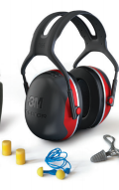
Doubling Up “Dual Protection”
Ear plug
NRR: 33
Ear muff
NRR: 26
Muffs + Earplugs
Estimated NRR: 38
RULE OF THUMB: To calculate NRR add 5 to the highest rated protection worn
Reduces an exposure of 105 dBA to 90 dBA
Source: Hear Forever, A Howard Leight by Honeywell Initiative.
Photos from 3M Hearing Solutions Catalog 2015
Notes:
What do you do when the noise on the job site is too loud and ear plugs or ear muffs are not enough to protect your ears?
Isolating the noise sources, using low noise equipment, limiting access to noisy areas to those workers essential for completing the work, and other engineering or administrative controls are always recommended. However, sometimes the noise levels are so high that you may need to wear both ear plugs and ear muffs. This is known as dual protection. The Mine Safety and Health Administration (MSHA) recommends that workers wear dual protection when exposed to noises over 105 decibels over an 8 hour time weighted average (TWA).
While dual protection provides more protection than using just one or the other, the level of protection is not equal to the sum of the NRR provided by the each. As a rule of thumb, you can estimate level of protection from wearing dual protection by adding 5 to the highest reported NRR that you are wearing. For example, if you use ear plugs with an NRR of 33 decibels with an ear muff with an NRR of 26 decibels the estimated NRR would be 38 -- not 59 decibels (33 plus 26). When adjusted for the realities of the jobsite, this dual protection would reduce an exposure of 105 decibels to roughly 90 decibels.
TELL THE CLASS:
Remember, for maximum protection, hearing protection must be worn correctly and consistently. Always take time to insert your ear plugs correctly, check for defects, and wear protection whenever you are working around noise. If you must shout to be heard by someone standing an arm’s length away from you – the noise is too loud and you need protection.
INSTRUCTOR NOTE:
There is not a set formula for how much wearing both ear plugs and muffs protect against noise. However, a rule of thumb is to add the 5 decibels to the higher NRR protection.

