Slide 1
Fall Protection in Residential Construction: Foremen’s Training
Washington University School of Medicine & Carpenters’ District Council
John Mormann
Lynda Drendell-Mueller
Vicki Kaskutas
Notes:
Vicki to do first 3 slides

Slide 2
What are your concerns about:
Working at heights?
Preventing falls?
What specific situations place your workers at high risk of falls?

Slide 3
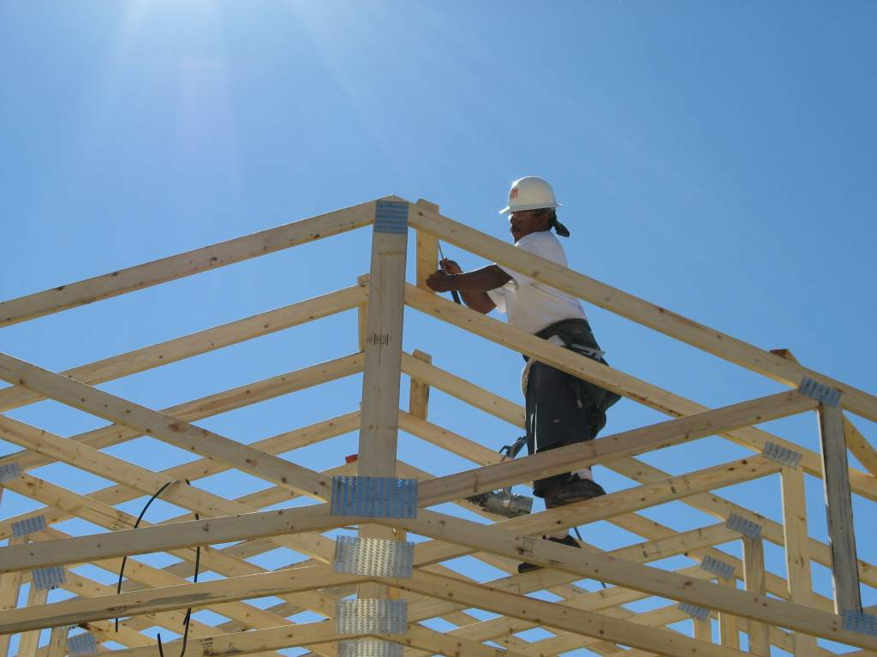
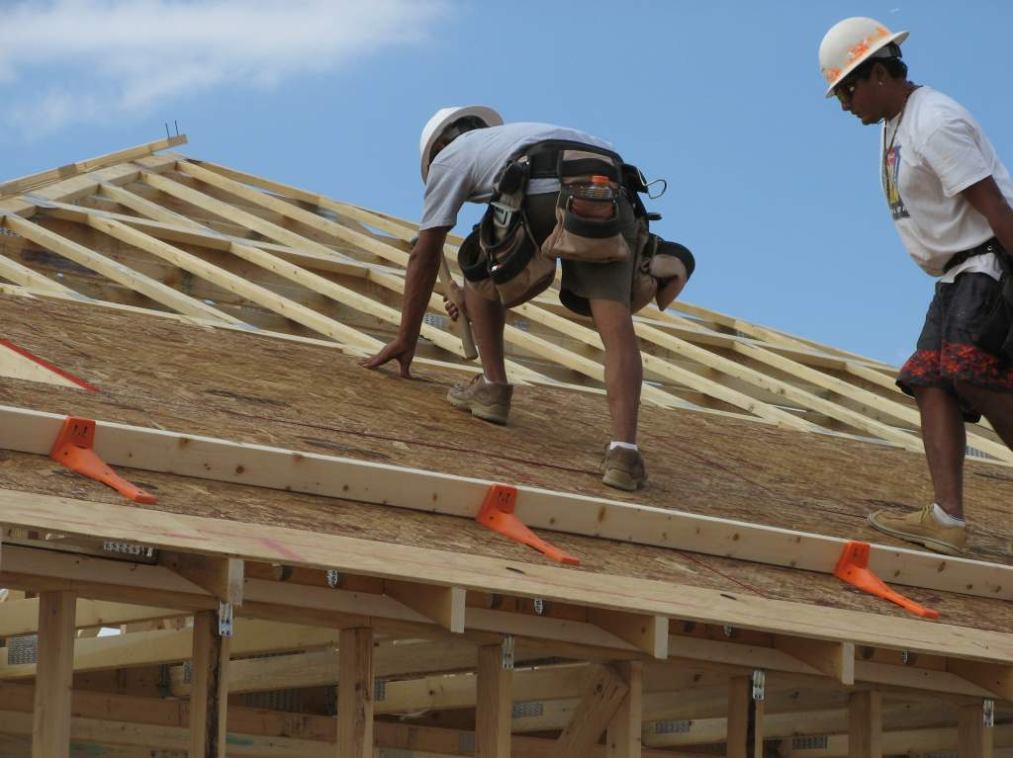
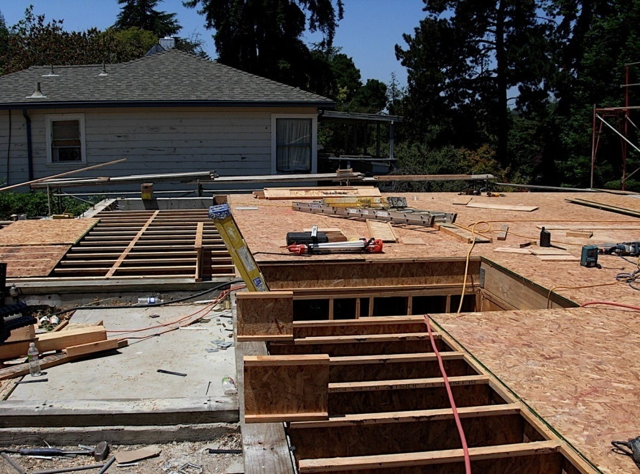
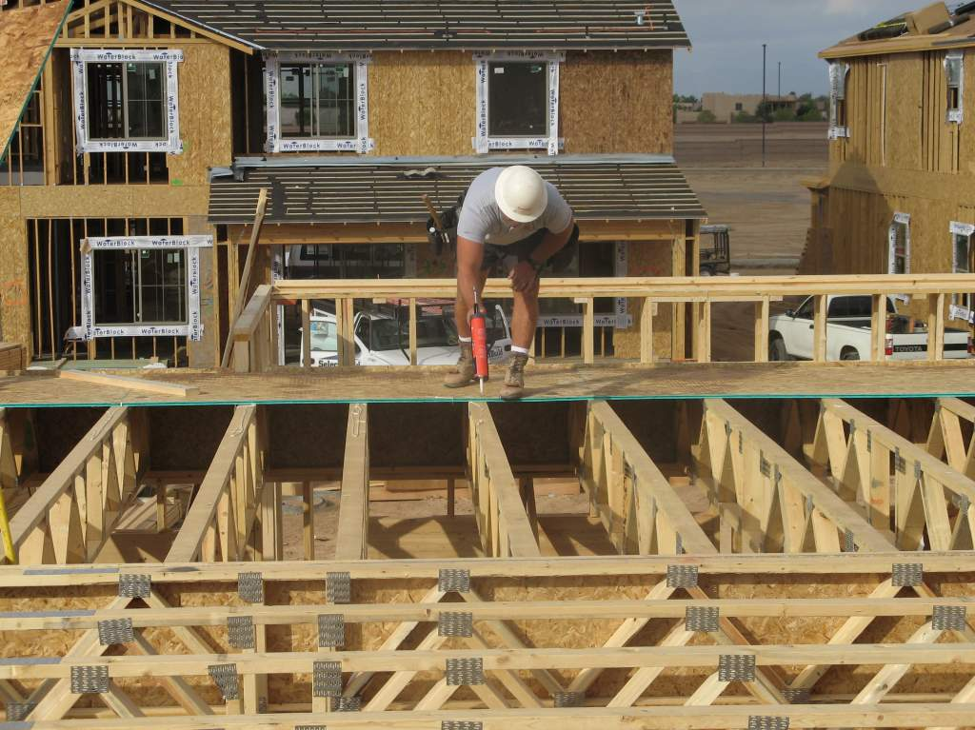
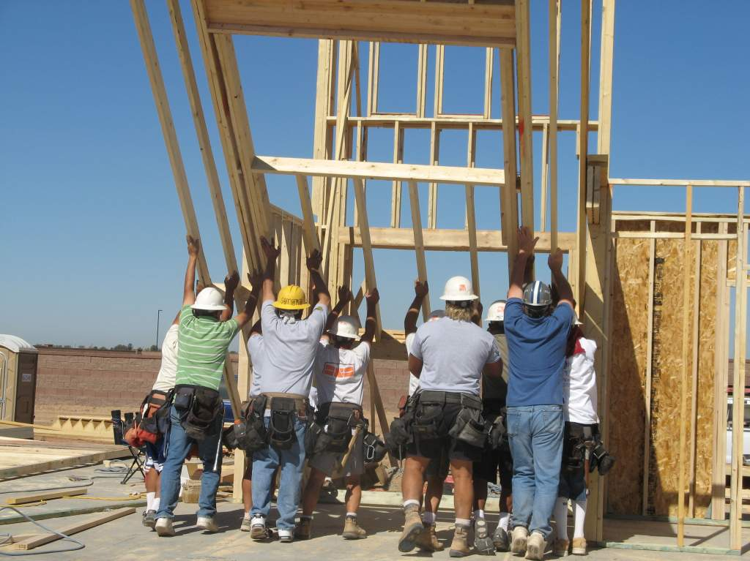
Fall Prevention Training Priorities
Truss setting
Roof sheathing
Setting floor joists
Leading edge & openings
Notes:
Looking for specific situations that are in our priority areas, Write on board if possible

Slide 4
Why Is Fall Protection (FP) Important?
Falls are #1 cause of residential construction deaths
49% - all construction, 64% - residential, 100% - framers
42% (159) of fatalities in OSHA Region VII (KS, MO, NE) from 1995 to 2010 were due to falls

Slide 5
Despite Residential Guidelines, fall protection was top OSHA violation
Fall Protection- Unprotected sides & edges
Fall protection – Residential construction 6’ or more
Head protection
Scaffolds - Fall protection
Scaffolds - Access
Standard & Subpart - 1926
Aerial lifts – Body belt & lanyard
Excavations - Protection of employees
-
-
Scaffolds - Platform construction
Fall hazards training program
Portable ladders 3 feet above landing surface

Slide 6
Local Fall Protection Violations
2/20/11: 6 serious and 5repeat safety violations for exposing workers to fall and other hazards, proposed penalties totaling $68,720.
2/17/11: 9 safety violations for repeatedly exposing workers to fall hazards during roofing operations, proposed penalties total $56,210.
8/17/11: 13 serious and 1 repeat fall protection violation while employees were performing work from ladders, scaffolding and rooftops up to 20 feet high, no fall protection when working on rooftops and in front of wall openings, failing to have a qualified, competent person conduct frequent and regular inspections, proposed penalties total $58,100.
7/14/10: 2 serious and 5 repeat safety violations for repeatedly exposing workers to fall hazards while working on scaffolding, misuse of portable ladders, lack of worksite inspections, unsafe scaffold access, lack of fall protection on a scaffold and a lack of or deficient scaffold training, proposed penalties total $221,600.
6/7/11: 7 violations for fall protection, residential union contractor, proposed penalties $29,000.

Slide 7
Courts are getting involved 5/24/11
The roofing contractor was sentenced to 1 year in San Francisco County Jail for involuntary manslaughter and other charges stemming from the 2008 death of a roofer working without protection when he fell from a 4-story apartment. Antonio Martinez, a 39-year-old roofer, plunged 38 feet to the sidewalk while working on a roof. Martinez was not wearing a harness, there was no supervision of his work along the roof edge, and there were no railings, scaffolds or other barriers to prevent a fall 38’ to the sidewalk.
The crew foreman will serve at least 6 months of a 1-year jail term for his role in the death. The prosecutor stated, "It's a year straight time in County Jail…this defendant is not eligible for home detention; he is not eligible for early release."

Slide 8
Recent Changes in Standards
Rescinded Fall Protection Guidelines for Residential Construction & all letters of reference to it
As of 6-16-11, must follow the 29 CFR 1926.501(b)
  Workers “engaged in residential construction activities 6 feet or more above lower levels shall be protected by guardrails, safety nets, or personal fall arrest systems”
  If can prove infeasible need site-specific fall protect plan
Fall Protection Guidance Document & presentation
  Shows equipment they believe is feasible for activities
  Highlights specific methods
Recent extended transition phase until 9-15-12
  Compliance assistance
  Inspection penalty reduction

Slide 9
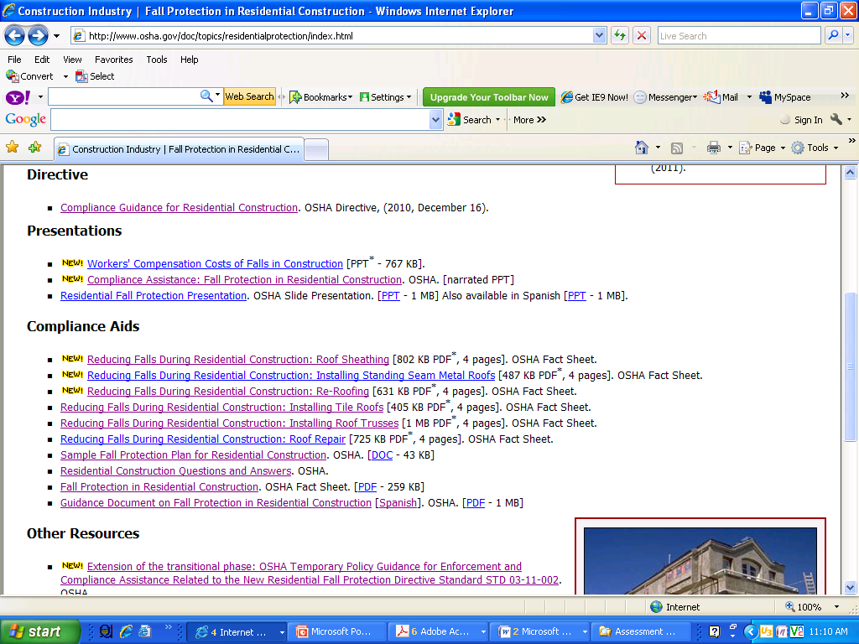
OSHA Resources

Slide 10
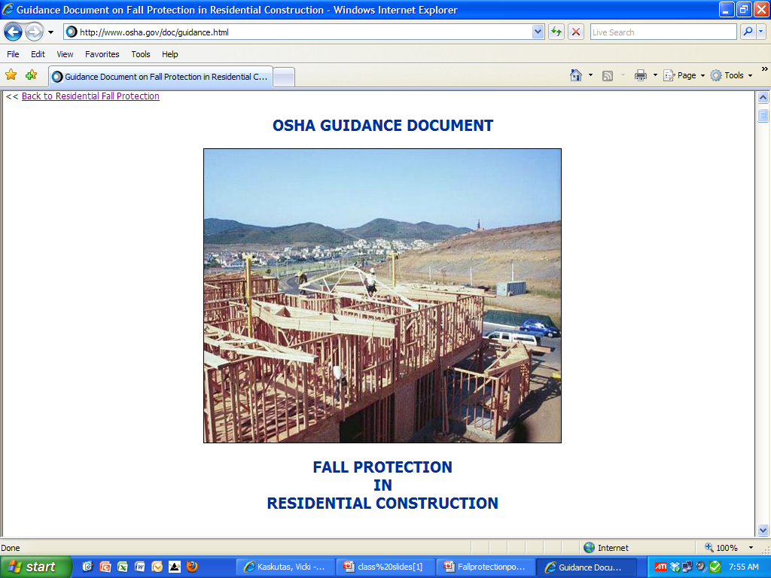

Slide 11
When is Fall Protection Required?
Walking surfaces 6’ from the lower level
  Floor openings
  Wall openings if lower than 39“ from floor
  Ground/foundation work if 6’ fall possible
  Wall erection if 6’ from lower level
  Setting floor joists if 6’ from lower level
  Truss installation
Scaffolds 10’ from the lower level
Not required on ladders, although rules apply

Slide 12
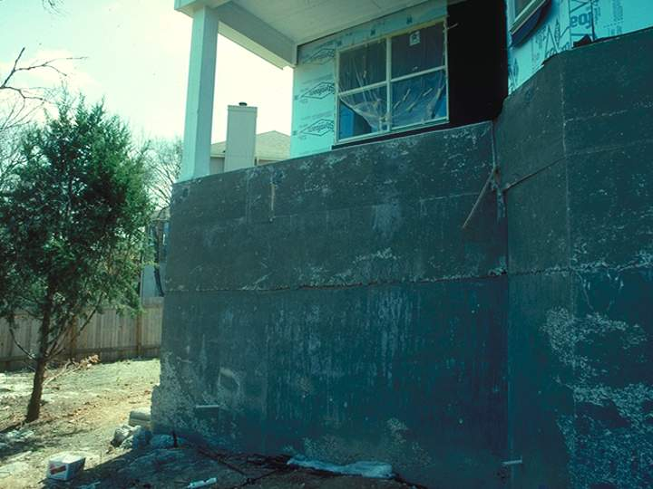
Greater Than 6’ Fall

Slide 13
Conventional Fall Protection Methods
Guardrails
Personal fall arrest systems
Safety nets
Conventional FP required unless infeasible or more dangerous
  Expense or time is not a reason for infeasibility

Slide 14
Alternative FP Methods?
Must prove that conventional methods are infeasible for specific operation at specific work site
Describe specific alternative method to be used, what to be used for, when, and by who (specific names)
Workers using alternative methods must be trained in alternative method and training must be documented
Only trained workers using alternative methods can be in the area of the fall exposure
Must document all of this in a site-specific FP plan
All workers on work site must know the plan
Plan must be at the worksite at all times
Alternative methods place workers at greater risk so OSHA will be critically evaluating all alternatives
Notes:
Here are some of the other fall protection measures allowed under 1926.501(b) for particular types of work. (pause)

Slide 15
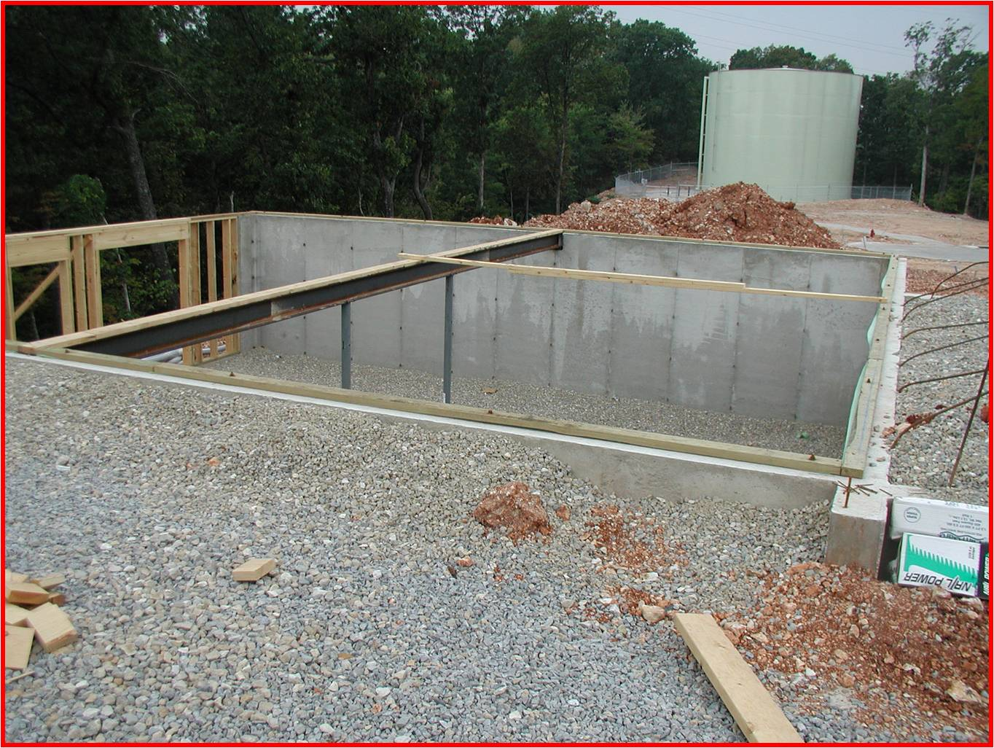
How do you currently lay out & set floor joists if over 6’ from lower level?

Slide 16
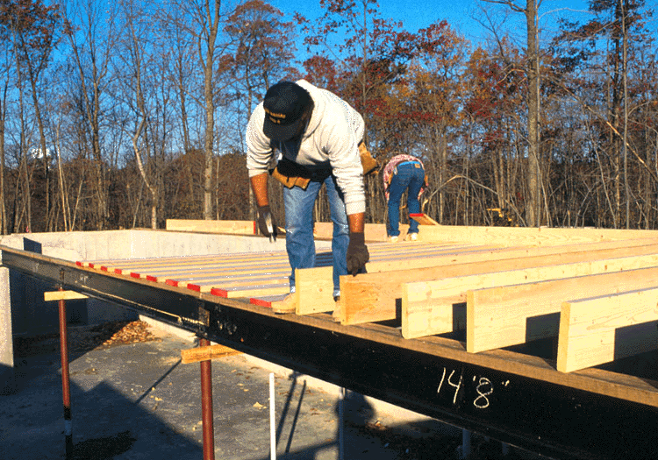
Setting floor joists – what is not allowed if over 6’ from lower level
Cannot stand on foundation wall, steel beam, or unstabilized joist if >6’ from lower level

Slide 17
Setting floor joists – what is not allowed if over 6’ from lower level
If basement, cannot set joists from ground if foundation wall is <39” without fall protection

Slide 18
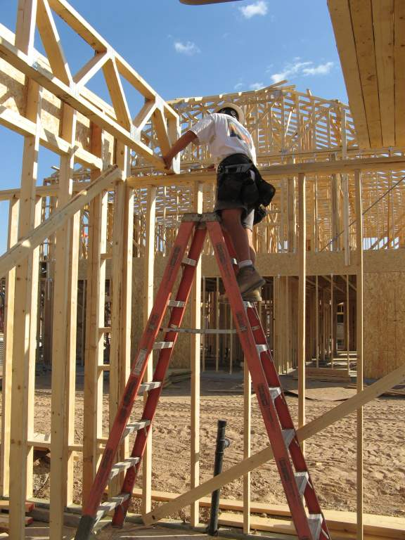
Setting floor joists – step & extension ladders
Must follow ladder standards

Slide 19
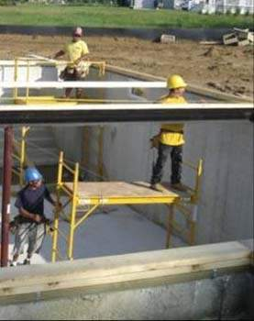
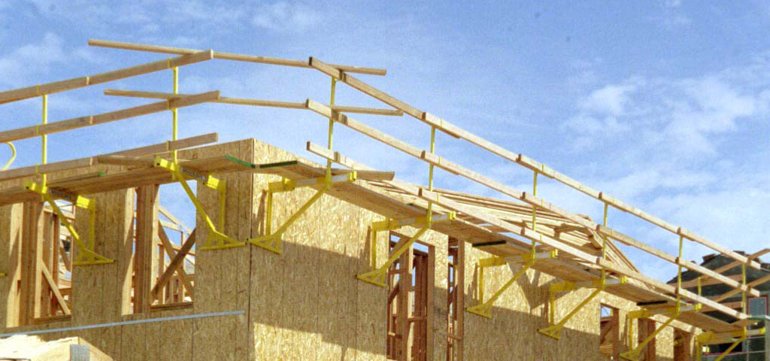
Setting floor joist – baker, platform & hanging scaffold
Must follow scaffold standards

Slide 20
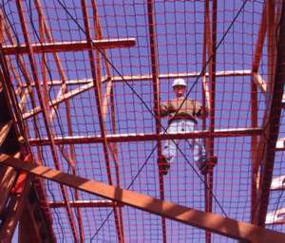
Setting floor joists – safety nets
Must follow safety net standards

Slide 21
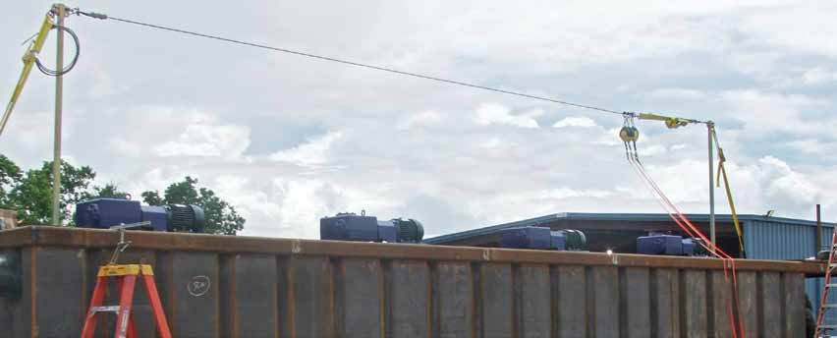
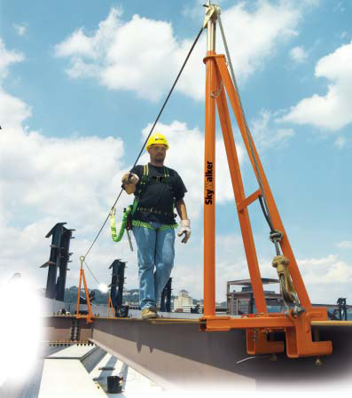
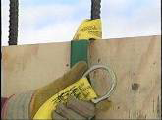
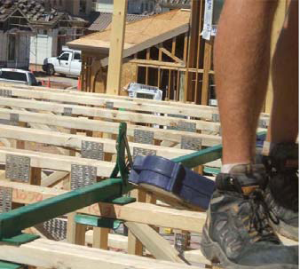
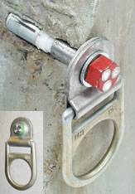
Setting floor joists – PFAS
Must follow PFAS standards

Slide 22
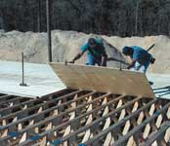
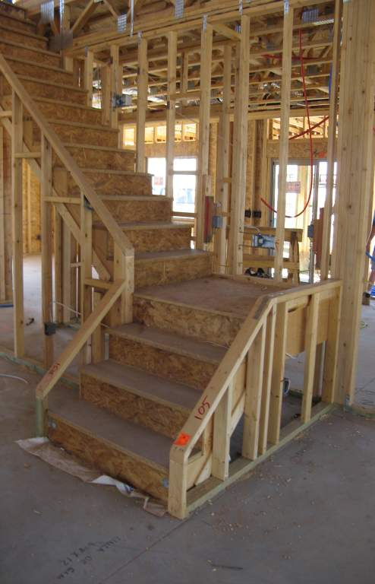
How do you currently working at floor openings/leading edges?

Slide 23
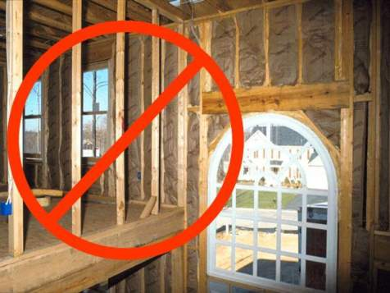
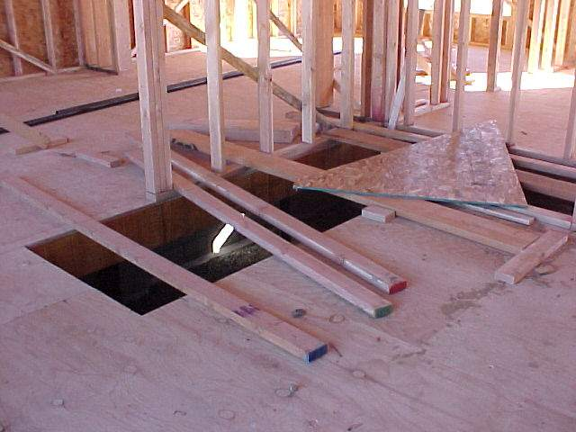
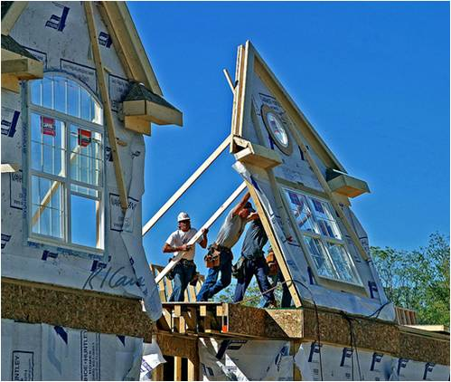
Work at openings/edges – what’s not allowed
Painted line ONLY

Slide 24
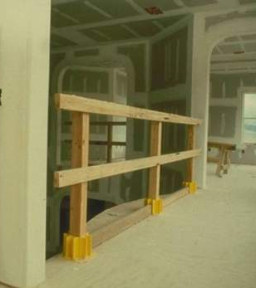
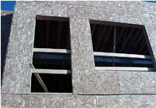
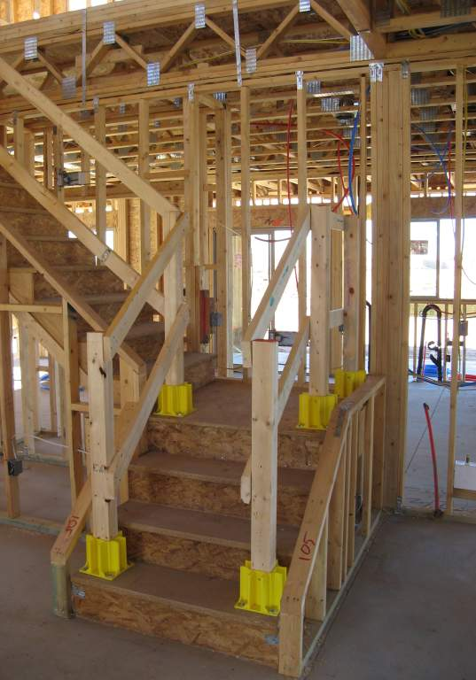
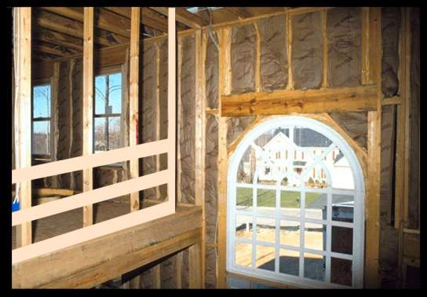
Working at openings/leading edges – guardrails

Slide 25
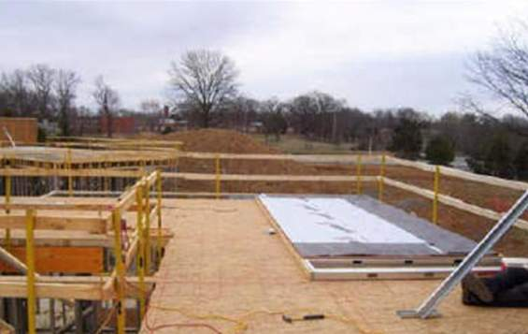
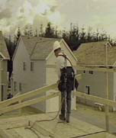
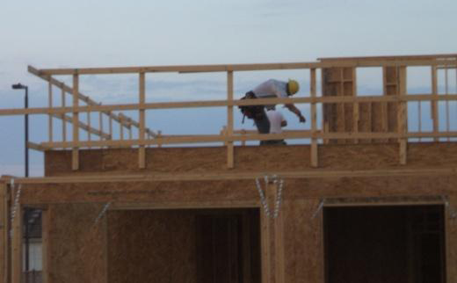
Working at openings/leading edges – guardrails

Slide 26
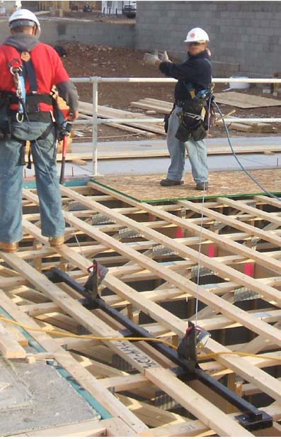
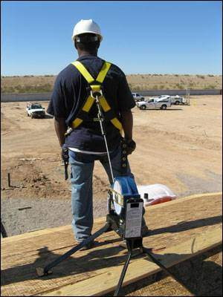
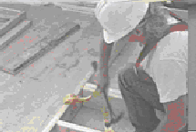
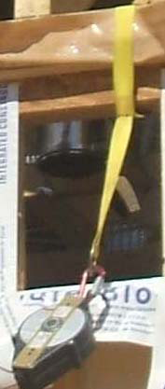
Working at openings/leading edges – PFAS
Water anchor on ground

Slide 27
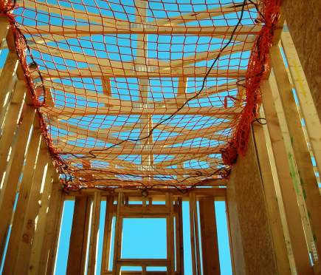
Working at openings/leading edges – safety nets

Slide 28
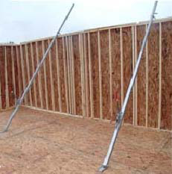
Working at openings/leading edges – wall jack?
Alternatives exist
Would have to build wall in center of home and have workers restrained from reaching edge
Approval is up to the OSHA inspector
Remember need detailed FP plan!

Slide 29
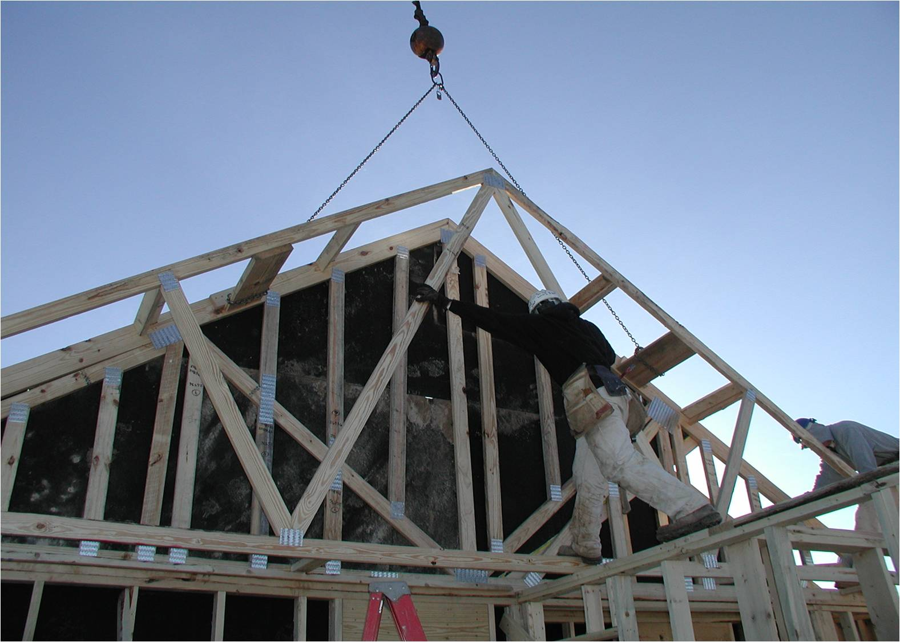
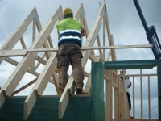
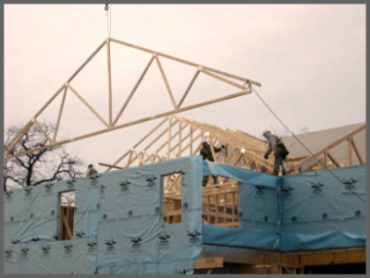
How do you currently lay out & set roof trusses?

Slide 30
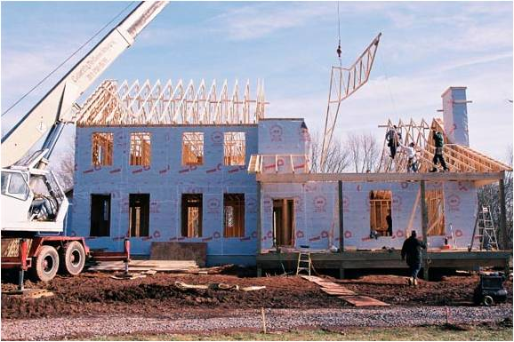
What is not allowed during truss installation?

Slide 31
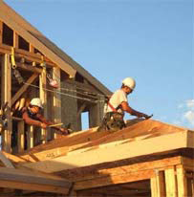
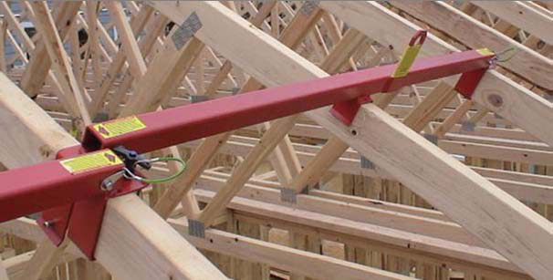
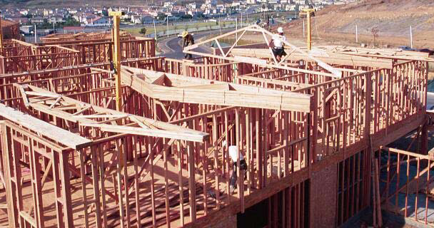
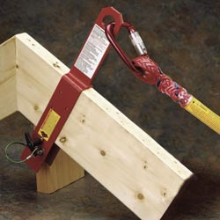
Roof truss installation – PFAS

Slide 32
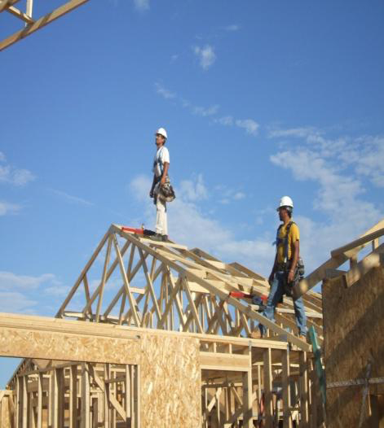
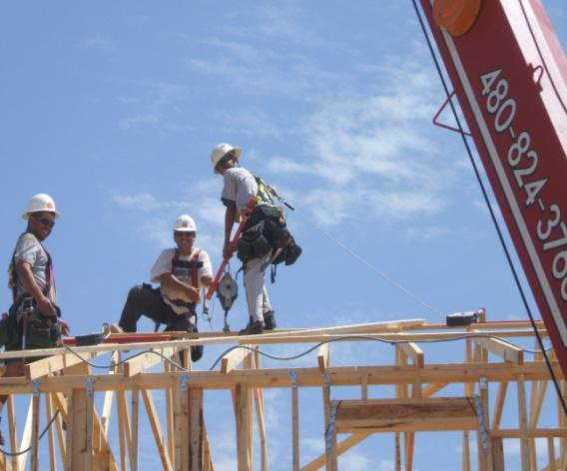
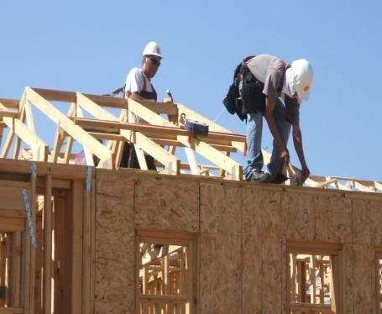
Roof truss installation – PFAS

Slide 33
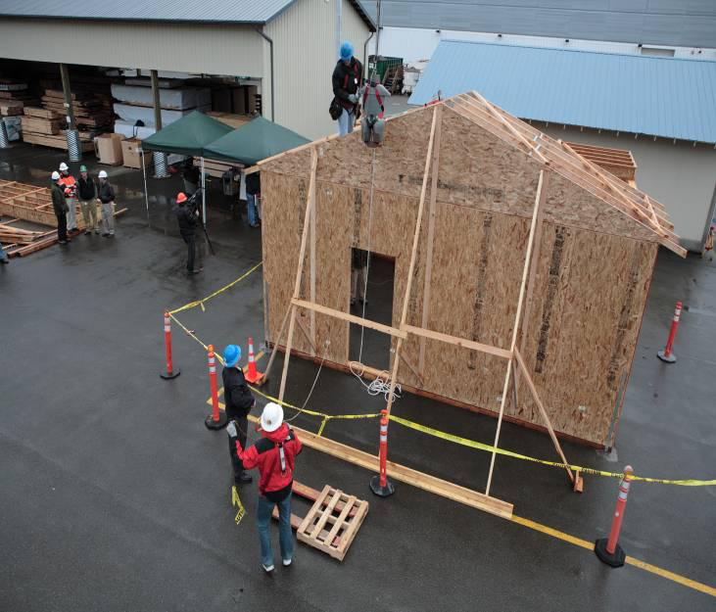
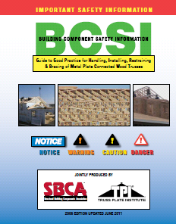

Trusses must be secure to anchor PFAS
Drop testing proved if man anchored to truss stabilized per BCSI temporary bracing guidelines, it will withstand the forces from the fall
If not…

Slide 34




Slide 35

Roof truss installation – ladders

Slide 36




Roof truss installation – scaffolds

Slide 37



Roof truss installation – pre-build on ground

Slide 38

Roof truss installation – pre-build on ground

Slide 39

Roof truss installation – other?
Ridge seat
– Still need PFAS
Board to stand on
  Still needs FP as working surface >6’ from lower level

Slide 40
How are you currently sheathing roofs?

Slide 41
Sheathing roof items – worksite audit
Conventional fall protection used – /1 (PFAS)
Didn’t see bottom row of sheathing installed to know if use ladder or scaffold – do you?
Slide guards were also used correctly – /1
  Used to protect workers from falling objects
  Additional means of fall protection
  Worker comfort

Slide 42
What is not allowed during roof sheathing?
Slide guards without PFAS
Risky edges:
Fall off house
Fall into house

Slide 43
Roof sheathing methods
Ladders to install bottom row
Scaffolds to install bottom row
Guardrails
  Installed on the roof after truss erection
  Built around the roof prior to or after truss setting
PFAS
Slide guards are NOT acceptable method of fall protection, can use for workers’ comfort

Slide 44



Roof sheathing - guardrails
Notes:
Protects from fall off side and bottom edge of roof, but not fall into the structure. Need PFAS also. Question what good these are for sheathing?

Slide 45

Roof sheathing – safety nets

Slide 46


Roof sheathing – PFAS

Slide 47

Roof Sheathing – Scaffolds
Serve as work surface & guard rails
Wall walker Power pole

Slide 48
Roof sheathing – combined methods
Guardrails only protect bottom edge, and side if in place. What protects top edge?

Slide 49
Guardrails
Floor openings > 6’ from lower level
  42” top rail height (39” – 45”)
  200 lbs strength requirement
  Mid-rail
  No lacerations
Wall openings < 39” tall that are > 6’ from lower level
  42” top
  200 lbs strength requirement
New applications for guardrails
  Roof sheathing
  Prior to exterior wall erection
Notes:
WHERE AND WHEN DO YOU USE GUARD RAILS ON YOUR JOBS????? LOOKING FOR STAIR HOLES, BALCONIES, WINDOW OPENINGS, ETC.

Slide 50
Safety net items – worksite audit
Used at worksite –
Nets are installed as close as possible under walking/working surface with sufficient clearance to prevent worker from hitting lower level –

Slide 51
Safety Nets
Installed as close as possible to work surface
30 foot maximum width
6” X 6” maximum net hole opening size
Inspected each shift
Notes:
WHERE DO YOU USE SAFETY NETS???? These are not common, WHY???

Slide 52
Personal Fall Arrest Systems
Keeps worker from hitting lower level after fall
  Body harness that distributes fall arrest forces to the thighs, pelvis. waist, chest and shoulders
  Secure anchorage point independent of means supporting worker; used to attach lanyard
  6 foot free fall
  Must be able to withstand 5,000 pounds of force
  Locking snap hooks
  No body belts for PFAS
Notes:
WHEN DO YOU TIE OFF??? ROOFS, PICK BOARDS, SUB FLOORS????

Slide 53
Anchorage Requirements for PFAS
All components of a PFAS do not have to support 5000 pounds.
Anchorages used for attachment of PFAS shall be independent of any anchorage being used to support or suspend platforms and capable of supporting at least 5,000 # per employee attached, or shall be designed, installed, and used as follows:

Slide 54
Anchorage Requirements for PFAS
As part of a complete PFAS which maintains a safety factor of at least 2; & under the supervision of a qualified person.
PFAS, when stopping a fall, shall:
  Limit maximum arresting force to 1800# when used with body harness
  Be rigged such that an employee can neither free fall more than 6 feet, nor contact any lower level
  Bring an employee to a complete stop and limit maximum deceleration distance an employee travels to 3.5 feet
  Have sufficient strength to withstand twice the potential impact energy of an employee free falling a distance of 6 feet ,or the free fall distance permitted by the system, whichever is less.

Slide 55
If the personal fall arrest system meets the criteria and protocols contained in Appendix C to subpart M, and if the system is being used by an employee having a combined person and tool weight of less than 310 pounds (140 kg), the system will be considered to be in compliance with the provisions of paragraph (d)(16) of this section.

Slide 56

PFAS – Components
4. Shock Absorbing Lanyard
2. Life Line
5. Full Body Harness
1. Anchor Point
3. Rope Grab

Slide 57





PFAS – anchor for truss
Notes:
WHEN DO YOU TIE OFF??? ROOFS, PICK BOARDS, SUB FLOORS????

Slide 58




PFAS – these type of anchors must be installed thru sheathing and truss
Notes:
WHEN DO YOU TIE OFF??? ROOFS, PICK BOARDS, SUB FLOORS????

Slide 59

PFAS – Anchor Placement

Slide 60

PFAS – Lanyards
Notes:
WHEN DO YOU TIE OFF??? ROOFS, PICK BOARDS, SUB FLOORS????

Slide 61



PFAS – SLR’s
Notes:
WHEN DO YOU TIE OFF??? ROOFS, PICK BOARDS, SUB FLOORS????

Slide 62
PFAS – SLR’s
SRL’s are available that can be used on flat roofs & leading edges despite the angle radius from worker to anchor point
Must install inline energy absorbing device between the end of the lifeline and the harness to reduce the arresting forces which may occur from an over the edge fall
Pay particular attention to areas where sharp edges may compromise the cable.
  Some manufacturers have specialty SRL’s for use at hard surface or sharp edge leading edges.
Equipment has different capabilities &limitations, so must understand limits and compatibility of the equipment used

Slide 63

PFAS – Harness
Notes:
WHEN DO YOU TIE OFF??? ROOFS, PICK BOARDS, SUB FLOORS????

Slide 64


Personal Fall Restraint System
OSHA accepts fall restraint system that is rigged to prevent worker from being exposed to the fall hazard
Work cannot reach the hazard, so it prevents fall, doesn’t break fall
Lanyard must be of correct length to prevent reaching leading edge, so it must be adjusted continually
Anchor must withstand twice the worker weight
Can use a belt or harness

Slide 65

Restricting Access
Notes:
The whole area should be a controlled access zone as there are unprotected openings, when using PFAS is unprotected when workers are gone.

Slide 66



Step ladders

Slide 67



Extension Ladders

Slide 68
Scaffolds
Conventional fall arrest required if scaffold 10 foot or higher
Bakers
Pump jacks
  Alum-a-pole
  Power pole
Ladder jacks
Hanging scaffolds
Bracket scaffold

Slide 69
Wall walker hanging scaffold
Exterior mount Interior mount

Slide 70
Scaffolds

Slide 71


Scaffolds
Power pole Alum-a-pole

Slide 72
Other issues that affect fall safety
Task and supply factors
  Materials, maintenance, equipment needs, tools
Environmental factors
  Housekeeping, weather, unplanned events, production pressure
Worker factors
  Absence, skills, fears, beliefs, experience, alertness, disruptions, frustration, fatigue, rushing
Supervision factors

Slide 73
Fall Protection Plans
If the employer can demonstrate that it is infeasible or creates a greater hazard to use the required fall protection systems, they can develop and implement a written site specific fall protection plan
  OSHA does not consider "economic infeasibility" to be a basis for failing to provide conventional fall protection
But remember, OSHA believes that the fall protection methods listed in 1926.501 can be used without significant safety or feasibility problems for the vast majority of residential construction activities.
Notes:
The Agency has never been convinced that there are significant safety or feasibility problems with the use of conventional fall protection equipment for the vast majority of residential construction activities.
But, we also acknowledge that there may be isolated situations where it may be infeasible or create a greater hazard to use conventional fall protection in residential construction. We believe that 29 CFR 1926.501(b)(13) provides sufficient flexibility to accommodate employers in those rare situations.

Slide 74
Fall Protection Plan
Alternatives to conventional FP
FP plan must be specific to the job site
Must be written
All workers on site must know the plan
Must state why FP is infeasible for activity
Must state specific method used for activity
Must state names of who will perform activity
These workers must be trained and it must be documented
Only workers performing activity are exposed
Foreman is the competent person in charge of designing and implementing the plan

Slide 75
Workers setting up FP
If a worker installing FP is only installing it and is not performing any building, then he/she does not need to be protected for that brief operation
This does not need to be documented on the FP plan per the local OSHA officer, but this was only one officer’s opinion

Slide 76
St. Louis Audit of Fall Safety – SAFR
General safety & housekeeping
Walking/working surfaces
Floor Joist/floor sheathing
Wall Erection/building
Roof sheathing
Truss setting
Ladders
Scaffolds
Conventional fall protection
Notes:
VICKI to do the SAFR – this is what Denny has been doing at your worksites. We’ve already shared some of our results in the training.
Denny will continue to do these at your worksites to track changes.
We will also do when we visit, John, Lynda, or I will be visiting monthly.
Items are scored yes/no. If all meet criteria, yes, if at least one does not, score no.
Not all items mean that it meets OSHA’s standards!!!

Slide 77
SAFR – Walking/working surfaces over 6’
Must have conventional fall protection if over 6’ from lower level or wall opening bottom edge <39”
Holes must be covered
Stairwell has sturdy handrail on at least one side that can withstand 200# of force
If not, there must be a fall protection plan

Slide 78
SAFR – Floor joist/floor sheathing
Conventional FP used
Secured from ladder, ground, scaffold
Fall restraint system used (must be in FP plan)
Install from existing decking (must prove infeasible and have in FP plan if >6’ high)
Can combine methods

Slide 79
SAFR – Wall building/erection
Conventional FP used
Fall restraint system used (must be in FP plan)
Use of a warning line (must prove infeasible and describe in FP plan)
Materials stored outside of 6’ from edge (must prove infeasible and describe in FP plan)

Slide 80
SAFR – Truss setting
Conventional FP used
Fall restraint system used (must be in FP plan)
Prepares and lays out from subfloor, ladder, scaffold, not top plate
If use ridge seat, standing platform or interior top plate with stable truss for support, must have proven conventional FP infeasible and describe in FP plan

Slide 81
SAFR – Roof sheathing
Conventional FP used
Fall restraint system used (must be in FP plan)
Bottom row installed from scaffold or ladders
Slide guards if prove infeasible and describe in FP plan

Slide 82
SAFR – Ladders
Condition
Set up on solid base and secured
Extension secured at top
Step opened and side locks engage, not leaned
Extension set at correct angle 1:4
No work from top 3 rungs of extension or top platform and top step of step
Maintain 3-points of contact, no carrying
Belt buckle within side rails and both feet on
Drag mud off shoes before climbing

Slide 83
SAFR – Scaffolds
If walk plank >10’ from lower level conventional FP used
Ladder jacks – secure, 20’ max, 12” walk board
Pump jacks – secure base and posts, 50’ max
Hanging – bracket fits top plate & secure, walk board >38” from top plate and secured
Job built – platform secure & stable, 18” min

Slide 84
SAFR – Conventional Fall Protection
PFAS
  Harness proper, lanyard 5000# anchor, length
Nets
  Installed close under walk/work surface with adequate clearance from ground if fall
Guardrails
  Floor openings – 200#, 42” top rail, 21” mid rail
  Wall openings – 200#, 42” top rail, 21” mid rail

Slide 85
SAFR – Alternative Fall Protection
Designated CAZ
Must have plan and all the details of plan that are required

Slide 86
SAFR use at the worksite
Suggest using all or parts of it regularly
Will increase awareness of problem areas
Can only fix it if you know a problem exists
Denny will use at work sites at 6, 12, 24 weeks
Trainers will use at monthly visits

Slide 87
Website of Fall Protection Devices for Residential Construction
Provide detailed information on devices in OSHA’s Guidance Document
  Device name, pictures, installation instructions, cost
  Links to videos, instruction manual, manufacturer, vendors
  Cross-walk devices to phase of construction
Easily accessible while in the field
Goals of the website:
  Increase awareness, access, and use of fall protection
  Help contractors identify practical solutions to comply with stricter residential safety requirements
  Prevent worker injury and death
  Funding: CPWR/NIOSH 13-5-PS

Slide 88

http://www.ot.wustl.edu/fptech/homepage.htm

Slide 89


Slide 90


Slide 91



Slide 92
Devices Cross-walked to the Phase of Construction

Slide 93


Slide 94
Small group problem solving task

Slide 95
Fall Protection Plans
If the employer can demonstrate that it is infeasible or creates a greater hazard to use the required fall protection systems, they can develop and implement a written site specific fall protection plan
  OSHA does not consider "economic infeasibility" to be a basis for failing to provide conventional fall protection
But remember, OSHA believes that the fall protection methods listed in 1926.501 can be used without significant safety or feasibility problems for the vast majority of residential construction activities.
Notes:
The Agency has never been convinced that there are significant safety or feasibility problems with the use of conventional fall protection equipment for the vast majority of residential construction activities.
But, we also acknowledge that there may be isolated situations where it may be infeasible or create a greater hazard to use conventional fall protection in residential construction. We believe that 29 CFR 1926.501(b)(13) provides sufficient flexibility to accommodate employers in those rare situations.

Slide 96
Experience with FP plans
Do you have site-specific fall protection plans at each worksite?
When do you use alternative methods?
If so, can you defend alternative methods you are using at work site?

Slide 97
Fall Protection Plan
Alternatives to conventional FP
FP plan must be specific to the job site
Must be written
All workers on site must know the plan
Must state why FP is infeasible for activity
Must state specific method used for activity
Must state names of who will perform activity
These workers must be trained and it must be documented
Only workers performing activity are exposed
Foreman is the competent person in charge of designing and implementing the plan

Slide 98
Workers setting up FP
If a worker installing FP is only installing it and is not performing any building, then he/she does not need to be protected for that brief operation
This does not need to be documented on the FP plan per the local OSHA officer, but this was only one officer’s opinion

Slide 99
How focused on fall protection are you?

Slide 100
St. Louis Audit of Fall Safety – SAFR
General safety & housekeeping
Walking/working surfaces
Floor Joist/floor sheathing
Wall Erection/building
Roof sheathing
Truss setting
Ladders
Scaffolds
Conventional fall protection
Notes:
VICKI to do the SAFR – this is what Denny has been doing at your worksites. We’ve already shared some of our results in the training.
Denny will continue to do these at your worksites to track changes.
We will also do when we visit, John, Lynda, or I will be visiting monthly.
Items are scored yes/no. If all meet criteria, yes, if at least one does not, score no.
Not all items mean that it meets OSHA’s standards!!!

Slide 101
SAFR – General Safety & Housekeeping
Hard hats
Eye protection
Pathways and access points

Slide 102
SAFR – Walking/working surfaces over 6’
Must have conventional fall protection if over 6’ from lower level or wall opening bottom edge <39”
Holes must be covered
Stairwell has sturdy handrail on at least one side that can withstand 200# of force
If not, there must be a fall protection plan

Slide 103
SAFR – Floor joist/floor sheathing
Conventional FP used
Secured from ladder, ground, scaffold
Fall restraint system used (must be in FP plan)
Install from existing decking (must prove infeasible and have in FP plan if >6’ high)
Can combine methods

Slide 104
SAFR – Wall building/erection
Conventional FP used
Fall restraint system used (must be in FP plan)
Use of a warning line (must prove infeasible and describe in FP plan)
Materials stored outside of 6’ from edge (must prove infeasible and describe in FP plan)

Slide 105
SAFR – Truss setting
Conventional FP used
Fall restraint system used (must be in FP plan)
Prepares and lays out from subfloor, ladder, scaffold, not top plate
If use ridge seat, standing platform or interior top plate with stable truss for support, must have proven conventional FP infeasible and describe in FP plan

Slide 106
SAFR – Roof sheathing
Conventional FP used
Fall restraint system used (must be in FP plan)
Bottom row installed from scaffold or ladders
Slide guards if prove infeasible and describe in FP plan

Slide 107
SAFR – Ladders
Condition
Set up on solid base and secured
Extension secured at top
Step opened and side locks engage, not leaned
Extension set at correct angle 1:4
No work from top 3 rungs of extension or top platform and top step of step
Maintain 3-points of contact, no carrying
Belt buckle within side rails and both feet on
Drag mud off shoes before climbing

Slide 108
SAFR – Scaffolds
If walk plank >10’ from lower level conventional FP used
Ladder jacks – secure, 20’ max, 12” walk board
Pump jacks – secure base and posts, 50’ max
Hanging – bracket fits top plate & secure, walk board >38” from top plate and secured
Job built – platform secure & stable, 18” min

Slide 109
SAFR – Conventional Fall Protection
PFAS
  Harness proper, lanyard 5000# anchor, length
Nets
  Installed close under walk/work surface with adequate clearance from ground if fall
Guardrails
  Floor openings – 200#, 42” top rail, 21” mid rail
  Wall openings – 200#, 42” top rail, 21” mid rail

Slide 110
SAFR – Alternative Fall Protection
Designated CAZ
Must have plan and all the details of plan that are required

Slide 111

SAFR Practice

Slide 112

SAFR Practice

Slide 113
SAFR use at the worksite
Suggest using all or parts of it regularly
Will increase awareness of problem areas
Can only fix it if you know a problem exists
Denny will use at work sites at 6, 12, 24 weeks
Trainers will use at monthly visits

Slide 114
Work crew fall prevention knowledge and skills
What do your crew members know about FP?
  Apprentices have had some training, but not up-to-date with residential changes at OSHA
  How knowledgeable are your journeymen?
More importantly, what do they DO about FP?
How will they accept changes in FP use?
How will you change your crew’s behaviors?
Demo: is this an effective way to see what a crew member knows or can do?
Notes:
5 day curric., term/knowledge, 10 day orientation curriculum, we have to teach the CORRECT WAY, ex. Metal stud screw spacing, minimum shop, lots of safety and math, apprentice gets confused when we teach safety and they go to work and are taught opposite, I understand different building techniques but safety????

Slide 115
Survey results:
Crew knowledge & behaviors

Slide 116
What is the best way to teach your crew members?
We all learn differently
  Read, see, hear, watch, do
  We all learn by example, monkey see monkey do
How do you learn best?
How do your crew members learn best?
Match your training method to the learner
Repetition is needed
Reinforcement is needed
Notes:
Does first impression determin your relationship with the apprentice, “I just don’t like this punk”

Slide 117
Teaching your crew
Use group and individual training
Can be formal or informal learning
Avoid extraneous information
Give adequate details, but not too many
Break up into small, manageable chunks
Have repeat, demonstrate, and practice
Give cues to remember
Give feedback to shape the behavior you want
Demo: is this a better way to teach?
Notes:
Do we give clear instruction or assume too much, give an example, bay header, rafter birds mouth, etc. Their examples when outcome was not desired

Slide 118
Tool box talks
Are tool box talks effective ways to teach FP?
How do you lead tool box talks?
How do you decide the topic?
How is it delivered, read, talk, discuss?
Demo: is this an effective tool box talk?
Notes:
When done discussing go to them giving toolbox talk, need scenarios

Slide 119
Survey results: Tool box talks

Slide 120
What not to do
Giving the talk when workers are not engaged
Delivering a canned tool box talk
Having workers read the talk off the paper or you reading it out loud
Saying one thing and doing something else
Give predictable talks that don’t lead to learning

Slide 121
What to do
Have objectives for the talk
Have workers apply material to what they know/do
Give workers time to reflect before you interrupt
Tell them you know they can do this, have done similar things before
Sense resistance and deal with it

Slide 122
Tool box talks “to do’s”
Give talk when workers are in a state of mind where they are open and willing to learn, alert and able to fully engage. May not be at 7am, may be just before or after the morning break.
Customize your talk to the risky tasks at hand for the day. Discuss specific conditions of the workplace and the challenges of the day.
Actively engage the crew in problem solving methods to deal with these risks while getting the work done safely. Ask workers for suggestions and be sure that each worker knows the plan and what their role will be.
Be sure that what you say should be done in the toolbox talk is actually what is done during the course of work. If the plan changes, let the workers know as the work progresses.

Slide 123
Tool box talks
Can use a series of tool box talks to train in FP
Training the entire crew at once can save time
Best if participatory, discussion, problem solving
Ask open-ended ? to get crew to share, stories
Stick to the topic of the day
Encourage everyone to talk and respect what say

Slide 124
Tool box talks
Make talk pertinent to activity/conditions of day
Analyze the fall risks present for each of the tasks
Discuss what each crew member will do
Brain storm how to protect workers at all times
Teach how to use conventional fall protection for each task, going over the specifics
Discuss what to do if have a fall using PFAS
What will you do to improve your tool box talks?
Demo: is this a better way to run tool box talks?

Slide 125
Informal day to day mentorship
Group training is good, but workers need individual attention to learn and change
What’s your role in mentoring workers?
How do you teach a new worker on your crew?
How about an experienced worker that needs to change their work methods?
How can you build on the tool box talk?
Demo: Is this an effective communication?

Slide 126
Survey results:
Informal mentoring

Slide 127
Survey results:
Benefits of day-to-day instruction by foreman

Slide 128
Informal day to day mentorship
Mentoring can address
  Carpentry knowledge and skills
  Fall prevention use
  General behaviors
  Life in general
Use good communication skills
  Be specific
  Mix modes of teaching – verbal, written, demonstrate, have them do
  Non-verbal behaviors – eye contact, proximity, energy
Demo: Is this an effective communication?

Slide 129
Survey results: feedback and rewards

Slide 130
Importance of feedback and reinforcement
Do you give crew members feedback?
How do you do it?
How do workers feel after feedback?
Do workers work safer after feedback?
Do they learn?
Demo: is this an effective interaction?

Slide 131
Steps to providing feedback
Clarify what you expect to see
State what behavior the worker demonstrated
Point out difference between what you expect and what was done
Discuss steps to fix the problem
Identify consequences of not changing behavior
End on an upbeat note

Slide 132
What not to do
Give general feedback, “good job”
Only give negative feedback, no positive
Wait too long to give feedback, must be timely
Criticize or judge the worker, be objective
Give negative feedback without suggesting alternative behaviors you would like to see
Give negative feedback in public

Slide 133
Steps to providing feedback
Be sure both parties are Open for a feedback session
Tell the person the exact Observations that you made, describe the incorrect behavior, do not interpret it or suggest why they did it.
Describe other Options to what was done, give 1 or 2 methods he/she can choose that are acceptable. Tell why these ways are safer or better. If there is only 1 way, be sure to say so.

Slide 134
Feedback
Be timely
Be specific, frequent, and sincere
Provide feedback for both good and bad acts
Focus on behaviors, not emotions
Be respectful
Leave worker feeling capable of new behavior
“Big mac” approach
Share

Slide 135
Foreman sets the pulse
Foreman has control of the worksite
Effects of an upbeat mood
Effects of a frustrated mood
Dealing with your mood in the workplace

Slide 136
Survey results: juggling safety and productivity

Slide 137
Juggling safety and productivity demands
Single-family home construction starts decreased from 1.7 million in 2005 to 400,000 in 2011 (Natl Assoc of Realtors)
Residential guidelines rescinded
Keeping work on schedule is hard for 35% of foremen
How do you deal with this?
  Internal: thoughts, planners, monitor system, stress mgmt
  Workers: keep team together, train,
  Work: audits, organize work, prevent rework, use timelines
  Work environment: good housekeeping, organization
  Management: their expectations and support for above
  External: crane scheduling, supplies on site

Slide 138
Survey results: journeymen mentoring (non-foreman)

Slide 139
Role of journeyman in fall prevention
How do you set up crews
Is any of your decision based on safety or which journeyman will be a good role model
Do you overlook safety deficiencies for a productive journeyman
Is the journey man setting the right example when you are gone, if he ignores safety or takes shortcuts this sets a bad example and the app will never get on board
Examples: top nail first, walking walls, leaning ladders, not tying off ladders, no fall protection, “cleaning up” the jobsite just before you arrive (safety: guardrails, toe boards), house keeping
How do we handle correcting our main guy, does he get special treatment??
How do they take criticism, are you afraid to correct them for fear of their production changing

Slide 140
Developing your individual plan for behavior change
Fall protection
Work site audit
Tool box talks
Informal mentoring
Feedback
Positive environment

