Slide 1
Green Building:
Defining Green
Chris Pyke, Ph.D.
Vice President Research
U.S. Green Building Council

Slide 2
Past
Green building started with market transformation and new construction…

Slide 3
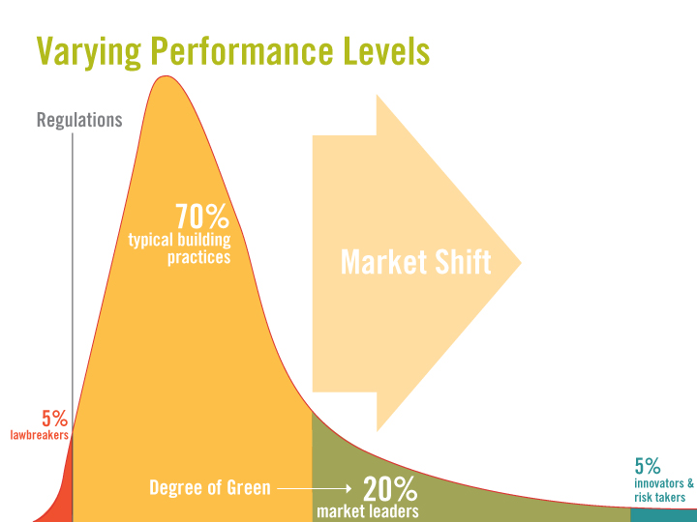

Slide 4
What is green building?
A market intervention
A collection of best practices
A strategy to provide information about buildings and communities
An approach for differentiation and competitive advantage

Slide 5
How does green building work?
It starts with a community…
Consensus about a desire to shift prevailing conditions in a market – a foundation of common goals and values
Coordinated action to identify and codify best practices
Processes to provide third-party review and verification of actions
Rewards for high performing projects

Slide 6
What are rating systems?
Tools for market transformation
LEED (US)
BREEAM (UK)
CASBEE (Japan)
DGNB (Germany)
Green Star (Australia)
IGBC/LEED (India)

Slide 7
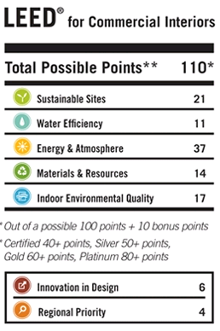
How does it work?
Minimum Program Requirements
Prerequisites
Credits
Options

Slide 8
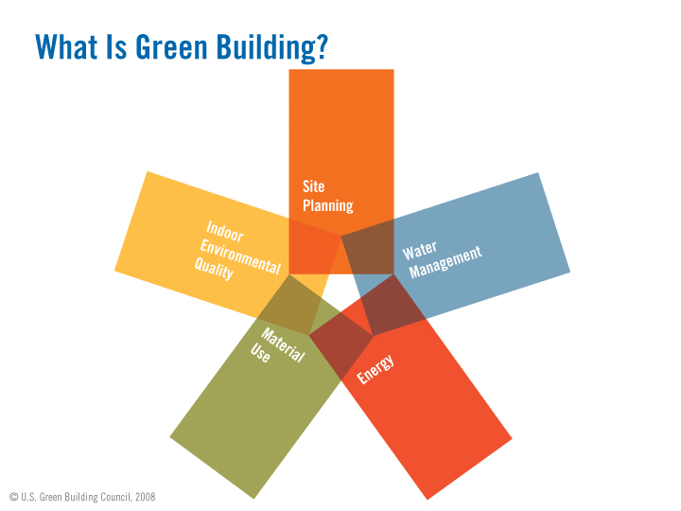

Slide 14
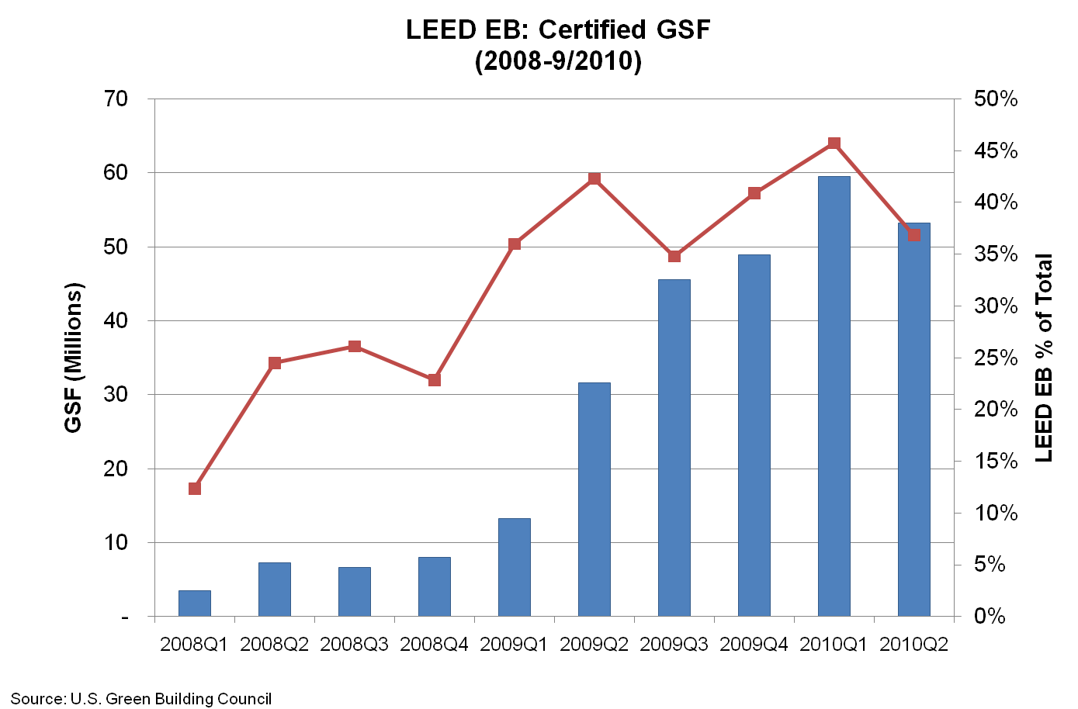
LEED EBOM GSF PER QUARTER

Slide 15
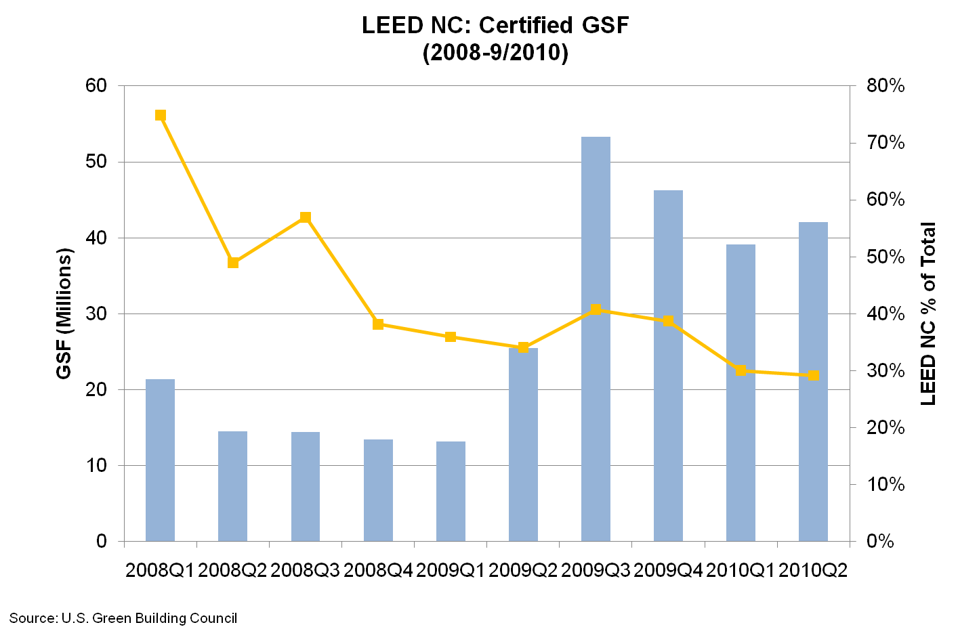
LEED NC GSF PER QUARTER

Slide 16
Clear priorities across lifecycle of buildings and communities
Present

Slide 17
Priorities
LEED 2009
An analytical basis for point allocation.
An extensible analytical foundation to address new issues and new green building strategies.

Slide 18
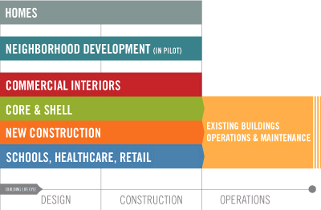
Lifecycle
Asset
Operations

Slide 19
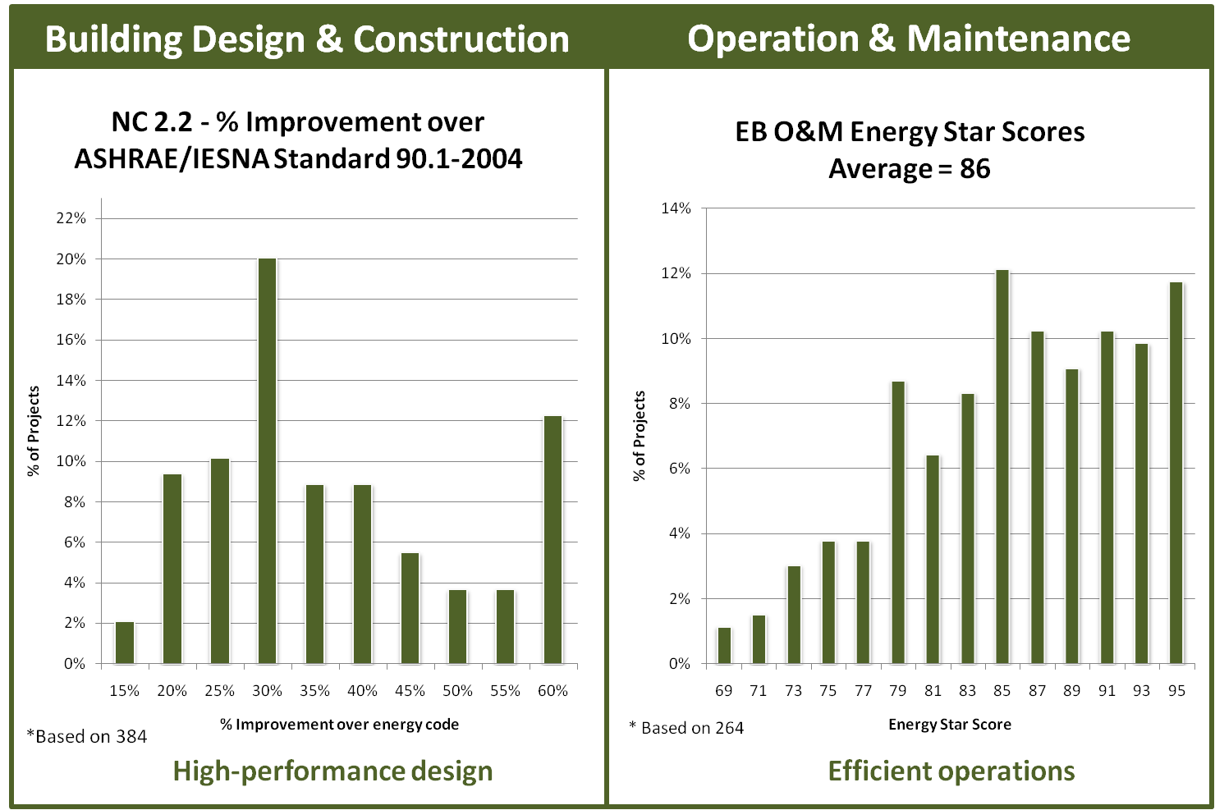

Slide 20
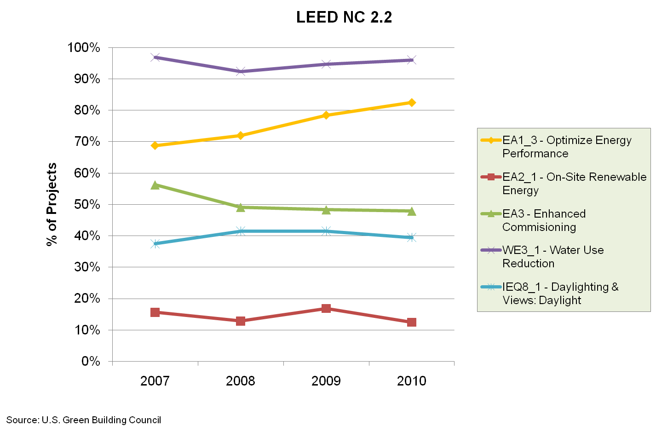
Prevalence of Practices

Slide 21
Envision green buildings and communities in 2015…
… driven by evidence.
… informed by place. …powered by information.
Future

Slide 22
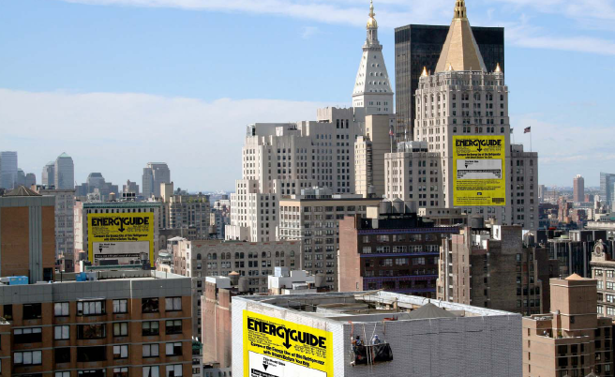
Source: CoStar

Slide 23
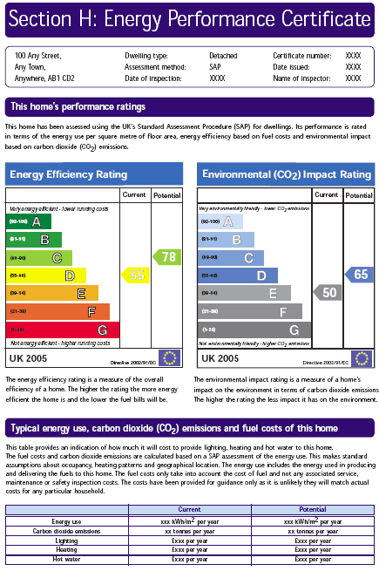

Slide 25
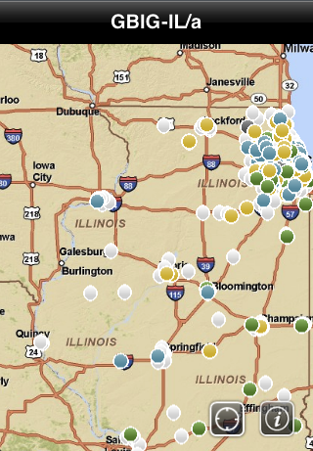
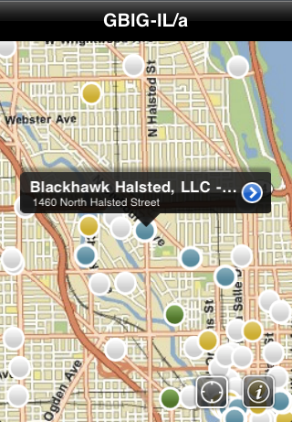
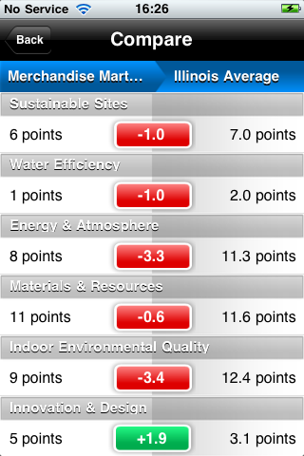
LEED SCORE
Back
Compare
Kraft Distribution Facility
Back
Map
Type: Office
Level: Silver (2005)
Rating: LEED NC Ver 2
Total Score 49
Water Efficiency 10/14
Energy & Atmosphere 16.5/35
Materials & Resources 6/10
Indoor Environmental Quality 12/15
Innovation & Design 4.5/6
Carbon Index 58

Slide 26
Green building is a process
Green building is a tool for market transformation
Historic preservation is a green building strategy
Historic preservation is a challenge for green building
Take Homes

Slide 27
This presentation does not represent official policies or positions of the US Green Building Council

