Slide 1

Assumptions/hypotheses
Construction organizations cannot create a strong safety culture without alignment with all project delivery systems & organizational objectives
Leadership alignment across roles is critical to strategic change
Assessing maturity level (culture/climate) may be helpful to organizational change but not sufficient in itself

Slide 2

TCM
Full Mechanical since 1953
  Plumbing, Pipefitting, Sheet Metal
  Fabrication & Installation
2nd Generation Family Ownership
150 to 250 employees
Signatory contractor
  SMWIA & UA
  SMACNA & MCAA/PMCA

Slide 3
Organizational Context
Strategic Safety Leadership Committee
  Formed Q4, 2005
  Engaged PM’s, Supts
History with NIOSH/CPWR Grants
  UO/Hecker, UI/Rosecrance
Collaboration with Colorado State Univ
  MCAA/PMCA & UA Local
  Zohar
  Interventions
    2007/08 – Communication Campaign
    2009 – Task Planning & Safety Mtg
    2013 – Active Safety Leadership/Leadership & Culture

Slide 4
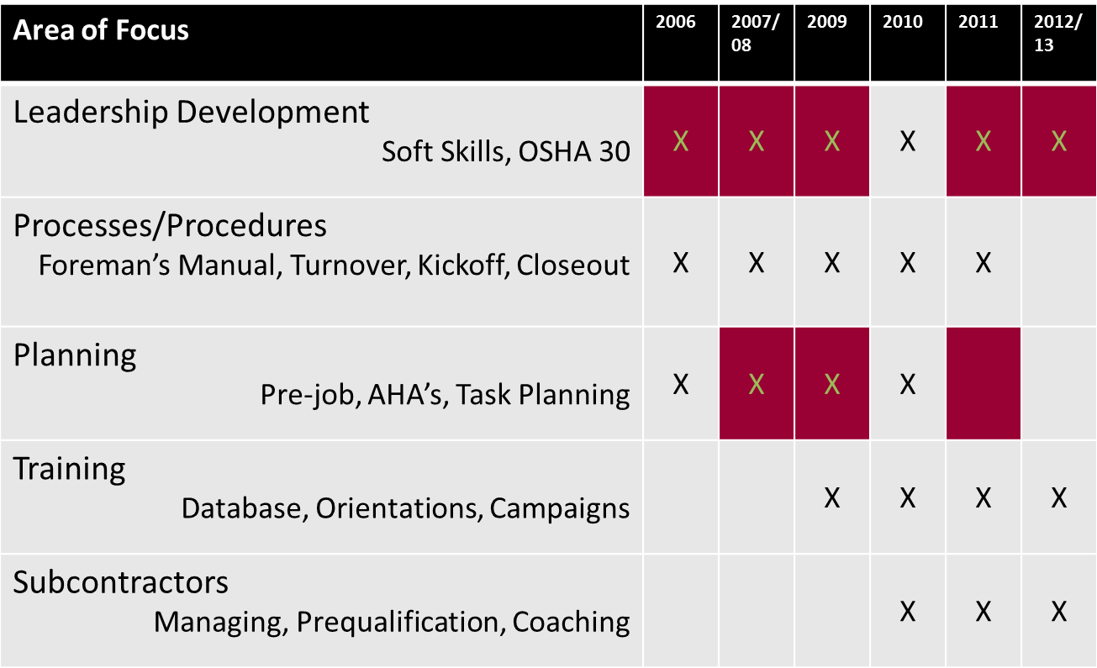
SSLC Strategic Plans &
Climate Survey Support

Slide 5
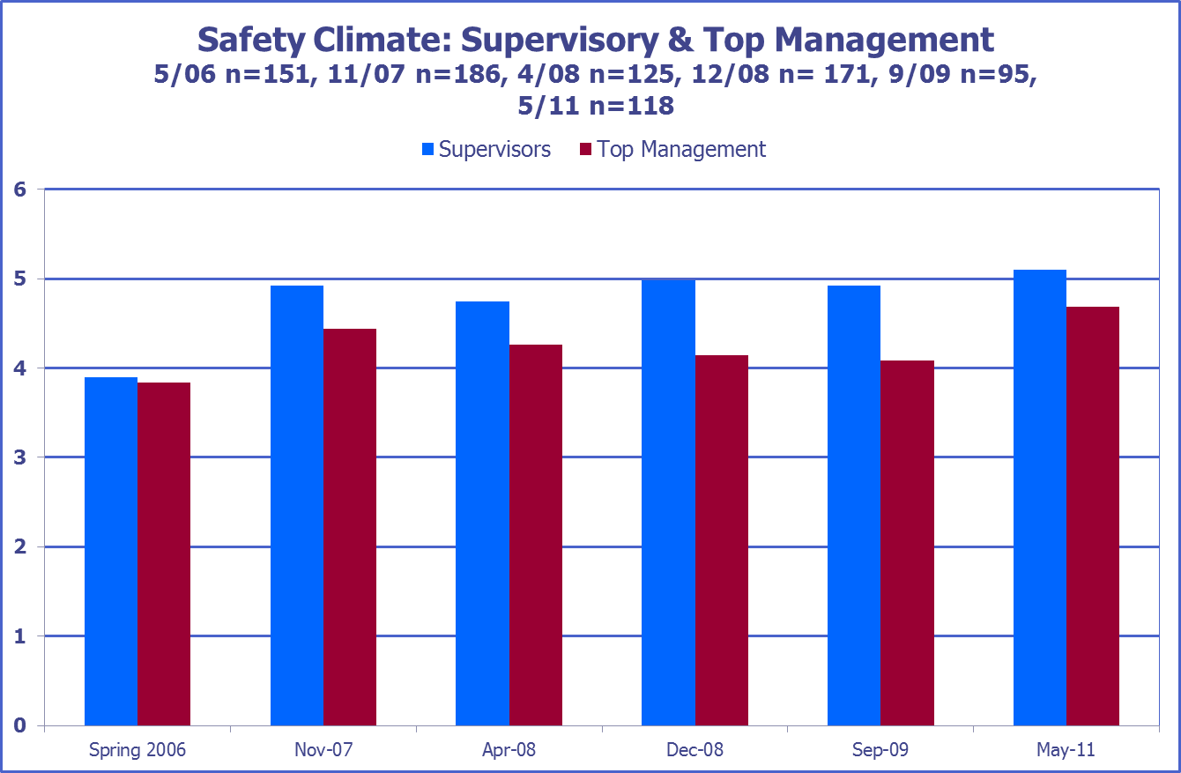

Slide 6
